Slide 1
Overview of Best Practices in HPC Software Development
Better Scientific Software Tutorial
David E. Bernholdt Computer Science and Mathematics Division and National Center for Computational Sciences Oak Ridge National Laboratory
Supercomputing 2018 Dallas, TX November 12, 2018
See slide 2 for license details

Slide 2
License, citation, and acknowledgements
License and Citation
This work is licensed under a Creative Commons Attribution 4.0 International License (CC BY 4.0).
Requested citation: David E. Bernholdt, Anshu Dubey, and Katherine Riley, Overview of Best Practices in HPC Software Development, Better Scientific Software tutorial, in SC ‘18: International Conference for High Performance Computing, Networking, Storage and Analysis, Dallas, Texas, 2018. DOI: 10.6084/m9.figshare.7304408.
Acknowledgements
This work was supported by the U.S. Department of Energy Office of Science, Office of Advanced Scientific Computing Research (ASCR), and by the Exascale Computing Project (17-SC-20-SC), a collaborative effort of the U.S. Department of Energy Office of Science and the National Nuclear Security Administration.
This work was performed in part at the Argonne National Laboratory, which is managed managed by UChicago Argonne, LLC for the U.S. Department of Energy under Contract No. DE-AC02-06CH11357
This work was performed in part at the Oak Ridge National Laboratory, which is managed by UT-Battelle, LLC for the U.S. Department of Energy under Contract No. DE-AC05-00OR22725.

Slide 3
Good scientific process requires good software practices
Good software practices increase scientific productivity

Slide 4
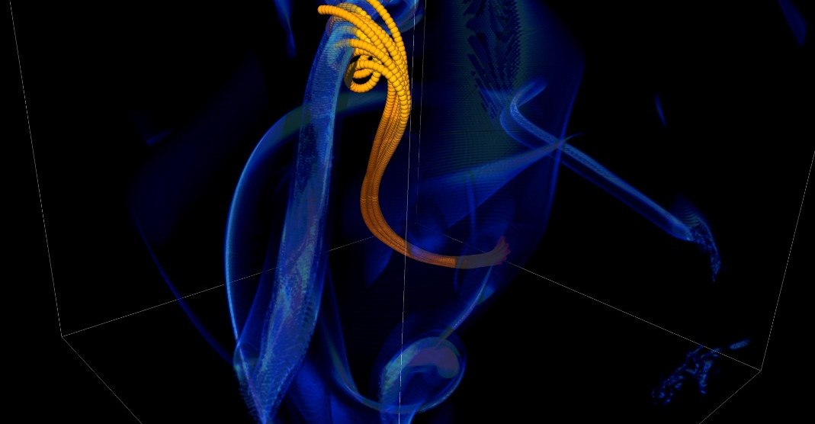
You Can Mitigate Risk But It Is Never Zero
Short notice availability of one of the biggest machines of it’s time
< 1month to get ready, run was 1.5 weeks
Quick and dirty development of particle capability in code
Error in tracking particles resulted in duplicated tags from round-off
Had to develop post-processing tools to correctly identify trajectories
6 months to process results
FLASH had a software process in place. It was tested regularly. This was one instance when the full process could not be applied because of time constraints.
Notes:
2005, BG/L
This was not even a situation like retracting results

Slide 5
Heroic Programming
Usually a pejorative term, is used to describe the expenditure of huge amounts of (coding) effort by talented people to overcome shortcomings in process, project management, scheduling, architecture or any other shortfalls in the execution of a software development project in order to complete it. Heroic Programming is often the only course of action left when poor planning, insufficient funds, and impractical schedules leave a project stranded and unlikely to complete successfully.
From http://c2.com/cgi/wiki?HeroicProgramming
Science teams often resemble heroic programming
Many do not see anything wrong with that approach
Notes:
Anecdote about offer to help with the development and get told a postdoc will do it because this is what we do.

Slide 6
What is wrong with heroic programming
Scientific results that could be obtained with heroic programming have run their course, because:
It is not possible for a single person to take on all these roles
Better scientific understanding
Math model
More complex software
Numerics
Different roles
and responsibilities
Verification
Performance

Slide 7
In Extreme-Scale science
Codes aiming for higher fidelity modeling
More complex codes, simulations and analysis
More moving parts that need to interoperate
Variety of expertise needed – the only tractable development model is through separation of concerns
It is more difficult to work on the same software in different roles without a software engineering process
Onset of higher platform heterogeneity
Requirements are unfolding, not known a priori
The only safeguard is investing in flexible design and robust software engineering process
Notes:
Numerical models

Slide 8
In Extreme-Scale science
Codes aiming for higher fidelity modeling
More complex codes, simulations and analysis
More moving parts that need to interoperate
Variety of expertise needed – the only tractable development model is through separation of concerns
It is more difficult to work on the same software in different roles without a software engineering process
Onset of higher platform heterogeneity
Requirements are unfolding, not known a priori
The only safeguard is investing in flexible design and robust software engineering process
Supercomputers change fast
Especially Now
Notes:
Numerical models

Slide 9
Technical Debt
Consequence of Choices
Quick and dirty collects interest which means more effort required to add features.
Accretion leads to unmanageable software
Increases cost of maintenance
Parts of software may become unusable over time
Inadequately verified software produces questionable results
Increases ramp-on time for new developers
Reduces software and science productivity due to technical debt

Slide 10
"... it seems likely that signiﬁcant software contributions to existing scientiﬁc software projects are not likely to be rewarded through the traditional reputation economy of science. Together these factors provide a reason to expect the over-production of independent scientiﬁc software packages, and the underproduction of collaborative projects in which later academics build on the work of earlier ones."
Howison & Herbsleb (2011)

Slide 11
Challenges Developing a Scientific Application
Technical
Sociological
All parts of the cycle can be under research
Requirements change throughout the lifecycle as knowledge grows
Verification complicated by floating point representation
Real world is messy, so is the software
Competing priorities and incentives
Limited resources
Perception of overhead without benefit
Need for interdisciplinary interactions

Slide 12
Customizations For Science Applications
Testing does not follow specific methods as understood by the software engineering research community
The extent and granularity reflective of project priorities and team size
Larger teams have more formalization
Lifecycle of science compare to lifecycle of development
Development model
Mostly ad-hoc, some are close to agile model, but none follows it explicitly
Much more responsive to the needs of the lifecycle

Slide 13
Lifecycle of Scientific Application
Modeling
Approximations
Discretizations
Numerics
Convergence
Stability
Implementation
Verification
Expected behavior
Validation
Experiment/observation
Physical World
Model
Model
fidelity
Validation
Equations
Model
fidelity
Discretize
Implementation
Difference equations
Verify accuracy
stability
Numerical solvers

Slide 14
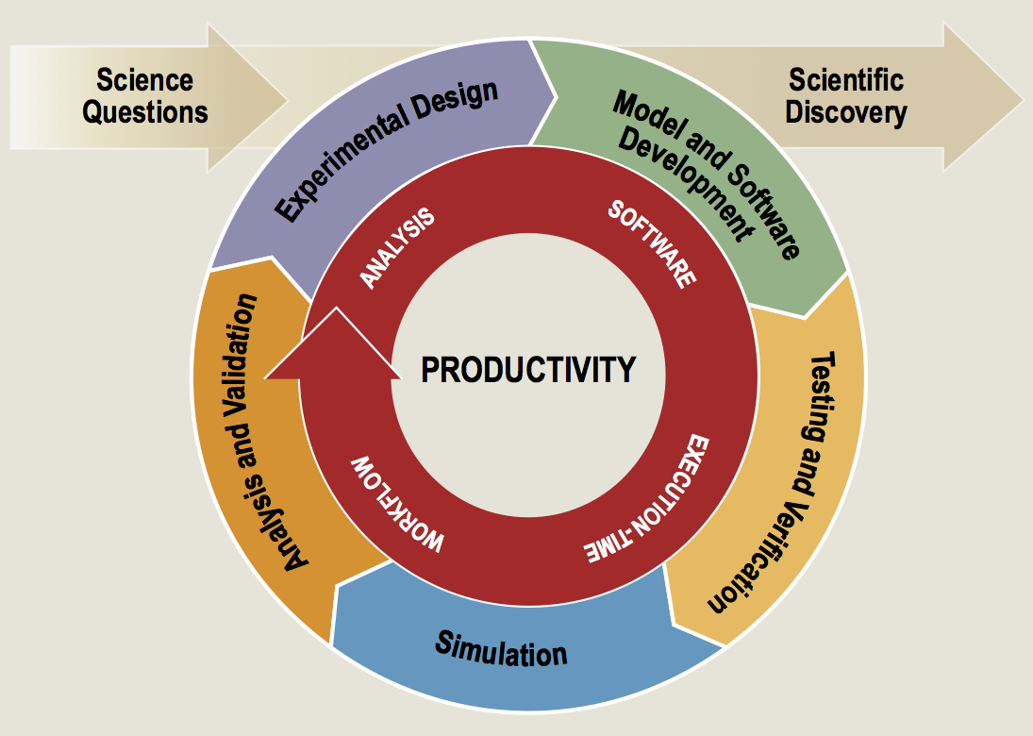
Software productivity cycle
http://www.orau.gov/swproductivity2014/SoftwareProductivityWorkshopReport2014.pdf

Slide 15
Software Process Best Practices
Baseline
Desirable
Invest in extensible code design
Use version control and automated testing
Institute a rigorous verification and validation regime
Define coding and testing standards
Clear and well defined policies for
Auditing and maintenance
Distribution and contribution
Documentation
Provenance and reproducibility
Lifecycle management
Open development and frequent releases

Slide 16
A Useful Resource
https://ideas-productivity.org/resources/howtos/
‘What Is’ docs: 2-page characterizations of important topics for SW projects in computational science & engineering (CSE)
‘How To’ docs: brief sketch of best practices
Emphasis on ``bite-sized'' topics enables CSE software teams to consider improvements at a small but impactful scale
We welcome feedback from the community to help make these documents more useful

Slide 17
Other resources
http://www.software.ac.uk/
http://software-carpentry.org/
http://flash.uchicago.edu/cc2012/
http://journals.plos.org/plosbiology/article?id=10.1371/journal.pbio.1001745
http://ieeexplore.ieee.org/xpls/icp.jsp?arnumber=4375255
http://www.orau.gov/swproductivity2014/SoftwareProductivityWorkshopReport2014.pdf
http://ieeexplore.ieee.org/xpl/articleDetails.jsp?arnumber=6171147

Slide 18
Why Community Codes?
Scientists can focus on developing for their algorithmic needs instead of getting bogged down by the infrastructural development
Graduate students do not start developing codes from scratch
Look at the available public codes and converge on the ones that most meet their needs
Look at the effort of customization for their purposes
Select the public code, and build upon it as they need
Important to remember that they still need to understand the components developed by others that they are using, they just don’t have to actually develop everything themselves. And this is particularly true of pesky detailed infrastructure/solvers that are too well understood to have any research component, but are time consuming to implement right

Slide 19
Why Community Codes Continued
Researchers can build upon work of others and get further faster, instead of reinventing the wheel
Code component re-use
No need to become an expert in every numerical technique
More reliable results because of more stress tested code
Enough eyes looking at the code will find any errors faster
New implementations take several years to iron out the bugs and deficiencies
Different users use the code in different ways and stress it in different ways
Open-source science results in more reproducible results
Generally good for the credibility

Slide 20
Communities Do Use Community Codes
Astrophysics, Molecular Dynamics, Chemistry, Climate, etc
Community/open-source approach more common in areas which need multi-physics and/or multi-scale
A visionary sees the benefit of software re-use and releases the code
Sophistication in modeling advances more rapidly in such communities
Others keep their software close for perceived competitive advantage
Repeated re-invention of wheel
General advancement of model fidelity slower

Slide 21
Summary
Good software practices are needed for scientific productivity
Science at extreme-scales is complex and requires multiple expertise
Software process does need to address reality
Open codes, community contribution, are a powerful tool
It is extremely important to recognize that science through computing is only as good as the software that produces it

Slide 22

Agenda
Tutorial evaluation form: http://bit.ly/sc18-eval
Time | Module | Topic | Speaker
8:30am-8:40am | 00 | Introduction and Setup | David E. Bernholdt, ORNL
8:40am-9:00am | 01 | Overview of Best Practices in HPC Software Development | David E. Bernholdt, ORNL
9:00am-10:00am | 02 | Git Workflows | Jared O’Neal, ANL
10:00am-10:30am |  | Break
10:30am-11:40am | 03 | Better (Small) Scientific Software Teams | Michael A. Heroux, SNL
11:40am-12:00pm | 04 | Improving Reproducibility through Better Software Practices | Michael A. Heroux, SNL
12:00pm-1:30pm |  | Lunch (C1/2/3/4 Ballroom, 2nd floor)
1:30pm-2:15pm | 05 | An Introduction to Software Licensing | David E. Bernholdt, ORNL
2:15pm-2:55pm | 06 | Verification and Refactoring | Anshu Dubey, ANL
2:55pm-3:00pm | 07 | Code Coverage and Continuous Integration | Jared O’Neal, ANL
3:00-3:30pm |  | Break
3:30pm-3:40pm | 07 | Code Coverage and Continuous Integration (continued) | Jared O’Neal, ANL
3:40pm-5:00pm | 08 | Hands-on Activities | Jared O’Neal, ANL, and team

