Slide 1
Better (Small) Scientific Software Teams
Better Scientific Software Tutorial
Michael A. Heroux Scientist in Residence, CSB|SJU Senior Scientist, Sandia National Laboratories Director of Software Technology, US DOE Exascale Computing Project
Supercomputing 2018 Dallas, TX November 12, 2018
See slide 2 for license details

Slide 2
License, citation, and acknowledgments
License and Citation
This work is licensed under a Creative Commons Attribution 4.0 International License (CC BY 4.0).
Requested citation: Michael A. Heroux, Better (Small) Scientific Software Teams, Better Scientific Software tutorial, in SC ‘18: International Conference for High Performance Computing, Networking, Storage and Analysis, Dallas, Texas, 2018. DOI: 10.6084/m9.figshare.7311776.
Acknowledgements
This work was supported by the U.S. Department of Energy Office of Science, Office of Advanced Scientific Computing Research (ASCR), and by the Exascale Computing Project (17-SC-20-SC), a collaborative effort of the U.S. Department of Energy Office of Science and the National Nuclear Security Administration.
Sandia National Laboratories is a multimission laboratory managed and operated by National Technology and Engineering Solutions of Sandia, LLC, a wholly owned subsidiary of Honeywell International, Inc., for the U.S. Department of Energy’s National Nuclear Security Administration under contract DE-NA0003525.

Slide 3
Outline
Small Team Models, Challenges.
Agile workflow management for small teams
Intro to terminology and approaches
Overview of Kanban
Free tools: Trello, GitHub.
Hands-on example of project management using GitHub

Slide 4
Small Teams
Ideas for managing transitions and steady work.

Slide 5
Small team interaction model
Team composition:
Senior staff, faculty:
Stable presence, in charge of science questions, experiments.
Know the conceptual models well.
Spend less time writing code, fuzzy on details.
Junior staff, students:
Transient, dual focus (science results, next position).
Staged experience: New, experienced, departing.
Learning conceptual models.
Write most code, know details.

Slide 6
Large team challenges
Composed of small teams (and all the challenges).
Additional interaction challenges.
Policies, regularly cultural exchanges important.

Slide 7
Small team challenges
Ramping up new junior members:
Background.
Conceptual models.
Software practices, processes, tools.
Preparing for departure of experienced juniors.
Doing today those things needed for retaining work value.
Managing dual focus.

Slide 8
Research Team Member Lifecycle
Initiation Setup
Identify project activities
Create initiation checklist
Ramp Up
Work initiation checklist
Initiate project activities
Ongoing Planning
Kanban workflow
Observe policies
Start
Team Member Lifecycle
Quick ramp up
Disciplined activities
Sustained contributions
Repeat
Start process again
Ongoing Work
Conduct activities
Observe policies
Depart
Work complete
Work transferred
Contribution sustained
Ramp Down
Work exit checklist
Leave project activities
Exit Setup
Identify final deliverables
Create exit checklist

Slide 9
Checklists & Policies
Team Member Phase
New Team Member | Steady Contributor | Departing Member
Checklist | Policies | Checklist
New, departing team member checklists:
Example: Trilinos New Developer Checklist.
https://software.sandia.gov/trilinos/developer/sqp/checklists/index.html
Steady state: Policy-driven.
Example: xSDK Community policies.
https://xsdk.info/policies/

Slide 10
Your checklists & policies?
Checklist: New team member?
Policies: Ongoing work?
Checklist: Before someone departs?

Slide 11
Collaborative Work Management
Managing with Kanban

Slide 12
Managing issues: Fundamental software process
Continual improvement
Issue: Bug report, feature request
Approaches:
Short-term memory, office notepad
ToDo.txt on computer desktop (1 person)
Issues.txt in repository root (small co-located team)
…
Web-based tool + Kanban (distributed, larger team)
Web-based tool + Scrum (full-time dev team)
Informal, less
training
Formal, more
training

Slide 13
Kanban principles
Limit number of “In Progress” tasks
Productivity improvement:
Optimize “flexibility vs swap overhead” balance. No overcommitting.
Productivity weakness exposed as bottleneck. Team must identify and fix the bottleneck.
Effective in R&D setting. Avoids a deadline-based approach. Deadlines are dealt with in a different way.
Provides a board for viewing and managing issues
Can be applied to any existing software project immediately!
Task: Have Eureka moment by Tuesday.
Scrum

Slide 14
Basic Kanban
Backlog | Ready | In Progress | Done
Any task idea Trim occasionally Source for other columns | Task + description of how to do it. Could be pulled when slot opens. Typically comes from backlog. | Task you are working on right now. The only kanban rule: Can have only so many “In Progress” tasks. Limit is based on experience, calibration. Key: Work is pulled. You are in charge! | Completed tasks. Record of your life activities. Rate of completion is your “velocity”.
Notes:
Ready column is not strictly required, sometimes called “Selected for development”.
Other common column: In Review
Can be creative with columns:
Waiting on Advisor Confirmation.
Tasks I won’t do.

Slide 15

Personal Kanban
Personal Kanban: Kanban applied to one person.
Apply Kanban principles to your life.
Fully adaptable.
Personal Kanban: Commercial book/website.
Useful, but not necessary.
http://www.personalkanban.com

Slide 16
Kanban tools
Wall, whiteboard, blackboard: Basic approach.
Software, cloud-based:
Trello, JIRA, GitHub Issues.
Many more.
I use Trello (browser, iPhone, iPad).
Can add, view, update, anytime, anywhere.

Slide 17
Big question: How many tasks?
Personal question.
Approach: Start with 2 or 3. See how it goes.
Use a freeway traffic analogy:
Does traffic flow best when fully packed? No.
Same thing with your effectiveness.
Spend time consulting board regularly.
Brings focus.
Enables reflection, retrospection.
Use slack time effectively.
When you get out of the habit, start up again.

Slide 18
Importance of “In Progress” concept for you
Junior community members:
Less control over task.
Given by supervisor.
In Progress column: Protects you.
If asked to take on another task, respond:
Is this important enough to become less efficient?
Sometimes it is.

Slide 19
Key Team Management Elements
Checklists:
Initiation, Transition, Exit
Policies:
How team conducts its work
Issue tracking system:
All work tracked, visible to team
Milestones: Aggregate related issues.
Kanban board
Regular meetings, updates

Slide 20
Samples from Collegeville Org: Policies, Initiation Checklist

Slide 21
Samples from Collegeville Org: Kanban Board

Slide 22
Team Management Example
Team Policy
Checklists
Kanban Board

Slide 23
Step 1: Create Issues-only GitHub repo
Go to https://github.com/username
Example: https://github.com/maherou
Create new repo:
Click on “+” (upper right).
Select New repository…
Give repo a name, e.g., Issues
Select Public. In real life, this repo is often private (requires $ or special status)
Init with README.
Don’t add .gitignore or license.
Click Create Repository.

Slide 24
Step 2: Define Team Policy
Create file:
Go to new repo: Issues.
Select <> Code tab.
Select Create new file TeamPolicy.md
Questions to address:
How members support team?
How team supports members?
Community version:
http://contributor-covenant.org
Policy is living document:
Informal good practices added.
Avoidable bad situations addressed.

Slide 25
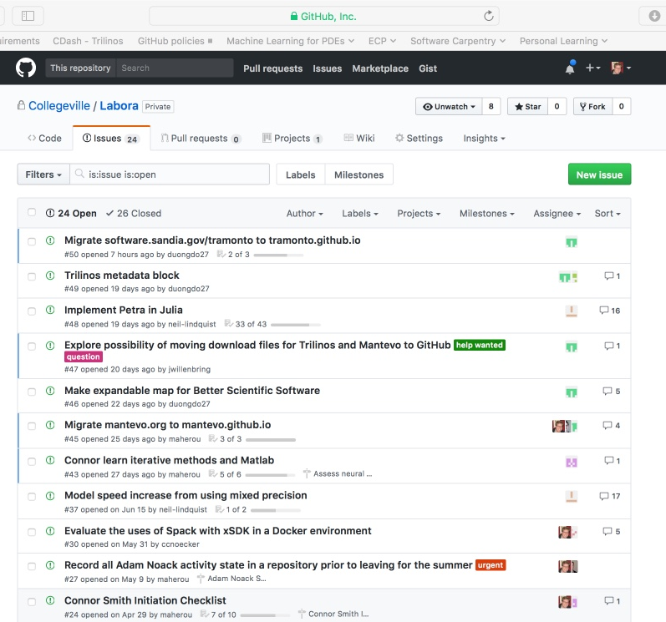
Step 3a: Create Issues
Select the Issues tab.
Click on New Issue.
Type in task statement 1 (from list).
Type in title only.
Click Submit new issue
Repeat.

Slide 26
Step 3b: Create Initiation Checklist
Select the Issues tab.
Click on New Issue.
Select a classmate.
Type in title: Pat Evans Initiation Checklist
Add checklist items:
Use syntax: - [ ] Description
Spaces required

Slide 27
Step 4: Create Kanban Board
Select Projects tab
Click New Project
Use title
Team Kanban board
Add these columns:
Backlog, Ready, In progress, In review, Done.
Click on +Add cards (upper right).
Move each issue to the proper Kanban column

Slide 28
Next Steps: Real Life
Create a GitHub Org and set of repos for your team:
Each team member has an individual repo.
Each project has a repo.
One special repo for issues.
Track all work:
Use checklists for initiation, exit, any big new effort.
Create Kanban board. Keep it current.
Aggregate related issues using milestones.
Drive meetings using Kanban board.
Adapt this approach to meet your needs.
When you start to get sloppy, get back on track.

Slide 29



Other Resources
The Agile Samurai: How Agile Masters Deliver Great Software (Pragmatic Programmers), Jonathan Rasmusson.
http://a.co/eUGIe95
Excellent, readable book on Agile methodologies.
Also available on Audible.
Code Complete: A Practical Handbook of Software Construction, Steve McConnell.
http://a.co/eEgWvKj
Great text on software.
Construx website has large collection of content.
Getting Things Done: The Art of Stress-Free Productivity, David Allen
http://a.co/22EPvt6
A classic in the personal productivity literature

Slide 30

Agenda
Tutorial evaluation form: http://bit.ly/sc18-eval
Time | Module | Topic | Speaker
8:30am-8:40am | 00 | Introduction and Setup | David E. Bernholdt, ORNL
8:40am-9:00am | 01 | Overview of Best Practices in HPC Software Development | David E. Bernholdt, ORNL
9:00am-10:00am | 02 | Git Workflows | Jared O’Neal, ANL
10:00am-10:30am |  | Break
10:30am-11:40am | 03 | Better (Small) Scientific Software Teams | Michael A. Heroux, SNL
11:40am-12:00pm | 04 | Improving Reproducibility through Better Software Practices | Michael A. Heroux, SNL
12:00pm-1:30pm |  | Lunch (C1/2/3/4 Ballroom, 2nd floor)
1:30pm-2:15pm | 05 | An Introduction to Software Licensing | David E. Bernholdt, ORNL
2:15pm-2:55pm | 06 | Verification and Refactoring | Anshu Dubey, ANL
2:55pm-3:00pm | 07 | Code Coverage and Continuous Integration | Jared O’Neal, ANL
3:00-3:30pm |  | Break
3:30pm-3:40pm | 07 | Code Coverage and Continuous Integration (continued) | Jared O’Neal, ANL
3:40pm-5:00pm | 08 | Hands-on Activities | Jared O’Neal, ANL, and team

