Slide 1
Verification and Refactoring
Better Scientific Software Tutorial
Anshu Dubey Mathematics and Computer Science Division Argonne National Laboratory
Supercomputing 2018 Dallas, TX November 12, 2018
See slide 2 for license details

Slide 2
License, citation, and acknowledgements
License and Citation
This work is licensed under a Creative Commons Attribution 4.0 International License (CC BY 4.0).
Requested citation: Anshu Dubey, Verification and Refactoring, Better Scientific Software tutorial, in SC ‘18: International Conference for High Performance Computing, Networking, Storage and Analysis, Dallas, Texas, 2018. DOI: 10.6084/m9.figshare.7303946.
Acknowledgements
Alicia Klinvex contributed many slides to this presentation
This work was supported by the U.S. Department of Energy Office of Science, Office of Advanced Scientific Computing Research (ASCR), and by the Exascale Computing Project (17-SC-20-SC), a collaborative effort of the U.S. Department of Energy Office of Science and the National Nuclear Security Administration.
This work was performed in part at the Argonne National Laboratory, which is managed by UChicago Argonne, LLC for the U.S. Department of Energy under Contract No. DE-AC02-06CH11357

Slide 3
Verification
Definitions
Why is testing important?

Slide 4
Verification
Code verification uses tests
It is much more than a collection of tests
It is the holistic process through which you ensure that
Your implementation shows expected behavior,
Your implementation is consistent with your model,
Science you are trying to do with the code can be done.

Slide 5
Stages and types of verification
During initial code development
Accuracy and stability
Matching the algorithm to the model
Interoperability of algorithms
In later stages
While adding new major capabilities or modifying existing capabilities
Ongoing maintenance
Preparing for production

Slide 6
Stages and types of verification
If refactoring
Ensuring that behavior remains consistent and expected
All stages have a mix of automation and human-intervention
Note that the stages apply to the whole code as well as its components

Slide 7
Other specific verification challenges
Functionality coverage
Particularly true of codes that allow composability in their configuration
Codes may incorporate some legacy components
Its own set of challenges
No existing tests at any granularity
Examples – multiphysics application codes that support multiple domains

Slide 8
Benefits of testing
Promotes high-quality software that delivers correct results and improves confidence
Increases quality and speed of development, reducing development and maintenance costs
Maintains portability to a variety of systems and compilers
Helps in refactoring
Avoid introducing new errors when adding new features
Avoid reintroducing old errors

Slide 9
How common are bugs?
Programs do not acquire bugs as people acquire germs, by hanging around other buggy programs. Programmers must insert them.
- Harlan Mills
Bugs per 1000 lines of code (KLOC)
Industry average for delivered software
1-25 errors
Microsoft Applications Division
10-20 defects during in-house testing
0.5 in released product
Code Complete (Steven McConnell)

Slide 10
Why testing is important: the protein structures of Geoffrey Chang
Some inherited code flipped two columns of data, inverting an electron-density map
Resulted in an incorrect protein structure
Retracted 5 publications
One was cited 364 times
Many papers and grant applications conflicting with his results were rejected
He found and reported the error himself

Slide 11
Why testing is important: the 40 second flight of the Ariane 5
Ariane 5: a European orbital launch vehicle meant to lift 20 tons into low Earth orbit
Initial rocket went off course, started to disintegrate, then self-destructed less than a minute after launch
Seven variables were at risk of leading to an Operand Error (due to conversion of floating point to integer)
Four were protected
Investigation concluded insufficient test coverage as one of the causes for this accident
Resulted in a loss of $370,000,000.

Slide 12
Why testing is important: the Therac-25 accidents
Therac-25: a computer-controlled radiation therapy machine
Minimal software testing
Race condition in the code went undetected
Unlucky patients were struck with approximately 100 times the intended dose of radiation, ~ 15,000 rads
Error code indicated that no dose of radiation was given, so operator instructed machine to proceed
Recalled after six accidents resulting in death and serious injuries

Slide 13
Test Definitions
Unit tests
Test individual functions or classes
Integration tests
Test interaction, build complex hierarchy
System level tests
At the user interaction level
Restart tests
Code starts transparently from a checkpoint
Regression (no-change) tests
Compare current observable output to a gold standard
Performance tests
Focus on the runtime and resource utilization

Slide 14
Test Development
Development of tests and diagnostics goes hand-in-hand with code development
Non-trivial to devise good tests, but extremely important
Compare against simpler analytical or semi-analytical solutions
When faced with legacy codes with no existing tests
More creative approach becomes necessary
Verify correctness
Always inject errors to verify that the test is working

Slide 15
Example from E3SM
Isolate a small area of the code
Dump a useful state snapshot
Build a test driver
Start with only the files in the area
Link in dependencies
Copy if any customizations needed
Read in the state snapshot
Restart from the saved state
state
driver

Slide 16
Workarounds for Granularity
Unit test
Real dependency
Mocked up
dependency
Approach the problem sideways
Components can be exercised against known simpler applications
Same applies to combination of components
Build a scaffolding of verification tests to gain confidence
Unit test
Unit test
Unit test
Unit test

Slide 17
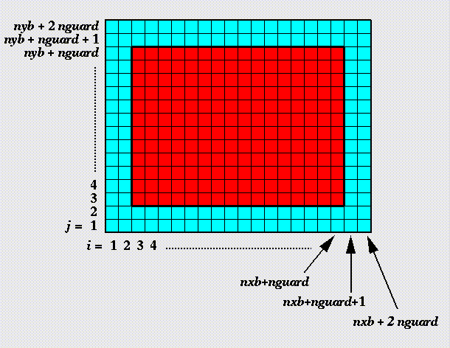
Example from FLASH
Unit test for Grid
Verification of guard cell fill
Use two variables A & B
Initialize A in all cells and B only in the interior cells (red)
Apply guard cell fill to B
Unit test

Slide 18
Example from Flash
Unit test
Unit test for Equation of State (EOS)
Three modes for invoking EOS
MODE1: Pressure and density as input, internal energy and temperature as output
MODE2: Internal energy and density as input temperature and pressure as output
MODE3: Temperature and density as input pressure and internal energy as output
Use initial conditions from a known problem, initialize pressure and density
Apply EOS in MODE1
Using internal energy generated in the previous step apply EOS in MODE2
Using temperature generated in the previous step apply EOS in MODE3
At the end all variables should be consistent within tolerance

Slide 19
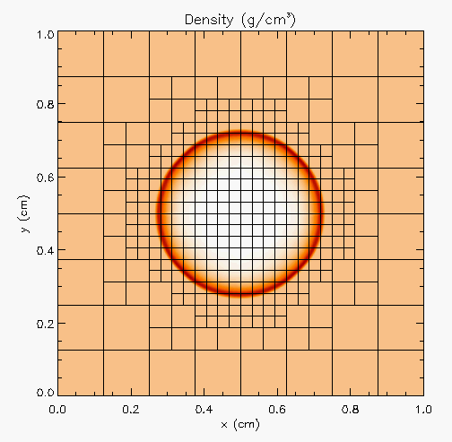
Example from FLASH
Unit test
Unit test for Hydrodynamics
Sedov blast wave
High pressure at the center
Shock moves out spherically
FLASH with AMR and hydro
Known analytical solution
Unit test
Unit test
Though it exercises mesh, hydro and eos, if mesh and eos are verified first, then this test verifies hydro
More testing needed for Grid using AMR
Flux correction and regridding

Slide 20
Example from FLASH
Reason about correctness for testing Flux correction and regridding
IF Guardcell fill and EOS unit tests passed
Run Hydro without AMR
If failed fault is in Hydro
Run Hydro with AMR, but no dynamic refinement
If failed fault is in flux correction
Run Hydro with AMR and dynamic refinement
If failed fault is in regridding

Slide 21
Selection of tests
Two purposes
Regression testing
May be long running
Provide comprehensive coverage
Continuous integration
Quick diagnosis of error
A mix of different granularities works well
Unit tests for isolating component or sub-component level faults
Integration tests with simple to complex configuration and system level
Restart tests
Rules of thumb
Simple
Enable quick pin-pointing

Slide 22
Why not always use the most stringent testing?
Effort spent in devising tests and testing regime are a tax on team resources
When the tax is too high…
Team cannot meet code-use objectives
When is the tax is too low…
Necessary oversight not provided
Defects in code sneak through
Evaluate project needs
Objectives: expected use of the code
Team: size and degree of heterogeneity
Lifecycle stage: new or production or refactoring
Lifetime: one off or ongoing production
Complexity: modules and their interactions

Slide 23
Commonalities
Unit testing is always good
It is never sufficient
Verification of expected behavior
Understanding the range of validity and applicability is always important
Especially for individual solvers

Slide 24
Test Selection
First line of defense – code coverage tools (demo later)
Necessary but not sufficient – don’t give any information about interoperability
Build a matrix
Physics along rows
Infrastructure along columns
Alternative implementations, dimensions, geometry
Mark <i,j> if test covers corresponding features
Follow the order
All unit tests – including full module tests
Tests representing ongoing productions
Tests sensitive to perturbations
Most stringent tests for solvers
Least complex test to cover remaining spots

Slide 25
Example
A test on the same row indicates interoperability between corresponding physics
Similar logic would apply to tests on the same column for infrastructure
More goes on, but this is the primary methodology
Tests | Symbol
Sedov | SV
Cellular | CL
Poisson | PT
White Dwarf | WD

Slide 26
Regular Testing
Part of ongoing verification
Automating is helpful
Can be just a script
Or a testing harness
Essential for large code
Set up and run tests
Evaluate test results
Easy to execute a logical subset of tests
Pre-push
Nightly
Automation of test harness is critical for
Long-running test suites
Projects that support many platforms
Jenkins
C-dash
Custom
(FlashTest)

Slide 27
Regular Testing
Testing regime is only useful if it is
Maintained
Tests and benchmarks periodically updated
Monitored regularly
Can be automated
Has rapid response to failure
Tests should pass most of the time

Slide 28
Refactoring

Slide 29
Considerations
Know bounds on acceptable behavior change
Know your error bounds
Bitwise reproduction of results unlikely after transition
Map from here to there
Check for coverage provided by existing tests
Develop new tests where there are gaps
Incorporate testing overheads into refactor cost estimates

Slide 30
Example FLASH
Grid
Manages data
Domain discretization
Hydro
simpleUnsplit
Unsplit
Driver
Time-stepping
Orchestrates interactions
Notes:
Highlight that simpleUnsplit and Unsplit are two different, but similar implementations. One is fully-featured and the other is lightweight and simple. This makes the latter useful for development and debugging. These two are mentioned later in the talk.

Slide 31
FLASH5
Refactoring for Next Generation Hardware
AMReX - Lawrence Berkeley National Lab
Designed for exascale
Node-level heterogeneity
Smart iterators hide parallelization
Goal: Replace Paramesh with AMReX
Plan:
Paramesh & AMReX coexist
Adapt interfaces to suit AMReX
Refactor Paramesh implementation
Compare AMReX implementation against Paramesh implementation
Notes:
Can point out that this graphic show the need to update the tree - two AMR implementations required a new AMR subfolder.

Slide 32
Refactoring plan
Design
Degree & scope of change
Formulate initial requirements
Prototyping
Explore & test design decisions
Update requirements
Implementation
Recover from prototyping
Expand & implement design decisions

Slide 33
Phase 1 - design
Sit, think, hypothesize, & argue
Derive and understand principal definitions & abstractions
Collect & understand Paramesh/AMReX constraints
Generally useful design due to two sets of constraints?
Collect & understand physics unit requirements on Grid unit
Design fundamental data structures & update interface
AMReX introduces iterators over blocks/tiles of mesh
Package up block/tile index with associated mesh metadata
Minimal prototyping with no verification
Notes:
Paramesh/AMReX constraints inform what we can implement and therefore offer clients through the interface.
The coupling to Hydro explains what is needed from Grid and how it must be requested.
The point is that we are looking at both sides of the interface to determine what shape it can tak

Slide 34
Phase 2 - prototyping
Quick, dirty, & light
Implement new data structures
Evolve design/implementation by iterating between Paramesh & AMReX
Explore Grid/physics unit interface
simpleUnsplit Hydro unit
Discover use patterns of data structures and Grid unit interface
Adjust requirements & interfaces
Verification
Single simpleUnsplit simulation
Quantitative regression test with Paramesh
Proof of concept with AMReX via qualitative comparison with Paramesh
Notes:
Prototyping is a first level stress testing of our design decisions and interface. To be an effective stress test, we should have likely expanded further out to capture more use cases of our interface. That said, Klaus and Anshu are already aware of these use cases and could have known that the limited scope of this phase was reasonably stressful and therefore informative.
Implementing with Hydro let us discover common usage patterns to build a gut-level understanding of whether or not the interface was a natural fit for the application.

Slide 35
Phase 3 - implementation
Toward quantifiable success & Continuous Integration
Derive & implement lessons learned
Clean code & inline documentation
Update Unsplit Hydro
Hybrid FLASH
AMReX manages data
Paramesh drives AMR
Fully-functioning simulation with AMReX
Prune old code
Verification
Git workflow
Grow test suite / CI with Jenkins
Add new feature/test
Create Paramesh baseline with FLASH4.4
Refactor Paramesh implementation
Implement with AMReX & compare against Paramesh baseline
Notes:
Point of hybrid method was first and foremost to build a proof of concept that worked on system-level tests. It was also a means to test out the design decisions and the efficiency of the associated implementations at a larger grained level. This is in contrast to the forward engineering being done by me at the level of routines, units, and unittests.
Adding new features or capabilities grew test suite.s

Slide 36
Other resources
Software testing levels and definitions:
http://www.tutorialspoint.com/software_testing/software_testing_levels.htm
Working Effectively with Legacy Code, Michael Feathers. The legacy software change algorithm described in this book is very straight-forward and powerful for anyone working on a code that has insufficient testing.
Code Complete, Steve McConnell. Includes testing advice.
Organization dedicated to software testing: https://www.associationforsoftwaretesting.org/
Software Carpentry: http://katyhuff.github.io/python-testing/
Tutorial from Udacity: https://www.udacity.com/course/software-testing--cs258
Papers on testing:
http://www.sciencedirect.com/science/article/pii/S0950584914001232
https://www.researchgate.net/publication/264697060_Ongoing_verification_of_a_multiphysics_community_code_FLASH
Resources for Trilinos testing:
Trilinos testing policy: https://github.com/trilinos/Trilinos/wiki/Trilinos-Testing-Policy
Trilinos test harness: https://github.com/trilinos/Trilinos/wiki/Policies--%7C-Testing

Slide 37
Simplified schematic of science through computation
Physical World
This is for simulations, but the philosophy applies to other computations too.
Model
Model
fidelity
Validation
Equations
Model
fidelity
Discretize
Many stages in the lifecycle have components that may themselves be under research => need modifications
Implementation
Difference equations
Verify accuracy
stability
Numerical solvers

Slide 38

Agenda
Tutorial evaluation form: http://bit.ly/sc18-eval
Time | Module | Topic | Speaker
8:30am-8:40am | 00 | Introduction and Setup | David E. Bernholdt, ORNL
8:40am-9:00am | 01 | Overview of Best Practices in HPC Software Development | David E. Bernholdt, ORNL
9:00am-10:00am | 02 | Git Workflows | Jared O’Neal, ANL
10:00am-10:30am |  | Break
10:30am-11:40am | 03 | Better (Small) Scientific Software Teams | Michael A. Heroux, SNL
11:40am-12:00pm | 04 | Improving Reproducibility through Better Software Practices | Michael A. Heroux, SNL
12:00pm-1:30pm |  | Lunch (C1/2/3/4 Ballroom, 2nd floor)
1:30pm-2:15pm | 05 | An Introduction to Software Licensing | David E. Bernholdt, ORNL
2:15pm-2:55pm | 06 | Verification and Refactoring | Anshu Dubey, ANL
2:55pm-3:00pm | 07 | Code Coverage and Continuous Integration | Jared O’Neal, ANL
3:00-3:30pm |  | Break
3:30pm-3:40pm | 07 | Code Coverage and Continuous Integration (continued) | Jared O’Neal, ANL
3:40pm-5:00pm | 08 | Hands-on Activities | Jared O’Neal, ANL, and team

