Slide 1
Hands-On Activities
Better Scientific Software Tutorial
Jared O’Neal
Mathematics and Computer Science Division
Argonne National Laboratory
And the rest of the team
Supercomputing 2018
Dallas, TX November 12, 2018
See slide 2 for license details
Notes:
Talk was originally designed to be 45 Minutes. However, this normally skips out detailed discussions of the other workflows. I have expanded these here since I will have an hour to talk this time.

Slide 2

License, citation, and acknowledgments
License and Citation
This work is licensed under a Creative Commons Attribution 4.0 International License (CC BY 4.0).
Requested citation: Jared O’Neal, David E. Bernholdt, Anshu Dubey, and Michael A .Heroux, Hands-On Activities, Better Scientific Software tutorial, in SC ‘18: International Conference for High Performance Computing, Networking, Storage and Analysis, Dallas, Texas, 2018. DOI: 10.6084/m9.figshare.7309172
Acknowledgements
Alicia Klinvex developed some of the hands-on examples
This work was supported by the U.S. Department of Energy Office of Science, Office of Advanced Scientific Computing Research (ASCR), and by the Exascale Computing Project (17-SC-20-SC), a collaborative effort of the U.S. Department of Energy Office of Science and the National Nuclear Security Administration.
This work was performed in part at the Argonne National Laboratory, which is managed managed by UChicago Argonne, LLC for the U.S. Department of Energy under Contract No. DE-AC02-06CH11357.
This work was performed in part at the Oak Ridge National Laboratory, which is managed by UT-Battelle, LLC for the U.S. Department of Energy under Contract No. DE-AC05-00OR22725.
This work was performed in part at Sandia National Laboratories. Sandia National Laboratories is a multi-mission laboratory managed and operated by National Technology and Engineering Solutions of Sandia, LLC., a wholly owned subsidiary of Honeywell International, Inc., for the U.S. Department of Energy’s National Nuclear Security Administration under contract DE-NA0003525. SAND NO SAND2017-5474 PE
Notes:
Alicia gave talk in the past. As such, this tutorial follows here talk closely and I am using some of her slides.

Slide 3
Hands-On Activities
Options
Suggested Approach
Kanban using GitHub Issues
See module 03 Teams, slide 23
Simplest CI example
https://github.com/jrdoneal/CI_HelloWorld
See also module 07 Coverage/CI, slide 14
CI example w/ multiple platforms and specific compiler versions
https://github.com/jrdoneal/CI_Multiplatform
Instructions in README.md
Code coverage, testing and CI tutorial (C++)
https://github.com/amklinv/morpheus
See following slide, then README.md
Code coverage, testing, and CI example (Fortran, C++)
https://github.com/jrdoneal/infrastructure
Instructions in README.md
Make sure you are setup appropriately
See module 00 Intro, slide 9
Work individually or in small groups (2-3)
Work at your on pace on whichever activities interest you
Use your yellow sticky note to signal If you need help
And take it down afterwards
Instructors will be circulating and available to help as needed
We’re also happy to discuss other topics from the tutorial

Slide 4
Special Notes for Morpheus Tutorial
A code coverage and testing tutorial can be found at the Morpheus repository doxygen pages
https://amklinv.github.io/morpheus/index.html
STEP 1: These exercises must be run on your own local machine or on a remote machine that you have access to.
If you cannot generate your own gcov output, the associated lcov output is online
https://amklinv.github.io/morpheus/lcovFiles/index.html

Slide 5
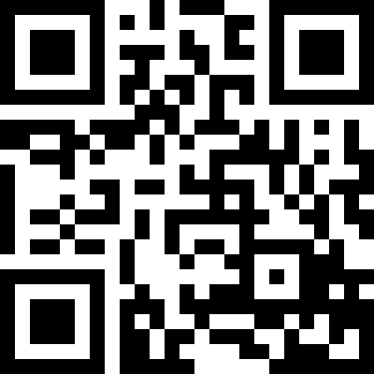
Agenda
Tutorial evaluation form: http://bit.ly/sc18-eval
Time | Module | Topic | Speaker
8:30am-8:40am | 00 | Introduction and Setup | David E. Bernholdt, ORNL
8:40am-9:00am | 01 | Overview of Best Practices in HPC Software Development | David E. Bernholdt, ORNL
9:00am-10:00am | 02 | Git Workflows | Jared O’Neal, ANL
10:00am-10:30am |  | Break
10:30am-11:40am | 03 | Better (Small) Scientific Software Teams | Michael A. Heroux, SNL
11:40am-12:00pm | 04 | Improving Reproducibility through Better Software Practices | Michael A. Heroux, SNL
12:00pm-1:30pm |  | Lunch (C1/2/3/4 Ballroom, 2nd floor)
1:30pm-2:15pm | 05 | An Introduction to Software Licensing | David E. Bernholdt, ORNL
2:15pm-2:55pm | 06 | Verification and Refactoring | Anshu Dubey, ANL
2:55pm-3:00pm | 07 | Code Coverage and Continuous Integration | Jared O’Neal, ANL
3:00-3:30pm |  | Break
3:30pm-3:40pm | 07 | Code Coverage and Continuous Integration (continued) | Jared O’Neal, ANL
3:40pm-5:00pm | 08 | Hands-on Activities | Jared O’Neal, ANL, and team
Please evaluate our tutorial!
http://bit.ly/sc18-eval
It helps us improve
It tells the organizers that you think tutorials and other events on software are an important part of Supercomputing
It is used to help decide if this tutorial should be offered again in the future

