Slide 1
Improving Reproducibility Through Better Software Practices
Better Scientific Software Tutorial
David E. Bernholdt
Oak Ridge National Laboratory
ECP Annual Meeting
January 14, 2019
See slide 2 for license details

Slide 2
License, citation, and acknowledgments
License and Citation
This work is licensed under a Creative Commons Attribution 4.0 International License (CC BY 4.0).
Requested citation: David E. Bernholdt and Michael A. Heroux, Improving Reproducibility Through Better Software Practices, in Better Scientific Software Tutorial, Exascale Computing Project Annual Meeting, Houston, Texas, 2019. DOI: 10.6084/m9.figshare.7581746
Acknowledgements
This work was supported by the U.S. Department of Energy Office of Science, Office of Advanced Scientific Computing Research (ASCR), and by the Exascale Computing Project (17-SC-20-SC), a collaborative effort of the U.S. Department of Energy Office of Science and the National Nuclear Security Administration.
This work was performed in part at the Oak Ridge National Laboratory, which is managed by UT-Battelle, LLC for the U.S. Department of Energy under Contract No. DE-AC05-00OR22725.
Sandia National Laboratories is a multimission laboratory managed and operated by National Technology and Engineering Solutions of Sandia, LLC, a wholly owned subsidiary of Honeywell International, Inc., for the U.S. Department of Energy’s National Nuclear Security Administration under contract DE-NA0003525.

Slide 3

Outline
Reproducibility taxonomies.
Increasing focus on reproducibility.
Role of better software practices.
Publication requirements.
Trustworthiness at Scale.
Personal Productivity Commitment.

Slide 4
Reproducible vs Replicable
Addressing Confusion in Taxonomies

Slide 7
Reproducibility is essential

Slide 8
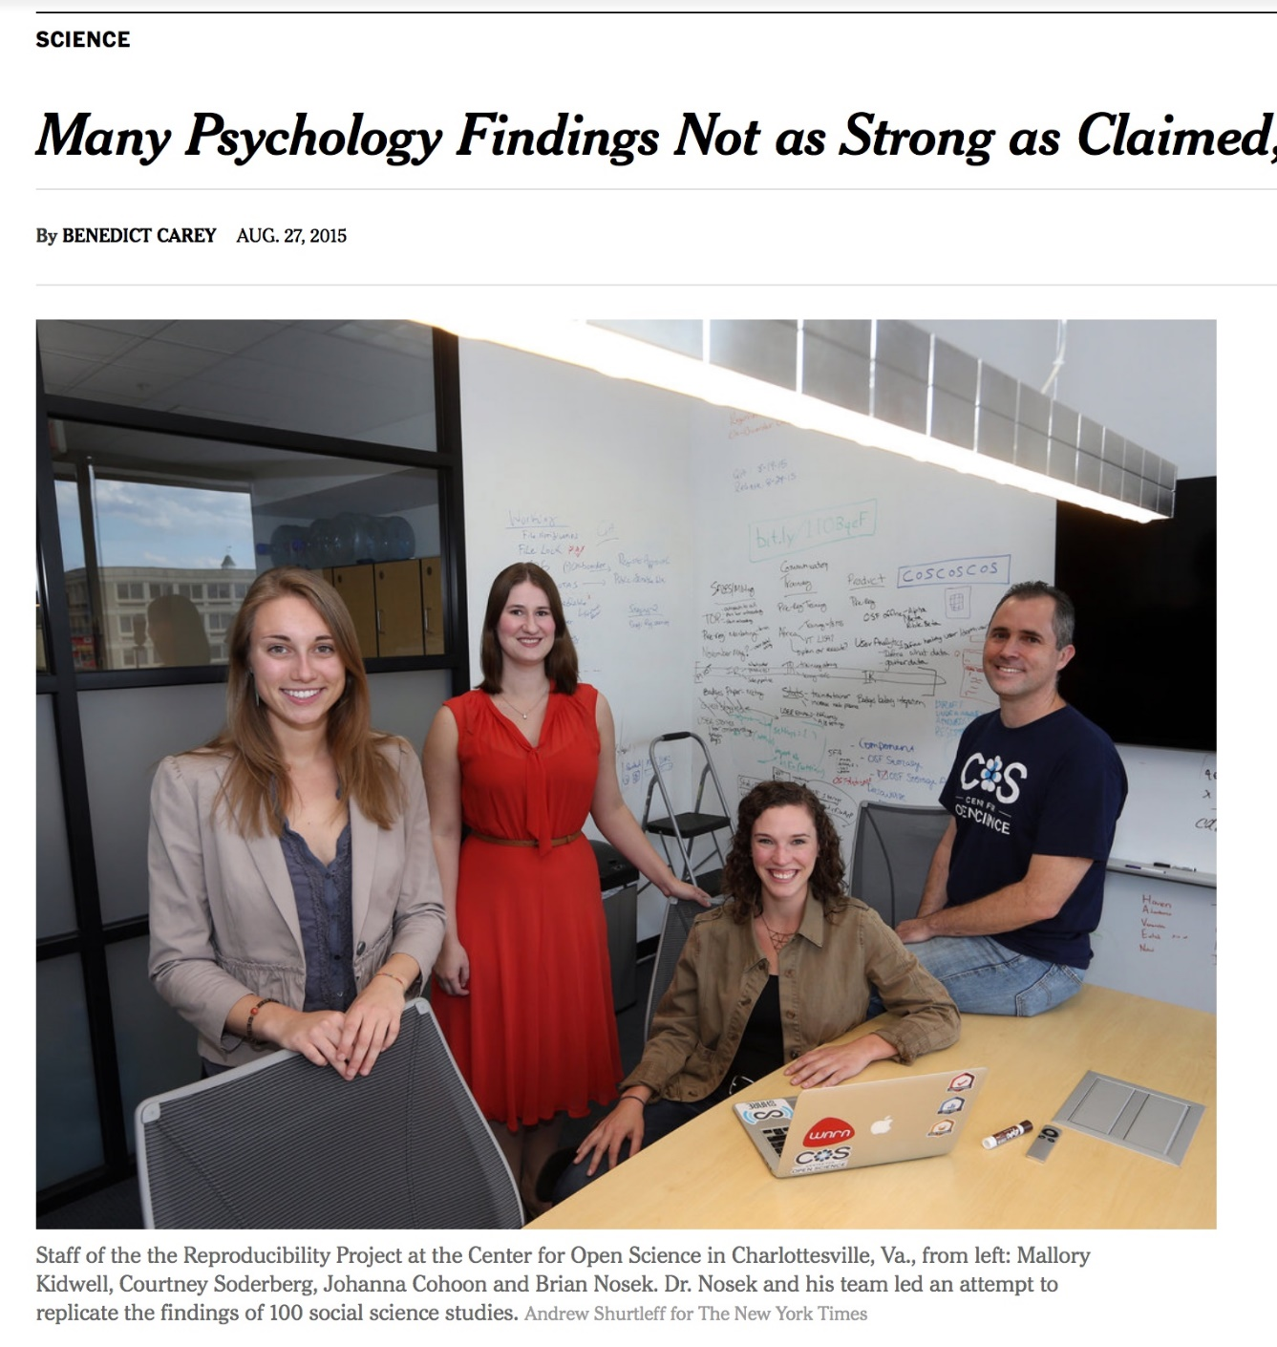
Reproducibility
NY Times highlights “problems”.
Only one of many cited examples.
Computational science had been spared this “spotlight”.
http://www.nytimes.com/2015/08/28/science/many-social-science-findings-not-as-strong-as-claimed-study-says.html?_r=0

Slide 9
Computational Science Example
Behavior of pure water just above homogeneous nucleation temperature (~ - 40 C/F).
Debenedetti/Princeton (2009):
2 possible phases: High or low density.
Chandler/Berkeley (2011):
Only 1 phase: High density.
No sharing of details across teams until 2016:
Chandler in Nature: “LAMMPS codes used in refs 5 and 12 are standard and documented, with scripts freely available upon request.”
Debenedetti with colleague Palmer: ”Send us your code.”
Received code after requests and appeal to Nature.
Source: https://physicstoday.scitation.org/do/10.1063/PT.6.1.20180822a/full/

Slide 10
Computational Science Example
Palmer located bug/feature in Berkeley code.
Used to speed up LAMMPS execution.
Replaced with more standard approach.
Obtained result similar to Debenedetti 2009.
Resolution took 7 years.
Source: https://physicstoday.scitation.org/do/10.1063/PT.6.1.20180822a/full/
For Palmer, the ordeal exemplifies the importance of transparency in scientific research, an issue that has recently drawn heightened attention in the science community. “One of the real travesties,” he says, is that “there’s no way you could have reproduced [the Berkeley team’s] algorithm—the way they had implemented their code—from reading their paper.” Presumably, he adds, “if this had been disclosed, this saga might not have gone on for seven years.”

Slide 11
Productivity and Sustainability
What do we mean?

Slide 12
Objectives
Productivity – Output per unit input.
Sustainability – The future cost of usability.
Goals for today:
Learn how to improve
Developer productivity.
Software sustainability.
For the purposes of better scientific productivity,
Using tools, processes and practices.

Slide 13
Tradeoffs: Better, faster, cheaper
“Better, faster, cheaper: Pick two of the three.”
Scenario: (Today) You are behind in developing a sophisticated new model in your software that you want to use for results in an upcoming paper.
Which of these could be reasonable choices?
Develop a simpler model for the paper.
Set other work aside and spend more time on development.
Ask for an extension on the paper deadline.
Develop sophisticated model, but don’t test its correctness.
Develop sophisticated model, but don’t document it or check it in.

Slide 14
Improved developer productivity
“Better, faster, cheaper: Pick all three.” – Near term.
Scenario: (6 months later) After investing in developer productivity improvements, you are on time in developing a sophisticated new model in your software that you want to use for results in an upcoming paper.
Invest in developer tools, processes, practices.

Slide 15
Improved software sustainability
“Better, faster, cheaper: Pick all three.” – Long term.
Scenario: (3 years later) After investing in software sustainability improvements, you are on time in developing several sophisticated new models in your software that you want to use for results in upcoming papers.
Invest in testing, documentation, integration for long-term software usability.

Slide 16
Which of These Enhance Reproducibility?
Code written by first-year, untrained grad student.
Tuning for high performance.
Dynamic parallelism of modern processors.
Better software testing.
Source code and versioning management.
Investing in developer productivity.
Investing in software sustainability.

Slide 17
Incentives To Change
Demand
Reproducibility
SW Quality Requirements
Employer Recognition
Productivity & Sustainability Investments
Enable
Common statement: “I would love to do a better job, but I need to:
Get this paper submitted.
Complete this project task.
Do something my employer values more.
Goal: Change incentives to include value of better software.

Slide 18
Reproducibility Terminology
V. Stodden, D. H. Bailey, J. Borwein, R. J. LeVeque, W. Rider, and W. Stein. 2013. Setting the Default to Reproducible: Reproducibility in Computational and Experimental Mathematics. (2013). https://icerm.brown.edu/tw12-5-rcem/icerm_report.pdf
Reviewable Research. The descriptions of the research methods can be independently assessed and the results judged credible. (This includes both traditional peer review and community review, and does not necessarily imply reproducibility.)
Replicable Research. Tools are made available that would allow one to duplicate the results of the research, for example by running the authors’ code to produce the plots shown in the publication. (Here tools might be limited in scope, e.g., only essential data or executables, and might only be made available to referees or only upon request.)
Confirmable Research. The main conclusions of the research can be attained independently without the use of software provided by the author. (But using the complete description of algorithms and methodology provided in the publication and any supplementary materials.)
Auditable Research. Sufficient records (including data and software) have been archived so that the research can be defended later if necessary or differences between independent confirmations resolved. The archive might be private, as with traditional laboratory notebooks.
Open or Reproducible Research. Auditable research made openly available. This comprised well-documented and fully open code and data that are publicly available that would allow one to (a) fully audit the computational procedure, (b) replicate and also independently reproduce the results of the research, and (c) extend the results or apply the method to new problems.

Slide 19

ACM TOMS Replicated Computational Results (RCR)
Submission: Optional RCR option.
Standard reviewer assignment: Nothing changes.
RCR reviewer assignment:
Concurrent with standard reviews.
As early as possible in review process.
Known to and works with authors during the RCR process.
RCR process:
Multi-faceted approach, Bottom line: Trust the reviewer.
Publication:
Replicated Computational Results Designation.
The RCR referee acknowledged.
Review report appears with published manuscript.

Slide 20
SC18 Reproducibility Initiative
Two appendices:
Artifact description (AD).
Blue print for setting up your computational experiment.
Makes it easier to rerun computations in future.
AD appendix will be mandatory for SC19 paper submissions.
Artifact Evaluation (AE).
Targets ”boutique” environments.
Improves trustworthiness when re-running hard, impossible.
Details:
https://collegeville.github.io/sc-reproducibility/

Slide 21
Coming to Your World Soon: Reproducibility Requirements
These conferences expect artifact evaluation appendices (most optionally):
CGO, PPoPP, PACT, RTSS and SC.
http://fursin.net/reproducibility.html
ACM Replicated Computational Results (RCR).
ACM TOMS, TOMACS.
http://toms.acm.org/replicated-computational-results.cfm
ACM Badging.
https://www.acm.org/publications/policies/artifact-review-badging
How can you prepare?

Slide 22
Improving Trustworthiness at Scale
What if we can’t re-run a computational experiment?

Slide 23
Reproducibility and Supercomputing
Scenario: You compute a “hero” calculation using 5M core-hours on Mira and submit your results for publication. During the review process, a referee questions the validity of your results. What options are feasible:
The reviewer re-runs your code on a laptop or cluster.
The reviewer re-runs your code on Mira.
You re-run your code on Mira.
Your results are rejected.
Your results are accepted, but with risk.

Slide 24
Sources for meta-computations
Synthetic operators with known:
Spectrum (Huge diagonals).
Rank (by constructions).
Invariant subspaces:
Example: Positional/rotational invariance (structures).
Conservation principles:
Example: Flux through a finite volume.
General:
Pre-conditions, post-conditions, invariants.
Can you think of something for your problems?

Slide 25
Personal Expectations
Calling out the best in team members

Slide 26
A Few Concrete Recommendations
Show me the person making the most commits on an undisciplined software project and I will show you the person who is injecting the most technical debt.
GitHub stats: Easy to find who made the most commits.
Some people: Pride in their high ranking.
Instead, be the person who ranks high in these ways:
Writes up requirements, analysis and design, even if simple.
Writes good GitHub issues, tracks their progress to completion.
Comments on, tests and accepts pull requests.
Provide good wiki, gh-pages content, responses to user issues.

Slide 27
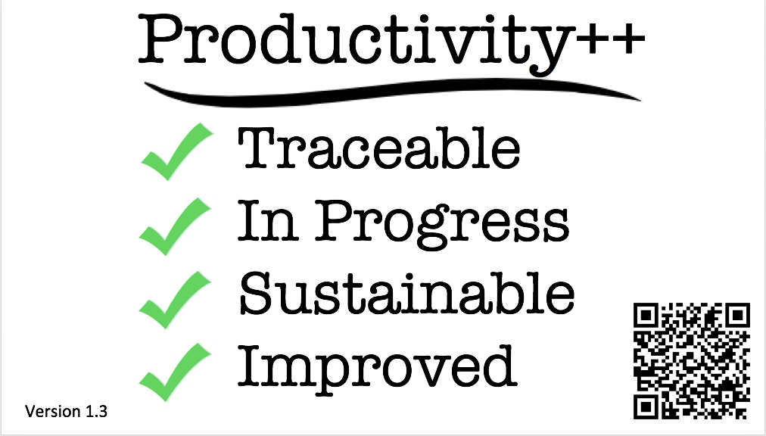
(Personal) Productivity++ Initiative Ask: Is My Work _______ ?
https://github.com/trilinos/Trilinos/wiki/Productivity---Initiative

Slide 28
Summary
Reproducibility demands are coming.
Conferences first, journals slower.
HPC software is particularly challenging:
Hardware variation.
Code optimization.
Dynamic parallelism.
Better software practices:
Improve chances for reproducibility.
Lower its cost.
Many tools emerging to enable reproducibility.

Slide 29
Agenda
Time | Module | Topic | Speaker
9:00am-9:30am | 01 | Overview of Best Practices in HPC Software Development | Anshu Dubey, ANL
9:30am-10:00am | 02 | Better (Small) Scientific Software Teams | David E. Bernholdt, ORNL
10:00am-10:30am | 03 | Improving Reproducibility through Better Software Practices | David E. Bernholdt, ORNL
10:30am-11:00am |  | Break
11:00am-11:45am | 04 | Verification & Refactoring | Anshu Dubey, ANL
11:45am-12:30pm | 05 | Git Workflow & Continuous Integration | Jared O’Neal, ANL

Slide 30
Other Software-Related Events at the ECP Annual Meeting
Tutorials
Better Scientific Software
Contemporary Peer Code Review in Scientific Software Development
Breakouts
Making Agile Work in your R&D Software Project
Contributing to Upstream Software: Why and How
From Good to Great: Getting Started with PSIP
Fostering a Culture of Passion and Productivity in ECP Teams
Posters
Tuesday Poster Session
IDEAS-EXAALT Collaboration: Adopting Continuous Integration for Long-Timescale Materials Simulation (poster 7)
Using Software Productivity and Sustainability Improvement Planning (PSIP) to Improve Application Development Productivity (51)
User Stories: Communicating about Software Requirements (52)
Better Scientific Software (BSSw): So our code will see the future (53)
IDEAS-ECP: Advancing Software Productivity for Exascale Applications (54)
Wednesday Poster Session
Improving the Exascale MPICH On-boarding Training Process through ECP IDEAS PSIP (9)
ECP ST Software Development Kits (SDKs) (65)

