Slide 1

Welcome to…
David E. Bernholdt, Anshu Dubey, Jared O’Neal
2:00pm-6:00pm, Sunday 16 June 2019
Download the presentations:
https://www.isc-hpc.com/isc19/tutorial_materials/
User: tutorial_materials
Password: ISC19green275
https://r.isc-hpc.com/tut130
(Please note the R before our domain)
See slide 2 for license details and requested citation

Slide 2
License, Citation and Acknowledgements
License and Citation
This work is licensed under a Creative Commons Attribution 4.0 International License (CC BY 4.0).
Each module of this tutorial is available individually with its own citation. The complete collection of modules comprising this tutorial has been archived under a single DOI.
The requested citation for the complete collection of modules comprising tutorial is: David E. Bernholdt, Anshu Dubey, and Jared O’Neal, Better Scientific Software Tutorial, in ISC High Performance Conference, Frankfurt, Germany, 2019. DOI: https://doi.org/10.6084/m9.figshare.8242859
Acknowledgements
This work was supported by the U.S. Department of Energy Office of Science, Office of Advanced Scientific Computing Research (ASCR), and by the Exascale Computing Project (17-SC-20-SC), a collaborative effort of the U.S. Department of Energy Office of Science and the National Nuclear Security Administration.
This work was performed in part at the Argonne National Laboratory, which is managed managed by UChicago Argonne, LLC for the U.S. Department of Energy under Contract No. DE-AC02-06CH11357.
This work was performed in part at the Oak Ridge National Laboratory, which is managed by UT-Battelle, LLC for the U.S. Department of Energy under Contract No. DE-AC05-00OR22725.
This work was performed in part at Sandia National Laboratories. Sandia National Laboratories is a multi-mission laboratory managed and operated by National Technology and Engineering Solutions of Sandia, LLC., a wholly owned subsidiary of Honeywell International, Inc., for the U.S. Department of Energy’s National Nuclear Security Administration under contract DE-NA0003525. SAND NO SAND2017-5474 PE

Slide 3
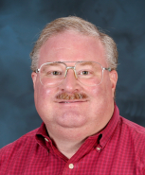
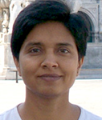
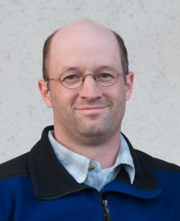


Tutorial Instructors
David Bernholdt, ORNL
Anshu Dubey, ANL
Jared O’Neal, ANL
Members of the IDEAS Productivity Project: http://ideas-productivity.org
Focus: Increasing CSE software productivity, quality, and sustainability
David
Anshu
Jared

Slide 4
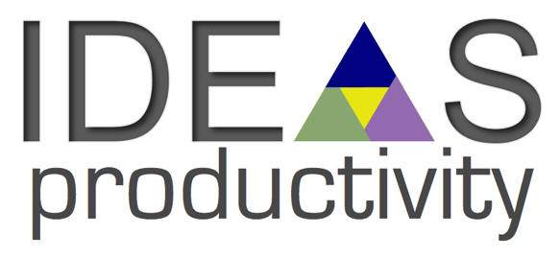
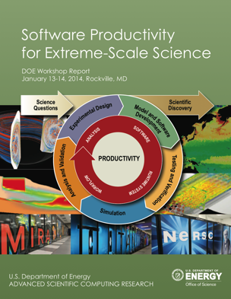
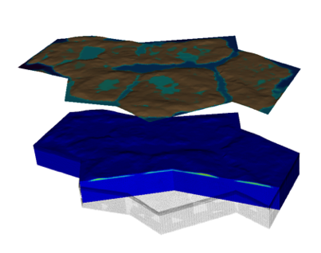


Interoperable Design of Extreme-scale Application Software (IDEAS)
Motivation
Enable increased scientific productivity, realizing the potential of extreme- scale computing, through a new interdisciplinary and agile approach to the scientific software ecosystem.
Project History
IDEAS began in 2014 as a DOE ASRC/BER partnership to improve application software productivity, quality, and sustainability. In 2017, the DOE Exascale Computing Project began supporting IDEAS to help application teams improve developer productivity and software sustainability while making major changes for exascale.
Impact on Applications & Programs
Terrestrial ecosystem use cases tied initial IDEAS activities to programs in DOE Biological and Environmental Research (BER). The Exascale Computing Project (ECP) supports a broad portfolio of applications furthering science, energy, national security, and economic competitiveness.
Objectives
Address confluence of trends in hardware and increasing demands for predictive multiscale, multiphysics simulations.
Respond to trend of continuous refactoring with efficient agile software engineering methodologies & improved software design.
Outreach and Community
Approach
Interdisciplinary multi-institutional team (ANL, LANL, LBNL, LLNL, ORNL, PNNL, SNL, U. Oregon) with broad experience in scientific software development
Close partnerships with applications teams ensures impact on science
Identification, documentation and dissemination of best practices for BER and ECP software teams and the broader community
Catalyzing software process improvements through tailored engagement with individual projects
Working to bend the curve of software development costs downwards
Use Cases: Terrestrial Modeling
Old Process
New Process
Software Productivity for Extreme-Scale Science
Cost
Methodologies for Software
Productivity
Extreme-Scale Scientific Software Development Kit (xSDK)
Start
Progress
Finish
ideas-productivity.org
Notes:
Qualitatively new approach based on making productivity the explicit and primary principle guiding our decisions and efforts.
Developing and demonstrating new approaches for producing, using, and supporting scientific software:
- Enhancing interoperability and performance portability of libraries and components
Establishing methodologies that facilitate delivery of software as reusable, interoperable components.
Right: Upper Colorado River System

Slide 5
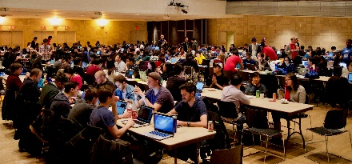

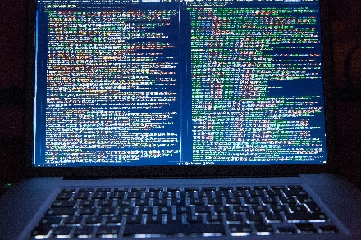
How does IDEAS Achieve Its Goals?
Tutorials
HPC-BP Webinars
Better Scientific Software
HPC/CSE Community
Minisymposia, Workshops, BOFs, etc.
ECP Code Teams

Slide 6
Additional Software-Related Events at ISC 2019
Tuesday — BOF — Spack Community BOF
Tuesday - Presentation - Parallel Programming - Painful or Productive?
Tuesday - Poster - (WHPC04) Research Software Engineering enabling HPC
Tuesday - Poster - (PP06): The International HPC Certification Program
Tuesday - Poster - (PP09): EPEEC: Productivity at Exascale
Tuesday — Poster — (PP24): Helping You Improve Software Sustainability and Development Productivity: An Overview of the IDEAS Project
Wednesday — Focus Session — New Approaches, Algorithms Towards Exascale Computing
Wednesday — BOF — Software Engineering and Reuse in Computational Science and Engineering (additional details: http://bit.ly/swe-cse-bof)
Wednesday - BOF - Performance Portability and Productivity: Panel Discussion
Note: Bold font denotes events (co-)organized by the IDEAS Productivity project

Slide 7

Building an Online Community
https://bssw.io
New community-based resource for scientific software improvement
A central hub for sharing information on practices, techniques, experiences, and tools to improve developer productivity and software sustainability for computational science & engineering (CSE)
Goals
Raise awareness of the importance of good software practices to scientific productivity and to the quality and reliability of computationally-based scientific results
Raise awareness of the increasing challenges facing CSE software developers as high-end computing heads to extreme scales
Help CSE researchers increase effectiveness as well as leverage and impact
Facilitate CSE collaboration via software in order to advance scientific discoveries
Site users can…
Find information on scientific software topics
Contribute new resources based on your experiences
Create content tailored to the unique needs and perspectives of a focused scientific domain

Slide 8
Tutorial Objectives
Overview of best practices in software engineering explicitly tailored for CSE
Why: Increase CSE software quality, sustainability, productivity
Better CSE software > better CSE research > broader CSE impact
Who: Practices relevant for projects of all sizes
emphasis on small teams, e.g., a faculty member and collaborating students
Approach:
Useful information, examples, exercises, pointers to other resources
Not to prescribe any particular practices as “must use”
Be informative about practices that have worked for some projects
Emphasis on adoption of practices that help productivity rather than put unsustainable burden
Customize as needed for each project
Remember: your code will live longer than you expect. Prepare for it!

Slide 9
Agenda
Time | Module | Topic | Speaker
2:00pm-2:40pm | 01 | Overview of Best Practices in HPC Software Development | Anshu Dubey, ANL
2:40pm-3:20pm | 02 | Better (Small) Scientific Software Teams | David E. Bernholdt, ORNL
3:20pm-4:00pm | 03 | Improving Reproducibility through Better Software Practices | David E. Bernholdt, ORNL
4:00pm-4:30pm |  | Break
4:30pm-5:15pm | 04 | Verification & Refactoring | Anshu Dubey, ANL
5:15pm-6:00pm | 05 | Git Workflow & Continuous Integration | Jared O’Neal, ANL
https://r.isc-hpc.com/tut130
(Please note the R before our domain)

Slide 10
Agenda
Time | Module | Topic | Speaker
2:00pm-2:40pm | 01 | Overview of Best Practices in HPC Software Development | Anshu Dubey, ANL
2:40pm-3:20pm | 02 | Better (Small) Scientific Software Teams | David E. Bernholdt, ORNL
3:20pm-4:00pm | 03 | Improving Reproducibility through Better Software Practices | David E. Bernholdt, ORNL
4:00pm-4:30pm |  | Break
4:30pm-5:15pm | 04 | Verification & Refactoring | Anshu Dubey, ANL
5:15pm-6:00pm | 05 | Git Workflow & Continuous Integration | Jared O’Neal, ANL
https://r.isc-hpc.com/tut130
(Please note the R before our domain)

