Slide 1
Overview of Best Practices in HPC Software Development
Better Scientific Software Tutorial
Anshu Dubey
Argonne National Laboratory
ISC High Performance Conference
June 16, 2019
See slide 2 for license details

Slide 2
License, citation, and acknowledgements
License and Citation
This work is licensed under a Creative Commons Attribution 4.0 International License (CC BY 4.0).
Requested citation: Anshu Dubey and David E. Bernholdt, Overview of Best Practices in HPC Software Development, in Better Scientific Software Tutorial, ISC High Performance Conference, Frankfurt, Germany, 2019. DOI: https://doi.org/10.6084/m9.figshare.8242859
Acknowledgements
This work was supported by the U.S. Department of Energy Office of Science, Office of Advanced Scientific Computing Research (ASCR), and by the Exascale Computing Project (17-SC-20-SC), a collaborative effort of the U.S. Department of Energy Office of Science and the National Nuclear Security Administration.
This work was performed in part at the Argonne National Laboratory, which is managed managed by UChicago Argonne, LLC for the U.S. Department of Energy under Contract No. DE-AC02-06CH11357
This work was performed in part at the Oak Ridge National Laboratory, which is managed by UT-Battelle, LLC for the U.S. Department of Energy under Contract No. DE-AC05-00OR22725.

Slide 3
Good scientific process requires good software practices
Good software practices increase scientific productivity

Slide 4
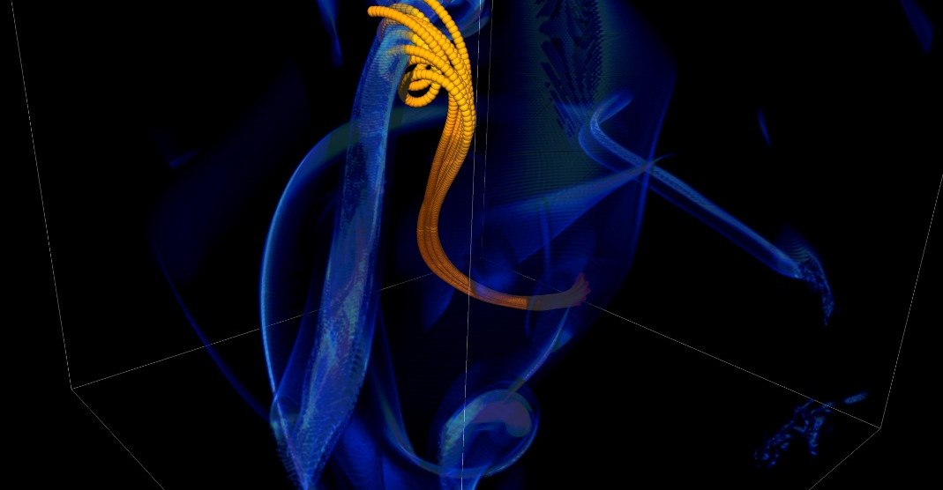
You Can Mitigate Risk But It Is Never Zero
Short notice availability of one of the biggest machines of it’s time
< 1month to get ready, run was 1.5 weeks
Quick and dirty development of particle capability in code
Error in tracking particles resulted in duplicated tags from round-off
Had to develop post-processing tools to correctly identify trajectories
6 months to process results
FLASH had a software process in place. It was tested regularly. This was one instance when the full process could not be applied because of time constraints.
Notes:
2005, BG/L
This was not even a situation like retracting results

Slide 5
Why Be Concerned with Software Engineering
Consequence of Choices
Quick and dirty collects interest which means more effort required to add features.
Accretion leads to unmanageable software
Increases cost of maintenance
Parts of software may become unusable over time
Inadequately verified software produces questionable results
Increases ramp-on time for new developers
Reduces software and science productivity due to technical debt

Slide 6
Taking stock
Software architecture and process design is an overhead
Value lies in avoiding technical debt (future saving)
Worthwhile to understand the trade-off
The target of the software
Proof-of-concept
Verification
Exploration of some phenomenon
Experiment design
Analysis
Other …
Cognizant of resource constraints
Dictate the rigor of the design and software process

Slide 7
Heroic Programming
Usually a pejorative term, is used to describe the expenditure of huge amounts of (coding) effort by talented people to overcome shortcomings in process, project management, scheduling, architecture or any other shortfalls in the execution of a software development project in order to complete it. Heroic Programming is often the only course of action left when poor planning, insufficient funds, and impractical schedules leave a project stranded and unlikely to complete successfully.
From http://c2.com/cgi/wiki?HeroicProgramming
Science teams often resemble heroic programming
Many do not see anything wrong with that approach
Notes:
Anecdote about offer to help with the development and get told a postdoc will do it because this is what we do.

Slide 8
What is wrong with heroic programming
Scientific results that could be obtained with heroic programming have run their course, because:
It is not possible for a single person to take on all these roles
Better scientific understanding
Math model
More complex software
Numerics
Different roles
and responsibilities
Verification
Performance

Slide 9
In Extreme-Scale science
More Scientific Understanding
More Hardware
Resources
Higher Fidelity
Model
Positive feedback loop
More complex codes, simulations and analysis
More moving parts that need to interoperate
Variety of expertise needed – the only tractable development model is through separation of concerns
It is more difficult to work on the same software in different roles without a software engineering process
Onset of higher platform heterogeneity
Requirements are unfolding, not known a priori
The only safeguard is investing in flexible design and robust software engineering process
More Diverse
Solvers
Notes:
Numerical models

Slide 10
In Extreme-Scale science
More Scientific Understanding
More Hardware
Resources
Higher Fidelity
Model
Positive feedback loop
More complex codes, simulations and analysis
More moving parts that need to interoperate
Variety of expertise needed – the only tractable development model is through separation of concerns
It is more difficult to work on the same software in different roles without a software engineering process
Onset of higher platform heterogeneity
Requirements are unfolding, not known a priori
The only safeguard is investing in flexible design and robust software engineering process
More Diverse
Solvers
Supercomputers change fast
Especially Now
Notes:
Numerical models

Slide 11
Lifecycle of a Scientific Application
Modeling
Approximations
Discretizations
Numerics
Convergence
Stability
Implementation
Verification
Expected behavior
Validation
Experiment/observation
Physical World
Model
Model
fidelity
Validation
Equations
Model
fidelity
Discretize
Implementation
Difference equations
Verify accuracy
stability
Numerical solvers

Slide 12
Expertise Map
Physical World
Domain
expert
Domain expert
Model
Model
fidelity
Validation
Equations
Software
Engineer,
optimization
experts
Domain
expert
Model
fidelity
Discretize
Implementation
Mesh/particles etc
Performance
Verify accuracy
stability
Applied
Mathematician
Applied
Mathematician
Numerical solvers

Slide 13
Lifecycle: Software engineering view

Slide 14
Challenges Developing a Scientific Application
Technical
Sociological
All parts of the cycle can be under research
Requirements change throughout the lifecycle as knowledge grows
Verification complicated by floating point representation
Real world is messy, so is the software
Competing priorities and incentives
Limited resources
Perception of overhead without benefit
Need for interdisciplinary interactions

Slide 15
Reconcile conflicting requirements
Separation of concerns
Encapsulation of functionalities where possible
Abstractions for encapsulations
Offload complexity where possible
Hard-nosed trade-offs
Flexibility and composability Vs raw performance
Extensibility and developer productivity

Slide 16
Architecting scientific codes
Taming the Complexity: Separation of Concerns
Subject of research
Model
Numerics
Client Code
Mathematically complex
logically separable functional units of computation
Encode into framework
Treat differently
Hide from one another
Applies to both kinds
Differentiate between private and public
More Stable
Discretization
I/O
Parameters
Infrastructure
Data structures and movement
Define interfaces

Slide 17
A successful model
Infrastructure
Capabilities
Requirements
Model
Software Architecture
API Design
API
Implement
Design
Develop
Test
Validate
Maintain
Augment
Integrate

Slide 18
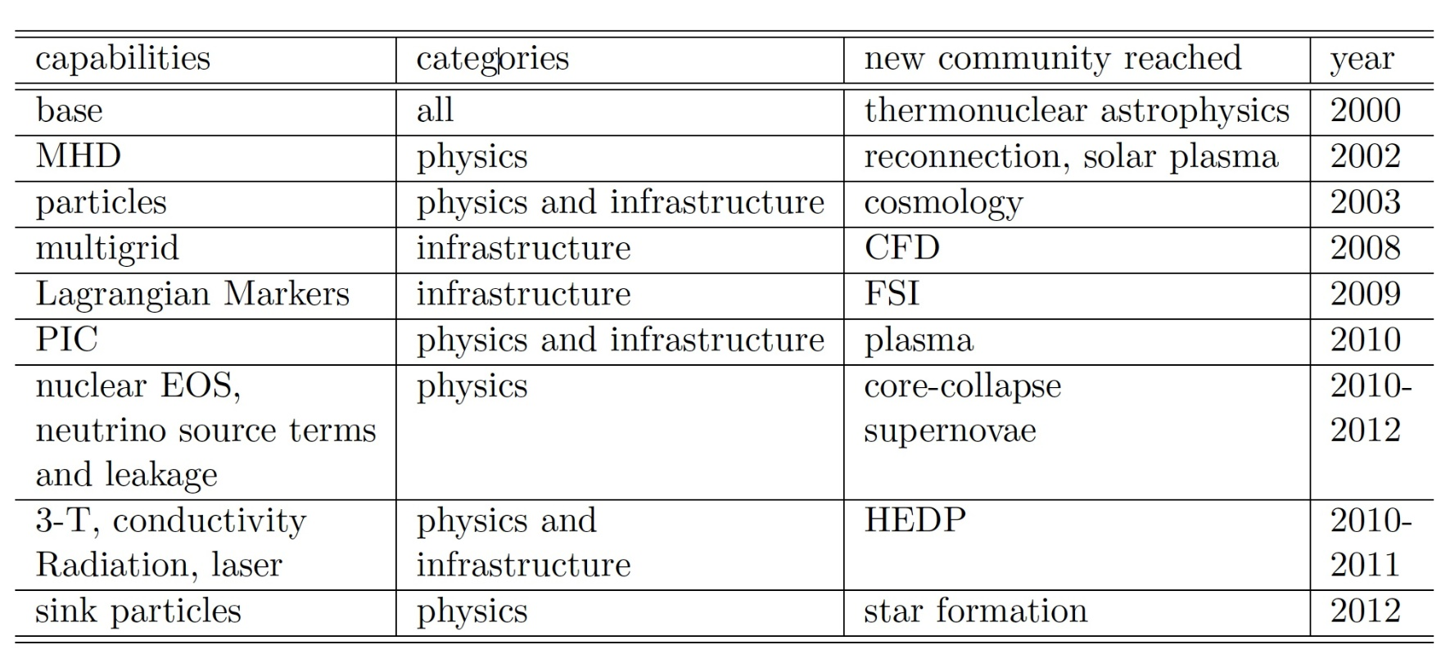
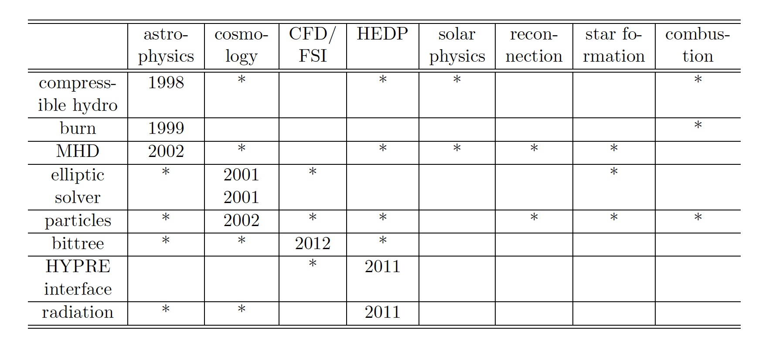
Design investment impact – Example FLASH
Notes:
This was the model followed for FLASH, a Multiphysics code that began in 1998. It underwent two major version revisions before it converged to the current backbone framework. The current framework was completed in 2006, and has not needed modification until the paradigm shift in the forthcoming platform architecture. The table above describes capabilities added to the code and the additional communities that were able to use it because of the newly added capabilities.

Slide 19
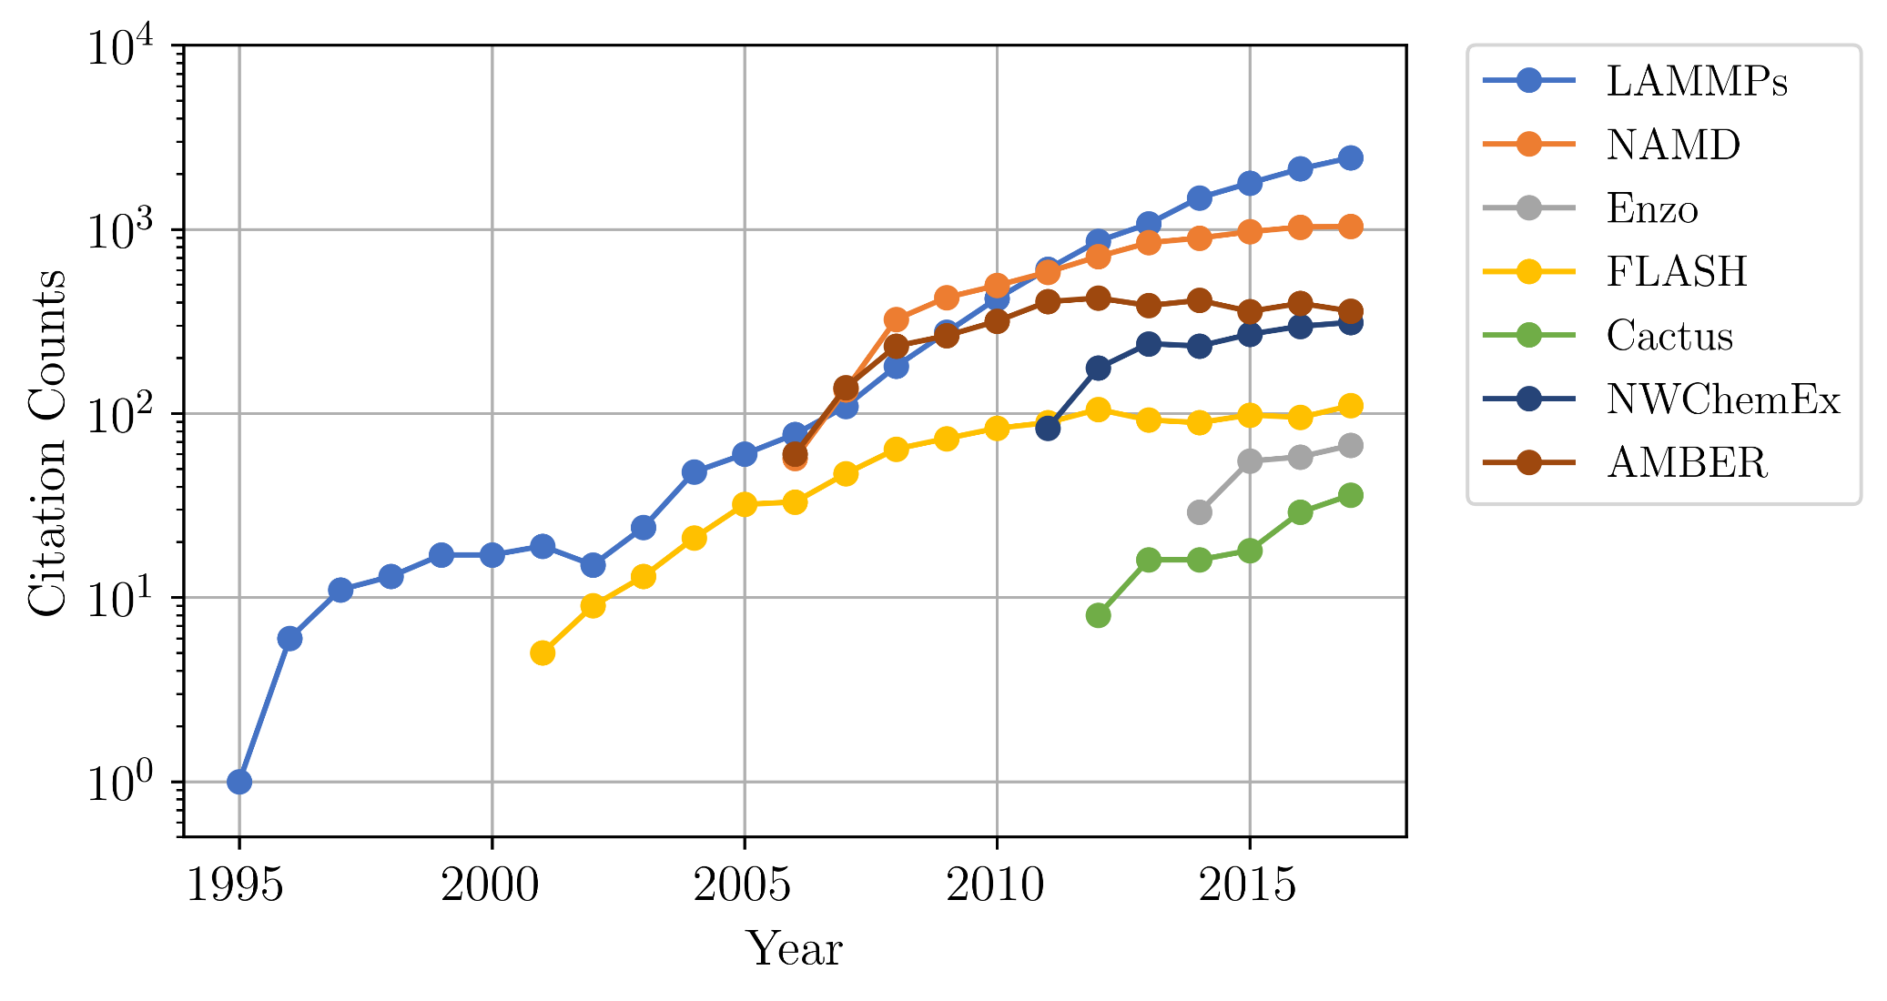
Community Impact of Well Done Software

Slide 20
Software Process Best Practices
Baseline
Desirable
Invest in extensible code design
Use version control and automated testing
Institute a rigorous verification and validation regime
Define coding and testing standards
Clear and well defined policies for
Auditing and maintenance
Distribution and contribution
Documentation
Provenance and reproducibility
Lifecycle management
Open development and frequent releases

Slide 21
A Useful Resource
https://ideas-productivity.org/resources/howtos/
‘What Is’ docs: 2-page characterizations of important topics for SW projects in computational science & engineering (CSE)
‘How To’ docs: brief sketch of best practices
Emphasis on ``bite-sized'' topics enables CSE software teams to consider improvements at a small but impactful scale
We welcome feedback from the community to help make these documents more useful

Slide 22
Other resources
http://www.software.ac.uk/
http://software-carpentry.org/
http://flash.uchicago.edu/cc2012/
http://journals.plos.org/plosbiology/article?id=10.1371/journal.pbio.1001745
http://ieeexplore.ieee.org/xpls/icp.jsp?arnumber=4375255
http://www.orau.gov/swproductivity2014/SoftwareProductivityWorkshopReport2014.pdf
http://ieeexplore.ieee.org/xpl/articleDetails.jsp?arnumber=6171147

Slide 23
Summary
Good software practices are needed for scientific productivity
Science at extreme-scales is complex and requires multiple expertise
Software process does need to address reality
Open codes, community contribution, are a powerful tool
It is extremely important to recognize that science through computing is at best as credible as the software that produces it

Slide 24
Agenda
Time | Module | Topic | Speaker
2:00pm-2:40pm | 01 | Overview of Best Practices in HPC Software Development | Anshu Dubey, ANL
2:40pm-3:20pm | 02 | Better (Small) Scientific Software Teams | David E. Bernholdt, ORNL
3:20pm-4:00pm | 03 | Improving Reproducibility through Better Software Practices | David E. Bernholdt, ORNL
4:00pm-4:30pm |  | Break
4:30pm-5:15pm | 04 | Verification & Refactoring | Anshu Dubey, ANL
5:15pm-6:00pm | 05 | Git Workflow & Continuous Integration | Jared O’Neal, ANL
https://r.isc-hpc.com/tut130
(Please note the R before our domain)

