Slide 1
Software Design and Testing
ATPESC 2019
Anshu Dubey
Computer Scientist
Mathematics and Computer Science Division
Q Center, St. Charles, IL (USA) July 28 – August 9, 2019
Notes:
Designed to be 45 Minute Talk. I hope for 30 minutes for RE and 15 for TDD.
NOTE: I have explicitly designed the RE portion of this talk to avoid using the terms plan-based or agile until the very end. This choose was made as these terms tend to polarize the population and could therefore using these terms could have the unfortunate side effect of bringing out biases and closing off people’s minds.

Slide 2
License, citation, and acknowledgments
License and Citation
This work is licensed under a Creative Commons Attribution 4.0 International License (CC BY 4.0).
Requested citation: Anshu Dubey, Software Design and Testing, in Better Scientific Software Tutorial, Argonne Training Program on Extreme-Scale Computing (ATPESC), St. Charles, IL, 2019. DOI: 10.6084/m9.figshare.9272813.
Acknowledgements
This work was supported by the U.S. Department of Energy Office of Science, Office of Advanced Scientific Computing Research (ASCR), and by the Exascale Computing Project (17-SC-20-SC), a collaborative effort of the U.S. Department of Energy Office of Science and the National Nuclear Security Administration..
This work was performed in part at the Argonne National Laboratory, which is managed managed by UChicago Argonne, LLC for the U.S. Department of Energy under Contract No. DE-AC02-06CH11357

Slide 3
Design

Slide 4
Science with Simulations Partial Workflow
Physical World
Domain
expert
Domain expert
Model
Model
fidelity
Validation
Equations
Software
Engineer,
optimization
experts
Domain
expert
Model
fidelity
Discretize
Implementation
Mesh/particles etc
Performance
Verify accuracy
stability
Applied
Mathematician
Applied
Mathematician
Numerical solvers

Slide 5
Motivation for Software Design
The default mode of growth by accretion leads to unmanageable software
Increases cost of maintenance
Parts of software may become unusable over time
Inadequately verified software produces questionable results
Increases ramp-on time for new developers
Reduces software and science productivity due to technical debt
Technical debt --> Consequence of Choices
Quick and dirty collects interest which means more effort required to add features.
It is extremely important to recognize that science through computing is only as credible as the software that produces it

Slide 6
Science with high performance computing
Compute on expensive, rare resources
Software continuously evolving
Many components of the software under research
More Scientific Understanding
More Hardware
Resources
Higher Fidelity
Model
More Diverse
Solvers

Slide 7
Taking stock
Software architecture and process design is an overhead
Value lies in avoiding technical debt (future saving)
Worthwhile to understand the trade-off
The target of the software
Proof-of-concept
Verification
Exploration of some phenomenon
Experiment design
Analysis
Other …
Cognizant of resource constraints
Dictate the rigor of the design and software process

Slide 8
Architecting scientific codes
Desirable Characteristics
Extensibility
Most use cases need additions and/or customizations
Portability
Even the same generation platforms are different
Performance
All machines need to be used well
Maintainability and Verifiability
For credible and reproducible results

Slide 9
Architecting scientific codes
Desirable Characteristics
Extensibility
Well defined structure and modules
Encapsulation of functionalities
Portability
Even the same generation platforms are different
Performance
All machines need to be used well
Maintainability and Verifiability
For credible and reproducible results

Slide 10
Architecting scientific codes
Desirable Characteristics
Extensibility
Well defined structure and modules
Encapsulation of functionalities
Portability
General solutions that work without significant manual intervention across platforms
Performance
All machines need to be used well
Maintainability and Verifiability
For credible and reproducible results

Slide 11
Architecting scientific codes
Desirable Characteristics
Extensibility
Well defined structure and modules
Encapsulation of functionalities
Portability
General solutions that work without significant manual intervention across platforms
Performance
Spatial and temporal locality of data
Minimizing data movement
Maximizing scalability
Maintainability and Verifiability
For credible and reproducible results

Slide 12
Architecting scientific codes
Desirable Characteristics
Extensibility
Well defined structure and modules
Encapsulation of functionalities
Portability
General solutions that work without significant manual intervention across platforms
Performance
Spatial and temporal locality of data
Minimizing data movement
Maximizing scalability
Maintainability and Verifiability
Clean code
Documentation
Comprehensive testing

Slide 13
Architecting scientific codes
Why it is challenging
Extensibility
Well defined structure and modules
Encapsulation of functionalities
Portability
General solutions that work without significant manual intervention across platforms
Performance
Spatial and temporal locality of data
Minimizing data movement
Maximizing scalability
Maintainability and Verifiability
Clean code
Documentation
Comprehensive testing

Slide 14
Architecting scientific codes
Why it is challenging
Extensibility
Same data layout not good for all solvers. Many corner cases. Necessary lateral interactions
Portability
General solutions that work without significant manual intervention across platforms
Performance
Spatial and temporal locality of data
Minimizing data movement
Maximizing scalability
Maintainability and Verifiability
Clean code
Documentation
Comprehensive testing

Slide 15
Architecting scientific codes
Why it is challenging
Extensibility
Same data layout not good for all solvers. Many corner cases. Necessary lateral interactions
Portability
Tremendous platform heterogeneity
A version for each class of device => combinatorial explosion
Performance
Spatial and temporal locality of data
Minimizing data movement
Maximizing scalability
Maintainability and Verifiability
Clean code
Documentation
Comprehensive testing

Slide 16
Architecting scientific codes
Why it is challenging
Extensibility
Same data layout not good for all solvers. Many corner cases. Necessary lateral interactions
Portability
Tremendous platform heterogeneity
A version for each class of device => combinatorial explosion
Performance
Low arithmetic intensity solvers with hard dependencies. Proximity and work distribution at cross purposes
Maintainability and Verifiability
Clean code
Documentation
Comprehensive testing

Slide 17
Architecting scientific codes
Why it is challenging
Extensibility
Same data layout not good for all solvers. Many corner cases. Necessary lateral interactions
Portability
Tremendous platform heterogeneity
A version for each class of device => combinatorial explosion
Performance
Low arithmetic intensity solvers with hard dependencies. Proximity and work distribution at cross purposes
Maintainability and Verifiability
Wrong incentives
Designing good tests is hard

Slide 18
Architecting scientific codes
Taming the Complexity: Separation of Concerns
Subject of research
Model
Numerics
Client Code
Mathematically complex
logically separable functional units of computation
Encode into framework
Treat differently
Hide from one another
Applies to both kind
Differentiate between private and public
More Stable
Discretization
I/O
Parameters
Infrastructure
Data structures and movement
Define interfaces

Slide 19
A successful model
Infrastructure
Capabilities
Requirements
Model
Software Architecture
API Design
API
Implement
Design
Develop
Test
Validate
Maintain
Augment
Integrate

Slide 20
Example From FLASH – Grid Unit
Grid
GridParticles
GridMain
GridSolvers
GridBC
GPMapToMesh
GPMove
UG
paramesh
UG
paramesh
PM4_package
PM4dev_ package
etc…
Sieve
PttoPt

Slide 21
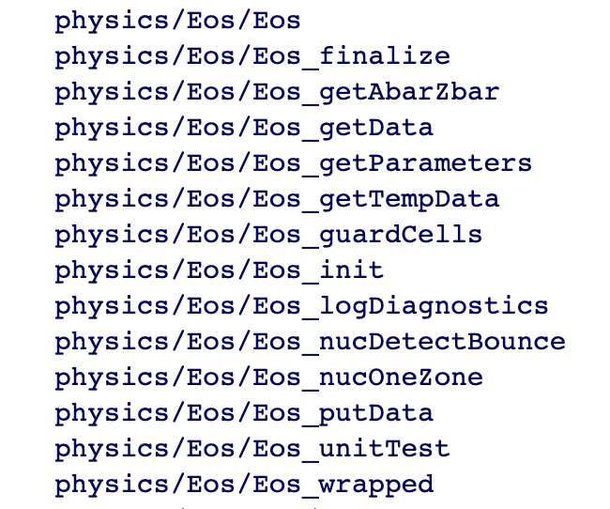
Example From FLASH: EOS interface Design
Hierarchy in complexity of interfaces
For collection of points
For sections of a block
Different levels in the hierarchy give different degrees of control to the client routines
Most of the complexity is completely hidden from casual users
More sophisticated users can bypass the wrappers for greater control
Done with elaborate machinery of masks and defined constants
Notes:
or full block vectorized input and output
wrappers to vectorize and configure the data
select derivative quantities to return with masking

Slide 22
Preparing for future
Much larger codes
Transition time much longer than before
Platform life <<< code lifecycle
Platform life ~= transition time
Same generation has different platforms
No single machine model to program to
Need to deepen parallel hierarchy and lift abstraction
Let abstraction and middle layers do the heavy lifting for portability
Many ideas, little convergence.

Slide 23
Overarching Theme
Differentiate between physical view and virtual view
Simpler world view at either end enables separation of concerns
Hard-nosed trade-offs

Slide 24
Design considerations - new
Composing tasks
Components or kernels
Task orchestration
Mapping tasks to devices
CPU, accelerators, specialized devices
Managing data movement between devices

Slide 25
Example: PDE’s
Real view : A
whole domain
with many
operators
Spatial
decomposition
Virtual view :
domain sections
as stand-alone
computation unit
code
transformation
Memory
access and
compute
optimization
Functional
decomposition
Abstraction at
solver level
Virtual view
collection of
components
Fusing
Functions
Parallelization
and scaling
optimization
Dynamic
Scheduling
Write solvers as independent tasks
Explicitly call out dependencies
Expose fusion possibilities
Notes:
Example of changing the block size to adjust to the cache memory
And point-to-point Vs collectives depending upon the scale of the problem

Slide 26
The flash approach
Virtual view :
domain sections
as stand-alone
computation unit
Application
discretized
whole
domain
and
multiple
operators
Memory
access and
compute
optimization
Hierarchical
Spatial
decomposition
Constrained
semantics
Fine grained
Functional
decomposition
Parallelization
and scaling
optimization
Virtual view
collection of
components
Notes:
Example of changing the block size to adjust to the cache memory
And point-to-point Vs collectives depending upon the scale of the problem

Slide 27
Components in play: infrastructure
Framework
Real view : A
whole domain
with many
operators
Spatial
Decomposition
Blocks/tiles
Virtual view :
domain sections
as stand-alone
computation unit
Load Distribution
Parallelization
and scaling
Scheduling
AMR infrastructure: refinement, load balancing, work redistribution
Scheduling and data movement at block and operator level

Slide 28
Components in Play: operators
Framework
Abstractions for performance portability
Data orchestration for memory hierarchy
Real view : A
whole domain
with many
operators
Functional
decomposition
Virtual view
collection of
components
code
transformation
Memory
access and
compute
Abstraction at
solver level
Fusing/inlining
Functions

Slide 29
Putting it all Together
The construction of operators
Express computation in the form of stencil operators or other appropriate abstraction
Specify the part of the domain, and the conditions under which the operators apply
Use masks to take care of branching
Mix-mode parallelism
Parameters to control the degree of tiling or other forms of mix-mode parallelism
Could be handed to the compiler when technology arrives
Framework forms the data containers
Dynamic tasking
Smarter iterators that are aware of mix-mode parallelism and dependencies
The iterating loops give up control and do while loops

Slide 30
Some available Options
Many efforts to provide tools to application developers
KoKKOs : Integrated Option with polymorphic arrays
Raja :
TiDA, HTA : managing tiling abstractions
GridTools : comprehensive solution from CSCS-ETH
Dash : managing multilevel locality
Task based processing – OCR, charm++, HPX, Quark etc
Language based solutions – Julia, Chapel, UPC++ etc
Domain specific languages

Slide 31
Other Things to Consider
Leverage existing software
Libraries may have better solvers
Off-load expertise and maintenance
Examine the interoperability constraints
Many times the cost is justified even if there is more data movement
More available packages are attempting to achieve interoperability
See if a combination meets your requirements
May be worthwhile to let the library dictate data layout if the corresponding operations dominate
Institute an extremely rigorous verification regime at the outset

Slide 32
Testing and verification

Slide 33
Verification
Code verification uses tests
It is much more than a collection of tests
It is the holistic process through which you ensure that
Your implementation shows expected behavior,
Your implementation is consistent with your model,
Science you are trying to do with the code can be done.

Slide 34
Stages and types of verification
During initial code development
Accuracy and stability
Matching the algorithm to the model
Interoperability of algorithms
In later stages
While adding new major capabilities or modifying existing capabilities
Ongoing maintenance
Preparing for production

Slide 35
Challenge with Exploratory Software
Verification implies one knows the outcome
The outcome is achieved or not achieved
What if one doesn’t exactly know the outcome?
Software is meant to understand the expected outcome

Slide 36
Other specific verification challenges
Functionality coverage
Particularly true of codes that allow composability in their configuration
Codes may incorporate some legacy components
Its own set of challenges
No existing tests at any granularity
Examples – multiphysics application codes that support multiple domains

Slide 37
Challenges with legacy codes
Checking for coverage
Legacy codes can have many gotchas
Dead code
Redundant branches
Interactions between sections of the code may be unknown
Can be difficult to differentiate between just bad code, or bad code for a good reason
Nested conditionals
Code coverage tools are of limited help

Slide 38
Components of Verification
Testing at various granularity
Individual components
Interoperability of components
Convergence, stability and accuracy
Validation of individual components
Testing practices
Error bars
Necessary for differentiating between drift and round-off
Selection of tests for coverage

Slide 39
Regular Testing
Part of ongoing verification
Automating is helpful
Can be just a script
Or a testing harness
Essential for large code
Set up and run tests
Evaluate test results
Easy to execute a logical subset of tests
Pre-push
Nightly
Automation of test harness is critical for
Long-running test suites
Projects that support many platforms
Jenkins
C-dash
Custom
(FlashTest)

Slide 40
Good Testing Practices
Must have consistent policy on dealing with failed tests
Issue tracking
How quickly does it need to be fixed?
Who is responsible for fixing it?
Someone should be watching the test suite
When refactoring or adding new features, run a regression suite before check in
Add new regression tests or modify existing ones for the new features
Code review before releasing test suite is useful
Another person may spot issues you didn’t
Incredibly cost-effective

Slide 41
Test Development
Development of tests and diagnostics goes hand-in-hand with code development
Non-trivial to devise good tests, but extremely important
Compare against simpler analytical or semi-analytical solutions
When faced with legacy codes with no existing tests
Isolate a small area of the code
Dump a useful state snapshot
Build a test driver
Start with only the files in the area
Link in dependencies
Copy if any customizations needed
Read in the state snapshot
Verify correctness
Always inject errors to verify that the test is working

Slide 42
Example from E3SM
Isolate a small area of the code
Dump a useful state snapshot
Build a test driver
Start with only the files in the area
Link in dependencies
Copy if any customizations needed
Read in the state snapshot
Restart from the saved state
state
driver

Slide 43
Workarounds for Granularity
Real dependency
Mocked up
dependency
Approach the problem sideways
Components can be exercised against known simpler applications
Same applies to combination of components
Build a scaffolding of verification tests to gain confidence
Unit test
Unit test
Unit test

Slide 44
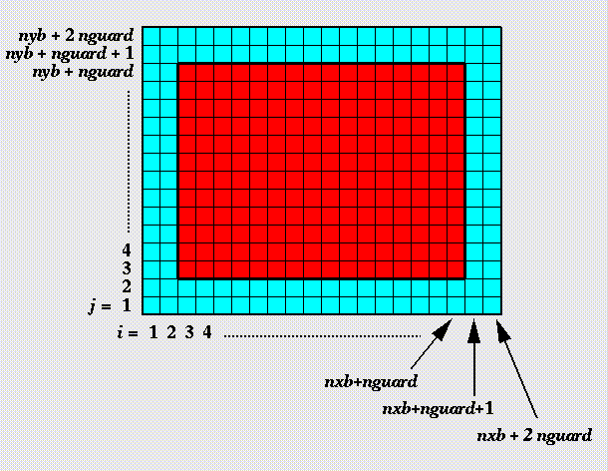
Example from FLASH
Unit test for Grid
Verification of guard cell fill
Use two variables A & B
Initialize A in all cells and B only in the interior cells (red)
Apply guard cell fill to B
Unit test

Slide 45
Example from Flash
Unit test
Unit test for Equation of State (EOS)
Three modes for invoking EOS
MODE1: Pressure and density as input, internal energy and temperature as output
MODE2: Internal energy and density as input temperature and pressure as output
MODE3: Temperature and density as input pressure and internal energy as output
Use initial conditions from a known problem, initialize pressure and density
Apply EOS in MODE1
Using internal energy generated in the previous step apply EOS in MODE2
Using temperature generated in the previous step apply EOS in MODE3
At the end all variables should be consistent within tolerance

Slide 46
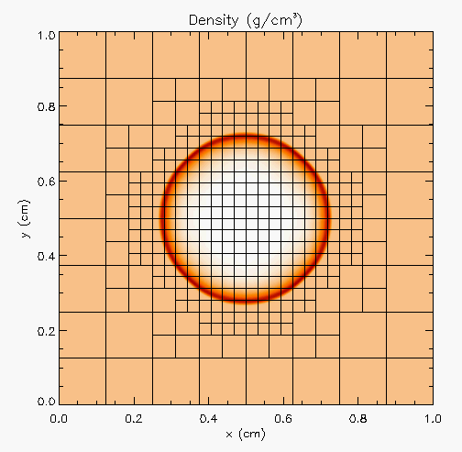
Example from FLASH
Unit test
Unit test for Hydrodynamics
Sedov blast wave
High pressure at the center
Shock moves out spherically
FLASH with AMR and hydro
Known analytical solution
Unit test
Unit test
Though it exercises mesh, hydro and eos, if mesh and eos are verified first, then this test verifies hydro
More testing needed for Grid using AMR
Flux correction and regridding

Slide 47
Example from FLASH
Reason about correctness for testing Flux correction and regridding
IF Guardcell fill and EOS unit tests passed
Run Hydro without AMR
If failed fault is in Hydro
Run Hydro with AMR, but no dynamic refinement
If failed fault is in flux correction
Run Hydro with AMR and dynamic refinement
If failed fault is in regridding

Slide 48
Selection of tests
Two purposes
Regression testing
May be long running
Provide comprehensive coverage
Continuous integration
Quick diagnosis of error
A mix of different granularities works well
Unit tests for isolating component or sub-component level faults
Integration tests with simple to complex configuration and system level
Restart tests
Rules of thumb
Simple
Enable quick pin-pointing

Slide 49
Why not always use the most stringent testing?
Effort spent in devising tests and testing regime are a tax on team resources
When the tax is too high…
Team cannot meet code-use objectives
When is the tax is too low…
Necessary oversight not provided
Defects in code sneak through
Evaluate project needs
Objectives: expected use of the code
Team: size and degree of heterogeneity
Lifecycle stage: new or production or refactoring
Lifetime: one off or ongoing production
Complexity: modules and their interactions

Slide 50
Commonalities
Unit testing is always good
It is never sufficient
Verification of expected behavior
Understanding the range of validity and applicability is always important
Especially for individual solvers

Slide 51
Test Selection
First line of defense – code coverage tools (demo later)
Necessary but not sufficient – don’t give any information about interoperability
Build a matrix
Physics along rows
Infrastructure along columns
Alternative implementations, dimensions, geometry
Mark <i,j> if test covers corresponding features
Follow the order
All unit tests – including full module tests
Tests representing ongoing productions
Tests sensitive to perturbations
Most stringent tests for solvers
Least complex test to cover remaining spots

Slide 52
Example
A test on the same row indicates interoperability between corresponding physics
Similar logic would apply to tests on the same column for infrastructure
More goes on, but this is the primary methodology
Tests | Symbol
Sedov | SV
Cellular | CL
Poisson | PT
White Dwarf | WD

Slide 53
Takeaways
Understand your needs
Do the cost-benefit analysis
Adopt what works for you without incurring technical debt
Design with portability, extensibility, reproducibility and maintainability in mind
Verify … verify … verify
…….Questions ?

