Slide 1

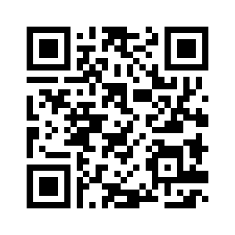
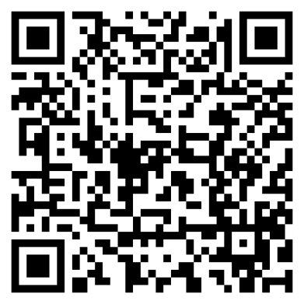
Welcome to…
David E. Bernholdt, Anshu Dubey, Michael Heroux, Jared O’Neal Assisted by Patricia Grubel, Rinku Gupta
8:30am-5:00pm, Monday 18 November 2019
Tutorial slides http://bit.ly/sc19-bssw-tutorial
Tutorial evaluation http://bit.ly/sc19-bssw-eval
See slide 2 for license details and requested citation

Slide 2
License, Citation and Acknowledgements
License and Citation
This work is licensed under a Creative Commons Attribution 4.0 International License (CC BY 4.0).
The requested citation the overall tutorial is: David E. Bernholdt, Anshu Dubey, Michael A. Heroux, and Jared O’Neal, Better Scientific Software tutorial, in SC ‘19: International Conference for High Performance Computing, Networking, Storage and Analysis, Denver, Colorado, 2019. DOI: 10.6084/m9.figshare.10114880
Individual modules may be cited as Speaker, Module Title, in Better Scientific Software Tutorial…
Acknowledgements
Additional contributors to this this tutorial include: Alicia Klinvex, Katherine Riley, and James Willenbring
This work was supported by the U.S. Department of Energy Office of Science, Office of Advanced Scientific Computing Research (ASCR), and by the Exascale Computing Project (17-SC-20-SC), a collaborative effort of the U.S. Department of Energy Office of Science and the National Nuclear Security Administration.
This work was performed in part at the Argonne National Laboratory, which is managed managed by UChicago Argonne, LLC for the U.S. Department of Energy under Contract No. DE-AC02-06CH11357.
This work was performed in part at the Oak Ridge National Laboratory, which is managed by UT-Battelle, LLC for the U.S. Department of Energy under Contract No. DE-AC05-00OR22725.
This work was performed in part at Sandia National Laboratories. Sandia National Laboratories is a multi-mission laboratory managed and operated by National Technology and Engineering Solutions of Sandia, LLC., a wholly owned subsidiary of Honeywell International, Inc., for the U.S. Department of Energy’s National Nuclear Security Administration under contract DE-NA0003525. SAND NO SAND2017-5474 PE

Slide 3
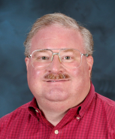
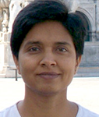
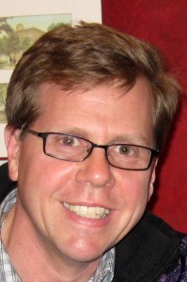
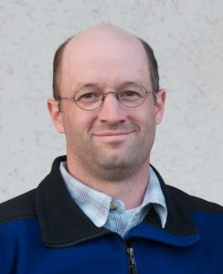
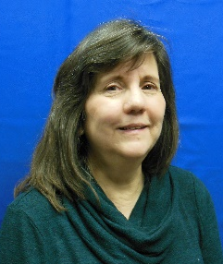
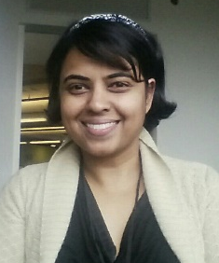




Tutorial Instructors
David Bernholdt, ORNL
Anshu Dubey, ANL
Mike Heroux, SNL
Jared O’Neal, ANL
Assisted by
Patricia Grubel, LANL
Rinku Gupta, ANL
Members of the IDEAS Productivity Project: http://ideas-productivity.org
Focus: Increasing CSE software productivity, quality, and sustainability
David
Anshu
Mike
Jared
Pat
Rinku

Slide 4

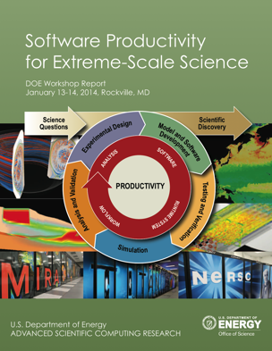
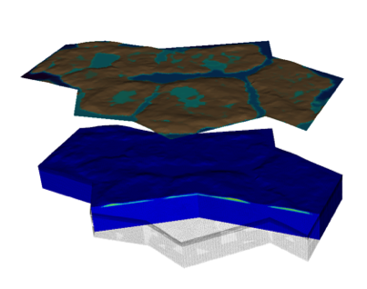


Interoperable Design of Extreme-scale Application Software (IDEAS)
Motivation
Enable increased scientific productivity, realizing the potential of extreme- scale computing, through a new interdisciplinary and agile approach to the scientific software ecosystem.
Project History
IDEAS began in 2014 as a DOE ASRC/BER partnership to improve application software productivity, quality, and sustainability. In 2017, the DOE Exascale Computing Project began supporting IDEAS to help application teams improve developer productivity and software sustainability while making major changes for exascale.
Impact on Applications & Programs
Terrestrial ecosystem use cases tied initial IDEAS activities to programs in DOE Biological and Environmental Research (BER). The Exascale Computing Project (ECP) supports a broad portfolio of applications furthering science, energy, national security, and economic competitiveness.
Objectives
Address confluence of trends in hardware and increasing demands for predictive multiscale, multiphysics simulations.
Respond to trend of continuous refactoring with efficient agile software engineering methodologies & improved software design.
Outreach and Community
Approach
Interdisciplinary multi-institutional team (ANL, LANL, LBNL, LLNL, ORNL, PNNL, SNL, U. Oregon) with broad experience in scientific software development
Close partnerships with applications teams ensures impact on science
Identification, documentation and dissemination of best practices for BER and ECP software teams and the broader community
Catalyzing software process improvements through tailored engagement with individual projects
Working to bend the curve of software development costs downwards
Use Cases: Terrestrial Modeling
Old Process
New Process
Software Productivity for Extreme-Scale Science
Cost
Methodologies for Software
Productivity
Extreme-Scale Scientific Software Development Kit (xSDK)
Start
Progress
Finish
ideas-productivity.org
Notes:
Qualitatively new approach based on making productivity the explicit and primary principle guiding our decisions and efforts.
Developing and demonstrating new approaches for producing, using, and supporting scientific software:
- Enhancing interoperability and performance portability of libraries and components
Establishing methodologies that facilitate delivery of software as reusable, interoperable components.
Right: Upper Colorado River System

Slide 5
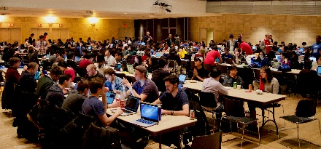

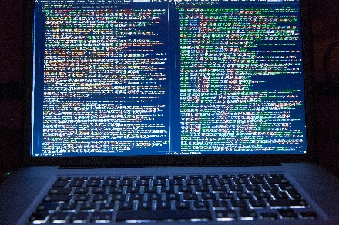
How does IDEAS Achieve Its Goals?
Tutorials
HPC-BP Webinars
Better Scientific Software
HPC/CSE Community
Minisymposia, Workshops, BOFs, etc.
ECP Code Teams

Slide 6

Building an Online Community
https://bssw.io
New community-based resource for scientific software improvement
A central hub for sharing information on practices, techniques, experiences, and tools to improve developer productivity and software sustainability for computational science & engineering (CSE)
Goals
Raise awareness of the importance of good software practices to scientific productivity and to the quality and reliability of computationally-based scientific results
Raise awareness of the increasing challenges facing CSE software developers as high-end computing heads to extreme scales
Help CSE researchers increase effectiveness as well as leverage and impact
Facilitate CSE collaboration via software in order to advance scientific discoveries
Site users can…
Find information on scientific software topics
Contribute new resources based on your experiences
Create content tailored to the unique needs and perspectives of a focused scientific domain

Slide 7
Additional Software-Related Events at SC19
Bold events (co-)organized by IDEAS
Day/Time | Event Type | Event Title
Sunday | Tutorial | Floating-Point Analysis and Reproducibility Tools for Scientific Software
Sunday | Workshop | The 2019 International Workshop on Software Engineering for HPC-Enabled Research (SE-HER 2019)
Monday | Tutorial | Better Scientific Software
Monday | Tutorial | Managing HPC Software Complexity with Spack
Monday | Workshop | 3nd International Workshop on Software Correctness for HPC Applications (Correctness 2019)
Monday | Students@SC | Students@SC: Modern Software Design, Tools, and Practices
Tuesday | BoF | Extreme-Scale Scientific Software Stack (E4S)
Tuesday | BoF | Exchanging Best Practices in Supporting Computational and Data-Intensive Research
Tuesday | Panel | Developing and Managing Research Software in Universities and National Labs
Wednesday | BoF | Software Engineering and Reuse in Modeling, Simulation, and Data Analytics for Science and Engineering
Thursday | BoF | Quality Assurance and Coding Standards for Parallel Software
Thursday | Panel | Sustainability of HPC Research Computing: Fostering Career Paths for Facilitators, Research Software Engineers, and Gateway Creators
Friday | Panel | The Road to Exascale and Beyond is Paved by Software: How Algorithms, Libraries and Tools Will Make Exascale Performance Real

Slide 8
Who Are You?
Undergrad students
Graduate students
Postdocs
Faculty/staff
Manager
Other
Academia
National Laboratories
Government
Industry
Other
Domain scientist
Computer scientist
Applied mathematician
Other

Slide 9
Tutorial Objectives
Overview of best practices in software engineering explicitly tailored for CSE
Why: Increase CSE software quality, sustainability, productivity
Better CSE software > better CSE research > broader CSE impact
Who: Practices relevant for projects of all sizes
emphasis on small teams, e.g., a faculty member and collaborating students
Approach:
Useful information, examples, exercises, pointers to other resources
Not to prescribe any particular practices as “must use”
Be informative about practices that have worked for some projects
Emphasis on adoption of practices that help productivity rather than put unsustainable burden
Customize as needed for each project
Remember: your code will live longer than you expect. Prepare for it!

Slide 10
Agenda
Time | Module | Topic | Speaker
8:30am-8:40am | 00 | Introduction and Setup | David E. Bernholdt, ORNL
8:40am-9:15am | 01 | Overview of Best Practices in HPC Software Development | David E. Bernholdt, ORNL
9:15am-10:00am | 02 | An Introduction to Software Licensing | David E. Bernholdt, ORNL
10:00am-10:30am |  | Break
10:30am-11:30am | 03 | Agile Methodologies and Useful GitHub Tools | Michael A. Heroux, SNL
11:30am-12:00pm | 04 | Improving Reproducibility through Better Software Practices | Michael A. Heroux, SNL
12:00pm-1:30pm |  | Lunch
1:30pm-2:15pm | 05 | Software Design and Testing | Anshu Dubey, ANL
2:15pm-2:45pm | 06 | Git Workflows | Jared O’Neal, ANL
2:45pm-3:00pm | 07 | Code Coverage and Continuous Integration | Jared O’Neal, ANL
3:00-3:30pm |  | Break
3:30pm-3:50pm | 07 | Code Coverage and Continuous Integration (continued) | Jared O’Neal, ANL
3:50pm-5:00pm | 08 | Hands-on Activities and Additional Q&A | All

Slide 11
Setup for Hands-On Activities
A few things that you can multi-task on while the tutorial proceeds
GitHub account
First used in module 03 Agile Methodologies
Travis CI account linked to your GitHub account if you would like to use hands-on time to create your own repository linked with Travis CI
First used in module 07 Coverage/CI or module 08 Hands-On
Optional: access to additional tools for a deeper dive in the Hands-On Activities
First used in module 08 Hands-On

Slide 12
Sign Up for a GitHub Account
Go to https://github.com/
Enter a username, your email address, and a password
Verify that you’re a real person
Select the free plan
Complete or skip the interests survey
Check your email and complete the verification
You’re ready to go!

Slide 13
Connect your GitHub Account to Travis CI
Go to https://travis-ci.com/
Click Sign Up with GitHub
Authorize Travis CI to access your GitHub account

Slide 14
Taking the Hands-On Elbows-Deep (Optional)
Depending on your interests, you will need access to a system with some or all of the following tools:
Could be local or remote
Git
Python and perl
A compiler suite (examples will be available in C++ and Fortran)
Gcov code coverage tool (part of GCC compiler suite)
Additional tools of possible interest, but not strictly necessary
Doxygen
Ruby, rake & FRUIT Fortran Unit Test Framework (talk to Jared if interested)
https://sourceforge.net/p/fortranxunit/wiki/Home/

Slide 15
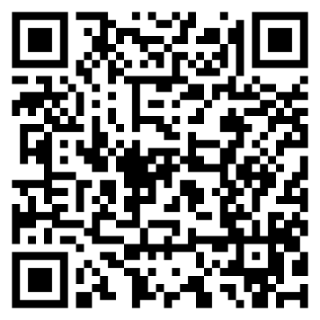
Agenda
Tutorial evaluation http://bit.ly/sc19-bssw-eval
Time | Module | Topic | Speaker
8:30am-8:40am | 00 | Introduction and Setup | David E. Bernholdt, ORNL
8:40am-9:15am | 01 | Overview of Best Practices in HPC Software Development | David E. Bernholdt, ORNL
9:15am-10:00am | 02 | An Introduction to Software Licensing | David E. Bernholdt, ORNL
10:00am-10:30am |  | Break
10:30am-11:30am | 03 | Agile Methodologies and Useful GitHub Tools | Michael A. Heroux, SNL
11:30am-12:00pm | 04 | Improving Reproducibility through Better Software Practices | Michael A. Heroux, SNL
12:00pm-1:30pm |  | Lunch
1:30pm-2:15pm | 05 | Software Design and Testing | Anshu Dubey, ANL
2:15pm-2:45pm | 06 | Git Workflows | Jared O’Neal, ANL
2:45pm-3:00pm | 07 | Code Coverage and Continuous Integration | Jared O’Neal, ANL
3:00-3:30pm |  | Break
3:30pm-3:50pm | 07 | Code Coverage and Continuous Integration (continued) | Jared O’Neal, ANL
3:50pm-5:00pm | 08 | Hands-on Activities and Additional Q&A | All

