Slide 1

Overview of Best Practices in HPC Software Development
David E. Bernholdt Oak Ridge National Laboratory
Anshu Dubey, Katherine M. Riley Argonne National Laboratory
Better Scientific Software Tutorial SC19, Denver, Colorado
See slide 2 for license details

Slide 2
License, Citation and Acknowledgements
License and Citation
This work is licensed under a Creative Commons Attribution 4.0 International License (CC BY 4.0).
The requested citation the overall tutorial is: David E. Bernholdt, Anshu Dubey, Michael A. Heroux, and Jared O’Neal, Better Scientific Software tutorial, in SC ‘19: International Conference for High Performance Computing, Networking, Storage and Analysis, Denver, Colorado, 2019. DOI: 10.6084/m9.figshare.10114880
Individual modules may be cited as Module Authors, Module Title, in Better Scientific Software Tutorial…
Acknowledgements
This work was supported by the U.S. Department of Energy Office of Science, Office of Advanced Scientific Computing Research (ASCR), and by the Exascale Computing Project (17-SC-20-SC), a collaborative effort of the U.S. Department of Energy Office of Science and the National Nuclear Security Administration.
This work was performed in part at the Argonne National Laboratory, which is managed managed by UChicago Argonne, LLC for the U.S. Department of Energy under Contract No. DE-AC02-06CH11357.
This work was performed in part at the Oak Ridge National Laboratory, which is managed by UT-Battelle, LLC for the U.S. Department of Energy under Contract No. DE-AC05-00OR22725.

Slide 3
The Success of Computational Science Creates the Challenges of Computational Science
•
Better Scientific Understanding
Positive feedback loop
More complex codes, simulations and analysis
More moving parts that need to interoperate
Variety of expertise needed – the only tractable development model is through separation of concerns
It is more difficult to work on the same software in different roles without a software engineering process
Onset of higher platform heterogeneity
Requirements are unfolding, not known a priori
The only safeguard is investing in flexible design and robust software engineering process
More Hardware
Resources
Higher Fidelity
Model
More Diverse
Solvers
Supercomputers change fast
Especially now!
Notes:
Numerical models

Slide 4
Challenges Developing a Scientific Application
Technical
Sociological
All parts of the cycle can be under research
Requirements change throughout the lifecycle as knowledge grows
Verification complicated by floating point representation
Real world is messy, so is the software
Competing priorities and incentives
Limited resources
Perception of overhead without benefit
Need for interdisciplinary interactions

Slide 5
Lifecycle of a Scientific Application
Modeling
Approximations
Discretizations
Numerics
Convergence
Stability
Implementation
Verification
Expected behavior
Validation
Experiment/observation
Physical World
Model
Model
fidelity
Validation
Equations
Model
fidelity
Discretize
Implementation
Difference equations
Verify accuracy
stability
Numerical solvers

Slide 6
Heroic Programming
•
•
Usually a pejorative term, is used to describe the expenditure of huge amounts of (coding) effort by talented people to overcome shortcomings in process, project management, scheduling, architecture or any other shortfalls in the execution of a software development project in order to complete it. Heroic Programming is often the only course of action left when poor planning, insufficient funds, and impractical schedules leave a project stranded and unlikely to complete successfully.
From http://c2.com/cgi/wiki?HeroicProgramming
Science teams often employ heroic programming
Many do not see anything wrong with that approach
Notes:
Anecdote about offer to help with the development and get told a postdoc will do it because this is what we do.

Slide 7
Expertise Map
•
•
Physical World
Domain
expert
Domain expert
Model
Each of these roles require deeper expertise as scientific requirements grow more complex.
It is no longer possible for a single person to take on all these roles
Model
fidelity
Validation
Equations
Software
Engineer,
optimization
experts
Domain
expert
Model
fidelity
Discretize
Implementation
Mesh/particles etc
Performance
Verify accuracy
stability
Applied
Mathematician
Applied
Mathematician
Numerical solvers

Slide 8
Good scientific process requires good software practices
Good software practices increase scientific productivity

Slide 9
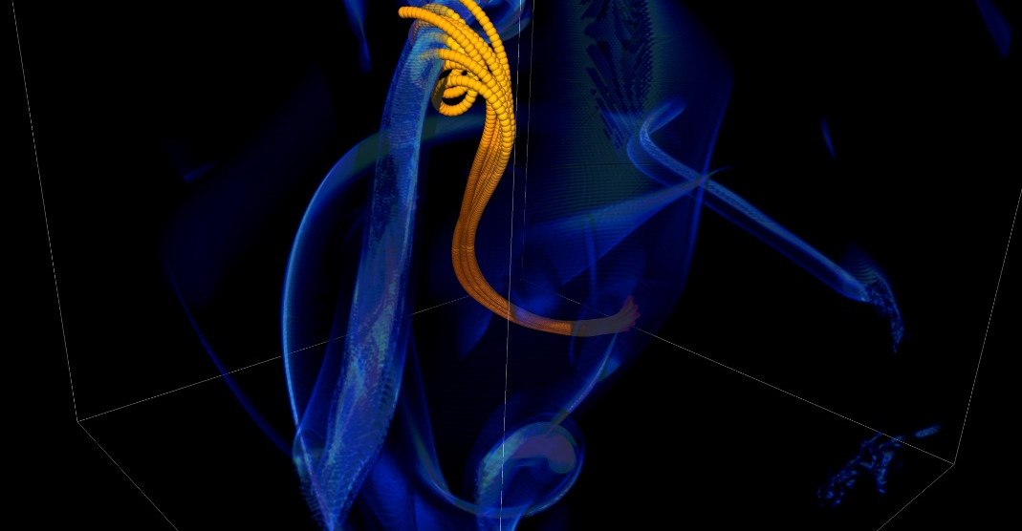
You Can Mitigate Risk, But It Is Never Zero
Short notice availability of one of the biggest machines of it’s time
< 1month to get ready, run was 1.5 weeks
Quick and dirty development of particle capability in code
Error in tracking particles resulted in duplicated tags from round-off
Had to develop post-processing tools to correctly identify trajectories
6 months to process results
FLASH had a software process in place. It was tested regularly. This was one instance when the full process could not be applied because of time constraints.
Notes:
2005, BG/L
This was not even a situation like retracting results

Slide 10
Why Be Concerned with Software Engineering?
•
Accretion leads to unmanageable software
Increases cost of maintenance
Parts of software may become unusable over time
Inadequately verified software produces questionable results
Increases ramp-on time for new developers
Reduces software and science productivity due to technical debt
Consequences of Choices
“Quick and dirty” collects technical debt, which means more effort required to add features.

Slide 11
Lifecycle: Software Engineering View
Requirements
gathering
model, framework
data, expectations
workflow
approximations, numerics
Design
storage, curation, retrieval, analysis
steps in scientific process
solvers, infrastructure
Implementation
algorithms, data structures
tools, interfaces
convergence, order, correction
Verification
Validation
validation, observations
provenance

Slide 12
Taking Stock of Your Situation
•
•
Software architecture and process design is an overhead
Value lies in avoiding technical debt (future saving)
Worthwhile to understand the trade-off
The goals of the software
Proof-of-concept
Verification
Exploration of some phenomenon
Experiment design
Analysis
Other …
Cognizant of resource constraints
Dictate the rigor of the design and software process

Slide 13
Reconcile Conflicting Requirements
Separation of concerns
Encapsulation of functionalities where possible
Abstractions for encapsulations
Offload complexity where possible
Hard-nosed trade-offs
Flexibility and composability vs raw performance
Extensibility and developer productivity

Slide 14
Architecting Scientific Codes
•
•
•
•
•
•
•
•
•
Taming the Complexity: Separation of Concerns
Subject of research
Model
Numerics
Client Code
Mathematically complex
Logically separable functional units of computation
Encode into framework
Treat differently
Hide from one another
Applies to both kinds
Differentiate between private and public
More Stable
Discretization
I/O
Parameters
Infrastructure
Data structures and movement
Define interfaces

Slide 15
A Successful Model
Infrastructure
Capabilities
Requirements
Model
Software Architecture
API Design
API
Implement
Design
Develop
Test
Validate
Maintain
Augment
Integrate

Slide 16
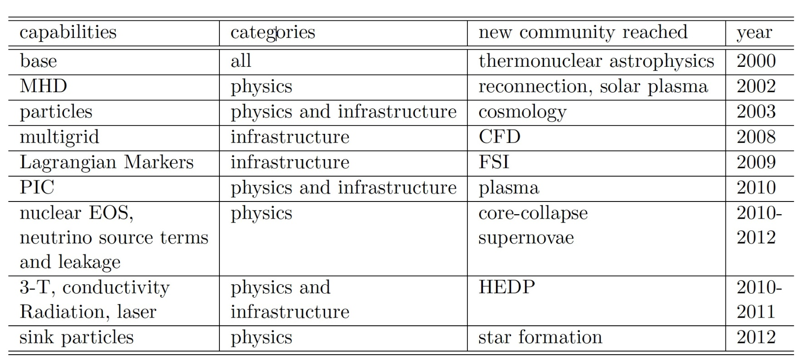
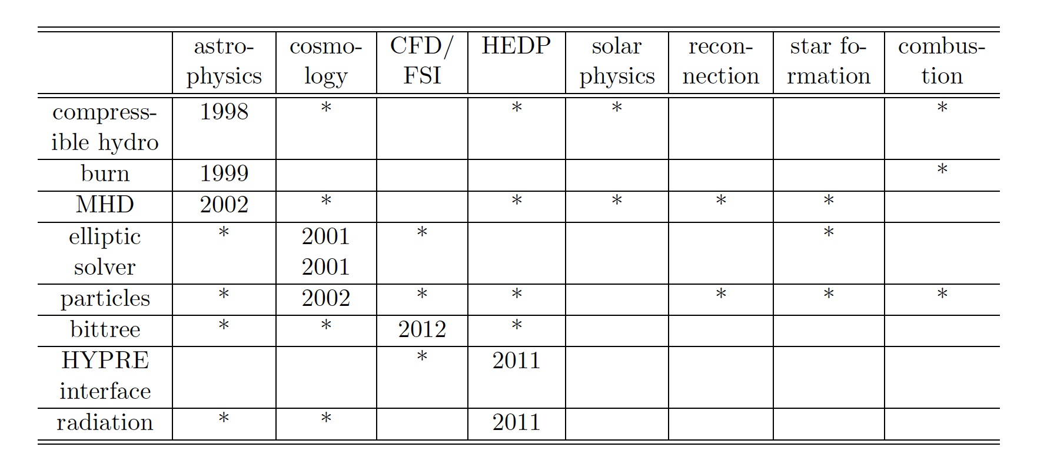
Design Investment Impact – FLASH Example
Notes:
This was the model followed for FLASH, a Multiphysics code that began in 1998. It underwent two major version revisions before it converged to the current backbone framework. The current framework was completed in 2006, and has not needed modification until the paradigm shift in the forthcoming platform architecture. The table above describes capabilities added to the code and the additional communities that were able to use it because of the newly added capabilities.

Slide 17
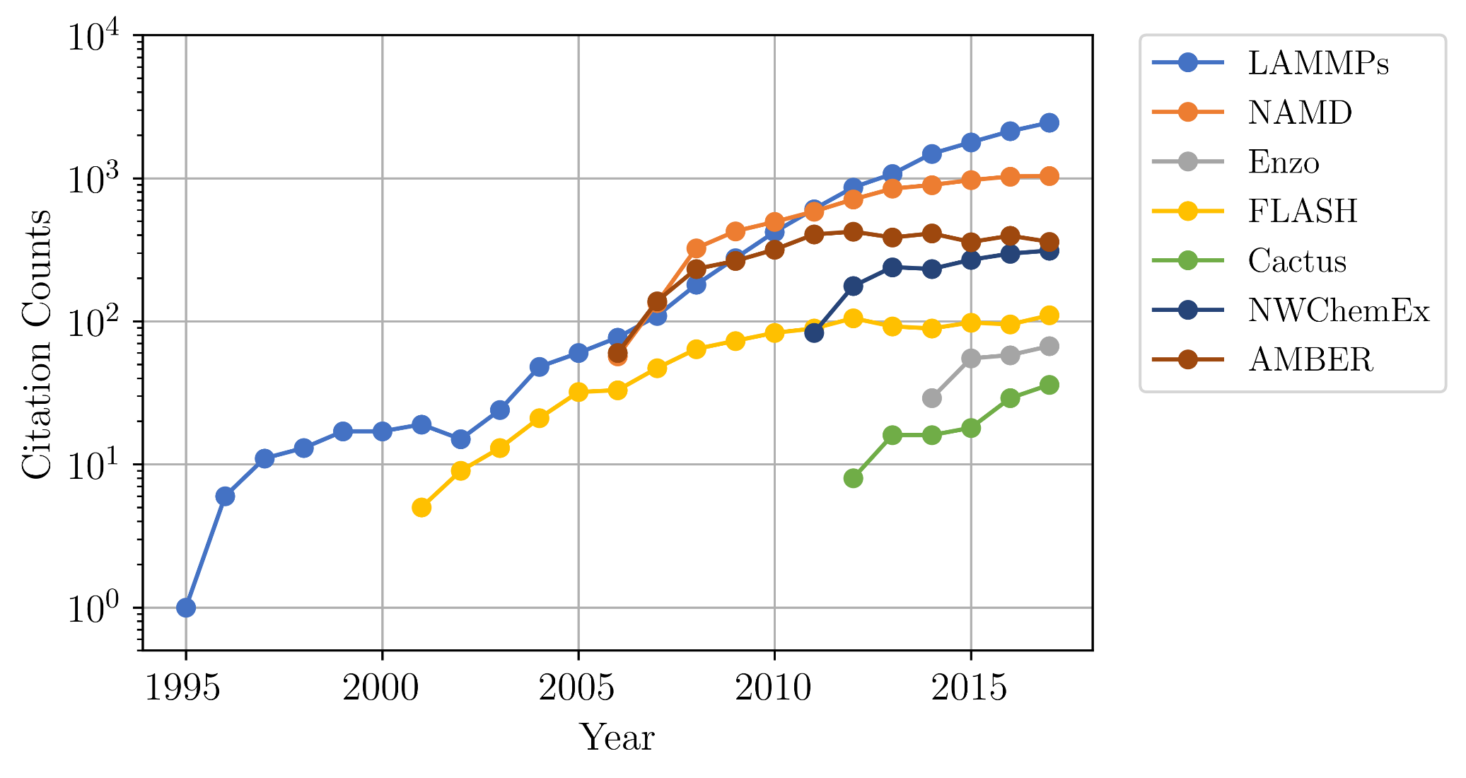
Community Impact of Well Done Software

Slide 18
Software Process Best Practices
Baseline
Desirable
Invest in extensible code design
Use version control and automated testing
Institute a rigorous verification and validation regime
Define coding and testing standards
Clear and well defined policies for
Auditing and maintenance
Distribution and contribution
Documentation
Provenance and reproducibility
Lifecycle management
Open development and frequent releases

Slide 19
A Useful Resource
https://ideas-productivity.org/resources/howtos/
‘What Is’ docs: 2-page characterizations of important topics for SW projects in computational science & engineering (CSE)
‘How To’ docs: brief sketch of best practices
Emphasis on ``bite-sized'' topics enables CSE software teams to consider improvements at a small but impactful scale
We welcome feedback from the community to help make these documents more useful

Slide 20
Other Resources
http://www.software.ac.uk/
http://software-carpentry.org/
http://flash.uchicago.edu/cc2012/
http://journals.plos.org/plosbiology/article?id=10.1371/journal.pbio.1001745
http://ieeexplore.ieee.org/xpls/icp.jsp?arnumber=4375255
http://www.orau.gov/swproductivity2014/SoftwareProductivityWorkshopReport2014.pdf
http://ieeexplore.ieee.org/xpl/articleDetails.jsp?arnumber=6171147

Slide 21
Summary
•
Good software practices are needed for scientific productivity
Science at extreme-scales is complex and requires multiple expertise
Software process does need to address reality
Open codes, community contribution, are a powerful tool
Science through computing is at best as credible as the software that produces it

Slide 22

Agenda
Tutorial evaluation http://bit.ly/sc19-bssw-eval
Time | Module | Topic | Speaker
8:30am-8:40am | 00 | Introduction and Setup | David E. Bernholdt, ORNL
8:40am-9:15am | 01 | Overview of Best Practices in HPC Software Development | David E. Bernholdt, ORNL
9:15am-10:00am | 02 | An Introduction to Software Licensing | David E. Bernholdt, ORNL
10:00am-10:30am |  | Break
10:30am-11:30am | 03 | Agile Methodologies and Useful GitHub Tools | Michael A. Heroux, SNL
11:30am-12:00pm | 04 | Improving Reproducibility through Better Software Practices | Michael A. Heroux, SNL
12:00pm-1:30pm |  | Lunch
1:30pm-2:15pm | 05 | Software Design and Testing | Anshu Dubey, ANL
2:15pm-2:45pm | 06 | Git Workflows | Jared O’Neal, ANL
2:45pm-3:00pm | 07 | Code Coverage and Continuous Integration | Jared O’Neal, ANL
3:00-3:30pm |  | Break
3:30pm-3:50pm | 07 | Code Coverage and Continuous Integration (continued) | Jared O’Neal, ANL
3:50pm-5:00pm | 08 | Hands-on Activities and Additional Q&A | All

