Slide 1

Improving Reproducibility Through Better Software Practices
Michael A. Heroux Senior Scientist, Sandia National Laboratories Director of Software Technology, US DOE Exascale Computing Project Scientist in Residence, CSB|SJU
Better Scientific Software Tutorial SC19, Denver, Colorado
See slide 2 for license details

Slide 2
License, Citation and Acknowledgements
License and Citation
This work is licensed under a Creative Commons Attribution 4.0 International License (CC BY 4.0).
The requested citation the overall tutorial is: David E. Bernholdt, Anshu Dubey, Michael A. Heroux, and Jared O’Neal, Better Scientific Software tutorial, in SC ‘19: International Conference for High Performance Computing, Networking, Storage and Analysis, Denver, Colorado, 2019. DOI: 10.6084/m9.figshare.10114880
Individual modules may be cited as Module Authors, Module Title, in Better Scientific Software Tutorial…
Acknowledgements
Additional contributors to this this tutorial include: Alicia Klinvex, Katherine Riley, and James Willenbring
This work was supported by the U.S. Department of Energy Office of Science, Office of Advanced Scientific Computing Research (ASCR), and by the Exascale Computing Project (17-SC-20-SC), a collaborative effort of the U.S. Department of Energy Office of Science and the National Nuclear Security Administration.
This work was performed in part at Sandia National Laboratories. Sandia National Laboratories is a multi-mission laboratory managed and operated by National Technology and Engineering Solutions of Sandia, LLC., a wholly owned subsidiary of Honeywell International, Inc., for the U.S. Department of Energy’s National Nuclear Security Administration under contract DE-NA0003525. SAND NO SAND2017-5474 PE

Slide 3

Outline
Reproducibility taxonomies.
Increasing focus on reproducibility.
Role of better software practices.
Publication requirements.
Trustworthiness at Scale.
Personal Productivity Commitment.

Slide 4
Reproducible vs Replicable
Addressing Confusion in Taxonomies

Slide 7
Transparency & Reproducibility
Why we pursue better software practices

Slide 8
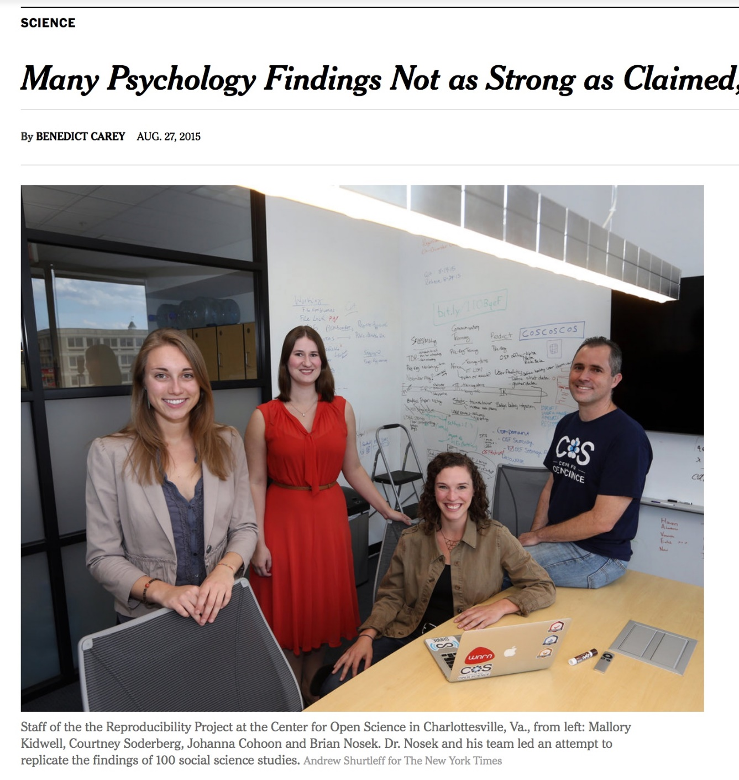
Transparency & Reproducibility
NY Times highlights “problems”.
Only one of many cited examples.
Computational science had been spared this “spotlight”.
http://www.nytimes.com/2015/08/28/science/many-social-science-findings-not-as-strong-as-claimed-study-says.html

Slide 9
Computational Science Example
Behavior of pure water just above homogeneous nucleation temperature (~ - 40 C/F).
Debenedetti/Princeton (2009):
2 possible phases: High or low density.
Chandler/Berkeley (2011):
Only 1 phase: High density.
No sharing of details across teams until 2016:
Chandler in Nature: “LAMMPS codes used in refs 5 and 12 are standard and documented, with scripts freely available upon request.”
Debenedetti with colleague Palmer: ”Send us your code.”
Received code after requests and appeal to Nature.
Source: https://physicstoday.scitation.org/do/10.1063/PT.6.1.20180822a/full/

Slide 10
Computational Science Example
Palmer located bug/feature in Berkeley code.
Used to speed up LAMMPS execution.
Replaced with more standard approach.
Obtained result similar to Debenedetti 2009.
Resolution took 7 years.
Source: https://physicstoday.scitation.org/do/10.1063/PT.6.1.20180822a/full/
For Palmer, the ordeal exemplifies the importance of transparency in scientific research, an issue that has recently drawn heightened attention in the science community. “One of the real travesties,” he says, is that “there’s no way you could have reproduced [the Berkeley team’s] algorithm—the way they had implemented their code—from reading their paper.” Presumably, he adds, “if this had been disclosed, this saga might not have gone on for seven years.”

Slide 11
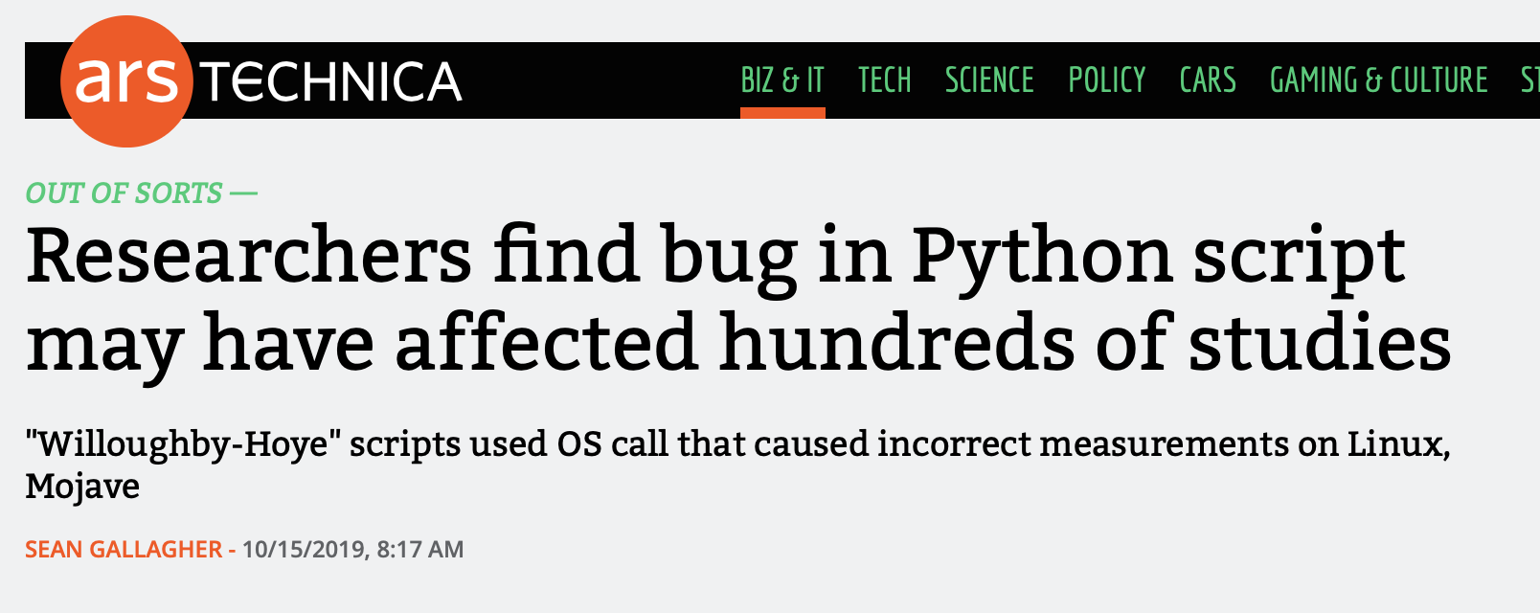
Most Recent Example: My Response, “What about a unit test?”
scripts' use of Python's glob module
Generated different file lists in Linux and Mac Mojave
Casts doubt on results in 150 papers.
https://arstechnica.com/information-technology/2019/10/chemists-discover-cross-platform-python-scripts-not-so-cross-platform/

Slide 12
Publication Trends
Increased Emphasis on Transparency & Reproducibility

Slide 13

ACM TOMS Reproducible Computational Results (RCR)
Submission: Optional RCR option.
Standard reviewer assignment: Nothing changes.
RCR reviewer assignment:
Concurrent with standard reviews.
As early as possible in review process.
Known to and works with authors during the RCR process.
RCR process:
Multi-faceted approach, Bottom line: Trust the reviewer.
Publication:
Reproducible Computational Results Designation.
The RCR referee acknowledged.
Review report appears with published manuscript.

Slide 14
SC19 Reproducibility Initiative
Two appendices:
Artifact description (AD).
Blue print for setting up your computational experiment.
Makes it easier to rerun computations in future.
AD appendix will be mandatory for SC19 paper submissions.
Artifact Evaluation (AE).
Targets ”boutique” environments.
Improves trustworthiness when re-running hard, impossible.
Details:
https://sc19.supercomputing.org/submit/reproducibility-initiative/

Slide 15
Improving Trustworthiness at Scale
What if we can’t re-run a computational experiment?

Slide 16
Reproducibility and Supercomputing
Scenario: You compute a “hero” calculation using 5M core-hours on Mira and submit your results for publication. During the review process, a referee questions the validity of your results. What options are feasible:
The reviewer re-runs your code on a laptop or cluster.
The reviewer re-runs your code on Mira.
You re-run your code on Mira.
Your results are rejected.
Your results are accepted, but with risk.

Slide 17
Sources for meta-computations
Synthetic operators with known:
Spectrum (Huge diagonals).
Rank (by constructions).
Invariant subspaces:
Example: Positional/rotational invariance (structures).
Conservation principles:
Example: Flux through a finite volume.
General:
Pre-conditions, post-conditions, invariants.
Can you think of something for your problems?

Slide 18
Example: HPCG Benchmark
Symmetry:
For any linear operator A, x^{T}Ay = y^{T}A^{T}x.
If A symmetric A = A^{T}, so x^{T}Ay = y^{T}Ax.
And x^{T}Ay - y^{T}Ax = 0.
HPCG computes the above expression for:
User matrix and the preconditioner.
Numerical detail: Need to scale by vector & matrix norms.

Slide 19
Coming to Your World Soon: Reproducibility Requirements
These conferences have artifact evaluation appendices:
CGO, PPoPP, PACT, RTSS and SC.
http://fursin.net/reproducibility.html
ACM Replicated Reproducible Computational Results (RCR).
ACM TOMS, TOMACS.
http://toms.acm.org/replicated-computational-results.cfm
ACM Badging.
https://www.acm.org/publications/policies/artifact-review-badging
NISO Committee on Reproducibility and Badging.
https://www.niso.org/niso-io/2019/01/new-niso-project-badging-scheme-reproducibility-computational-and-computing
Publishers: ACM, IEEE, figshare, STM, Reed Elsevier, Springer Nature

Slide 20
Questions, comments?

Slide 21
Better Productivity and Sustainability
Essential for affordable reproducibility

Slide 22
Incentives Demand Investments, Enabled by Investments
Demand
Transparency & Reproducibility Requirements
Productivity & Sustainability Investments
Enable
Common statement: “I would love to do a better job on my software, but I need to:
Get this paper submitted.
Complete this project task.
Do something my employer values more.
Goal: Change incentives to include value of better software, better science.

Slide 23
Tradeoffs: Better, faster, cheaper
“Better, faster, cheaper: Pick two of the three.”
Scenario: (Today) You are behind in developing a sophisticated new model in your software that you want to use for results in an upcoming paper.
Which of these could be reasonable choices?
Develop a simpler model for the paper.
Set other work aside and spend more time on development.
Ask for an extension on the paper deadline.
Develop sophisticated model, but don’t test its correctness.
Develop sophisticated model, but don’t document it or check it in.

Slide 24
Improved developer productivity
“Better, faster, cheaper: Pick all three.” – Near term.
Scenario: (6 months later) After investing in developer productivity improvements, you are on time in developing a sophisticated new model in your software that you want to use for results in an upcoming paper.
Invest in developer tools, processes, practices.

Slide 25
Improved software sustainability
“Better, faster, cheaper: Pick all three.” – Long term.
Scenario: (3 years later) After investing in software sustainability improvements, you are on time in developing several sophisticated new models in your software that you want to use for results in upcoming papers.
Invest in testing, documentation, integration for long-term software usability.

Slide 26
Which of These Enhance Reproducibility?
Code written by first-year, untrained grad student.
Tuning for high performance.
Dynamic parallelism of modern processors.
Better software testing.
Source code and versioning management.
Investing in developer productivity.
Investing in software sustainability.

Slide 27
Personal Expectations
Calling out the best in team members

Slide 28
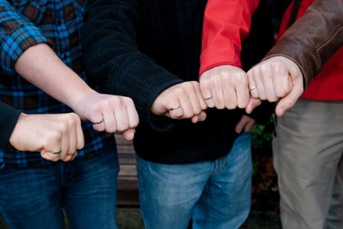
Final Thoughts: Commitment to Quality
Canadian engineers' oath (taken from Rudyard Kipling):
My Time I will not refuse;
my Thought I will not grudge;
my Care I will not deny
toward the honour, use,
stability and perfection of
any works to which I may be
called to set my hand.
https://www.egbc.ca/Member-Programs/Students/Iron-Ring

Slide 29
A Few Concrete Recommendations
Show me the person making the most commits on an undisciplined software project and I will show you the person who is injecting the most technical debt.
GitHub stats: Easy to find who made the most commits.
Some people: Pride in their high ranking.
Instead, be the person who ranks high in these ways:
Writes up requirements, analysis and design, even if simple.
Writes good GitHub issues, tracks their progress to completion.
Comments on, tests and accepts pull requests.
Provide good wiki, gh-pages content, responses to user issues.

Slide 30
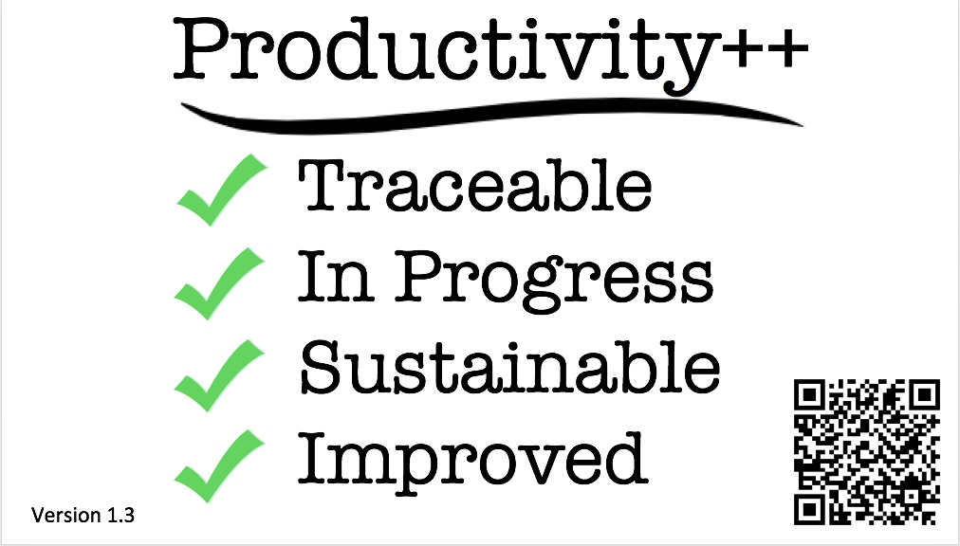
(Personal) Productivity++ Initiative Ask: Is My Work _______ ?
https://github.com/trilinos/Trilinos/wiki/Productivity---Initiative

Slide 31
Summary
Reproducibility demands are coming.
Conferences first, journals slower.
HPC software is particularly challenging:
Hardware variation.
Code optimization.
Dynamic parallelism.
Better software practices:
Improve chances for reproducibility.
Lower its cost.
Many tools emerging to enable reproducibility.

Slide 32
Other resources
Editorial: ACM TOMS Replicated Computational Results Initiative. Michael A. Heroux. 2015. ACM Trans. Math. Softw. 41, 3, Article 13 (June 2015), 5 pages. DOI: http://dx.doi.org/10.1145/2743015
Enhancing Reproducibility for Computational Methods. Victoria Stodden, Marcia McNutt, David H. Bailey, Ewa Deelman, Yolanda Gil, Brooks Hanson, Michael A. Heroux, John P.A. Ioannidis, Michela Taufer Science (09 Dec 2016), pp. 1240-1241

Slide 33

Agenda
Tutorial evaluation http://bit.ly/sc19-bssw-eval
Time | Module | Topic | Speaker
8:30am-8:40am | 00 | Introduction and Setup | David E. Bernholdt, ORNL
8:40am-9:15am | 01 | Overview of Best Practices in HPC Software Development | David E. Bernholdt, ORNL
9:15am-10:00am | 02 | An Introduction to Software Licensing | David E. Bernholdt, ORNL
10:00am-10:30am |  | Break
10:30am-11:30am | 03 | Agile Methodologies and Useful GitHub Tools | Michael A. Heroux, SNL
11:30am-12:00pm | 04 | Improving Reproducibility through Better Software Practices | Michael A. Heroux, SNL
12:00pm-1:30pm |  | Lunch
1:30pm-2:15pm | 05 | Software Design and Testing | Anshu Dubey, ANL
2:15pm-2:45pm | 06 | Git Workflows | Jared O’Neal, ANL
2:45pm-3:00pm | 07 | Code Coverage and Continuous Integration | Jared O’Neal, ANL
3:00-3:30pm |  | Break
3:30pm-3:50pm | 07 | Code Coverage and Continuous Integration (continued) | Jared O’Neal, ANL
3:50pm-5:00pm | 08 | Hands-on Activities and Additional Q&A | All

Slide 34
Additional Software-Related Events at SC19
Bold events (co-)organized by IDEAS
Day/Time | Event Type | Event Title
Sunday | Tutorial | Floating-Point Analysis and Reproducibility Tools for Scientific Software
Sunday | Workshop | The 2019 International Workshop on Software Engineering for HPC-Enabled Research (SE-HER 2019)
Monday | Tutorial | Better Scientific Software
Monday | Tutorial | Managing HPC Software Complexity with Spack
Monday | Workshop | 3nd International Workshop on Software Correctness for HPC Applications (Correctness 2019)
Monday | Students@SC | Students@SC: Modern Software Design, Tools, and Practices
Tuesday | BoF | Extreme-Scale Scientific Software Stack (E4S)
Tuesday | BoF | Exchanging Best Practices in Supporting Computational and Data-Intensive Research
Tuesday | Panel | Developing and Managing Research Software in Universities and National Labs
Wednesday | BoF | Software Engineering and Reuse in Modeling, Simulation, and Data Analytics for Science and Engineering
Thursday | BoF | Quality Assurance and Coding Standards for Parallel Software
Thursday | Panel | Sustainability of HPC Research Computing: Fostering Career Paths for Facilitators, Research Software Engineers, and Gateway Creators
Friday | Panel | The Road to Exascale and Beyond is Paved by Software: How Algorithms, Libraries and Tools Will Make Exascale Performance Real

