Slide 1
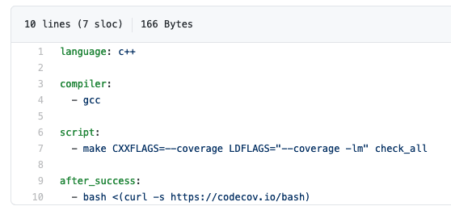
Many Alternatives, e.g. gitlab, circle-ci, and Travis CI:
.travis.yml
Notes:
Update example to use GitLab? Should we even have this part? Stress getting things generally in order so they are adaptable to ECP CI.

Slide 2
CI Testing is one part of the “Shift Left” movement in DevOps
Advantage

Slide 3
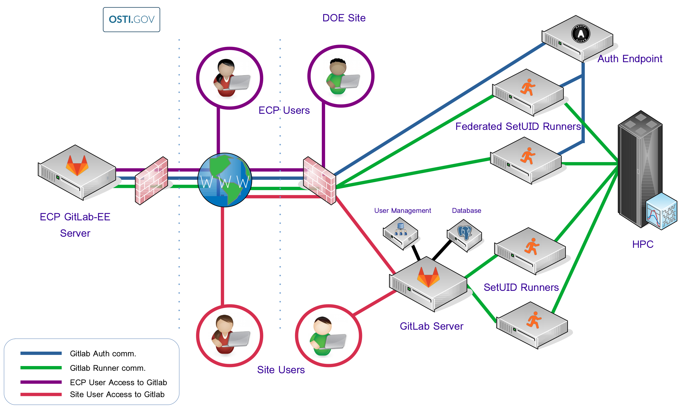
ECP CI Resources
ECP investing in GitLab for complex-wide CI
Complex-wide Federation
Many hurdles still to overcome
More about ECP CI at the Annual Meeting
Benefitting From ECP CI
Wednesday 2:30-3:30 Eastern
ECP CI Startup Tutorial
Friday 2:30-6 Eastern
Documentation and on-boarding help
https://ecp-ci.gitlab.io
Notes:
Here I should reference other presentations at the annual meeting

Slide 4
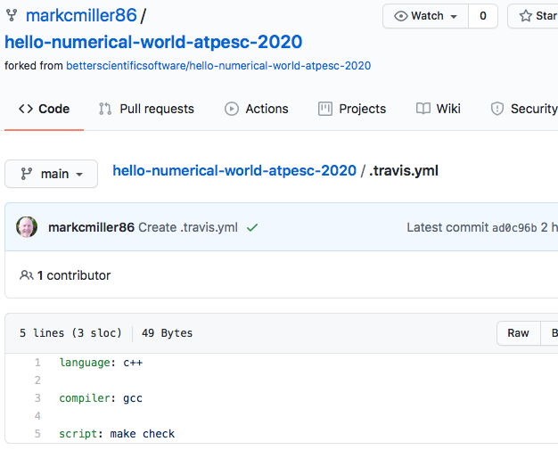
Getting started with CI:
Example .travis.yml file (also doing coverage analysis)
Setting up CI
Service | Interface
Travis | repo YAML file [& repo scripts] | /.travis.yml in root of repo
GitLab | Web page configurator + repo YAML file [& repo scripts] | /.gitlab-ci.yml in root of repo
Bamboo | Web page configurator + repo scripts
GitHub Actions . . | Repo YAML file | .github/workflows/<test_name>.yml
Specify environment
Commands to run test
Keywords defined by service provider’s YAML docs
Notes:
Update example to use GitLab? Should we even have this part? Stress getting things generally in order so they are adaptable to ECP CI.

Slide 5
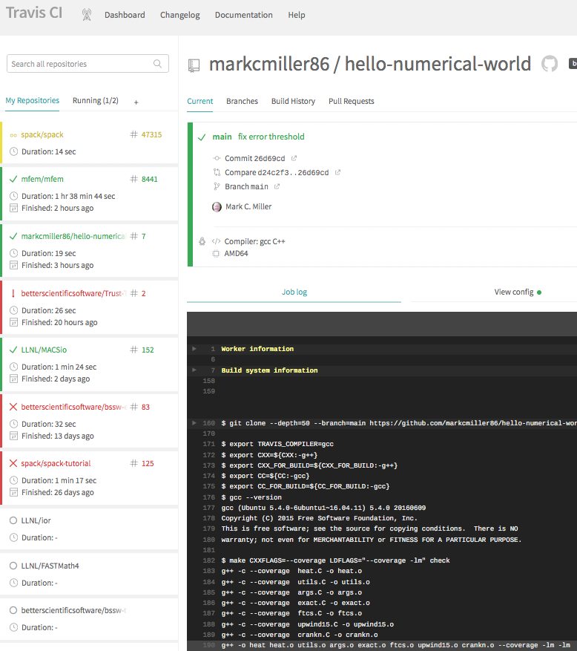
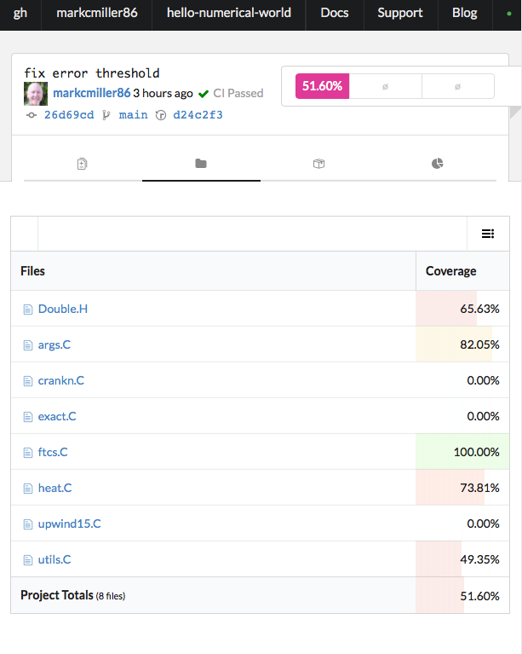
travis-ci.com
codecov.io
Notes:
Consider dropping this slide?

