Slide 1
Motivation and Overview of Best Practices in HPC Software Development
Patricia Grubel (she/her) Los Alamos National Laboratory
Better Scientific Software tutorial @ SC21
Contributors: David E. Bernholdt (ORNL), Anshu Dubey (ANL), Patricia A. Grubel (LANL), Katherine M. Riley (ANL)
LA-UR-21-29819

Slide 2
License, Citation and Acknowledgements
License and Citation
This work is licensed under a Creative Commons Attribution 4.0 International License (CC BY 4.0).
The requested citation the overall tutorial is: David E. Bernholdt, Anshu Dubey, Patricia A. Grubel, Rinku K. Gupta, and Gregory R. Watson, Better Scientific Software tutorial, in the International Conference for High-Performance Computing, Networking, Storage, and Analysis (SC21), St. Louis, MO, USA and online, 2021. DOI: 10.6084/m9.figshare.16556628
Individual modules may be cited as Speaker, Module Title, in Better Scientific Software tutorial…
Acknowledgements
This work was supported by the U.S. Department of Energy Office of Science, Office of Advanced Scientific Computing Research (ASCR), and by the Exascale Computing Project (17-SC-20-SC), a collaborative effort of the U.S. Department of Energy Office of Science and the National Nuclear Security Administration.
This work was performed in part at the Argonne National Laboratory, which is managed by UChicago Argonne, LLC for the U.S. Department of Energy under Contract No. DE-AC02-06CH11357.
This work was performed in part at the Oak Ridge National Laboratory, which is managed by UT-Battelle, LLC for the U.S. Department of Energy under Contract No. DE-AC05-00OR22725.
This work was performed in part at the Lawrence Livermore National Laboratory, which is managed by Lawrence Livermore National Security, LLC for the U.S. Department of Energy under Contract No. DE-AC52-07NA27344.
This work was performed in part at the Los Alamos National Laboratory, which is managed by Triad National Security, LLC for the U.S. Department of Energy under Contract No.89233218CNA000001
This work was performed in part at Sandia National Laboratories. Sandia National Laboratories is a multi-mission laboratory managed and operated by National Technology and Engineering Solutions of Sandia, LLC., a wholly owned subsidiary of Honeywell International, Inc., for the U.S. Department of Energy’s National Nuclear Security Administration under contract DE-NA0003525.

Slide 3
Science through computing is, at best, as credible as the software that produces it!
Notes:
Fundamental message

Slide 4
The Success of Computational Science Creates the Challenges of Computational Science
Better Scientific Understanding
Positive feedback loop
More complex codes, simulations and analysis
More moving parts that need to interoperate
Variety of expertise needed – the only tractable development model is through separation of concerns
It is more difficult to work on the same software in different roles without a software engineering process
Onset of higher platform heterogeneity
Requirements are unfolding, not known a priori
The only safeguard is investing in flexible design and robust software engineering process
More Hardware
Resources
Higher Fidelity
Model
More Diverse
Solvers
Supercomputers change fast
Especially now!
Notes:
Numerical models

Slide 5
Challenges Developing Scientific Applications Today
Technical
Sociological
All parts of the model and software system can be under research
Requirements change throughout the lifecycle as knowledge grows
Verification complicated by floating point representation
Real world is messy, so is the software
Increasing architectural diversity
Competing priorities and incentives
Sponsors often care more about scientific publications than software per se
Balancing development and maintenance with research
Limited resources
Need for interdisciplinary interactions
Many different kinds of expertise to be successful

Slide 6
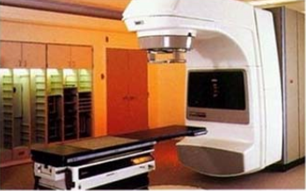
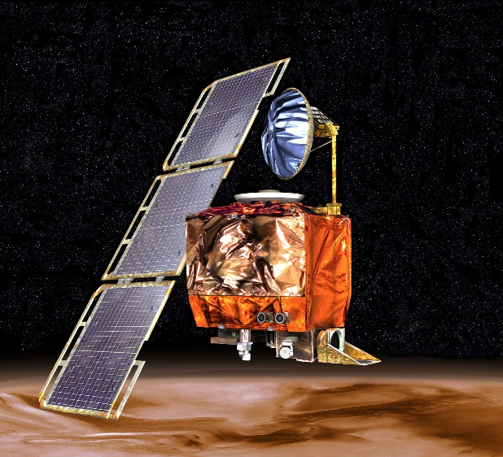
High-Consequence Software-Related Scientific Failures
Therac-25 (1985-1987)
Mars Climate Orbiter (1999)
Computer-controlled radiation therapy system
Poor software design, development and testing practices allowed flaws that let to at least six cases of substantial radiation overdoses, three fatal
Incorrect trajectory adjustment caused loss of the orbiter as it was supposed to enter Martian orbit
Discrepancy in the units used in two different software components
One component didn’t follow specifications
Inadequate testing at the interface
Concerns raised earlier in the mission were ignored because they weren’t properly documented
Just two of many examples

Slide 7
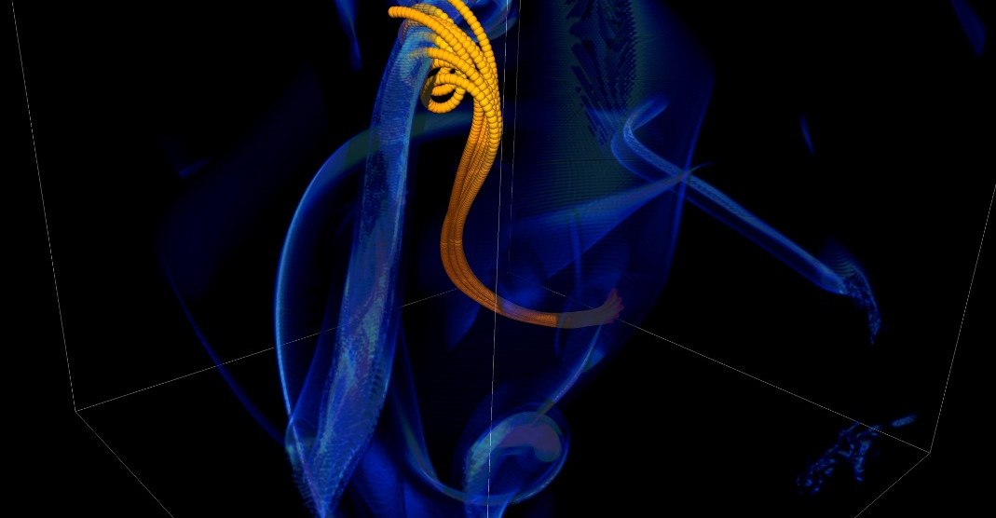
More Subtle Impacts on Scientific Productivity
In 2005, the FLASH astrophysics team was offered a unique opportunity to access one of the biggest machines in the world at that time (BG/L) for a dedicated run
Short notice to prepare
< 1month to get ready for 1.5 week run
Quick and dirty development of particle capability in code
Error in tracking particles resulted in duplicated tags from round-off
Had to develop post-processing tools to correctly identify trajectories
6 months to process results
FLASH had a software process in place. It was tested regularly. This was one instance when the full process could not be applied because of time constraints.
Notes:
2005, BG/L
This was not even a situation like retracting results

Slide 8
Technical Debt
The implied cost of additional rework caused by choosing an easy (limited) solution now instead of using a better approach that would take longer.
-- Wikipedia
Like monetary debt, the more you accumulate, the harder it is to pay off
Increases cost of maintenance
Parts of software may become unusable over time
Inadequately verified software produces questionable results
Increases ramp-up time for new developers
Overall, reduces software and science productivity

Slide 9
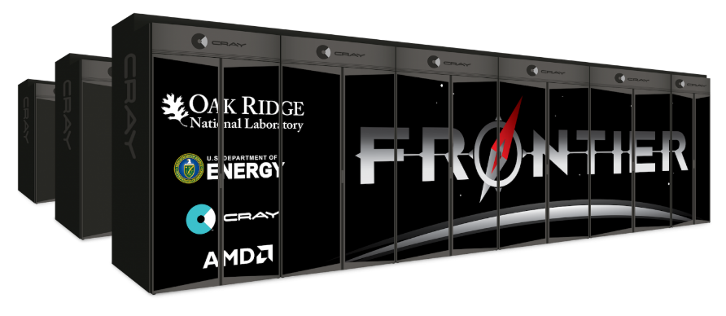
Scientific Facilities Provide Valuable Resources
Major supercomputers often cost O($100M)
All cost millions more to operate, annually
Significant allocations on large supercomputers can be worth millions
Even if you don’t pay the $ you have to spend the time and effort to get the allocation
Sponsors’ concern: Are you being a good steward of the resources?
Your concern: Are you getting the most science possible out of your work (aka scientific productivity)?

Slide 10
Good scientific process requires good software practices
Good software practices increase software sustainability
Good software practices increase scientific productivity
Software sustainability
increases scientific productivity

Slide 11
So, What Are Good Software Practices?
There is no fixed, universally agreed set of best practices for scientific software
Specifics of what’s appropriate will depend on the software, how it is used, and the team
Let’s look at a few recommendations from different perspectives…

Slide 12
Example 1: Best Practices for Scientific Computing (1/2)
Wilson, et al., (2014) https://doi.org/10.1371/journal.pbio.1001745
Write programs for people, not computers.
A program should not require its readers to hold more than a handful of facts in memory at once.
Make names consistent, distinctive, and meaningful.
Make code style and formatting consistent.
Let the computer do the work.
Make the computer repeat tasks.
Save recent commands in a file for re-use.
Use a build tool to automate workflows.
Make incremental changes.
Work in small steps with frequent feedback and course correction.
Use a version control system.
Put everything that has been created manually in version control.
Don't repeat yourself (or others).
Every piece of data must have a single authoritative representation in the system.
Modularize code rather than copying and pasting.
Re-use code instead of rewriting it.
Plan for mistakes.
Add assertions to programs to check their operation.
Use an off-the-shelf unit testing library.
Turn bugs into test cases.
Use a symbolic debugger.

Slide 13
Example 1: Best Practices for Scientific Computing (2/2)
Wilson, et al., (2014) https://doi.org/10.1371/journal.pbio.1001745
Optimize software only after it works correctly.
Use a profiler to identify bottlenecks.
Write code in the highest-level language possible.
Document design and purpose, not mechanics.
Document interfaces and reasons, not implementations.
Refactor code in preference to explaining how it works.
Embed the documentation for a piece of software in that software.
Collaborate.
Use pre-merge code reviews.
Use pair programming when bringing someone new up to speed and when tackling particularly tricky problems.
Use an issue tracking tool.

Slide 14
Example 2: Good Enough Practices in Scientific Computing (1/2)
Wilson, et al., (2017) https://doi.org/10.1371/journal.pcbi.1005510
Data management
Save the raw data.
Ensure that raw data are backed up in more than one location.
Create the data you wish to see in the world.
Create analysis-friendly data.
Record all the steps used to process data.
Anticipate the need to use multiple tables, and use a unique identifier for every record.
Submit data to a reputable DOI-issuing repository so that others can access and cite it.
Manuscripts (out of order to save space)
Write manuscripts using online tools with rich formatting, change tracking, and reference management.
Write the manuscript in a plain text format that permits version control.
Software
Place a brief explanatory comment at the start of every program.
Decompose programs into functions.
Be ruthless about eliminating duplication.
Always search for well-maintained software libraries that do what you need.
Test libraries before relying on them.
Give functions and variables meaningful names.
Make dependencies and requirements explicit.
Do not comment and uncomment sections of code to control a program's behavior.
Provide a simple example or test data set.
Submit code to a reputable DOI-issuing repository.

Slide 15
Example 2: Good Enough Practices in Scientific Computing (2/2)
Wilson, et al., (2017) https://doi.org/10.1371/journal.pcbi.1005510
Collaboration
Create an overview of your project.
Create a shared "to-do" list for the project.
Decide on communication strategies.
Make the license explicit.
Make the project citable.
Project organization
Put each project in its own directory, which is named after the project.
Put text documents associated with the project in the doc directory.
Put raw data and metadata in a data directory and files generated during cleanup and analysis in a results directory.
Put project source code in the src directory.
Put external scripts or compiled programs in the bin directory.
Name all files to reflect their content or function.
Keeping track of changes
Back up (almost) everything created by a human being as soon as it is created.
Keep changes small.
Share changes frequently.
Create, maintain, and use a checklist for saving and sharing changes to the project.
Store each project in a folder that is mirrored off the researcher's working machine.
Add a file called CHANGELOG.txt to the project's docs subfolder.
Copy the entire project whenever a significant change has been made.
Use a version control system.

Slide 16
Example 3: Linux Foundation Core Infrastructure Initiative (CII) Best Practices Badging Program
https://bestpractices.coreinfrastructure.org/en
Not specifically intended for scientific software
Three levels
Passing focuses on best practices that well-run FLOSS projects typically already follow. Getting the passing badge is an achievement; at any one time only about 10% of projects pursuing a badge achieve the passing level.
Silver is a more stringent set of criteria than passing but is expected to be achievable by small and single-organization projects.
Gold is even more stringent than silver and includes criteria that are not achievable by small or single-organization projects.
Combination of MUST and SHOULD criteria

Slide 17
CII Best Practices Criteria Summary
Basics
Basic project website content (P, S)
FLOSS license (P)
Documentation (P, S)
Project oversight (S, G)
Accessibility and internationalization (S)
Change control
Public version controlled source repo. (P, G)
Unique version numbering (P)
Release notes (P)
Previous versions (S)
Reporting
Bug-reporting process (P, S)
Vulnerability reporting process (P, S)
Quality
Working build system (P, S, G)
Automated test suite (P, S, G)
New functionality testing (P, S)
Warning flags (P, S)
Coding standards (S, G)
Installation system (S)
Externally-maintained components (S)
Security
Secure development knowledge (P, S)
Use basic good crypto. practices (P, S, G)
Secured delivery against MITM attacks (P, G)
Publicly known vulnerabilities fixed (P)
Secure release (S)
Analysis
Static code analysis (P, S)
Dynamic code analysis (P, S, G)
(P, S, G) denotes additional criteria required at passing, silver, or gold certification levels
Each topic area listed will have one or more specific criteria

Slide 18
Software Engineering Advice Often Needs Adaptation for Scientific Software
The CII Best Practices are a good example of software engineering advice “in the wild”
Experiences reported in the wild often don’t consider the special nature of scientific software
But that doesn’t mean we should ignore all of the software engineering experience
Many useful concepts, approaches, and tools we can just adopt
Some approaches may need to be adapted to work for scientific software
Find out how colleagues have addressed the challenges you’re facing
Probably you will find multiple ways
In the end, some approaches may not work well
Don’t be afraid to experiment with adaptations
Consider using the PSIP process (coming up)

Slide 19
How Much (Time, Effort) Should I Spend on Software Engineering?
Your project should include “just enough” software engineering so that you can meet your short-term and longer-term scientific goals effectively

Slide 20

Continual, Incremental Software Process Improvement
Target: your project should include “just enough” software engineering so that you can meet your short-term and longer-term scientific goals effectively
Identify your team’s “pain points” in your software development processes
Help: RateYourProject assessment tool: https://rateyourproject.org/
Set a goal for something to improve
Target processes and behaviors, not just tasks
Pick something that you can address in a few months that will give you a noticeable benefit
Agree on a plan to address it, identify markers of progress and what is “done”
Write them down
Help: Progress tracking card examples: https://bssw-psip.github.io/ptc-catalog/catalog
Work your plan, track your progress
When you are done, celebrate…
…then pick a new pain point to address
Old Process
New Process
Cost
Start
Progress
Finish
The new process costs something to implement, but it pays off over time
Productivity and Sustainability Improvement Planning https://bssw.io/psip
A goal of BSSw.io is to provide resources for improving your software processes. If you find useful resources that aren’t on BSSw.io, consider contributing. Its easy and quick.

Slide 21
About Today’s Tutorial
There are many useful topics that could help you improve your scientific software development process
We’re going to focus on a few where the software engineering advice in the wild typically doesn’t address scientific software
Project management
Collaboration around software development
Designing software for flexibility and extensibility
Testing strategies for complex software systems
Systematic refactoring of large, complex software systems
Continuous integration testing
Reproducibility

Slide 22
Agenda (Morning)
The agenda is also available on the tutorial web page. Visit https://bssw-tutorial.github.io and click on the link for today’s tutorial
Time (CST) | Module | Title | Presenter
8:00 AM | 0 | Introduction and Setup | David E. Bernholdt (ORNL)
8:10 AM | 1 | Motivation and Overview of Best Practices in HPC Software Development | Patricia A. Grubel (LANL)
8:30 AM | 2 | Git Workflows | Patricia A. Grubel (LANL)
9:00 AM | 3 | Agile Methodologies | Rinku K. Gupta (ANL)
9:30 AM | 4 | Scientific Software Design | David E. Bernholdt (ORNL)
10:00 AM |  | Break
10:30 AM | 5 | Agile Methodologies Redux | Rinku K. Gupta (ANL)
10:45 AM | 6 | Improving Reproducibility Through Better Software Practices | David E. Bernholdt (ORNL)
11:30 AM |  | Hands-on & Discussion
12:00 PM |  | Lunch

Slide 23
Agenda (Afternoon)
The agenda is also available on the tutorial web page. Visit https://bssw-tutorial.github.io and click on the link for today’s tutorial
Time (CST) | Module | Title | Presenter
12:00 PM |  | Lunch
1:00 PM | 7 | Software Testing Introduction | Gregory R. Watson (ORNL)
1:30 PM | 8 | Continuous Integration | Gregory R. Watson (ORNL)
1:55 PM | 9 | Testing Complex Software | Anshu Dubey (ANL)
2:15 PM | 10 | Refactoring Scientific Software | Anshu Dubey (ANL)
3:00 PM |  | Break
3:30 PM | 11 | Summary | David E. Bernholdt (ORNL)
3:45 PM |  | Hands-on & Discussion
5:00 PM |  | Adjourn

