Slide 1
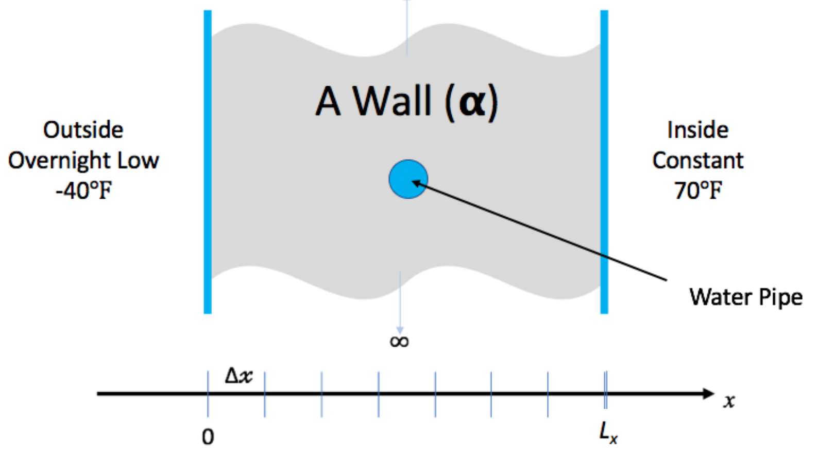
Hands-On Activities
We have created a simple example to give you some (optional) hands-on experience with some of the concepts in this tutorial
You don’t need to understand the math/physics to do the exercises, or find them useful
We have some time in the agenda for the hands-on activities, but feel free to continue to work on them outside of the tutorial. We’ll give feedback on pull requests and issues filed (or email us, see next slide).
Instructions on the tutorial web site: https://bssw-tutorial.github.io/ and click the link for today’s tutorial
Notes:
Variant for hands-on being part of the agenda.

Slide 2
Hands-On Activities
We have created a simple example to give you some (optional) hands-on experience with some of the concepts in this tutorial
You don’t need to understand the math/physics to do the exercises, or find them useful
We do not have time in the agenda for the hands-on activities, but feel free to work on them outside of the tutorial. We’ll give feedback on pull requests and issues filed (or email us, see next slide).
Instructions on the tutorial web site: https://bssw-tutorial.github.io/ and click the link for today’s tutorial
Notes:
Variant for hands-on not being part of the agenda.

