Slide 1
Scientific Software Design
Anshu Dubey(she/her) Argonne National Laboratory
Better Scientific Software tutorial @ Improving Scientific Software conference (2023)
Contributors: Anshu Dubey (ANL), Mark C. Miller (LLNL), David E. Bernholdt (ORNL)

Slide 2
License, Citation and Acknowledgements
License and Citation
This work is licensed under a Creative Commons Attribution 4.0 International License (CC BY 4.0).
The requested citation the overall tutorial is: David E. Bernholdt, Patricia A. Grubel, and David M. Rogers, Better Scientific Software tutorial, in Improving Scientific Software, Boulder, Colorado and online, 2023. DOI: 10.6084/m9.figshare.22179748.
Individual modules may be cited as Speaker, Module Title, in Tutorial Title, …
Acknowledgements
This work was supported by the U.S. Department of Energy Office of Science, Office of Advanced Scientific Computing Research (ASCR), and by the Exascale Computing Project (17-SC-20-SC), a collaborative effort of the U.S. Department of Energy Office of Science and the National Nuclear Security Administration.
This work was performed in part at the Argonne National Laboratory, which is managed by UChicago Argonne, LLC for the U.S. Department of Energy under Contract No. DE-AC02-06CH11357.
This work was performed in part at the Lawrence Livermore National Laboratory, which is managed by Lawrence Livermore National Security, LLC for the U.S. Department of Energy under Contract No. DE-AC52-07NA27344.
This work was performed in part at the Los Alamos National Laboratory, which is managed by Triad National Security, LLC for the U.S. Department of Energy under Contract No.89233218CNA000001
This work was performed in part at the Oak Ridge National Laboratory, which is managed by UT-Battelle, LLC for the U.S. Department of Energy under Contract No. DE-AC05-00OR22725.
This work was performed in part at Sandia National Laboratories. Sandia National Laboratories is a multi-mission laboratory managed and operated by National Technology and Engineering Solutions of Sandia, LLC., a wholly owned subsidiary of Honeywell International, Inc., for the U.S. Department of Energy’s National Nuclear Security Administration under contract DE-NA0003525.

Slide 3
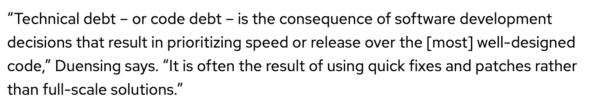
Introduction
Investing some thought in design of software makes it possible to maintain, reuse and extend it
Even if some research software begins its life as a one-off use case, it often gets reused
Without proper design it is likely to accrete features haphazardly and become a monstrosity
Acquires a lot of technical debt in the process
Many projects have had this happen
Most end up with a hard reset and start over again
In this module we will cover general design principles and those that are tailored for scientific software
We will also work through two use cases
definition from https://enterprisersproject.com/article/2020/6/technical-debt-explained-plain-english

Slide 4
General Design Principles for Maintainable Software
Some definitions from the web
Encapsulate what varies
Favor composition over inheritance
Program to interfaces not implementations
Loose coupling – interacting components should have minimal knowledge about each other
SOLID
https://bootcamp.uxdesign.cc/software-design-principles-every-developers-should-know-23d24735518e

Slide 5
General Design Principles for Maintainable Software
Found on the web
Encapsulate what varies
Favor composition over inheritance
Program to interfaces not implementations
Loose coupling – interacting components should have minimal knowledge about each other
SOLID
https://bootcamp.uxdesign.cc/software-design-principles-every-developers-should-know-23d24735518e
SOLID
Single responsibility
Class/method/function should do only one thing
Open/closed
Open for extension, close for modification
Liskov substitution
Implementations of an interface should give same result
Interface segregation
Client should not have to use methods it does not need
Dependency inversion
High level modules should not depend on low level modules, only on abstractions

Slide 6
Designing Software – High Level Phases
Requirements
gathering
Decomposition
Connectivity
Features and capabilities
Constraints
Limitations
Target users
Other …..
Understand design space
Decompose into high level components
Bin components into types
Understand component hierarchy
Figure out connectivity among components
Articulate dependencies

Slide 7
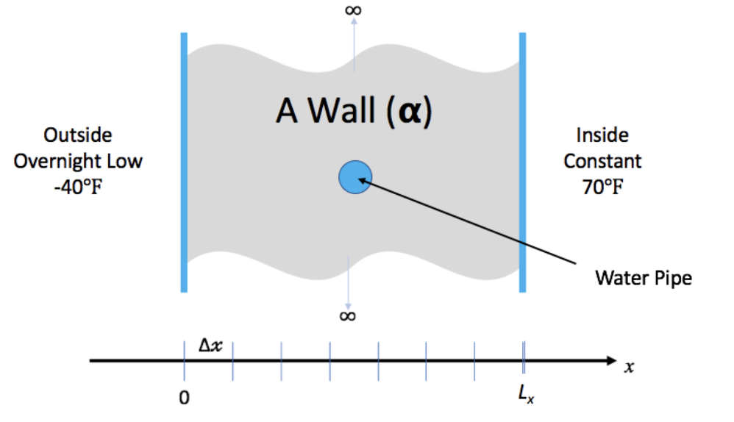
Example 1 – Problem Description
We have a house with exterior walls made of single material of thickness L_{x}
The wall has some water pipes shown in the picture.
The inside temperature is kept at 70 degrees. But outside temperature is expected to be -40 degrees for 15.5 hours.
Will the pipes freeze before the storm is over

Slide 8
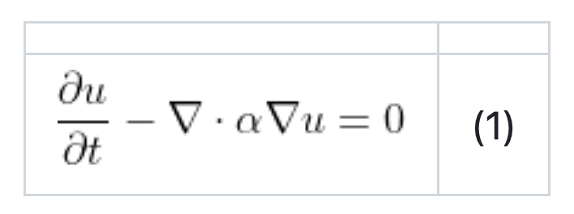
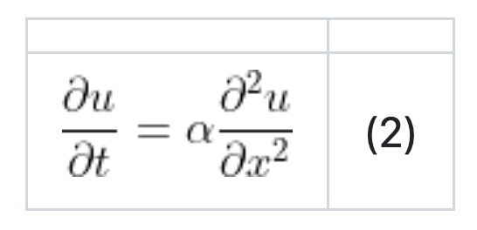
Mathematical formulation
The repository has solutions using three numerical methods
Foward Time Centered Space (FTCS), an explicit method
Crank-Nicholson, an implicit method
Upwind-15, another explicit method with higher spatial order than FTCS.
We will use FTCS for this exercise
Heat conduction is governed by a partial differential equation
We make some simplifying assumptions
The thermal diffusivity is constant for all space and time.
The only heat source is from the initial and/or boundary conditions.
We will deal only with the one dimensional problem in Cartesian coordinates.
That reduces the heat equation to

Slide 9
Requirements gathering
To solve heat equation we need:
a discretization scheme
a driver for running and book-keeping
an integration method to evolve solution
Initial conditions
Boundary conditions
To make sure that we are doing it correctly we need:
Ways to inspect the results
Ways of verification

Slide 10
Decomposition
This is a small design space
Several requirements can directly map to components – in this instance functions
Driver
Initialization – data containers
Mesh initialization – applying initial conditions
Integrator
I/O
Boundary conditions
Comparison utility
Binning components
Components that will work for any application of heat equation
Driver
Initialization – data containers
I/O
Comparison utility
Components that are
Mesh initialization – applying initial conditions
Integrator
Boundary conditions

Slide 11
Connectivity
Mesh generation
Compare results
Initialize
Data containers
Driver
Write results
Boundary conditions
Integrator
Initial conditions

Slide 12
Connectivity – alternative possibility
Mesh generation
Compare results
Initialize
Data containers
Driver
Write results
Initial conditions
Boundary conditions
Integrator

Slide 13
Interactive Portion
-- https://bit.ly/desEx
Code repository in python
https://github.com/abiswas-odu/heateq-design-intersect-2023
A few possibilities of design exploration
Did we need three different interfaces for update solution ?
What would have been needed to make it into one interface
If you wish to explore the whole exercise in C++ on your own checkout
https://xsdk-project.github.io/MathPackagesTraining2020/lessons/hand_coded_heat/

Slide 14
Research Software Challenges
More Scientific Understanding
Many parts of the model and software system can be under research
Requirements change throughout the lifecycle as knowledge grows
Verification complicated by floating point representation
Real world is messy
More Hardware
Resources
Higher Fidelity
Model
More Diverse
Solvers

Slide 15
SOLID Principles Pose Some Difficulties
Single responsibility
Class/method/function should do only one thing
Open/closed
Open for extension, close for modification
Liskov substitution
Implementations of an interface should give same result
Interface segregation
Client should not have to use methods it does not need
Dependency inversion
High level modules should not depend on low level modules, only on abstractions
Function calls have overheads
Performance matters – quick turnaround of results desirable
New insights may cause modification
May lead to unmaintainable code duplication
It is not always possible to eliminate lateral interactions
Not always possible

Slide 16
Additional Considerations for Research Software
Considerations
Multidisciplinary
Many facets of knowledge
To know everything is not feasible
Two types of code components
Infrastructure (mesh/IO/runtime …)
Science models (numerical methods)
Codes grow
New ideas => new features
Code reuse by others
Design Implications
Separation of Concerns
Shield developers from unnecessary complexities
Work with different lifecycles
Long-lasting vs quick changing
Logically vs mathematically complex
Extensibility built in
Ease of adding new capabilities
Customizing existing capabilities

Slide 17
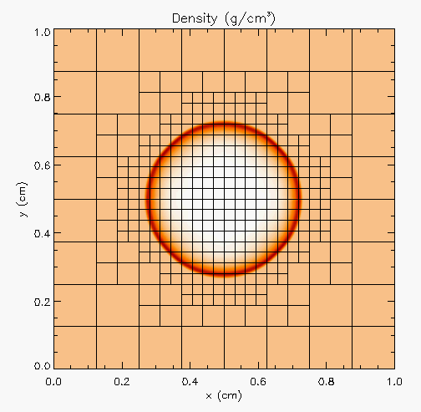
More Complex Application Design – Sedov Blast Wave
Description
High pressure at the center cause a shock to moves out in a circle. High resolution is needed only at and near the shock
Requirements
Adaptive mesh refinement
Easiest with finite volume methods
Driver
I/O
Initial condition
Boundary condition
Shock Hydrodynamics
Ideal gas equation of state
Method of verification

Slide 18
Deeper Dive into Requirements
Adaptive mesh refinement => divide domain into blocks
Blocks need halos to be filled with values from neighbors or boundary conditions
At fine-coarse boundaries there is interpolation and restriction
Blocks are dynamic, go in and out of existence
Conservation needs reconciliation at fine-coarse boundaries
Shock hydrodynamics
Solver for Euler’s equations at discontinuities
EOS provides closure
Riemann solver
Halo cells are fine-coarse boundaries need EOS after interpolation
Method of verification
An indirect way of checking – shock distance traveled can be computed analytically

Slide 19
Components
Deeper Dive into some Components
Driver
Iterate over blocks
Implement connectivity
Mesh
Data containers
Halo cell fill, including application of boundary conditions
Reconciliation of quantities at fine-coarse block boundaries
Remesh when refinement patterns change
I/O
Getting runtime parameters and possibly initial conditions
Writing checkpoint and analysis data
Binned Components
Unchanging or slow changing infrastructure
Mesh
I/O
Driver
Comparison utility
Components evolving with research – physics solvers
Initial and boundary conditions
Hydrodynamics
EOS

Slide 20
Connectivity
Initial conditions
Compare results
Mesh
Driver
I/O
Boundary conditions
Hydrodyn-amics
EOS

Slide 21
Connectivity
Initial conditions
Compare results
Mesh
Driver
I/O
Boundary conditions
Hydrodyn-amics
EOS

Slide 22
Connectivity
Initial conditions
Compare results
Mesh
Driver
I/O
Boundary conditions
Hydrodyn-amics
EOS

Slide 23
Connectivity
Initial conditions
Compare results
Mesh
Driver
I/O
Boundary conditions
Hydrodyn-amics
EOS

Slide 24
Connectivity
Initial conditions
Compare results
Mesh
Driver
I/O
Boundary conditions
Hydrodyn-amics
EOS

Slide 25
Exploring design space -- Abstractions
Virtual view of functionalities
Decomposition into components
Spatial
decomposition
Virtual view :
domain sections
as stand-alone
computation unit
Real view : A
whole domain
with many
operators
base
abstraction
Functional
decomposition
Virtual view
collection of
components
Notes:
Example of changing the block size to adjust to the cache memory
And point-to-point Vs collectives depending upon the scale of the problem

Slide 26
Exploring design space -- Abstractions
Constraints
Only infrastructure components have global view
All physics solvers have block view only
Other Design Considerations
Data scoping
Interfaces in the API
Virtual view of functionalities
Decomposition into components
Spatial
decomposition
Virtual view :
domain sections
as stand-alone
computation unit
Real view : A
whole domain
with many
operators
base
abstraction
Functional
decomposition
Virtual view
collection of
components
Notes:
Example of changing the block size to adjust to the cache memory
And point-to-point Vs collectives depending upon the scale of the problem

Slide 27
Exploring design space -- Abstractions
Constraints
Only infrastructure components have global view
All physics solvers have block view only
Other Design Considerations
Data scoping
Interfaces in the API
Virtual view of functionalities
Decomposition into components
Spatial
decomposition
Virtual view :
domain sections
as stand-alone
computation unit
Real view : A
whole domain
with many
operators
base
abstraction
Minimal Mesh API
Initialize_mesh
Halo_fill
Access_to_data_containers
Reconcile_fluxes
Regrid
Functional
decomposition
Virtual view
collection of
components
Notes:
Example of changing the block size to adjust to the cache memory
And point-to-point Vs collectives depending upon the scale of the problem

Slide 28
A Design Model for Separation of Concerns
Infrastructure
Capabilities
Requirements
Model
Software Architecture API Design
API
Implement
Design
Develop
Test
Validate
Maintain
Augment
Integrate

Slide 29
Separation of Concerns Applied
Virtual view of functionalities
Decomposition into units and definition of interfaces
Spatial
decomposition
Virtual view :
domain sections
as stand-alone
computation unit
Parallelization
and scaling
optimization
Implemented by
domain experts
and applied
mathematicians
Implemented by
software and
performance
engineers
Real view : A
whole domain
with many
operators
Functional
decomposition
Virtual view
collection of
components
Memory
access and
compute
optimization
Notes:
Example of changing the block size to adjust to the cache memory
And point-to-point Vs collectives depending upon the scale of the problem

Slide 30
Takeaways So far
Differentiate between slow changing and fast changing components of your code
Understand the requirements of your infrastructure
Implement separation of concerns
Design with portability, extensibility, reproducibility and maintainability in mind

Slide 31
New Paradigm Because of Platform Heterogeneity
More Scientific Understanding
Heterogeneous
models
More Hardware
Resources
Higher Fidelity
Model
Software complexity
Distributed
memory
model
More Diverse
Solvers
Platform complexity

Slide 32
New Paradigm Because of Platform Heterogeneity
Question - do the design principles change?
Heterogeneous
models
Software complexity
Platform complexity

Slide 33
New Paradigm Because of Platform Heterogeneity
Question - do the design principles change?
The answer is – not really
The details get more involved
Heterogeneous
models
Software complexity
Platform complexity

Slide 34
A Design Model for Separation of Concerns
Infrastructure
Capabilities
Requirements
Model
Software Architecture API Design
API
Implement
Design
Develop
Test
Validate
This is where maximum
change is likely
Maintain
Augment
Integrate

Slide 35
Platform Heterogeneity
Computation
Memory
Network

Slide 36
Platform Heterogeneity
Computation
Memory
Network
CPU
GPU
Other acceler-ators
Other devices

Slide 37
Platform Heterogeneity
Computation
Memory
Network
CPU
GPU
Cache hierar-chy
Device memory
Other accelero-ators
Other devices
NVram
Other types

Slide 38
Platform Heterogeneity
Computation
Memory
Network
CPU
GPU
Cache hierar-chy
Device memory
Between nodes
Within node
Other acceler-ators
Other devices
NVram
Other types
With I/O
Other types

Slide 39
Platform Heterogeneity
Computation
Memory
Network
CPU
GPU
Cache hierar-chy
Device memory
Between nodes
Within node
Other acceler-ators
Other devices
NVram
Other types
With I/O
Other types
And memory access models: unified memory / gpu-direct / explicit transfer

Slide 40
Mechanisms Needed by the Code
Mechanisms to unify expression of computation
Minimize maintained variants of source suitable for all computational devices
Reconcile differences in data structures
Notes:
Various forms :: CUDE, HIP, OpenACC, OpenMP, OneAPI, SYCL etc etc

Slide 41
Mechanisms Needed by the Code
Mechanisms to unify expression of computation
Minimize maintained variants of source suitable for all computational devices
Reconcile differences in data structures
Mechanisms to move work and data to computational targets
Moving between devices
Launching work at the destination
Hiding latency of movement
Moving data off node

Slide 42
Mechanisms Needed by the Code
Mechanisms to unify expression of computation
Minimize maintained variants of source suitable for all computational devices
Reconcile differences in data structures
Mechanisms to move work and data to computational targets
Moving between devices
Launching work at the destination
Hiding latency of movement
Moving data off node
Mechanisms to map work to computational targets
Figuring out the map
Expression of dependencies
Cost models
Expressing the map

Slide 43
Mechanisms Needed by the Code
Mechanisms to unify expression of computation
Minimize maintained variants of source suitable for all computational devices
Reconcile differences in data structures
Mechanisms to move work and data to computational targets
Moving between devices
Launching work at the destination
Hiding latency of movement
Moving data off node
So, what do we need?
Abstractions layers
Code transformation tools
Data movement orchestrators
Mechanisms to map work to computational targets
Figuring out the map
Expression of dependencies
Cost models
Expressing the map

Slide 44
Features and Abstractions that must Come in
Framework
Real view : A
whole domain
with many
operators
Spatial
Decomposition
Blocks/tiles
Virtual view :
domain sections
as stand-alone
computation unit
Load Distribution
Offloading
and scaling
optimization
Runtime
management
Functional
decomposition
Virtual view
collection of
components
Abstraction at
solver level
code
transformation
Memory
access and
compute
optimization

Slide 45
Underlying Ideas: Unification of Computational Expressions
Make the same code work on different devices
Same algorithm different data layouts or operation sequence:
A way to let compiler know that ”this” expression can be specialized in many ways
Definition of specializations
Often done with template meta-programming
More challenging if algorithms need to be fundamentally different
Support for alternatives

Slide 46
Underlying Ideas: Moving Work and Data to the Target
Parallelization Models
Hierarchy in domain decomposition
Distributed memory model at node level – still very prevalent, likely to remain so for a while
Also done with PGAS models – shared with locality being important
Assigning work within the node
“Parallel For” or directives with unified memory
Directives or specific programming model for explicit data movement
More complex data orchestration system for asynchronous computation
Task based work distribution
Notes:
most accelerator systems these days have mechanisms for sharing (reading/writing) memory between host and device. Easy, but generally not the most performant approach
confounding differences between systems with regard to how well that sharing is supported.
Task based examples – Legion, PaRSEC, HPX, StarPU, Charm++

Slide 47
Underlying Ideas: Mapping Work to Targets
This is how many abstraction layers work
Infer the structure of the code
Infer the map between algorithms and devices
Infer the data movements
Map computations to devices
These are specified either through constructs or pragmas
It can also be the end user who figures out the mapping
In either case performance depends upon how well the mapping is done
.

Slide 48
Mechanisms Needed by the Code : Example Flash-X
Mechanisms to unify expression of computation
Macros with inheritance

Slide 49
Mechanisms Needed by the Code : Example Flash-X
Mechanisms to unify expression of computation
Macros with inheritance
Mechanisms to move work and data to computational targets
Domain specific runtime

Slide 50
Mechanisms Needed by the Code : Example Flash-X
Mechanisms to unify expression of computation
Macros with inheritance
Mechanisms to move work and data to computational targets
Domain specific runtime
Mechanisms to map work to computational targets
DSL for recipes with code generator

Slide 51
Mechanisms Needed by the Code : Example Flash-X
Mechanisms to unify expression of computation
Macros with inheritance
Mechanisms to move work and data to computational targets
Domain specific runtime
Mechanisms to map work to computational targets
DSL for recipes with code generator
Composability in the source
A toolset of each mechanism
Independent tool sets

Slide 52
Construction of Application with Components and Tools
Static physics code
Encoded with macros
Including optimization hints as directives
code for target device
Source code for physics operators
Optimizer
Translator
Fully assembled and configured source code
Platform specific information
Code assembler
Library of templates for time-stepping
Source code for time
stepping
and
runtime pipeline
Recipe for control flow in time
stepping
Compiler
Human in the loop
Recipe translator
Library of runtime configurations
Executable

Slide 53
Final takeaways
Requirements gathering and intentional design are indispensable for sustainable software development
Many books and online resources available for good design principles
Research software poses additional constraints on design because of its exploratory nature
Scientific research software has further challenges
High performance computing research software has even more challenges
That are further exacerbated by the ubiquity of accelerators in platforms
Separation of concerns at various granularities, and abstractions enable sustainable software design

