Slide 1
Testing Complex Software
David M. Rogers (he/him) Oak Ridge National Laboratory
Developing a Testing and Continuous Integration Strategy for your Team tutorial @ Exascale Computing Project Annual Meeting
Contributors: David E. Bernholdt (ORNL), Anshu Dubey (ANL), Rinku Gupta (ANL), Mark C. Miller (LLNL), David M. Rogers (ORNL)
Notes:
So, your software's current functionality has been documented, and some initial tests are written. Where do you go from here? How do you improve your testing situation to the point where it's considered "done"?

Slide 2
License, Citation and Acknowledgements
License and Citation
This work is licensed under a Creative Commons Attribution 4.0 International License (CC BY 4.0).
The requested citation the overall tutorial is: Gregory R. Watson and David M. Rogers, Developing a Testing and Continuous Integration Strategy for your Team tutorial, in Exascale Computing Project Annual Meeting, online, 2022. DOI: 10.6084/m9.figshare.19608927
Individual modules may be cited as Speaker, Module Title, in Better Scientific Software tutorial…
Acknowledgements
This work was supported by the U.S. Department of Energy Office of Science, Office of Advanced Scientific Computing Research (ASCR), and by the Exascale Computing Project (17-SC-20-SC), a collaborative effort of the U.S. Department of Energy Office of Science and the National Nuclear Security Administration.
This work was performed in part at the Argonne National Laboratory, which is managed by UChicago Argonne, LLC for the U.S. Department of Energy under Contract No. DE-AC02-06CH11357.
This work was performed in part at the Oak Ridge National Laboratory, which is managed by UT-Battelle, LLC for the U.S. Department of Energy under Contract No. DE-AC05-00OR22725.
This work was performed in part at the Lawrence Livermore National Laboratory, which is managed by Lawrence Livermore National Security, LLC for the U.S. Department of Energy under Contract No. DE-AC52-07NA27344.
This work was performed in part at the Los Alamos National Laboratory, which is managed by Triad National Security, LLC for the U.S. Department of Energy under Contract No.89233218CNA000001
This work was performed in part at Sandia National Laboratories. Sandia National Laboratories is a multi-mission laboratory managed and operated by National Technology and Engineering Solutions of Sandia, LLC., a wholly owned subsidiary of Honeywell International, Inc., for the U.S. Department of Energy’s National Nuclear Security Administration under contract DE-NA0003525.

Slide 3
How to build your test suite?
Two “levels”
Automated / scheduled testing
May be long running
Provide comprehensive coverage
Continuous integration
Quick diagnosis of error
A mix of different granularities works well
Unit tests for isolating component or sub-component level faults
Integration tests with simple to complex configuration and system level
Restart tests
Rules of thumb
Simple
Enable quick pin-pointing
Useful resources https://ideas-productivity.org/resources/howtos/
Notes:
Let's think about this problem as "selecting the right tests." Taking a step back, there are two 'levels' of tests (regression testing and CI-type tests), and there are multiple 'granularities' of tests (from unit to integration). Computer scientists tend to gravitate towards tests that run quickly and check data structures, types, definitions, syntax, and error reporting. These quick tests are great for a continuous integration suite. Domain scientists tend to think of ways to compare program outputs to external measures - like known solutions and example run cases. These tests can be long-running, and need interpretation to understand what's going on. Such tests are often better suited for scheduled testing - which can be set up to run on dedicated servers on a nightly or weekly schedule. And there is a range of intermediate levels of testing pertaining to interoperability in component-based software systems, verification of non-trivial functionality such as transparent restart from a checkpoint etc. Since testing is so broad, individual tests can also vary in complexity. As a rule of thumb, complicated tests get -100 points. Tests should be as simple as possible, and always provide information on what went wrong. If a test can't help to diagnose an error condition, it's not a useful test.

Slide 4
Why not always use the most stringent testing?
Effort spent in devising running and maintaining test suite is a tax on team resources
When the tax is too high…
Team cannot meet code-use objectives
When is the tax is too low…
Necessary oversight not provided
Defects in code sneak through
Notes:
You might be tempted to get overly creative with test cases, or turn every possible scenario into a test. This can be counterproductive. Time spent on creating, maintaining, and interpreting tests takes team resources. Ideally, tests are either closely aligned with the science objectives for single domain codes, in which case the tests themselves provide baselines, and are motivating to create and maintain. If testing goes too far away from that, it can distract the project away from achieving its next great features. Or, for multi-domain general purpose code the collection of tests should maximize coverage while minizing the cost of developing and running the tests.
On the other hand, if there is not enough testing, then defects in the code can slip through. For example, users might assume the overlap region between processors is communicated correctly during a halo exchange. If there's no test that tries this out with varying halo size, there's no way to know when that assumption breaks down.
This line of thought leads to the idea of a team meeting focused specifically on creating a "testing plan". The goal of such a meeting is to clearly map out the expected use of the code. What parts of the code are critical to long-term stability? Who on your team should be responsible for ensuring each piece works? Are there additional difficulties coming from interacting modules? How can these be reasonably addressed with example use cases?

Slide 5
Why not always use the most stringent testing?
Effort spent in devising running and maintaining test suite is a tax on team resources
When the tax is too high…
Team cannot meet code-use objectives
When is the tax is too low…
Necessary oversight not provided
Defects in code sneak through
rank 2
rank 3
halo cells
Notes:
For example, users might assume the overlap region between processors is communicated correctly during a halo exchange. If there's no test that tries this out with varying halo size, there's no way to know when that assumption breaks down.
This line of thought leads to the idea of a team meeting focused specifically on creating a "testing plan". The goal of such a meeting is to clearly map out the expected use of the code. What parts of the code are critical to long-term stability? Who on your team should be responsible for ensuring each piece works? Are there additional difficulties coming from interacting modules? How can these be reasonably addressed with example use cases?

Slide 6
Why not always use the most stringent testing?
Effort spent in devising running and maintaining test suite is a tax on team resources
When the tax is too high…
Team cannot meet code-use objectives
When is the tax is too low…
Necessary oversight not provided
Defects in code sneak through
Evaluate project needs:
Objectives: expected use of the code
Lifecycle stage: new or production or refactoring
Team: size and degree of heterogeneity
Lifetime: one off or ongoing production
Complexity: modules and their interactions
rank 2
rank 3
halo cells
Notes:
For example, users might assume the overlap region between processors is communicated correctly during a halo exchange. If there's no test that tries this out with varying halo size, there's no way to know when that assumption breaks down.
This line of thought leads to the idea of a team meeting focused specifically on creating a "testing plan". The goal of such a meeting is to clearly map out the expected use of the code. What parts of the code are critical to long-term stability? Who on your team should be responsible for ensuring each piece works? Are there additional difficulties coming from interacting modules? How can these be reasonably addressed with example use cases?

Slide 7
Additional Notes: Good Testing Practices
Verify Code coverage
Must have consistent policy on dealing with failed tests
Issue tracking
How quickly does it need to be fixed?
Who is responsible for fixing it?
Someone should be watching the test suite
When refactoring or adding new features, run a regression suite before check in
Add new regression tests or modify existing ones for the new features
Code review before releasing test suite is useful
Another person may spot issues you didn’t
Incredibly cost-effective
Notes:
OK - now everyone is onboard with your testing plan, and your code is in a good place. What happens next? You can double-check your work using a code coverage tool. You can create a policy on what to do with failed tests and issues marked as "bugs." It helps to assign responsibility for the test suite - both so that things happen, and also so that you can recognize the hard work put in by that team member. You should consider your test suite during refactorings, and use it for the code release process. Cost-effectiveness comes in here because, if you already have defined functionalities and tests, then it's much less likely that your team will get side-tracked by maintaining fixes and patches for past releases. That is a rabbit-hole nobody wants to go down.

Slide 8
Example 1: Test Development For a New Code
Development of tests and diagnostics goes hand-in-hand with code development
Compare against simpler analytical or semi-analytical solutions
Build granularity into testing
Use scaffolding ideas to build confidence
Always inject errors to verify that the test is working
Non-trivial to devise good tests, but extremely important
Notes:
With those general guidelines in mind, let's get down to some specific examples from the collected experiences of our team members. Many of these come from Anshu Dubey's work with the E3SM and Flash codes. Example 1 is an ideal case. You're developing a new code, and develop your diagnostics as your developing the code itself. Taking the extra time to harden those diagnostics into a test suite will save you headaches later. You'll likely have a lot of comparisons against known, expected solutions. You should try and make things as granular as possible, though. The scaffolding idea, discussed later, finds a way to "build up" a program, testing each new piece. Remember to inject errors, so that you know your code will discover erroroneous input correctly. As the package gets more complex, it's non-trivial to devise good tests. Nevertheless, good tests are extremely important.
Proper testing procedures can also help encourage new contributors. Only recently, I had this experience contributing a feature to the "alpaka" code. The first thing I did was check that the team wanted the feature. Then I ran their test suite locally. Everything worked, and then I could build my feature one line at a time – testing everything. When I finally pushed it to the main repository, I was sure it was something the team onboard with, and that could be easily shown to work well.

Slide 9
Example 2:
Test Development For a Legacy Code
There may not be existing tests
Isolate a small area of the code
Dump a useful state snapshot
Build a test driver
Start with only the files in the area
Link in dependencies
Copy if any customizations needed
Read in the state snapshot
Restart from the saved state
Verify correctness
Always inject errors to verify that the test is working
state
driver
Notes:
Here's an example from the E3SM code, the Exascale Earth System Model. Although advanced now, it originated in a combination of Fortran codes dealing with various aspects of climate modeling. The project came together from a collection of independent projects and development practices. They imposed structure on the code through the use of Fortran modules. However, the focus was on running whole models, so their architecture and testing strategies evolved to work with that goal. That led to an unforeseen difficulty. For several sections of the code, even the simplest modification would take running the entire model to test. This meant enqueuing the job in a batch queue that would take non-trivial amount of time to run. What was missing was granular testing. And it wasn’t easy to separate out code sections for testing independently because one Fortran module gets data from another, that in turn gets data from yet another and so on … This is an example of a methodology used to generate an independent test for a code section.
Review the dependencies. Here the model needs to be at a certain ”state” to invoke the target code.
Look for dependencies on Fortran data modules that are outside the sub-tree containing the source code for this section
For each of the data modules determine where the dependencies can be pruned.
d) Run the full model and capture the “state” just before the invocation of the target section.
e) Create a separate working directory for the test
f) In this working area create soft links to the files that have dependencies
g) Where the dependence is to be pruned create a copy of the corresponding file in the working area and modify it as needed.
e) Create a test driver to load the state and exercise the unit.
d) If extra functions from the code were accessed, these were sym-linked into the test directory. Here, the branch at the right represents some helper functions that can be imported easily.
e) That doesn't always work. The red dot represents a module with lots of dependencies - not needed for this test. In these cases, the module was modified to remove unnecessary dependencies.
f) With all the code dependencies sorted out, the test driver itself becomes an isolated unit. For this example, the original test took hours to run through the batch queue of a cluster. The new unit test ran in 20 seconds on a developer's laptop.

Slide 10
Example 3: Structuring Tests to pinpoint bugs
Real dependency
Mocked up
dependency
Bottom-up picture
Components can be exercised against known simpler applications
Same applies to combination of components
Build a scaffolding of verification tests to gain confidence
Unit test
Unit test
Unit test
Notes:
This third example comes from the FLASH code, which simulates particles and fields in astrophysics, like exploding stars. Here, the unit-testing framework was developed as a series of layers that build up from basic to advanced functionality. For example, the cell grid can be tested by creating "fake" functions to put onto the grid, and verifying their behavior. This mocked dependency means that the test looks directly at the cell grid implementation. After checking the cell grid works, we are free to use it as a real dependency in subsequent tests of more complicated objects.

Slide 11
Example 3: Structured Testing
Unit test for Grid halo cell fill
Verification of guard/ghost/halo cell fill
Initialize field on interior cells (red)
Apply guard cell fill
Check for equivalence with known fill pattern
rank 2
rank 3
halo cells
gc test
Notes:
Here's another example of verifying the halo exchange on a cell grid. The test initializes interior cells with a known function, does the halo exchange, and checks whether the guard cell has been properly copied over. Similarly, a unit test can be written to verify parts of the computations - like computing energy from pressure and temperature.

Slide 12
Example 3: Structured Testing
Unit test for Grid halo cell fill
Verification of guard/ghost/halo cell fill
Initialize field on interior cells (red)
Apply guard cell fill
Check for equivalence with known fill pattern
rank 2
rank 3
halo cells
gc test
Eos test
Next, build an EOS Test – is E(V,T) consistent with P(V,T)?
Notes:
Here's another example of verifying the halo exchange on a cell grid. The test initializes interior cells with a known function, does the halo exchange, and checks whether the guard cell has been properly copied over. Similarly, a unit test can be written to verify parts of the computations - like computing energy from pressure and temperature.

Slide 13
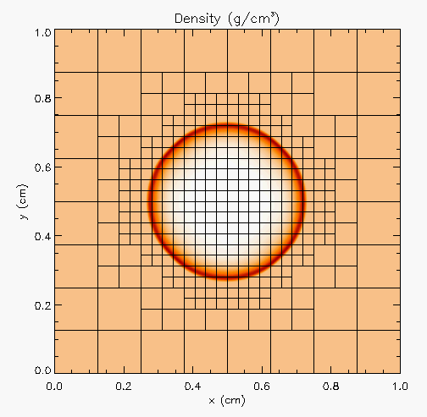
Example 3: Structured Testing
Hydro test
Unit test for Hydrodynamics
Sedov blast wave
High pressure at the center
Shock moves out spherically
Known analytical solution
gc test
Eos test
Though it exercises mesh, hydro and eos, if mesh and eos are verified first, then this test verifies hydro
More testing needed for Grid using AMR
Flux correction and regridding
Notes:
Once those basic unit tests are done, we can create a unit test at the next level. Here, the Sedov blast wave is simulated using the cell grid and equation of state previously tested. The Sedov wave has a known analytical solution, which provides an error estimate for the implementation. Out-of-tolerance errors at this stage indicate a problem specific to hydrodynamics, since the cells and equation of state are already tested. In addition, plotting errors vs. space and time helps to train graduate students.

Slide 14
Example 3: Structured Testing
For AMR, correct behavior of flux conservation and regridding should also be verified.
Reason about correctness for testing Flux correction and regridding
IF Guardcell fill and EOS unit tests passed
Run Hydro without AMR
If failed fault is in Hydro
Run Hydro with AMR, but no dynamic refinement
If failed fault is in flux correction
Run Hydro with AMR and dynamic refinement
If failed fault is in regridding
Notes:
This test can be developed further too. For example, if one is using AMR in the code, then the steps shown here can become tests for specific AMR functionalities in the code.
Run Gcfill and EOS with AMR and sedov with UG. If all three pass, run sedov with no dynamic refinement. The only new AMR feature exercised in this configuration is reconciliation of fluxes at fine-coarse boundaries.
If that passed run with dynamic refinement, where that is the only new feature added. The basic takeaway is in each new test only one new feature is exercised so that a failure can pin-point the cause.

Slide 15
Example 4: Coverage Matrix (Interoperabilities)
First line of defense – code coverage tools
Code coverage tools necessary but not sufficient
Do not give any information about interoperability
Map your tests and examples – what do they do?
Follow the order
All unit tests – including full module tests (e.g. CL)
Tests sensitive to perturbations (e.g. SV)
Most stringent tests for solvers (e.g. WD, PT)
Least complex test to cover remaining spots (Aha!)
Notes:
This final example shows a graphical way to "map" areas of your code for testing. The x-axis has physical capabiliies. The y-axis has infrastructure and generic solvers. List out all test and mark the corresponding squares in the matrix if the two corresponding features are exercised together in the test. For example here SV stands for the Sedov test run with Uniform grid and includes tracer particles. Similarly the celluar test (CL) runs with AMR and also includes nuclear burning and particles in addition to Hydro and EOS. The idea is to know which of these squares need to be marked to have sufficient amount of interoperability coverage needed by the code. Not every square needs to be covered, though. It also helps document areas of your code that are needed for each science scenario.
This type of map is complementary to code coverage. If your program is well-structured, there should be some correspondence between this map and the files that coverage shows as "tested".
The Order described here gives guidelines for how to select the tests to maximize the needed coverage while minimizing the cost. It is always desirable to run the fastest and most lightweight tests that can pinpoint the error.

Slide 16
Incentives for Paying Attention to Reproducibility
Common statement: “I would love to do a better job on my software, but I need to..."
Get this paper submitted
Complete this project task
Do something my employer values more
Goal: Change incentives to include valuing of better software, better science
This is a long-term goal, requiring a culture change in (computational) science which in the early stages
Demand
Transparency & Reproducibility Requirements
Productivity & Sustainability Investments
Enable
Notes:
Slides from reproducibility talk

Slide 17


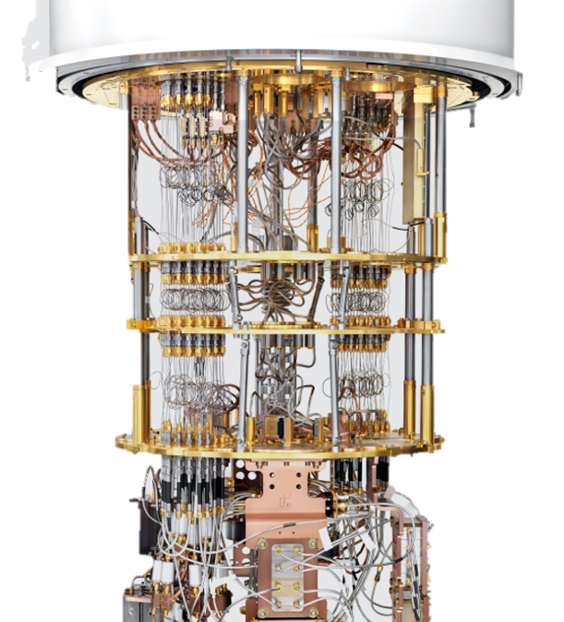
Additional Motivation – Testing Practices
Supercomputer Cycles are Scarce Resources
Goal = capture QA details during science runs
Many people need to have confidence
in your results:
You
Your project lead or boss
Your sponsor
Your reviewers or referees
Your readers
Testing helps build credibility without repeating runs.
Notes:
Slides from reproducibility talk

Slide 18
Strategies for Improving Reproducibility
Solid versioning practices are fundamental to reproducibility
Source code, dependencies, copy through to outputs
Build in quality from the start
Expectation for documentation and level of testing (write in-sync with code).
Increasing expectations as code becomes more "public"
Peer review / team productivity tracking meetings
Watch Out for Numerical Artifacts
Integer overflows, floating point underflows, numerical algorithm stability
Plan Ahead for Experimental Campaign Progression
How do scaling tests & intermediate outputs relate to code features?
What in-run correctness checks exist?
What if a patch needs to be applied during a campaign?
Notes:
Slides from reproducibility talk

Slide 19
Testing Strategies for Improving Reproducibility
Testing, testing, and more testing!
Add “regression tests”
If you fix a bug, add a test to make sure that bug doesn’t creep back in
Add more tests
Be creative
Think about common cases, then corner cases
Think about misuse (unintentional or intentional)
Think about synthetic tests with synthetic data
Think about low-cost tests that can be “always on” (even if they’re not so stringent)
Can you detect silent data corruption?
Physics/math based strategies
Conserved quantities, symmetries, synthetic operators
Design by Contract
Input/output specifications, program invariants
Test your third-party dependencies
Are your tools doing what you think they’re doing?
What if you’re using a new version?
How do you decide if it is okay to upgrade to a new version?
Test your tests!
Make sure tests fail when they’re supposed to!
Thoroughly verify the code
Does the code do what you intended it to do?
On all relevant platforms (compilers, hardware, etc.)
Test regularly
To identify and document where changes to the underlying platform change code behavior/results
Notes:
Slides from reproducibility talk

Slide 20
Takeaways
Context: understand testing needs and costs
Devise tests to enable quick pinpointing of errors through reasoning about their behavior
test at various granularities – bottom-up (UNIT/verification) through top-down (integration/validation)
Tests at various complexities – CI vs. regression
Maintain a holistic validation strategy: think globally, act locally
…….Questions ?

