Slide 1
A Journey Toward Lab Notebooks One ex-experimentalist’s perspective
Jared O’Neal
(he/him)
Argonne National Laboratory
Software Productivity and Sustainability track @ Argonne Training Program on Extreme-Scale Computing summer school
Contributors: Jared O’Neal (ANL)

Slide 2
TODO: Add license page in accord with official process

Slide 3
Why discuss experimental sciences at ATPESC?
“… practicing the scientific method properly requires good software practices. This is understood in the experimental community…The computational science side has had a historic problem with it. As we can see, it’s getting better.”
- Katherine Riley, Director of Science at ALCF, ATPESC 2019
Scientific HPC is several young fields that “on close examination, have not really stabilized or optimized their collaborative processes in a manner analogous to that of more mature, "classical" sciences. As a consequence, valuable science is often needlessly lost, or left uncollected.”
- Carlo Graziani, Computational Scientist at ANL, BSSW blog article
Find Mike’s quote
Refer back to content in Intro?
Notes:
This talk has grown from many interesting conversations that I have had with a variety of different computational sciences. This includes different disciplines and different experience levels. When I have these conversations, all parties generally tend to learn something. This module will continue along those lines. I am not here to convince anyone of anything. I am not here to preach. I am just here to present a novel experience. Please ask me questions. I will be direct and state strong opinions. Therefore, please be direct and push back on some of these.

Slide 4
Why me?
Experimental condensed matter physics background
Low-energy positron diffraction
Low-temperature, ultra-high-vacuum scanning tunneling microscopy
Professional experience in observational science environment
European Southern Observatory’s Paranal Observatory
Systems engineer specialized in adaptive optics
Scientific software developer
Primarily focused on applications
Always working on scientific instrumentation
Notes:
Physics was mostly about designing, constructing, all aspects of scientific data including data analysis.
* Observatory was working to ensure high-quality results with full context so that public can do science
While my experimental background was closer to R&D, the laboratory work was clearly more about operations - Paranal is a science factory. This is different in some ways, very rigorous, and at a very large scale. To adapt ideas/tips/tricks/tools for observatory, there needs to be some simplification.
Part of working on scientific instrumentation is understanding how the data is generated and therefore understanding how to correctly and rigorously analyse data and draw conclusions from data.
Emphasize that implicit in this is my belief that developing scientific software is developing a scientific instrument. How many people share this view? If not, how do people view their software and how they use it?

Slide 5
DIKUW
A classification scheme that overloads every day words so that we can use the same language and understand each other.
Data
Information
Knowledge
Understanding
Wisdom
Notes:
Point out that if they search for this, they will find many pages. Those pages have changed over time. For instance, I often times no longer see understanding included. I don’t know much beyond this classification, but find the classification to be quite useful.

Slide 6
Data & Information
Data
Collection of numbers, symbols, text, etc.
It has value only because it was recorded and exists.
Example: Timeseries data of temperature, relative humidity, and precipitation.
Information
Facts gleaned from data
Answers questions such as who, what, when, how much, how long, etc.
Example: Starting at 2pm the temperature dropped by 5ºF over 15 minutes. At 2:05 pm it started to rain and 0.25” of rain was accumulated over the next 30 minutes.
Notes:
Information

Slide 7
Knowledge & Understanding
Knowledge
Derived from information, experience, and understanding.
Example: When relative humidity levels are high and the temperature drops, there is an increased probability of precipitation. TODO: Add in better paragraph.
Understanding
A deep theoretical background in and practical experience with thesystem whose data was acquired and studied.
Example: A meteorologist could explain (at different levels of detail) how the atmosphere works to substantiate the knowledge.
You can share knowledge, can you share understanding?
Notes:
I didn’t use the given timeseries information to derive this knowledge. Someone with understanding of meteorology did they have a deep understanding derived from years of study and experience. However, that person presented and communicated the knowledge for consumption by those without understanding.
When you go to school, are your teachers and professors putting understanding in your head or do they share knowledge and create an environment in which one can generate understanding. When you read the internet are you gaining knowledge of understanding?
Understanding is built on the shoulders of giants. You read an article that helps you generate understanding. But the author of that article generated it from understanding he developed from taking classes with other

Slide 8
Obligatory Einstein Quote
“Any fool can know. The point is to understand.”
- Albert Einstein
Is understanding always the ultimate goal?
Are there times when mere knowledge is sufficient?

Slide 9
Sometimes we just want “good enough”
I don’t need to understand atmospheric science or weather prediction. I just need basic knowledge to determine if I should take an umbrella with me.
Not every developer needs to be an expert in git
We want the people designing the rules of how we use and interact through git to have understanding so that collaborating in git requires minimal git knowledge
This workflow should protect code so that we can’t do damage
Focus on the development/testing and not on git
Lower barrier for newcomers

Slide 10
Knowledge Management
DIKUW is about knowledge management.
Performing scientific work including developing/maintaining scientific instruments can benefit from knowledge management.
We want to
Recognize when we generate knowledge
Capture and preserve that knowledge
Communicate that knowledge
Is knowledge communication only about communicating to others?
Notes:
Really most any project benefits from some sort of knowledge management.

Slide 11
An Example: Lessons Learned
After we live through an experience we want to derive lessons learned.
Experience is valuable, more so if we reflect and are thoughtful
Take the time to study the experience to create and capture knowledge so that we can grow, improve, and avoid difficulties/mistakes
We get more if we derive lessons learned together.
Create more or higher quality knowledge
Communicate the knowledge implicitly
We hope that understanding can be improved or generated.
Should we communicate lessons learned to others?
Notes:
When we go through experiences we can grow and improve. But processes exist to help us maximize that growth and improvement.

Slide 12
Which leads us to documentation
Documentation is a fundamental form of knowledge communication.
Studying documentation can lead to increased understanding.
The cynical point of view
We want and appreciate documentation that is well done,
We love to consume documentation; write it, not so much.
Rephrased
We want and appreciate it when others share knowledge with us.
We don’t want to take the time to capture, preserve, and communicate knowledge we generate.
This is one aspect of productivity
One person decreases their short-term efficiency so that many (and the team) achieve long-term efficiency and quality.

Slide 13
Hierarchy of Documentation Not all documents are alike
Data at the bottom. Knowledge as we move up?
Some documents frozen at creation. Others are living.
Does this capture how hard it is to do documentation in a distributed, digital world?
Notes:
Mention that this is just a cartoon. If we want a real hierarchy we might need to think some more about this.
Developer docs are an example of living docs. PRs and Issue are living but the frozen. Commit messages are frozen.

Slide 14
And finally we reach our destination
Lab notebooks are
a fundamental part of communication as well as rigorous, reproducible science in a lab,
a tool for preventing scientific fraud and for defending against allegations of fraud,
a common-place or required part of an experimental laboratory, and
Populating a scientific “lab notebook” was an “automated” process at the observatory.
"...to write with enough detail and clarity that another scientist could pick up the notebook at some time in the future, repeat the work based on the written descriptions, and make the same observations that were originally recorded. If this guideline is followed, even the original author will be able to understand the notes when looking back on them after considerable time has passed!”
- Howard Kanare, “Writing the Laboratory Notebook”, 1985
Notes:
Automated is in quotes because the TIOs and astronomers still needed to input information into a system. But there was a process for them to input such data into tools that aggregated their input with other notes.

Slide 15
Lab notebooks in the hierarchy
Lab notebooks
Should be used regularly,
Should be comprehensive and never filtered,
Don’t need perfect grammar and full sentences,
Content is frozen at creation, and
Hopefully contains more than just data (e.g., motivation, reasoning, conclusions).
They aren’t good at communicating knowledge, but
people interact, evolve, and grow by collaborating through the notebook.
Notes:
Kanare’s quote does not imply that we need to put in motivation, reasoning, conclusions. The quote makes it sound more like a cookbook. I like to expand that so that the content captures the state of my brain and my train of thought. Then, rereading my notes helps me load that state into my brain.

Slide 16
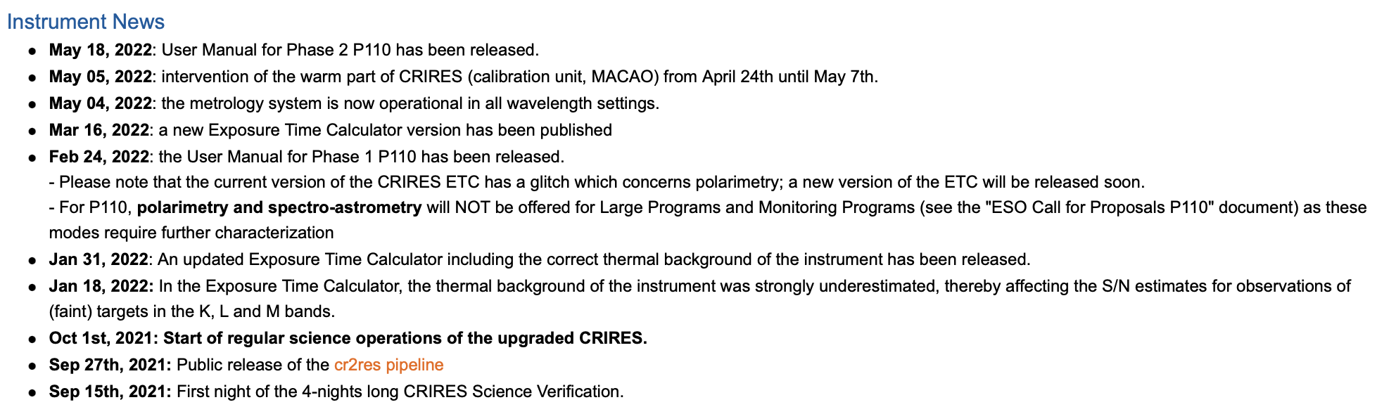
Not all lab notebooks are alike
Lab notebooks to record work done on instrument
Lab notebooks to record acquisition of data
Filtered lab notebook for users – higher up the hierarchy
From the CRIRES+ News (ESO) page
Notes:
The filtered lab notebook is from the instrument CRIRES+. You have a team that has worked on the science verification and interfacing with public (user manual, tools), a team that works on data analysis pipelines (pipeline changes), a team that works on the hardware. We can imagine that each team maintained a true lab notebook for their work. These were then filtered and merged for the consumption by public.
The filtering should not be too strong as one cannot know what details are necessary for all the public scientists to do their work.

Slide 17
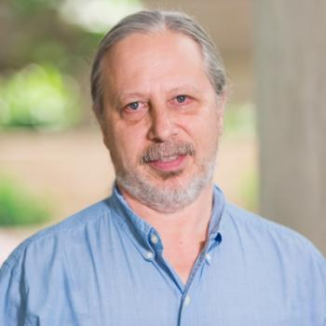
Conversations with Carlo
Carlo Graziani is a Computational Scientist at ANL and author of the BSSW blog article HPC and the Lab Manager
My take away from the article and conversations
As junior researchers progress,
the problems become more complex and larger,
previous informal techniques for executing a study start to fail,
the researchers sense that something is missing, and
they invent processes and tools to compensate.
This happened to Carlo and at some point he realized that
“I had re-invented the lab notebook!”
Notes:
Ask if any of the attendees ever sensed in their gut that things were not being done sufficiently cleanly or well. Does this notion of inventing techniques resonate with them? Have you reinvented the wheel?
Is this surprising to anyone? Does anyone already use something akin to a lab notebook?

Slide 18
Tried and True
Nothing will ever beat good ol’ paper and pencil.
Anyone can use paper and pencil in any situation
It can be quicker to scribble down notes than to use a digital tool
Concentrate on the work that I am performing rather than on tooling
Sometimes it’s good if notetaking slows down progress
Open format can allow for creativity and easier annotation
The notebook is stored publicly next to where it is used
Notes:
Let’s me concentrate on the work

Slide 19
No really. I’m not joking…
“Since at least the 1990s, articles on technology have predicted the imminent, widespread adoption of electronic laboratory notebooks (ELNs) by researchers. It has yet to happen — but more and more scientists are taking the plunge.”
- Roberta Kwok, “How to pick an electronic laboratory notebook”, Nature, 2017.
Some must be purchased to access features and lift resource limits
Some include templates and collaboration tools
Tied to technology that could fail
Overwhelming variety of possible solutions with different pros and cons
Uncertainty about future of tool, increased costs, inability to export
Does funding restrict where and how digital notes can be stored?
Notes:
I have tried playing around with multiple different non-ELN tools to adapt them to my needs. To date, Microsoft OneNote was the closest to what I expect and need, but still fell short.
I, and I have seen others, end up jumping around, which might work if done well, but could make life harder.

Slide 20
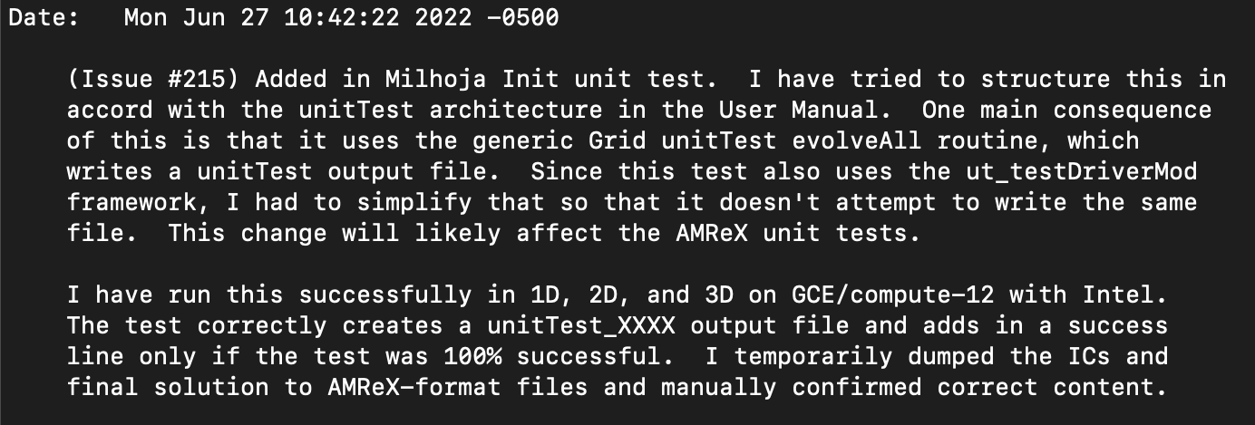
What would a lab notebook look like for us?
We work anywhere and sometimes in distributed way. Paper won’t work.
Should notebooks be public and how to do that?
How many different types of notebooks do we need?
Do we use a single ELN or distribute notes across a suite of tools?
How can we use automation appropriately to overcome difficulties and increase productivity?
Details not obvious from commit diff:
Motivation, reasoning, consequences
Testing notes
Notes:
If we scatter notes across multiple tools, how do we and should we be able to combine them into something that looks like an actual lab notebook?
I would imagine that many developers would say that this commit message is not great.
The git commit message is not just about recording changes. I want it to encapsulate the state of my brain a bit so that I can reload it into my brain if I need to study or revisit the commit. If I’m hunting for a bug, I want to know how I tested code to understand how a bug was undetected. These messages can also help me design a set of manual testing in the future. Therefore, this is as much of a communication to other developers as it is a communication to myself.
Rereading my commit messages as a first part of a code review helps me load the chronology and the big picture.

Slide 21
Citations
TODO: Add in all citations

