Slide 1

Refactoring Scientific Software
Anshu Dubey Argonne National Laboratory
Better Scientific Software Tutorial, ISS, March 2021
See slide 2 for license details

Slide 2
License, Citation and Acknowledgements
License and Citation
This work is licensed under a Creative Commons Attribution 4.0 International License (CC BY 4.0).
The requested citation the overall tutorial is: David E. Bernholdt, Anshu Dubey, Rinku K. Gupta, and David M. Rogers, Better Scientific Software tutorial, in Improving Scientific Software conference, online, 2021. DOI: 10.6084/m9.figshare.14256257
Individual modules may be cited as Speaker, Module Title, in Better Scientific Software tutorial…
Acknowledgements
Additional contributors include: Mike Heroux, Alicia Klinvex, Mark Miller, Jared O’Neal, Katherine Riley, David Rogers, Deborah Stevens, James Willenbring
This work was supported by the U.S. Department of Energy Office of Science, Office of Advanced Scientific Computing Research (ASCR), and by the Exascale Computing Project (17-SC-20-SC), a collaborative effort of the U.S. Department of Energy Office of Science and the National Nuclear Security Administration.
This work was performed in part at the Argonne National Laboratory, which is managed by UChicago Argonne, LLC for the U.S. Department of Energy under Contract No. DE-AC02-06CH11357.
This work was performed in part at the Oak Ridge National Laboratory, which is managed by UT-Battelle, LLC for the U.S. Department of Energy under Contract No. DE-AC05-00OR22725.
This work was performed in part at the Lawrence Livermore National Laboratory, which is managed by Lawrence Livermore National Security, LLC for the U.S. Department of Energy under Contract No. DE-AC52-07NA27344.
This work was performed in part at the Los Alamos National Laboratory, which is managed by Triad National Security, LLC for the U.S. Department of Energy under Contract No.89233218CNA000001
This work was performed in part at Sandia National Laboratories. Sandia National Laboratories is a multi-mission laboratory managed and operated by National Technology and Engineering Solutions of Sandia, LLC., a wholly owned subsidiary of Honeywell International, Inc., for the U.S. Department of Energy’s National Nuclear Security Administration under contract DE-NA0003525.

Slide 3
What is Refactoring
Definition: Refactoring is a disciplined technique for restructuring an existing body of code, altering its internal structure without changing its external behavior.
Different from development
You have a working code
You know and understand the behavior
You have a baseline that you can use for comparison

Slide 4
What is Refactoring
General motivations
Modularity enhancement
Improve sustainability
Release to outside users
Easier to use and understand
Port to new platforms
Performance portability
Expand capabilities
Structural flexibility
Definition: Refactoring is a disciplined technique for restructuring an existing body of code, altering its internal structure without changing its external behavior.
Different from development
You have a working code
You know and understand the behavior
You have a baseline that you can use for comparison

Slide 5
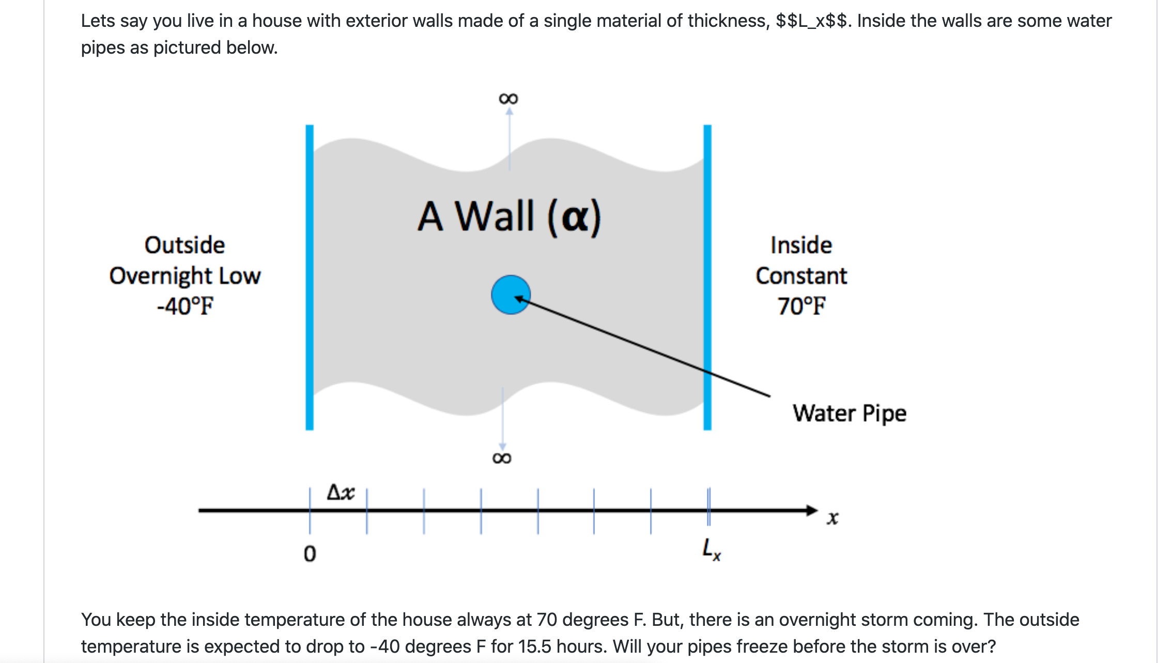
Look at the Running Example
In the repository there are two versions
One is a single file with monolithic code
The other is modularized reusable maintainable code
If we had only the first version, we would be refactoring to get to the second

Slide 6
Considerations for Refactoring
Know why you are refactoring
Is it necessary
Where should the code be after refactoring
In heat example version 1
It is necessary because
It is a monolithic code
No reusability of any part of the code
Devising tests is hard
Limited extensibility
Where do we want to be after refactoring
Closer to the second version
More modular, maintainable and extensible

Slide 7
Considerations for Refactoring
To convert the monolithic code
Separate out utilities, generalize interfaces
Put global definitions in a header file
Create a general build function
No new code or intrusive changes
Know the scope of refactoring
How deep a change
How much code will be affected
In heat example
No capability extension
No performance consideration
Cleaner, more maintainable code

Slide 8
Before Starting
Know your cost estimates
Verification
Check for coverage provided by existing tests
Develop new tests where there are gaps
Make sure tests exist at different granularities
There should be demanding integration and system level tests

Slide 9
Before Starting
Know your cost estimates
Verification
Check for coverage provided by existing tests
Develop new tests where there are gaps
Make sure tests exist at different granularities
There should be demanding integration and system level tests
Know your bounds
on acceptable behavior change
error bounds
bitwise reproduction of results unlikely after transition
Map from here to there
Incorporate testing overheads into refactoring cost estimates

Slide 10
Exercise: Refactoring the Running Example
Convert heatAll.C to the cleaner version with reusable code.
Think about how you want your final product to be and then go through the exercise of refactoring
Here as an example exercise, I am taking the clean solution and generalizing the update_solution interface
Motivation: Do not want to change heat.C for adding another method
For this exercise we will use “ftcs” and “upwind15” as alternative options

Slide 11
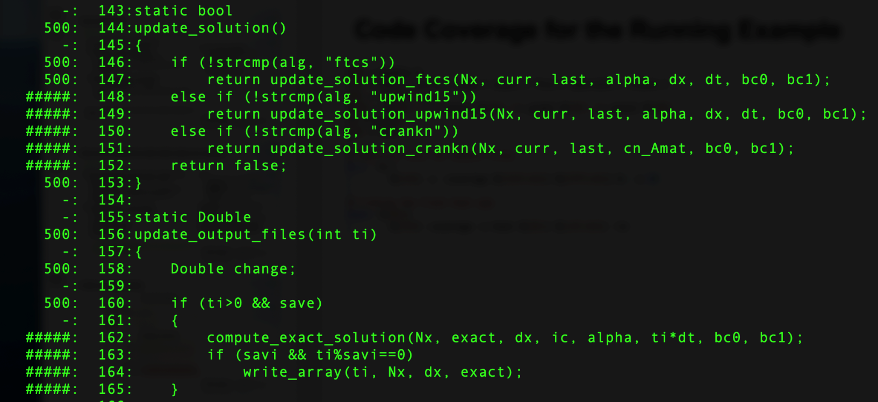
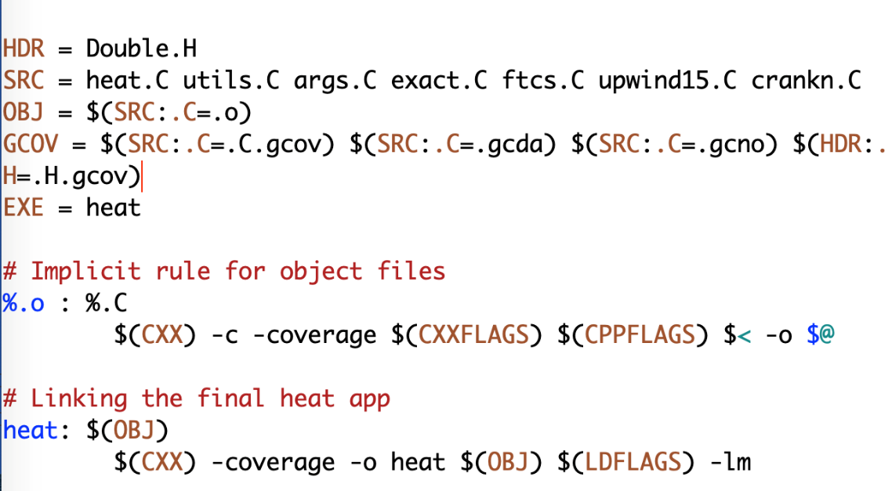
Preparing for Refactoring – check coverage
Run ./heat runame=“ftcs_results”
Run gcov heat.C
Examine heat.C.gcov
A dash indicates non-executable line
A number indicated the times the line was called
##### indicates line wasn’t exercised

Slide 12
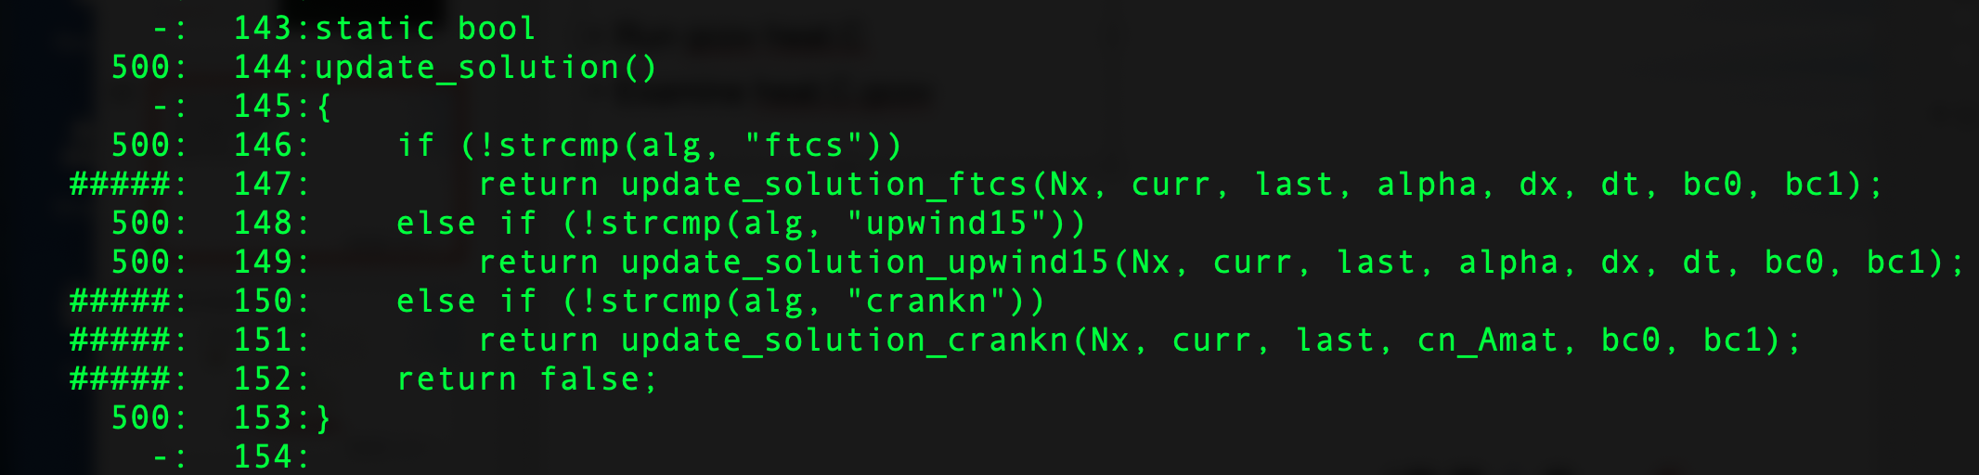
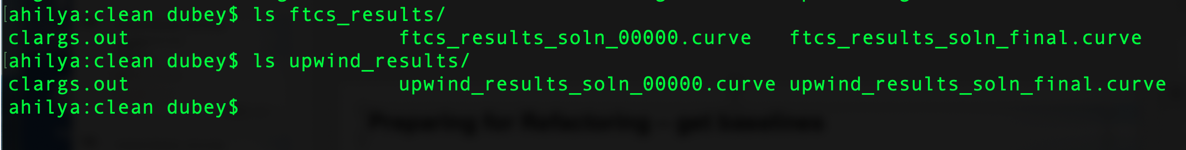
Preparing for Refactoring – get baselines
Call to upwind15 not exercised
Run ./heat alg=“upwind15” runame=“upwind_results
We have baselines for ftcs and upwind

Slide 13
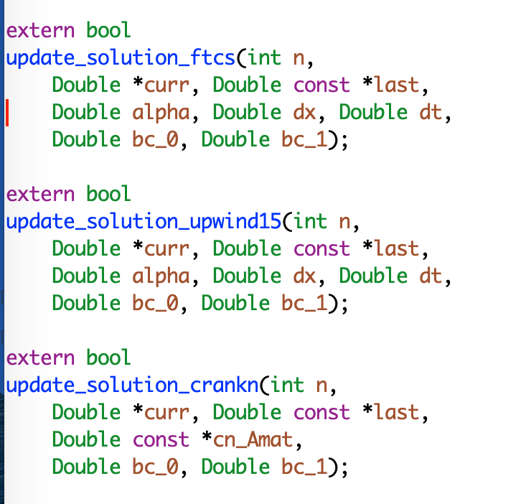
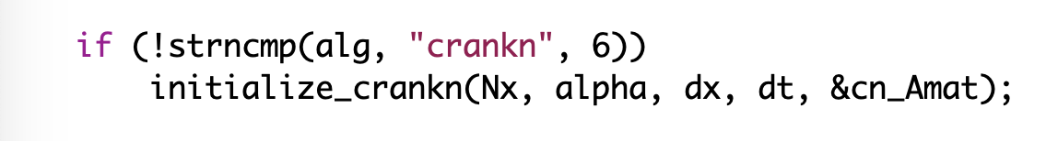
Refactoring – The starting code
Interfaces are not identical
crankn has an extra argument
It also has an extra step in initialization

Slide 14
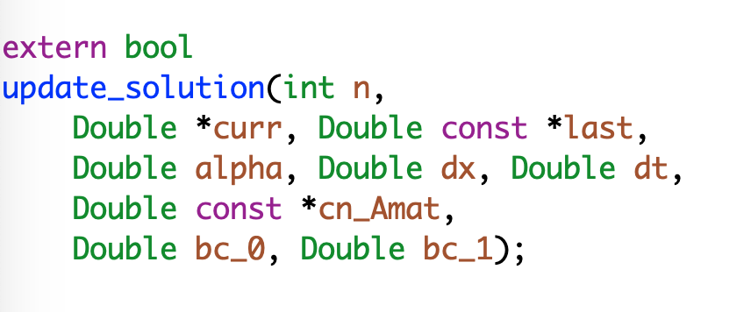
Refactoring
Generalize the interface
Modify the makefile

Slide 15
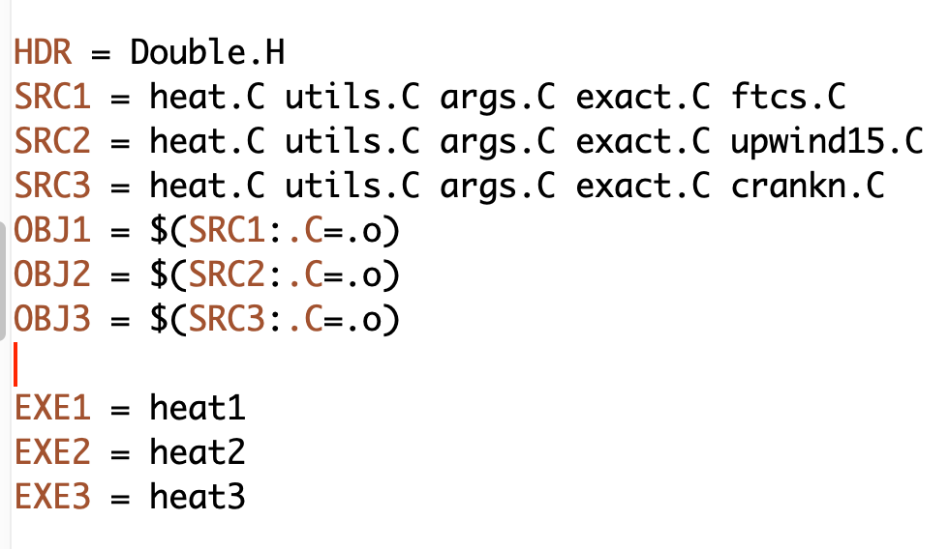
Refactoring
Generalize the interface
Modify the makefile

Slide 16
Refactoring
Generalize the interface
Modify the makefile
Add null implementations of initialize_crank in ftcs and upwind15

Slide 17
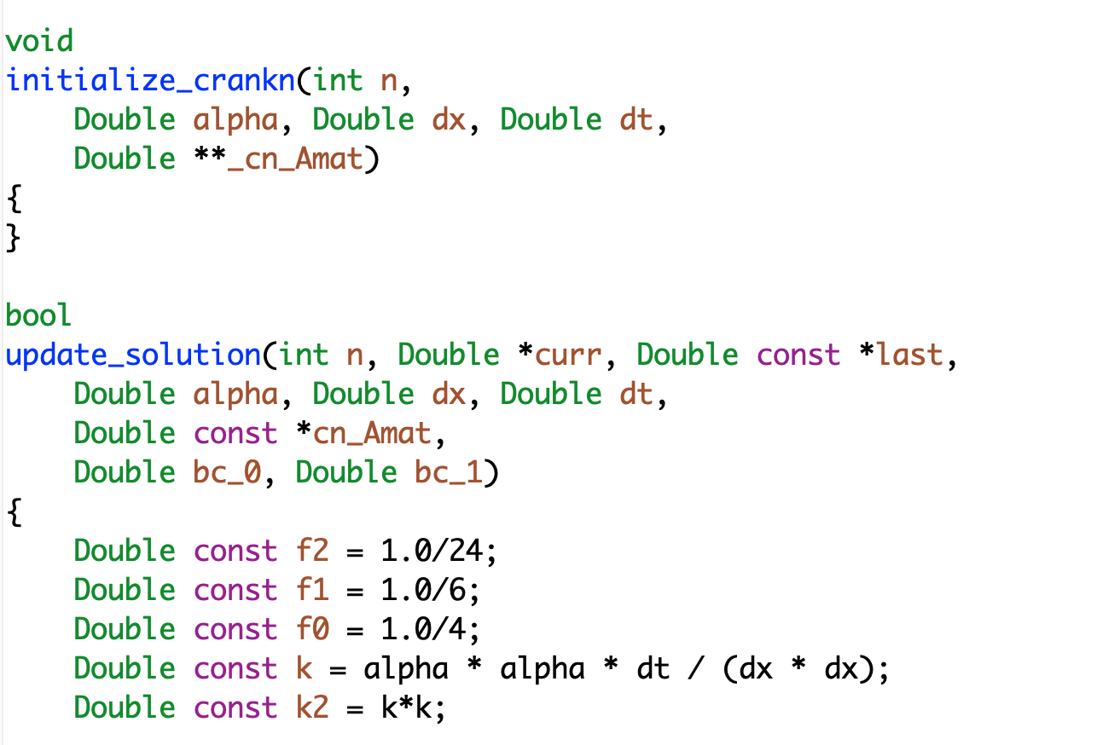
Refactoring
make heat1
Run ./heat runame=“ftcs_results”
Make heat2
Run ./heat runame=“upwind_results”
Verify against baseline

Slide 18
A Real World Example: FLASH
Refactoring for Next Generation Hardware
AMReX - Lawrence Berkeley National Lab
Designed for exascale
Node-level heterogeneity
Smart iterators hide parallelization
Goal: Replace Paramesh with AMReX
Plan: Getting there from here
On ramping
Design
Intermediate steps
Realizing the goal
Notes:
Can point out that this graphic show the need to update the tree - two AMR implementations required a new AMR subfolder.

Slide 19
Considerations
In FLASH
Initial estimate at 6-12 months
Took close to 12 months
Cost estimation
Expected developer time
Extent of disruption in production schedules
Get a buy-in from the stakeholders
That includes the users
For both development time and disruption

Slide 20
Steps in the Process

Slide 21
Steps in the Process

Slide 22
Steps in the Process

Slide 23
Steps in the Process

Slide 24
To have good outcome from refactoring
Know why
Know how much
Know the cost
Plan
Have strong testing and verification
Get buy-in from stakeholders

Slide 25
Agenda
Time (MDT) | Module | Topic | Speaker
1:00pm-1:05pm | 00 | Introduction | David E. Bernholdt, ORNL
1:05pm-1:15pm | 01 | Motivation and Overview of Best Practices in HPC Software Development | David E. Bernholdt, ORNL
1:15pm-1:45pm | 02 | Agile Methodologies | Rinku K. Gupta, ANL
1:45pm-2:00pm | 03 | Git Workflows | Rinku K. Gupta, ANL
2:00pm-2:20pm | 04 | Software Testing 1 | David M. Rogers, ORNL
2:20pm-2:40pm |  | Break (optional Q&A) | All
2:40pm-3:00pm | 05 | Software Design | Anshu Dubey, ANL
3:00pm-3:15pm | 06 | Software Testing 2 | David M. Rogers
3:15pm-3:40pm | 07 | Refactoring | Anshu Dubey, ANL
3:40pm-3:55pm | 08 | Reproducibility | David E. Bernholdt, ORNL
3:55pm-4:00pm | 09 | Summary | David E. Bernholdt, ORNL

