Slide 1
Managing Computational Experiments
Jared O’Neal (he/him) & Anshu Dubey (she/her)
Argonne National Laboratory
Software Productivity and Sustainability track @ Argonne Training Program on Extreme-Scale Computing summer school
Contributors: Jared O’Neal (ANL), Anshu Dubey (ANL)

Slide 2
License, Citation and Acknowledgements
License and Citation
This work is licensed under a Creative Commons Attribution 4.0 International License (CC BY 4.0).
The requested citation the overall tutorial is: David E. Bernholdt, Anshu Dubey, Todd Gamblin, Jared O’Neal, and Boyana R. Norris, Software Productivity and Sustainability track, in Argonne Training Program on Extreme-Scale Computing, St. Charles, Illinois, 2022. DOI: 10.6084/m9.figshare.20416215.
Individual modules may be cited as Speaker, Module Title, in Better Scientific Software tutorial, ISC, 2022 …
Acknowledgements
This work was supported by the U.S. Department of Energy Office of Science, Office of Advanced Scientific Computing Research (ASCR), and by the Exascale Computing Project (17-SC-20-SC), a collaborative effort of the U.S. Department of Energy Office of Science and the National Nuclear Security Administration.
This work was performed in part at the Argonne National Laboratory, which is managed by UChicago Argonne, LLC for the U.S. Department of Energy under Contract No. DE-AC02-06CH11357.
This work was performed in part at the Lawrence Livermore National Laboratory, which is managed by Lawrence Livermore National Security, LLC for the U.S. Department of Energy under Contract No. DE-AC52-07NA27344.
This work was performed in part at the Los Alamos National Laboratory, which is managed by Triad National Security, LLC for the U.S. Department of Energy under Contract No.89233218CNA000001
This work was performed in part at the Oak Ridge National Laboratory, which is managed by UT-Battelle, LLC for the U.S. Department of Energy under Contract No. DE-AC05-00OR22725.
This work was performed in part at Sandia National Laboratories. Sandia National Laboratories is a multi-mission laboratory managed and operated by National Technology and Engineering Solutions of Sandia, LLC., a wholly owned subsidiary of Honeywell International, Inc., for the U.S. Department of Energy’s National Nuclear Security Administration under contract DE-NA0003525.
This work was performed in part at University of Oregon through a subcontract with Argonne National Laboratory.

Slide 3
My high-level experience
I try to adapt tips, tools, & techniques to computational science world
Doing computational science work is hard
What is supposed to make the work easier can often make it harder
I miss simple, physical laboratories
Work in one space and on the same machines with all tools at hand
Evolution of machines and tools is slow
Your collaborators are usually co-located, ready to share, and ready to talk
Paper lab notebooks are “good enough”
I experienced something like an apprenticeship
Notes:
Co-location of people from same discipline => easy knowledge generation & communication => less need for documentation. At the observatory we had a team A and a team B and much work was multidisciplinary. Therefore, need for documentation was greater. Distributed & multidisciplinary nature of CSME demands more documentation.
Examples are difficulties of lab notebooks and documentation. We have many tools to help us, but difficulties can grow when N tools scaled out. Extra layers of automation can add more effort and decrease maintainability.
One thing that is easier in CSME is version control – time travel and reversibility!

Slide 4
We never discussed the W in DIKUW! The accumulated wisdom of a community
In life and in labs we learn and repeat short phrases
General
The devil’s in the details
If it’s worth doing, it’s worth doing well
Perfect is the enemy of good
It’s better to be correct, than fast
Hardware
Know your tools
Use the right tool for the job
Measure twice, cut once
Clean your workspace
Software
Code is meant to be written once and read many times
Premature optimization is the root of all evil – Donald Knuth
Beware of code smells
Refactor or reassess design
Notes:
Code is usually not written once. But, we understand that the point is that a programmer should not write the code for them, but rather for their future self and for the larger community.
Ask if people have heard these SW wisdoms? Are they aware of others?
In the spirit of searching for commonalities rather than differences, I have tried to adapt the experimental wisdoms to the computational world. In other words, try to squeeze as much utility as we can from the accumulated wisdom of a different community. It might be that only someone with my diverse experience is capable of doing this initially, but if people engage in meaningful conversations with other and with an open mind, they might be able to.
It’s easy to find differences
It’s harder to determine if those differences are important
It’s harder still to adapt commonalities to a different field
Does this explain why people search out differences rather that commonalities?

Slide 5
Know your tools / Right tool for the job
Experimental World
What is the tool’s intended use?
How does the tool work?
Will this damage the tool?
Will this damage the work piece?
Will I get a better result if I use a different tool?
Will a different tool be more efficient?
Computational World
If a function has 10 optional variables, you should know what each does and set each one.
If you design a library, make sure that users can learn how to use your tool.
Is it OK to use high-level productivity tools blindly?
Notes:
I have heard of cases where documentation refer to an article to help explain role of ”optional” arguments, but that article doesn’t help.
If designing a library, shoot for making interface as mature as possible as quickly as possible so that users don’t have to keep updating their knowledge of how to use the tool or worse aren’t aware that they need to relearn how to use the tool.
Mention Spack/containers last as this leads into next slide. Should you only be able to use a container or Spack once you have understood all pitfalls associated with setting up a SW environment? Should you only be able to use a container built and maintained by another person after you have learned to build and maintain a container yourself? This is analogous to the idea of an apprenticeship. When someone wants to work with metal, they might be given a chunk of metal and metal file. Their job is to work until they turn it into a cube with just the file. After that, they can use more sophisticated tools.
Would such an experience help you learn about pitfalls as well as what tools to use to sanity check an env/container?

Slide 6
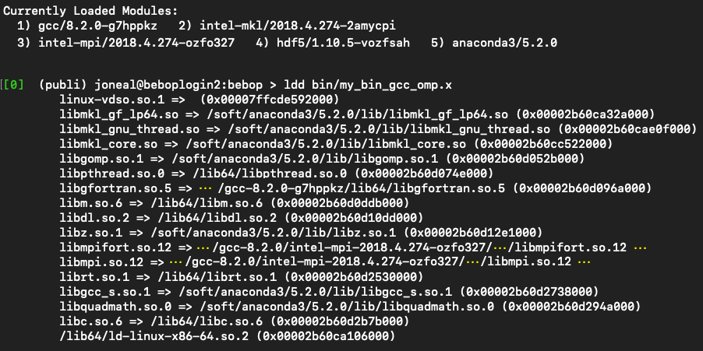
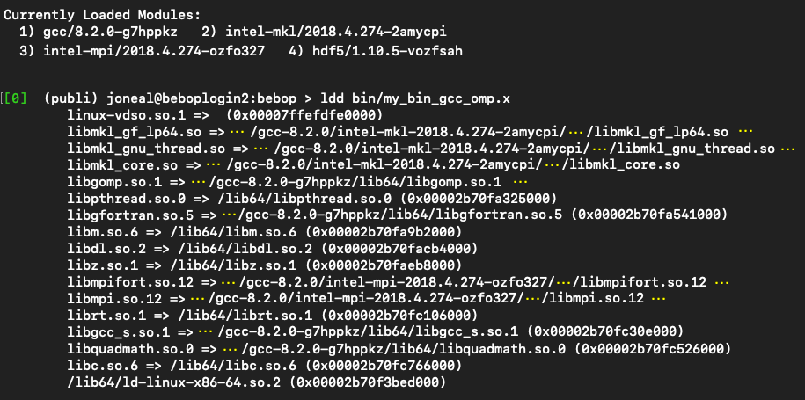
Know your tools: Example
Explicit software stack construction – don’t get it right by accident or coincidence
ldd prints external dependencies
Include ldd output in build & job logs
Python needed by build system only
SW Environment at Build
SW Environment at Execution
!
!
!
Yellow ellipses in library paths indicate snipped content
Notes:
Imagine the situation that we need basic python to build our binary. Rather than use a system python or load minimal python, we load anaconda and leave it loaded for the entire build. However, when we use the binary, we don’t need python and therefore don’t load anaconda. Does the SW environment change?
I have seen a similar situation with Matlab.
I have also seen that I did not anticipate an external dependency. Ldd showed that the dependency could be located. Rather than accept this, I explicitly loaded a module and satisfy the dependency with that one.
Including module list and ldd output in log files is part of automating the creation of some lab notes!
As a result of this, I try to use just bare python when possible and only load it when needed (e.g., unload at compile/link time if not needed).

Slide 7
Measure twice, cut once
Experimental World
Some actions are not reversible
Slow down!
Think before you act
Don’t waste materials
Don’t waste time & effort
Computational World
Do appropriate level of planning
Don’t waste energy
Don’t waste core hours
Don’t produce bad data
Long-term efficiency
Maximize scientific impact
Notes:
Anshu works off of this later. Don’t enter into too much detail here so that she can expand upon it in a more appropriate portion of the talk.
Motivation is using telescopes at night for technical study. People let me know before hand that it costs 50 kEuros/hour to run telescope. Not so subtle hint to make sure that I not only knew that I could use the telescope/instrument to gather data but that I could maximize the use of the telescope and data to get maximal impact. After using the telescopes a few times, I started to figure out what was “appropriate” level of planning. For example, I would do dress rehearsals during day. This should sound like using ALCF or OLCF.
Bronson informed me that using Summit costs ~$90k/hour.

Slide 8
Clean your workspace Last 15 minutes of workday is for cleaning
Experimental World
Leave a safe and clean area
Don’t lose tools or equipment
Prevent damage to tools & equipment by others
Respect your tools & clean them
Leave equipment in obvious state
Computational World
Write good commit messages
Maintain issues, PRs, & docs up-to-date as you work
Don’t leave clones in undocumented intermediate state
Communicate bugs & errors explicitly and obviously
Notes:
When I am switching from one project to the next, I dump the state of my brain in an Issue or PR and make/update a checklist of next steps to be done so that when I come back to the project, I can hit the ground running.

Slide 9
Experimental laboratory environment
In an experimental lab,
have all my tools at hand, clean, and ready for use,
know how to use my tools,
fully characterized and configured instrument,
understand broken or underperforming instrument performance, and
I want to take comprehensive lab notes quickly and easily.
The Goal
Concentrate on acquiring data, analyzing the data, drawing conclusions, designing next steps, and recording the work for reproducibility.
Notes:
Instrument characterized and configured so that I know that I am collecting the correct data and so that I know how to use the data appropriately
Again, easier to do when I am in the same environment every day and it is under my control.
This is where we can talk about observatory environment in which we just want to EXECUTE a study. It is an operational environment. Everything is ready to go and we only concentrate on the task at hand. If you are making big, decisions that require thought, something has gone deeply wrong. From here forward, try to enforce that we are creating an operational environment for executing science.
Use Carlo’s quote “in-flight airplane repair.”
Also, if something is broken or underperforming, we need to communicate this to others explicitly and clearly.

Slide 10
Computational laboratory environments
Use many simple, minimal lab environments
Tailor formality, complexity, and automation to each use case
Store context & metadata next to data
Each code repository has dedicated test environment
One environment per scientific study
Each developer can have dedicated development environment (optional)
Environments are encapsulated
Dedicated documentation
Dedicated software environments
Can be updated and managed independently
Notes:
Let’s say that I want to execute a study on the same system on which I have built up testing. Can the study just use the external dependencies built up for testing? Bad idea if the people who manage the tests aren’t involved in the study. They might update the libraries without my knowledge in the middle of my study. More work, but cleaner with obvious ownership and less communication/coordination needed.
As an example, we want the test environment to be well-structured and setup, with good documentation, clearly defined processes for managing the environment. This cannot fail and its management is part of scientific rigor.
A similar statement can be made for studies, but these can be simpler because each study will eventually end and therefore doesn’t need to be used continuously and be maintained.
Development environment is potentially the least demanding and can be setup in accord with a particular person’s work style and expertise.

Slide 11
A system of repositories
Each environment is encapsulated in an individual repository
Some complexity transferred to interconnecting repositories
Systems of repos exist & seem to be increasingly common
Oval size indicates
environment size/complexity
Notes:
I see this more and more as projects grow and tasks grow more complex.
We are working on complex problems. We cannot make complexity disappear, but we can try to transfer to areas where we are capable of managing the complexity well and with confidence. If people believe that they have made the complexity disappear, then more likely than not, they do not appreciate that they have moved the complexity elsewhere. An example to work up here is Spack. We can move the complexity of constructing and managing SW stacks out to modules and spack. Here we have transferred the complexity to a team of experts that we trust (i.e., the spack development team as well as platform management team that installs modules for us). In this sense, the complexity still exists, but at the larger scope of the HPC community rather than at the level of a research team.

Slide 12
Constructing computational lab environment Start from the bottom
File storage, protection, maintenance, & sharing
Try to avoid deep folder structures & long names
Construct software environments
File management tools
Compilation & libraries (e.g., Spack env)
Data analysis tools (e.g., python virtual env)
Platform-specific build systems
Platform-specific job scripts
Testing, verification, & validation
Analysis tools
Documentation infrastructure, & workflow
Article infrastructure
Build, test, & officially verify.
Don’t alter or update afterward.
Notes:
When mentioning that we do this upfront effort to avoid ”inflight airplane repair”, EMPHASIZE that you’ll never be perfect. That will likely happen every now and then. You just hope that it happens less frequently and is less catastrophic. Also, that it’s likely a bad idea to over design your environment to absolutely avoid this. This is necessary to mesh better with what Anshu said on slide 19.
SW env should prefer platform-specific, expert—built modules, then Spack, then hand-built dependencies.
Motivate folder structure naming convention in terms of observatory. Good tools allow for simple and cleaner file management.
Is the bottom-up approach a variant of data-driven design? My prime goal is to save all data
Is this also a case of slowing me down helps me identify unappreciated difficulties and subtlties?

Slide 13
Documentation
We don’t want a single 10,000 line README
Lab notebook for changes to sci instrument
Changes in code repo necessary for study
Changes to SW environments
Changes to build/job files and build systems
Lab notebook for data analysis tools
Lab notebook to detail how experiment was designed and executed
Right tool for the job
Need flexibility to structure data and documentation in repo

Slide 14
Documentation: READMEs
High-level road maps with motivation, documented decisions, and conclusions
Concise living docs that function as executive summaries
READMEs distributed through folder structure
Each sub-experiment has its own README?

Slide 15
Documentation: Version control tools
Locate lab notes associated with code “next” to the instrument
Commit messages
Issues to capture design discussions & requirements?
Pull requests to document code review, verification/validation, etc.?

Slide 16
Documentation: Data context & metadata
Automate as much as possible
Build dates, user, system name, git hashes, configuration data in file headers
Self-documenting files
A lot of this comes from build & job logs
Software environment info
git diffs
Environment variables

Slide 17
Documentation: Jupyter notebooks
Jupyter notebook can put context & metadata next to data
High-level design & motivation up top
Low-level lab notes for acquiring data
Load & use data
Generate visualizations in place
Comment on results
Figuring how to structure work into notebooks helps structure lab env
Where do notebooks fit into the documentation hierarchy?

Slide 18
Is this working?
Work in progress (and always will be)
Used for different types of studies across different projects
I’m not the only one
2018 BSSW Fellow Ivo Jimenez
Popper tool for implementing scientific exploration pipelines that yield reproducible results
Aaron Lentner – George Washington University
FlashKit a high-level interface for helping users structure and manage research with Flash-X
For your exploration: Computational Lab Environment Example
Notes:
While these creators might not call their tools lab environments, I see them as analogous or trying to manage the same issues – create an environment/tool layer/workflow dedicated to EXECUTING work

Slide 19
So far we have talked about setting up the infrastructure that is needed to collect and analyze results.
We still haven’t talked about how to plan running the study/experiments
This section talks about preparing for a successful simulation campaign

Slide 20
So far we have talked about setting up the infrastructure that is needed to collect and analyze results.
We still haven’t talked about how to plan running the study/experiments
This section talks about preparing for a successful simulation campaign
Running simulations at large scales for science discovery is more of a craft and less of science. More than any other aspect of computational science it relies on experience and acquired wisdom that helps one develop a nose for fruitful possibilities.

Slide 21
Why do you need to plan?
Machines are expensive and rare resources
Operating them is also very expensive
If you made a mistake in your input parameters and got garbage results on a large scale run, you just wasted hundreds of thousands of dollars
Many people are competing for these resources
Your wasted run is likely to be either your or someone else’s opportunity lost
You are likely charting new scientific territory
Some aspect of using your code may not have been important before, but may become critical in the new study
Some solver may run up against the limits of its validity
Inflight correction may be needed to parameters to continue with the study

Slide 22
Why do you need to plan?
Machines are expensive and rare resources
Operating them is also very expensive
If you made a mistake in your input parameters and got garbage results on a large scale run, you just wasted hundreds of thousands of dollars
Many people are competing for these resources
Your wasted run is likely to be either your or someone else’s opportunity lost
You are likely charting new scientific territory
Some aspect of using your code may not have been important before, but may become critical in the new study
Some solver may run up against the limits of its validity
Inflight correction may be needed to parameters to continue with the study
Aim for no surprises, but be prepared for them

Slide 23
Why do you need to plan?
Machines are expensive and rare resources
Operating them is also very expensive
If you made a mistake in your input parameters and got garbage results on a large scale run, you just wasted hundreds of thousands of dollars
Many people are competing for these resources
Your wasted run is likely to be either your or someone else’s opportunity lost
You are likely charting new scientific territory
Some aspect of using your code may not have been important before, but may become critical in the new study
Some solver may run up against the limits of its validity
Inflight correction may be needed to parameters to continue with the study
Aim for no surprises, but be prepared for them
In the 2005 simulation mentioned earlier, out of 5 teams, ours was the only team that had success in getting a good science outcome

Slide 24
How do you plan
Focused verification of the target simulation on the target platform
Over and above regular testing
Emphasis on understanding solver validity regime
Pathfinder runs to get a good estimate of needed resources
Cost benefit analysis of fidelity vs reaching science goals in allocated resources

Slide 25
How do you plan
Develop helpful diagnostics
Low overhead ways of confirming the health of the run
Are conserved quantities conserved?
Has any quantity become unphysical?
Develop hierarchy of analysis
Full analysis of runs is not feasible in flight
Intermediate level analysis can give further insight into health of the simulation
Notes:
Comment about making sure that your diagnostics actually flag errors.

Slide 26
Story of one simulation campaign
Theory of Type Ia supernova explosion – 2006/2007
Evidence from observations:
Light curve powered by Ni56 decay
Evidence of medium weight elements, but in much smaller quantities
Implied transition from deflagration to detonation
A 2D exploratory run had given a tantalizing answer to how?
To confirm a full 3D run was needed at good enough resolution
It would be the largest run of its kind at the time – totally uncharted territory
Until then 3D runs had been octants relying on symmetry
The 2D run had shown that symmetry had to be avoided

Slide 27
Preparation Steps
Step 1 – develop a test that represents the most complex physics interactions
Challenges:
Features take a long time to develop
Want to ensure that at least one refinement step occurs during the test
IO too slow to restart from a large checkpoint at late stage of the run
Also test would need a large chunk of the machine
Use physics understanding to create initial conditions that would quickly develop comparable complexity

Slide 28
Preparation Steps
Step 2 – Use the new test to characterize the performance behavior of the target platform
Motivation:
Standard performance studies could not give crucial information
AMR refinement patterns make each application different
Interoperability and trade-off opportunities needed to explored in a closely resembling simulation behavior
Full fidelity 2D runs, and a set of runs of the new test provided enough information to extrapolate and estimate needed CPU hours

Slide 29
Preparation Steps
Step 3 – Look for trade-offs and optimization opportunities
Motivation:
Initial CPU estimates too high to complete the runs within allocations
Exploration of any parameter space needs to minimize individual run times
Many opportunities were found, documented in reference below.
Identify redundant refinement and get rid of it
Coarsen computations for some physics
Move some computations to post-processing
All optimizations were based on scientific and numerical intuitions
Dubey A, Calder AC, Daley C, et al. Pragmatic optimizations for better scientific utilization of large supercomputers. The International Journal of High Performance Computing Applications. 2013;27(3):360-373. doi:10.1177/1094342012464404

Slide 30
Preparation Steps
Step 4 – Prepare diagnostics and quick analysis mechanism
Examples-- diagnostics
Conservation of mass, momentum energy
Changes in dt recorded in the logfiles
Spikes in variable values
Examples – quick analysis
Quick visualization of random 2D slices
Inspection of critical quantities in 1D

Slide 31
Preparation Steps
Step 4 – Prepare diagnostics and quick analysis mechanism
Examples-- diagnostics
Conservation of mass, momentum energy
Changes in dt recorded in the logfiles
Spikes in variable values
Examples – quick analysis
Quick visualization of random 2D slices
Inspection of critical quantities in 1D
Lab notebook artifacts
every run registers all configurations and runtime parameters in a logfile.
logfiles are cumulative
dedicate space for storing all results in a preconfigured directory structure
scripts to move output from scratch to the dedicated space

Slide 32
Outcome
A successful campaign
But not without hitches
Optimization related runs were not given the same level of care
Data was considered disposable
Code changes were documented

Slide 33
Outcome
A successful campaign
But not without hitches
Optimization related runs were not given the same level of care
Data was considered disposable
Code changes were documented
For the paper the referee asked for details from optimizations
We did not have them
Fortunately the referee was satisfied with reasoning and other supporting evidence we produced

Slide 34
Summary and Takeaways
Good science with computation is a craft -- training is needed in how to do it
Machines are expensive to build and expensive to run
They provide opportunity for great work
Care is needed to ensure that the outcome meets expectations
Reproducible results are a necessity, not a luxury
There is no credible science without provenance
https://aip.scitation.org/doi/10.1063/1.476021 "a parameter combination
that induces erroneous results is easily selected"

