Slide 1
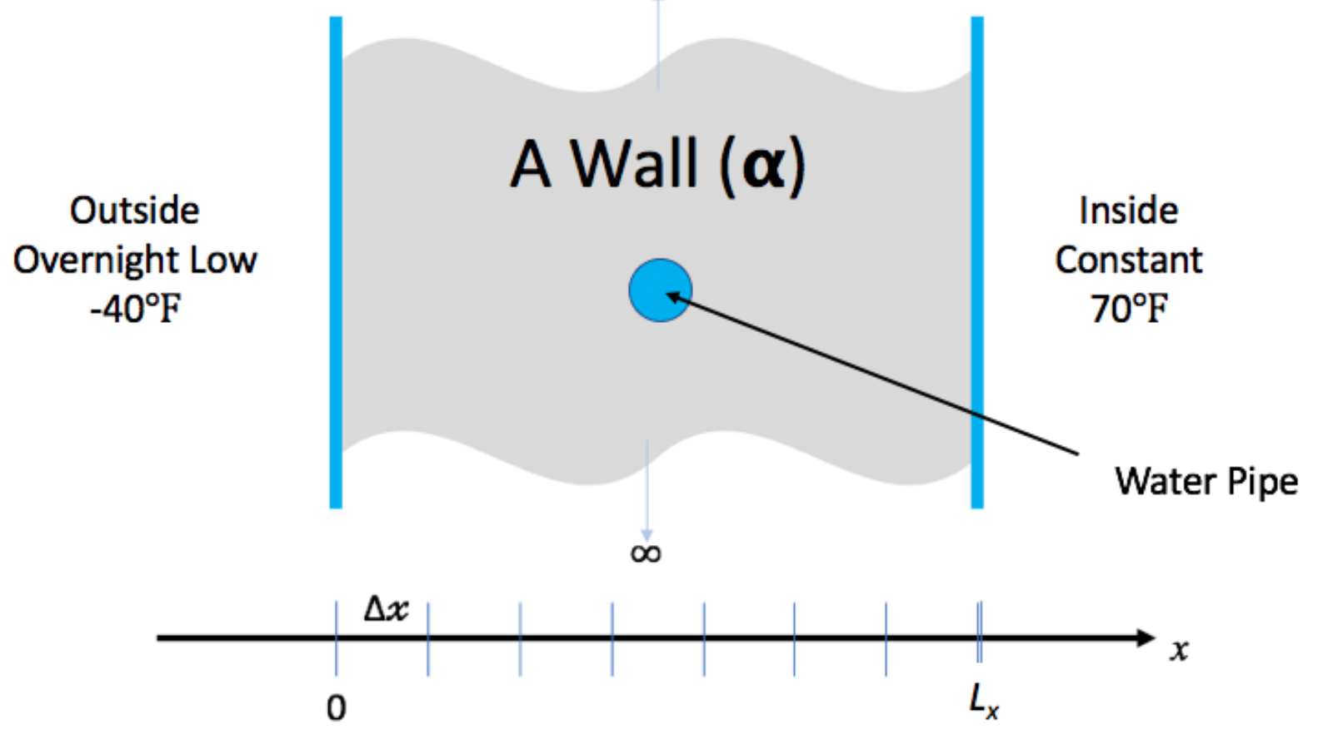
Hands-On Activities
We have created a simple example to give you some (optional) hands-on experience with some of the concepts in this tutorial
You don’t need to understand the math/physics to do the exercises, or find them useful
We have some time in the agenda for the hands-on activities, but feel free to continue to work on them outside of the tutorial. We’ll give feedback on pull requests and issues filed (or email us, see next slide).
Instructions on the tutorial web site: https://bssw-tutorial.github.io/ and click the link for today’s tutorial
Notes:
Variant for hands-on being part of the agenda.

Slide 2
Hands-On Activities
We have created a simple example to give you some (optional) hands-on experience with some of the concepts in this tutorial
You don’t need to understand the math/physics to do the exercises, or find them useful
We do not have time in the agenda for the hands-on activities, but feel free to work on them outside of the tutorial. We’ll give feedback on pull requests and issues filed (or email us, see next slide).
Instructions on the tutorial web site: https://bssw-tutorial.github.io/ and click the link for today’s tutorial
Notes:
Variant for hands-on not being part of the agenda.

Slide 3
Hands-On Activities
We have created a simple example to give you some (optional) hands-on experience with some of the concepts in this tutorial
You don’t need to understand the math/physics to do the exercises, or to find them useful
We have some time in the agenda for the hands-on activities
But feel free to start early (i.e. during breaks) and continue after the tutorial
We’ll give feedback on pull requests and issues filed (or email us, see next slide).
Instructions on the tutorial web site: https://bssw-tutorial.github.io/ and click the link for today’s tutorial

Slide 4
Hands-On Activities
We have created a simple example to give you some (optional) hands-on experience with some of the concepts in this tutorial
You don’t need to understand the math/physics to do the exercises, or to find them useful
We have time this afternoon which we can use for hands-on activities (optional)
You can also work the hands-on activities on your own and email us if you have questions
Instructions on the tutorial web site: https://bssw-tutorial.github.io/ and click the link for today’s tutorial

Slide 5
We Want to Interact with You!
We find these tutorials most interesting and informative (for everyone) if you ask questions and share experiences!
We learn too!
Please use Zoom chat to ask questions at any time
We will hang around in Zoom during breaks and lunch for live Q&A/discussions with anyone interested
Also during the hands-on session
If you work on the hands-on activities, we’ll be glad to provide feedback
Submit a pull request and we’ll take a look
After the tutorial email us at bssw-tutorial@lists.mcs.anl.gov
With questions or feedback
The list moderator will allow your messages to be posted
Refer to bssw-tutorial.github.io page for all tutorial materials

Slide 6
We Want to Interact with You!
We find these tutorials most interesting and informative (for everyone) if you ask questions and share experiences!
We learn too!
Please use Zoom chat to ask questions at any time
We will hang around in Zoom during the break for live Q&A/discussions
We have an optional session this afternoon specifically for more interaction
Can do hands-on activities, Q&A about the presentations, or broader discussion of sw dev.
If you work on the hands-on activities, we’ll be glad to provide feedback
Submit a pull request and we’ll take a look
After the tutorial email us at bssw-tutorial@lists.mcs.anl.gov
With questions or feedback
The list moderator will allow your messages to be posted
Refer to bssw-tutorial.github.io page for all tutorial materials

