Slide 1
Motivation and Overview
Greg Watson (he/him) Oak Ridge National Laboratory
Developing a Testing and Continuous Integration Strategy for your Team tutorial @ Exascale Computing Project Annual Meeting
Contributors: David E. Bernholdt (ORNL), Anshu Dubey (ANL), Patricia A. Grubel (LANL), Rinku K. Gupta (ANL), Katherine M. Riley (ANL), Gregory R. Watson (ORNL)

Slide 2
License, Citation and Acknowledgements
License and Citation
This work is licensed under a Creative Commons Attribution 4.0 International License (CC BY 4.0).
The requested citation the overall tutorial is: Gregory R. Watson and David M. Rogers, Developing a Testing and Continuous Integration Strategy for your Team tutorial, in Exascale Computing Project Annual Meeting, online, 2022. DOI: 10.6084/m9.figshare.19608927
Individual modules may be cited as Speaker, Module Title, in Better Scientific Software tutorial…
Acknowledgements
This work was supported by the U.S. Department of Energy Office of Science, Office of Advanced Scientific Computing Research (ASCR), and by the Exascale Computing Project (17-SC-20-SC), a collaborative effort of the U.S. Department of Energy Office of Science and the National Nuclear Security Administration.
This work was performed in part at the Argonne National Laboratory, which is managed by UChicago Argonne, LLC for the U.S. Department of Energy under Contract No. DE-AC02-06CH11357.
This work was performed in part at the Oak Ridge National Laboratory, which is managed by UT-Battelle, LLC for the U.S. Department of Energy under Contract No. DE-AC05-00OR22725.
This work was performed in part at the Lawrence Livermore National Laboratory, which is managed by Lawrence Livermore National Security, LLC for the U.S. Department of Energy under Contract No. DE-AC52-07NA27344.
This work was performed in part at the Los Alamos National Laboratory, which is managed by Triad National Security, LLC for the U.S. Department of Energy under Contract No.89233218CNA000001
This work was performed in part at Sandia National Laboratories. Sandia National Laboratories is a multi-mission laboratory managed and operated by National Technology and Engineering Solutions of Sandia, LLC., a wholly owned subsidiary of Honeywell International, Inc., for the U.S. Department of Energy’s National Nuclear Security Administration under contract DE-NA0003525.

Slide 3
Science through computing is, at best, as credible as the software that produces it!
Notes:
Fundamental message

Slide 4
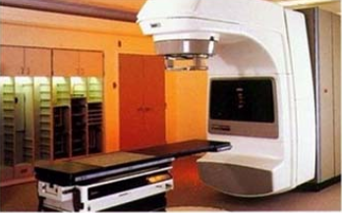
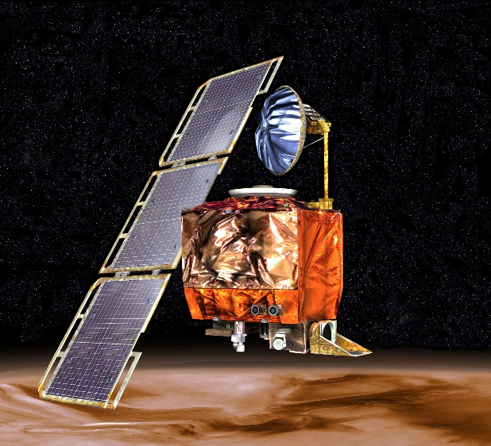
High-Consequence Software-Related Scientific Failures
Therac-25 (1985-1987)
Mars Climate Orbiter (1999)
Computer-controlled radiation therapy system
Poor software design, development and testing practices allowed flaws that let to at least six cases of substantial radiation overdoses, three fatal
Incorrect trajectory adjustment caused loss of the orbiter as it was supposed to enter Martian orbit
Discrepancy in the units used in two different software components
One component didn’t follow specifications
Inadequate testing at the interface
Concerns raised earlier in the mission were ignored because they weren’t properly documented
Just two of many examples

Slide 5
Challenges Developing Scientific Applications Today
Technical
Sociological
All parts of the model and software system can be under research
Requirements change throughout the lifecycle as knowledge grows
Verification complicated by floating point representation
Real world is messy, so is the software
Increasing architectural diversity
Competing priorities and incentives
Sponsors often care more about scientific publications than software per se
Balancing development and maintenance with research
Limited resources
Need for interdisciplinary interactions
Many different kinds of expertise to be successful

Slide 6
Best Practices for Scientific Software Development
Baseline
Desirable
Invest in extensible code design
Use version control and automated testing
Institute a rigorous verification and validation regime
Define and enforce coding and testing standards
Clear and well-defined policies for
Auditing and maintenance
Distribution and contribution
Documentation
Provenance and reproducibility
Lifecycle management
Open development and frequent releases
This tutorial will focus primarily on scientific software as distinct from more generic software engineering best practices

Slide 7

General Categories of Testing
Development tests
Tests run to protect stability while making changes to the code
Can include: unit, functional, integration, system, regression, verification, performance, etc.
Post-installation “smoke” tests
Simple tests to ensure the build/install process has succeeded
Typically take only a few minutes
Could be a subset of development tests
Continuous integration tests
Rapid feedback aimed at preventing changes from breaking key branches of the code
Run quickly, fail fast, catch problems that would impact other developers
Usually associated with automation
Code coverage,
Complexity
acceptance
system
test suite
functional
unit tests

Slide 8
(Some) Challenges of Testing Complex Software Systems
Designing tests
Complex software tends to have an extensive network of interdependencies
For complex scientific software it may be hard to construct a priori tests for some cases
Implementing tests
Introducing testing into legacy code (legacy == untested)
Understanding and progressively improving code coverage
Automating tests
Just get started – easy to get lost in all of the options
You have to have tests to be able to automate them!
What to run where, and when?
Consider what resources are required, and what the tests are used for
Testing is a very large subject. This is what we have time for today

Slide 9

Continual, Incremental Software Process Improvement
Target: your project should include “just enough” software engineering so that you can meet your short-term and longer-term scientific goals effectively
Identify your team’s “pain points” in your software development processes
Help: RateYourProject assessment tool: https://rateyourproject.org/
Set a goal for something to improve
Target processes and behaviors, not just tasks
Pick something that you can address in a few months that will give you a noticeable benefit
Agree on a plan to address it, identify markers of progress and what is “done”
Write them down
Help: Progress tracking card examples: https://bssw-psip.github.io/ptc-catalog/catalog
Work your plan, track your progress
When you are done, celebrate…
…then pick a new pain point to address
Old Process
New Process
Cost
Start
Progress
Finish
The new process costs something to implement, but it pays off over time
Productivity and Sustainability Improvement Planning https://bssw.io/psip
A goal of BSSw.io is to provide resources for improving your software processes. If you find useful resources that aren’t on BSSw.io, consider contributing. Its easy and quick.

Slide 10
Agenda
The agenda is also available on the tutorial web page. Visit https://bssw-tutorial.github.io and click on the link for today’s tutorial
Time (EDT) | Module | Title | Presenter
2:30 PM | 0 | Introduction and Setup | Gregory R. Watson (ORNL)
2:35 PM | 1 | Motivation and Overview | Gregory R. Watson (ORNL)
2:40 PM | 2 | Software Testing Introduction | Gregory R. Watson (ORNL)
3:00 PM | 3 | Testing Complex Software | David M. Rogers (ORNL)
3:25 PM | 4 | Continuous Integration | David M. Rogers (ORNL)
3:55 PM | 5 | Summary | David M. Rogers (ORNL)
4:00 PM |  | Adjourn

