Slide 1
music ML representation
Making Music with Machine Learning
Two symbolic generation tasks on the Nottingham folk corpus
compose -> harmonize -> listen
1034
46
29
2
tunes parsed
melody tokens
chord labels
MIDI deliverables
Thesis: compact sequence models are enough to beat transparent baselines and produce a full folk-tune workflow.
1
Notes:
Hi everyone. This project is about making music with machine learning, but in a deliberately compact and explainable setting. Instead of trying to generate raw audio, We work symbolically, at the note and chord level, using the Nottingham folk corpus.
The project has two tasks. The first is unconditioned melody generation: learn a probability distribution over melodies, written as p(melody), and sample new folk-like tunes from it. The second is conditioned generation: harmonization. Given a melody, predict the chord sequence, written as p(chords | melody).
The reason We paired these two is that they form a full pipeline. Task 1 composes a melody, and Task 2 harmonizes that melody. The whole system trains from scratch on a laptop, uses 1034 parsed tunes, and produces two MIDI deliverables: `symbolic_unconditioned.mid` and `symbolic_conditioned.mid`.

Slide 2
story arc
The assignment is one compose-then-harmonize system
shared pipeline
Raw MIDI
Representation
Task 1
Task 2
Demo
melody track + chord track
16th-step tokens + bar chords
LSTM samples p(melody)
BiLSTM predicts p(chords | melody)
generated melody + chords
The same normalized representation feeds both models, so the output of Task 1 can become the input melody for Task 2.
2
Notes:
Here is the whole assignment as a single system. We start with raw MIDI files from the Nottingham corpus. Each file has a melody track and a chord track. From there, We build a shared representation: melody steps and bar-level chord labels.
That representation supports both tasks. For Task 1, the melody token stream goes into an LSTM language model, which samples a new melody. For Task 2, that generated melody is summarized bar by bar, and a BiLSTM predicts the chord labels.
The key design choice is that both tasks share the same preprocessing and split. So the project is not two unrelated experiments. It is one compose-then-harmonize workflow, and the output of the first model is a valid input to the second model.

Slide 3
data and code path
Representation makes a small corpus usable
Quantize timing to a 16th-note grid: GRID = 4 steps per quarter.
Harmonization feature
bar -> 12-d melody pitch-class histogram -> chord label
Encode melody as one token per step: REST, HOLD, or MIDI pitch onset.
Normalize key with Krumhansl-Schmuckler, transposing to C major / A minor.
This collapses note-level MIDI into a supervised sequence-tagging problem while keeping enough tonal information for chords.
Convert chord track to one per-bar label using pitch-class templates.
97.5%
827/103/104
nbcode.py
notes on C-major scale after key normalization
train / validation / test tune split
melody_to_steps, estimate_key, melody_chords_by_bar
3
Notes:
The representation is the quiet win in this project. The corpus is not huge, so the data needs to be normalized into a form where the model can actually reuse patterns.
There are four preprocessing steps. First, timing is quantized to a 16th-note grid. In the code, `GRID = 4`, meaning four steps per quarter note. This works because the MIDI files are already clean and aligned.
Second, the melody becomes one token per 16th-note step. Each token is either `REST`, `HOLD`, or a MIDI pitch onset. So instead of modeling arbitrary note objects, the model reads a sequence very much like a language model reads words or characters.
Third, we normalize key. The code estimates a key using the Krumhansl-Schmuckler key profiles, then transposes major tunes to C major and minor tunes to A minor. This is important because the same folk phrase in D major and G major should count as the same pattern after transposition.
Fourth, the chord track is turned into one chord label per bar. For harmonization, each bar of melody becomes a 12-dimensional pitch-class histogram, and the target is the chord label for that bar.
After normalization, 97.5 percent of melody notes fall on the C-major scale, which is a good sign that the key normalization is doing what it should.

Slide 4
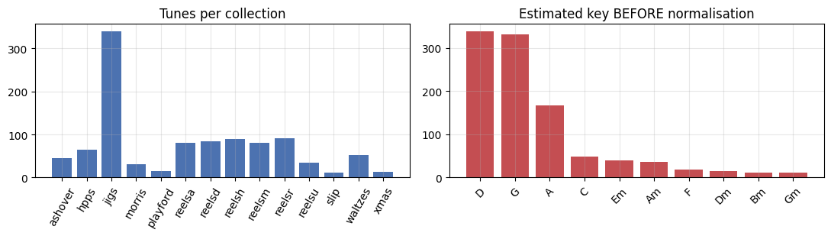
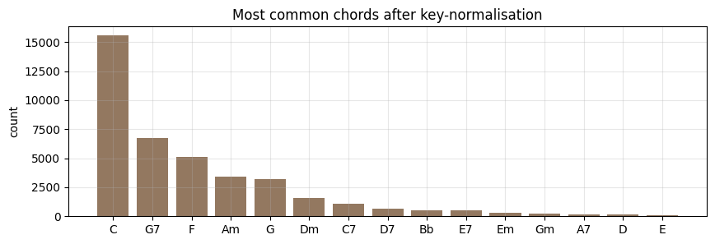
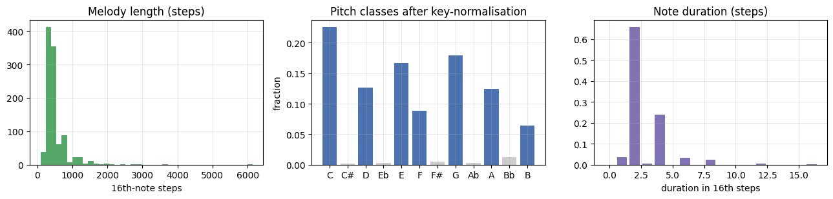
notebook EDA evidence
The corpus is regular, tonal, and friendly to compact models
collections and original key clusters
melody lengths, pitch classes, durations
dominant folk harmony vocabulary
C / G7 / F / Am
8ths + 16ths
small but consistent
top chord labels after normalization
rhythms dominate the dance-tune corpus
regularity lets lightweight models compete
Punchline: the model does not need to learn every possible musical style. It needs to learn a compact, key-relative folk style.
4
Notes:
These are the main exploratory plots from the executed notebook. The first plot shows the tune collections and the estimated keys before normalization. The key distribution clusters around D, G, and A, which makes sense for folk tunes played on instruments like fiddle and flute.
The second group shows melody lengths, pitch classes after normalization, and note durations. The duration plot is especially useful musically: 8th notes and 16th notes dominate, which is exactly the rhythmic vocabulary of dance tunes like jigs and reels.
The third plot shows the most common chords after normalization. C, G7, F, and Am dominate. That is functional tonal harmony: tonic, dominant, subdominant, and relative minor. This matters because it tells us the task is learnable with compact models. We are not asking a small LSTM to discover every style in music. We are asking it to model a consistent, key-normalized folk style.
That regularity is also the reason the baselines are meaningful. A Markov model and a rule-based harmonizer are reasonable simple baselines here. If the learned models win, the comparison is fair.

Slide 5
symbolic unconditioned generation
Task 1 is language modeling over melody steps
p(x_1:T) = product_t p(x_t | x_<t)
Example token stream
BOS REST 74 HOLD 76 77 HOLD ... EOS
Train with per-token negative log-likelihood; report perplexity = exp(NLL).
46
939K
temperature
symbolic_unconditioned.mid
melody vocabulary tokens
LSTM parameters
sampling knob for generation
required output melody
5
Notes:
Task 1 is melody generation as language modeling. The melody is a token sequence, and the model factorizes the probability of the whole tune as a product of next-token probabilities.
So at each step, the model predicts the next token conditioned on the previous tokens. Training minimizes cross-entropy, or negative log-likelihood, and the main intrinsic metric is perplexity. Lower perplexity means the model predicts real held-out folk melodies better.
Generation is then straightforward. Start with a beginning token, sample the next token from the model distribution, feed it back in, and continue until an end token or max length. Temperature controls how conservative or surprising the sample is.
The final melody vocabulary has 46 tokens, including special symbols and pitch onsets. The learned model is a 939K-parameter LSTM, which is small enough to train quickly but expressive enough to carry a phrase-level hidden state.

Slide 6
Task 1 model choice
The learned hidden state is the difference
Markov n-gram baseline
2-layer LSTM language model
Transparent transition counts
Embedding -> LSTM -> token head
Order-n context only
baseline to beat
Hidden state carries phrase context
Tables get sparse as n grows
Captures cadences and repetition
Good baseline, weak phrase memory
Less interpretable, but more musical
Assignment logic: keep the baseline simple and honest, then show that the learned sequence model adds long-range structure.
6
Notes:
The baseline is an order-n Markov model. It is transparent: it counts transitions and uses add-k smoothing and backoff. This is useful because we can understand exactly what it is doing.
But the limitation is built in. It only sees the last n tokens. If we increase n, the context gets more specific, and the count table gets sparse. That means the model can capture local note transitions, but it has a hard time with longer musical structure like phrase shape, cadence, and repetition.
The LSTM has a different kind of memory. It embeds the current token, updates a hidden state, and predicts the next token from that state. It is less interpretable than counts, but it can learn longer-range dependencies without exploding the table size.
So the comparison here is not "neural model versus nothing." It is a learned sequence model versus a clean, reasonable n-gram baseline.

Slide 7
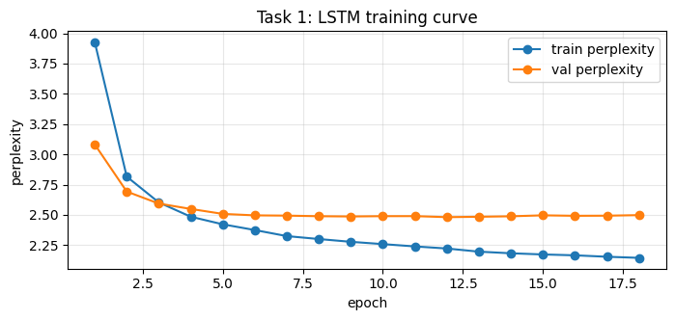
Task 1 quantitative result
LSTM cuts melody perplexity below every Markov order
held-out test perplexity (lower is better)
4.27
3.35
3.18
2.42
validation perplexity settles near 2.5
M1
M2
M3
LSTM
The n-gram improves from order 1 to 3, then plateaus as contexts become sparse. The LSTM keeps a learned state instead of a fixed table, so it predicts real tunes more confidently.
7
Notes:
Here are the Task 1 results. The training curve shows validation perplexity dropping quickly, then settling near the mid-2s. On the right is the held-out test perplexity comparison.
The Markov models improve from order 1 to order 3: 4.27, then 3.35, then 3.18. But the gain starts to plateau as the contexts become sparse. The LSTM reaches 2.42, which is substantially lower.
The interpretation is that the LSTM is not just memorizing local transitions. Its hidden state gives it a better estimate of what should come next in a real folk melody. For this assignment, this is the first main result: the learned model beats the Module-3-style Markov baseline on the intrinsic objective.
But perplexity is not the whole story. A melody model can have low perplexity and still produce boring or strange music, so the next slide checks the generated samples musically.

Slide 8
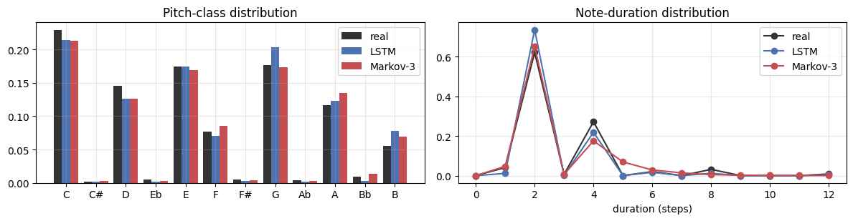
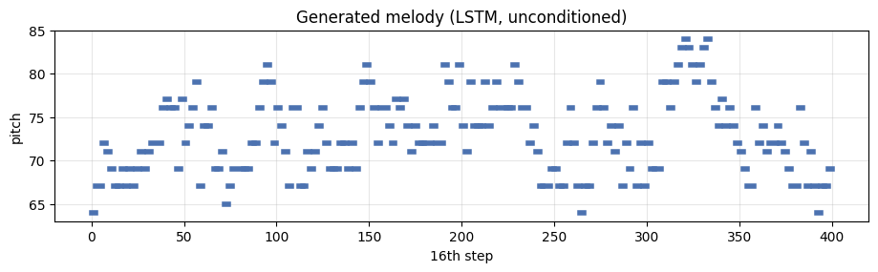
Task 1 musical evaluation
Perplexity agrees with the musical texture checks
metric
real
LSTM
Markov-3
PC cosine
1.000
0.994
0.996
duration cosine
1.000
0.991
0.983
in-key fraction
0.975
0.989
0.969
4-gram diversity
0.020
0.043
0.080
generated pitch-class and duration distributions
184 notes
0.043
sample exported to symbolic_unconditioned.mid
LSTM 4-gram diversity, closer to real repetition
The nuance is repetition: Markov is too random, while the LSTM stays closer to the repetitive structure of real folk tunes.
generated melody piano roll
8
Notes:
For musical evaluation, We compare generated melodies to real held-out tunes using distributional metrics. The plots show pitch-class and note-duration distributions. Both the LSTM and Markov model match the local statistics pretty well. That makes sense: scale membership and common durations are relatively local.
The more interesting metric is 4-gram diversity. Real folk tunes are repetitive: only about 2 percent of their 4-grams are unique. The LSTM sample has 4.3 percent unique 4-grams, while the Markov model has 8 percent.
That means the Markov model is too random. It wanders more and repeats less like the real corpus. The LSTM is not perfect, but it is much closer to the real repetition structure, and it also has the highest in-key fraction at 0.989.
The piano roll is the generated melody that gets exported to `symbolic_unconditioned.mid`. So Task 1 has both a quantitative win and a concrete musical output.

Slide 9
symbolic conditioned generation
Task 2 turns melody into one chord label per bar
melody bar
12-d pitch-class vector
chord label
duration-weighted notes
[0.42, 0, 0.20, ...]
C, G7, F, Am, ...
C D E F G A B
bar-level
chord + root
multiple answers
sequence labeling, not full audio synthesis
evaluation metrics
accuracy under-counts musical acceptability
9
Notes:
Task 2 changes from unconditioned generation to conditioned generation. Now the input is a melody, and the output is a sequence of chord labels.
The framing is sequence labeling. For each bar, We summarize the melody as a 12-dimensional pitch-class histogram. That histogram tells the model how much of the bar is C, C sharp, D, and so on. The target is a chord label like C, G7, F, or Am.
The main metric is bar-level chord accuracy against the original chord track. We also report root accuracy, because predicting the right root with a slightly different chord quality is less wrong than predicting a completely different harmonic function.
There is an important caveat: multiple chords can fit one melody bar. So accuracy is useful, but it under-counts musical acceptability. That is why We also inspect the confusion matrix and listen to the final MIDI.

Slide 10
Task 2 model choice
Harmonization is contextual, not just pitch matching
Majority
Template rule
BiLSTM
Always predict tonic C
Match each bar to a chord pitch-class template
Read bars left-to-right and right-to-left
simple floor
no progression memory
learns cadential context
A passing melody note can make the local pitch set misleading.
A good chord also depends on what came before and where the phrase is going.
10
Notes:
For harmonization, We compare two baselines to the learned model.
The first baseline is majority class: always predict C, the tonic. It is trivial, but because the corpus is tonal, it is not a useless baseline.
The second is a template-matching rule. For each bar, it picks the chord whose pitch-class template best matches the melody notes in that bar. This sounds musically plausible, but it has a serious limitation: it only looks at instantaneous pitch content.
The learned model is a BiLSTM tagger. It reads the bar sequence in both directions, so each chord prediction can use the melody before and after the current bar. That matters because harmony is contextual. A passing note can make the local pitch set misleading, and a chord choice often depends on where the progression is going.
The headline lesson for this task is: harmonization is not just pitch matching. It is progression modeling.

Slide 11
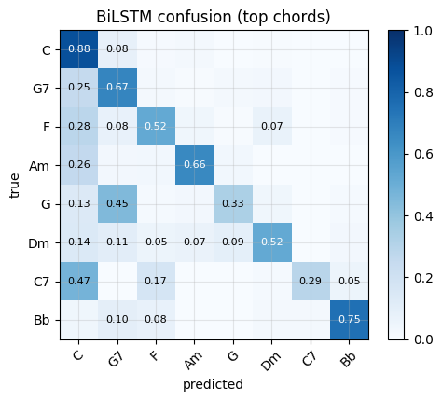
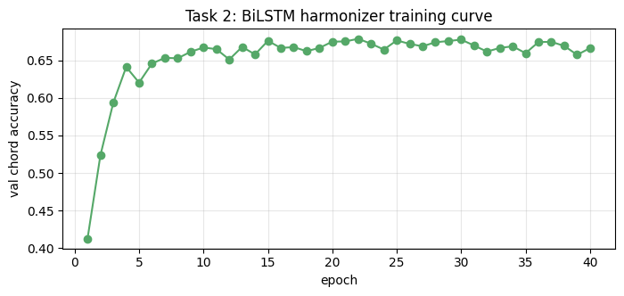
Task 2 quantitative result
BiLSTM roughly doubles the majority baseline
accuracy (higher is better)
0.716
0.655
0.394
0.238
Maj chord
Rule chord
BiLSTM chord
BiLSTM root
validation chord accuracy
top-chord confusion matrix
0.655
0.716
0.238
The main mistakes are musical substitutions such as C <-> Am and G <-> G7, which is exactly why listening complements accuracy.
BiLSTM chord accuracy
BiLSTM root accuracy
template rule is worse than tonic majority
11
Notes:
The results make that lesson very clear. The majority baseline gets 0.394 chord accuracy and 0.420 root accuracy. The template rule, surprisingly, is worse: 0.238 chord accuracy and 0.329 root accuracy.
That is one of the most interesting findings in the project. The rule-based baseline sounds smarter than always guessing C, but without context it gets fooled by passing notes and ambiguous bars.
The BiLSTM reaches 0.655 chord accuracy and 0.716 root accuracy, roughly doubling the majority baseline in chord accuracy and improving root accuracy even more.
The training curve shows validation accuracy rising and stabilizing. The confusion matrix gives the musical nuance: many of the model's errors are substitutions like C versus Am or G versus G7. Those are not random failures; they are harmonically related choices.
So the second main result is that a contextual sequence model beats both a trivial baseline and an instantaneous rule baseline for harmonization.

Slide 12
end-to-end deliverable
The final demo chains the two tasks together
LSTM melody
BiLSTM chords
symbolic_unconditioned.mid
symbolic_conditioned.mid
Task 1 generated melody
78%
C G7 C G F Am ...
held-out reelsa-c60 bars exactly matched
predicted chord sequence begins tonally
Recording cue: play the unconditioned melody first, then the conditioned file so the audience hears what the harmonizer adds.
12
Notes:
This slide shows the full pipeline working. The piano roll on the left is the melody sampled by the Task 1 LSTM. That melody is exported as `symbolic_unconditioned.mid`.
Then the Task 2 BiLSTM takes that generated melody, summarizes it bar by bar, and predicts chords. The harmonized output is exported as `symbolic_conditioned.mid`.
As a qualitative check on real data, one held-out tune, `reelsa-c60.mid`, has 78 percent exact bar matches between the BiLSTM predictions and the original chords. That is not the same as perfect composition, but it shows the model has learned a meaningful harmonic mapping.
In the recording, this is where We would play the melody alone first, then the harmonized version, so the listener can hear exactly what the second model adds.

Slide 13
related work
The project is a lightweight version of standard music ML ideas
Dataset lineage
Melody generation
Harmonization
Nottingham folk corpus
Magenta Melody RNN
DeepBach and Coconet
Boulanger-Lewandowski et al. 2012
step-token monophonic stream
neural context for harmony
folk-rnn / ABC LSTMs
Music Transformer as longer-context successor
ours predicts chord labels, not full voicing
Our scale is intentionally smaller: the point is to show the same learned-sequence advantage over n-gram and rule baselines inside a fast laptop assignment.
13
Notes:
This project sits in a standard symbolic music modeling lineage. The Nottingham corpus was popularized by Boulanger-Lewandowski, Bengio, and Vincent in 2012 as a benchmark for RNN-based symbolic music models. Later systems like folk-rnn also trained LSTMs on folk tunes, often using ABC notation.
For Task 1, the closest conceptual relative is Magenta's Melody RNN: a monophonic melody stream tokenized over time and modeled with an LSTM. Modern models like Music Transformer use attention for much longer context, but here the small LSTM is the right scale for a fast assignment.
For Task 2, related work includes DeepBach and Coconet, which harmonize Bach chorales using deep models. My version is much lighter: it predicts chord labels per bar rather than full four-part voicing.
The findings line up with the literature: learned sequence models beat local baselines, local statistics are easier than long-range form, and objective metrics still need listening.

Slide 14
takeaways
What to remember before we listen
2.42
Representation is the quiet win: key-normalized step tokens make the data learnable.
LSTM melody perplexity
For melody, LSTM beats Markov on perplexity and matches repetition better.
0.655 / 0.716
For harmony, context beats pitch-template rules; progressions matter.
BiLSTM chord / root accuracy
Metrics guide us, but the final judge is the audio.
listen twice
melody alone, then harmonized
Play: symbolic_unconditioned.mid -> symbolic_conditioned.mid
14
Notes:
The main takeaways are these.
First, representation matters. Key-normalized step tokens and bar-level chord labels turn raw MIDI into a learnable symbolic problem.
Second, for melody generation, the LSTM beats the Markov baseline on perplexity and better matches real repetition structure.
Third, for harmonization, context matters more than instantaneous pitch matching. The BiLSTM beats both the tonic majority baseline and the template rule.
Finally, metrics guide the work, but music has to be heard. So the recording should close by playing `symbolic_unconditioned.mid`, then `symbolic_conditioned.mid`.
Optional final line: the project starts with a folk corpus, learns a melody model, learns a harmony model, and ends with a generated tune that can actually be listened to.
Play `symbolic_unconditioned.mid` first.
Then play `symbolic_conditioned.mid`.
If screen-recording from `workbook.html`, scroll to section 5, where both audio clips are embedded.

