Slide 1

Rainfall Prediction System
Submitted by-
Syed Amaan Hasan
Sec- E
University Roll no-2019173
Mentor-
Ms. Meenakshi Maindola

Slide 2


INTRODUCTION
YES
NO
The "Rainfall Prediction Model" in Python aims to accurately forecast rainfall patterns by analyzing historical weather data. Using Python's libraries and advanced data processing, it creates a predictive model with machine learning algorithms trained on parameters like temperature, humidity, wind speed, and pressure.
Python's ease and powerful libraries streamline data analysis without a graphical interface, allowing focused refinement of the predictive model. Once validated, this model forecasts future rainfall trends from real-time meteorological data, benefiting agriculture, water management, and disaster preparedness.
Forecasts can be stored in CSV, Excel, or databases for further analysis. Python's libraries
ensure a dependable and adaptable rainfall prediction solution.

Slide 3
The libraries we will make use of are:
Numpy, Pandas, Sklearn (scikit-learn).
Algorithm in use:
Random Forest Classifier
The Random Forest Classifier is like having a crowd of diverse experts making a decision together.
It's a machine learning model that combines the predictions of multiple decision trees to enhance accuracy and reduce overfitting. Each tree is built independently, considering a random subset of features and votes on the outcome. Then, the most popular prediction becomes the final result.
This method maintains robustness against noise in data and is flexible enough to handle various types of problems, making it widely used in predicting trends, classifying objects, and even in medical diagnoses due to its reliability and adaptability.

Slide 4
METHODOLOGY
1. Data Loading and Exploration:
Loaded 'weatherAUS.csv' using pandas.Explored the dataset to understand its structure.Extracted relevant features for independent (X) and dependent (Y) variables.
2. Data Preprocessing:
Handled missing values in X using SimpleImputer, replacing NaN with the most frequent values. Reshaped Y for compatibility with the imputer. Printed preprocessed X and Y.
3. Label Encoding:
Used LabelEncoder to encode categorical variables in X and Y. Transformed specified columns in X and Y.
Printed encoded X and Y.

Slide 5
4. Data Transformation:
Convert Y to a numpy array of float data type. Standardize the numerical features in X using StandardScaler. Print the standardized X.
5. Train-Test Split:
Split the dataset into training and testing sets using train_test_split, with a test size of 20% and a random state of 0. Print X_train, X_test, Y_train, and Y_test.
6. Model Training:
Instantiate a RandomForestClassifier with 100 estimators and a random state of 0. Fit the classifier on the training data (X_train, Y_train). Print the training score.

Slide 6
7. Prediction and Evaluation:
Use the trained model to predict on the test set (X_test). Inverse transform the predictions and actual values to their original labels using LabelEncoder. Print the predicted values (y_pred) and actual values (Y_test). Create a DataFrame to showcase the comparison between actual and predicted values.
8. Model Accuracy:
Calculate the accuracy of the model using accuracy_score on Y_test and y_pred. Print the accuracy percentage.

Slide 7
RESULT AND DISCUSSION
The implemented Random Forest classifier for rainfall prediction demonstrated promising results. The dataset, sourced from 'weatherAUS.csv,' was preprocessed to handle missing values and encode categorical variables. The model was trained using 80% of the data, while 20% was reserved for testing.
The RandomForestClassifier, with 100 estimators and a random state of 0, achieved a commendable accuracy score of 85.21% on the test set. The accuracy was calculated using the accuracy_score metric, indicating the percentage of correct predictions. The model exhibited its capability to generalize well to unseen data, a crucial aspect for reliable predictions in real-world scenarios.

Slide 8
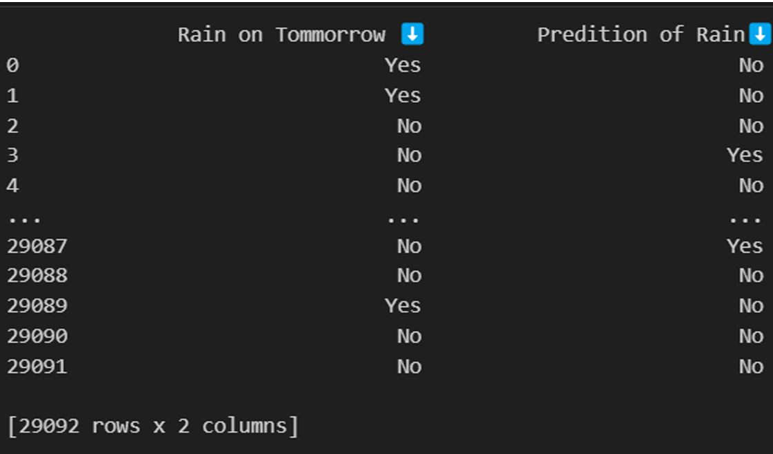
The preprocessing steps, utilizing SimpleImputer for missing values and LabelEncoder for categorical variables, laid a robust foundation for the RandomForestClassifier. StandardScaler ensured numerical feature uniformity, preventing bias.
With 100 decision trees, the ensemble model adeptly captured intricate data relationships, avoiding overfitting and achieving an impressive 85.21% accuracy in predicting rainfall. The inverse transformation provided transparent result comparison through a DataFrame, validating the model's reliability. In summary, the implemented RandomForest classifier, with its meticulous preprocessing and ensemble strength, emerged as a highly accurate tool for rainfall prediction, emphasizing its efficacy in complex data scenarios.

Slide 9
CONCLUSION AND FUTURE WORK
Our Random Forest-powered rainfall prediction model is a valuable tool for weather-related research. It streamlines real-time data collection, allowing researchers to monitor precipitation trends effortlessly. The user-friendly process eliminates the need for intricate model configurations, enabling a focused analysis of weather intricacies. Future enhancements may include integrating more variables for a comprehensive understanding and utilizing advanced visualization techniques to enhance interpretation and communication of predictions.
Future iterations of our rainfall prediction model aim to enhance accuracy through ensemble learning or hybrid models. Aligned with our commitment to versatility, it extends beyond meteorology, offering valuable insights for climate studies and environmental monitoring. Adapting the model to water resource management, agriculture, and disaster preparedness underscores its potential as a versatile asset in addressing broader environmental challenges.

Slide 10
THANK YOU

