Slide 1
Sprint 2 Presentation
Team C
Will Anderson, Nathaniel Beckstead, Matt Clements, Cam Downs, Josh Tellier

Slide 2
Architecture
UI
Handles HTTP requests and responses
Application
Controls high-level flow of application
Model
Stores and processes game data

Slide 3
Separation of Concerns
GameCenter maintains list of active games
PlayerLobby maintains list of active players
Each have single set of responsibilities

Slide 4
Moves
Simple Move
Simple Jump Move
Multiple Jump Move

Slide 5
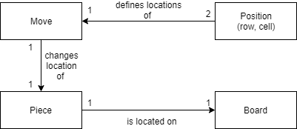
Moves Class Diagram

Slide 6
Walkthrough
Implemented using a Queue
Loop through when move submitted
Multiple Jumps

Slide 7
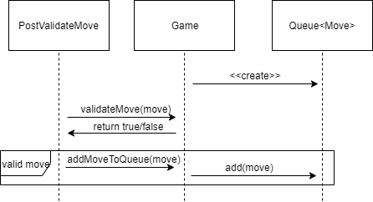
Validate Move Sequence Diagram

Slide 8
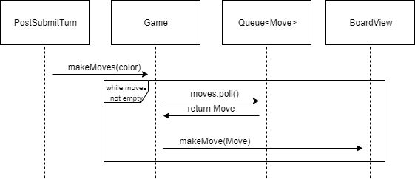
Make Moves Sequence Diagram

Slide 9
Walkthrough
Switching Turns/ The players BoardViews

Slide 10
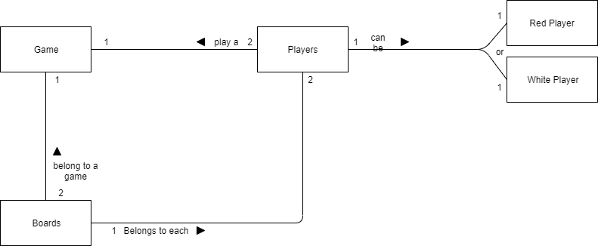
Game Diagram

Slide 11
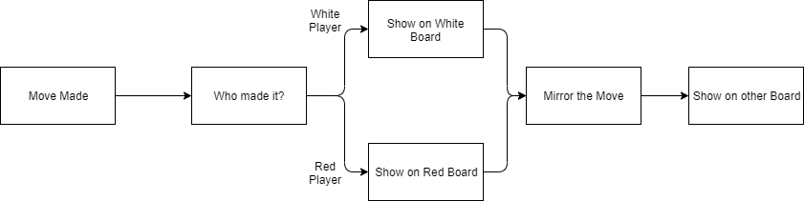
Switching Turns State Diagram

Slide 12
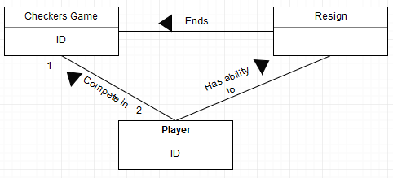
Resign

Slide 13
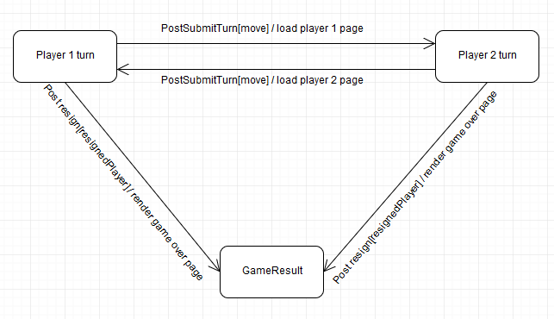
Resign at any time

Slide 14
Problems
Label a game as finished
Allow the opponent to identify game state
Differentiate resigned games and completed games

Slide 15
Solutions
Detailed Game Result
Game state flags
gameActive
gameOverConfirmation

Slide 16
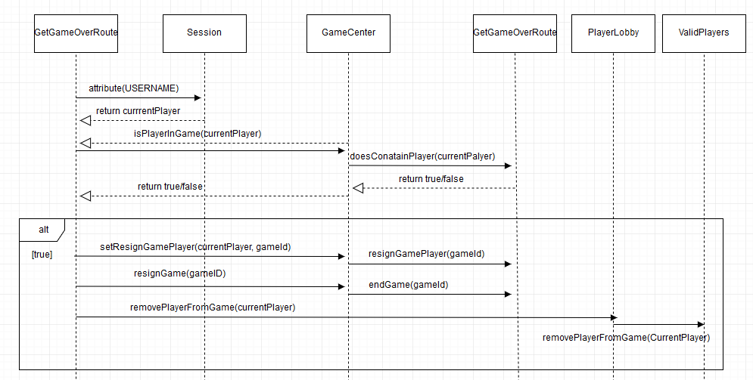
Resign
GetGameOverRoute

Slide 17
Questions?

