Slide 1
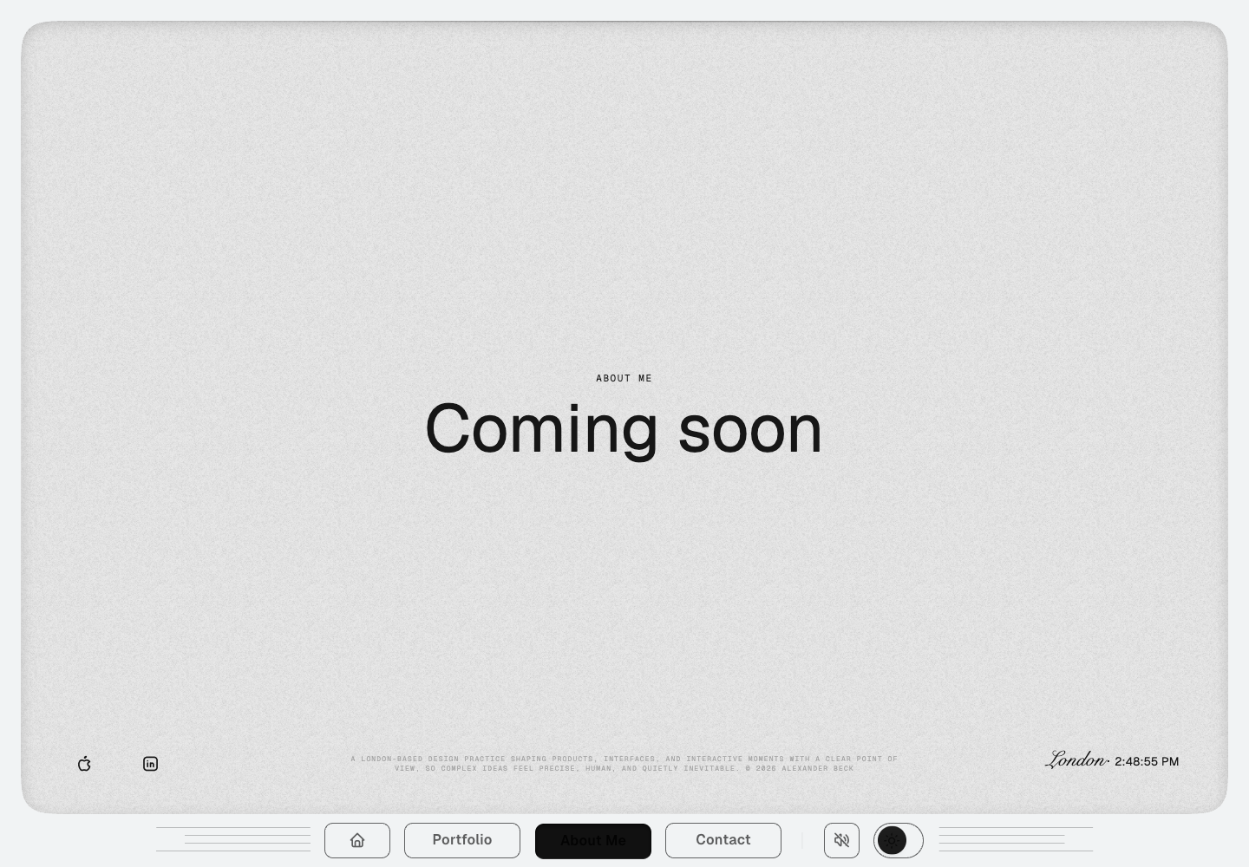
What an award-winning About page should do
ABOUT ME · CREATIVE DIRECTION
40 sites · Awwwards, Webbys and CSSDA
Research, motion evidence and three concept frames
Notes:
Communication job: by the end, Alexander should know which About-page model to pursue, why it fits the evidence, and what to prepare next.
Detailed evidence: docs/research/about-page-direction/research-catalogue.json and research-catalogue.txt

Slide 2
Build a living editorial profile, not a scrolling CV.
THESIS
12 JULY 2026
Notes:
Detailed evidence: docs/research/about-page-direction/research-catalogue.json and research-catalogue.txt

Slide 3
40 award-winning About pages point to one clear direction
Sample
Award-verified personal portfolios and small creative studios with substantive About, Profile or Studio pages.
40
13
3
sites
researched
pages at or
below 220 words
award
bodies
Notes:
Detailed evidence: docs/research/about-page-direction/research-catalogue.json and research-catalogue.txt
Metrics: {"site_count":40,"lane_counts":{"Awwwards":14,"The Webby Awards":13,"CSS Design Awards":13},"median_word_count":354,"mean_word_count":442,"at_or_below_220_words":13,"at_or_below_300_words":18,"shortest_word_count":80,"longest_word_count":2311}

Slide 4
What the research had to answer
01 | What does an About page need to say?
02 | How long can it be?
03 | How does confidence stay human?
04 | Which interaction adds meaning?
05 | How can side work feel purposeful?
06 | What should beck.fyi do differently?
Notes:
Detailed evidence: docs/research/about-page-direction/research-catalogue.json and research-catalogue.txt

Slide 5
The shell is ready. The story is not.
Current state
About Me is an intentional placeholder inside a finished, stable shell. The opportunity is to turn scrolling into a concise professional story without changing the physical frame.
Notes:
Current live page captured 12 July 2026: https://www.beck.fyi/about.html

Slide 6
The best About pages position, prove and humanize.
The repeated pattern
The page earns attention by stating a useful position, earns trust through concrete evidence, and earns memory through one human point of view.
Position
What do I do now, for whom, and why does it matter?
Prove
Use clients, dates, outcomes and artifacts after the claim.
Humanize
Add one belief, fascination or detail that explains the work.
Notes:
Repeated pattern across all three research lanes.
Detailed evidence: docs/research/about-page-direction/research-catalogue.json and research-catalogue.txt

Slide 7
Most award-winning About pages are longer than one minute
Length finding
The median page is 354 words. The strongest one-minute references cluster around 150–220 words; clarity correlates with editing, not volume.
354
13
18
median
word count
pages at or
below 220 words
pages at or
below 300 words
Notes:
Detailed evidence: docs/research/about-page-direction/research-catalogue.json and research-catalogue.txt
Counts computed from the 40-site catalogue.

Slide 8
Confidence works when evidence follows the claim
Research pattern
Bold statements land when the next beat names a decision, scope, collaborator, client or observable result.
Confident
“I led…” — then name the scope, client and consequence.
Self-important
“I am world-class…” — with no observable evidence.
Claim first
Proof immediately after
One clear point of view
Adjectives first
Awards as the climax
Generic values
Notes:
Detailed evidence: docs/research/about-page-direction/research-catalogue.json and research-catalogue.txt

Slide 9
Four useful narrative models appear again and again
No single model wins
The right answer for Alexander combines the edit of a calm ledger, the drama of kinetic type and the humanity of a personal cabinet.
Calm ledger
Concise role, proof and contact. Strong credibility; little emotion.
Kinetic statement
Oversized type turns one belief into an experience.
Personal cabinet
Artifacts reveal taste, curiosity and side work.
Studio manifesto
Strong rhythm, usually too broad and long for one person.
Notes:
Detailed evidence: docs/research/about-page-direction/research-catalogue.json and research-catalogue.txt

Slide 10
Scrolling should reveal the story; interaction should reward curiosity
Native scroll is the only required navigation.
The best motion pages remain understandable as plain text. Pointer, tap, audio or drag expand what is already visible.
Text is readable before motion ends
Tap reveals optional proof
Pointer perturbs locally
Reduced motion preserves every beat
No hover-only essential detail
Notes:
Detailed evidence: docs/research/about-page-direction/research-catalogue.json and research-catalogue.txt

Slide 11
Change the rhythm every one or two screens
00–20s
20–40s
40–60s
Statement
One decisive line, then a short trajectory.
Proof
Clients, specialties and one concrete example.
Personality
Side work, aspiration and a light ending.
Notes:
Pattern synthesized from Maria Vareva, Antoine Wodniack, Camila Rosa, Giacomo Agnello Modica, Thibaud Fellay and Veronica Zubakova.

Slide 12
The examples that most directly inform beck.fyi
CASE STUDIES
6 OF 40
Notes:
Detailed evidence: docs/research/about-page-direction/research-catalogue.json and research-catalogue.txt

Slide 13
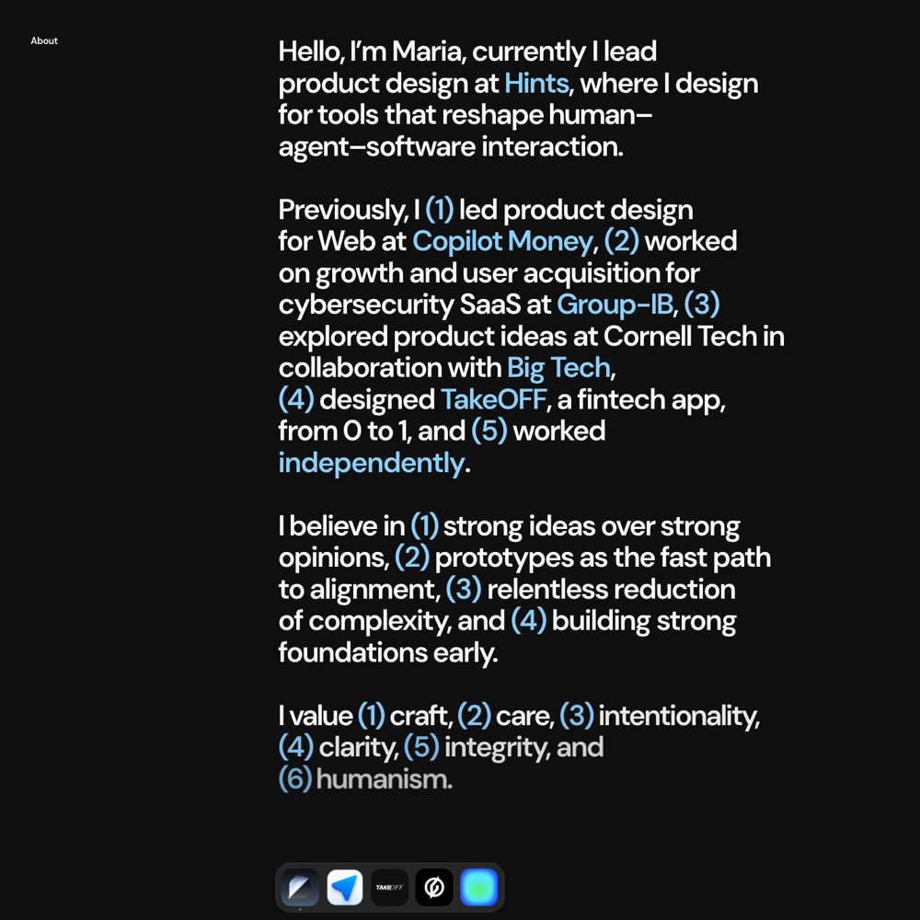
Maria Vareva · structured biography
151 words
Present role → five selective turns → four beliefs → six values. Numbers create structure; links provide proof.
Borrow: selective trajectory and decision-led beliefs.
Avoid: asking text to carry every visual beat.
Notes:
Award source: https://www.cssdesignawards.com/sites/maria-vareva/48730/
Live About: https://mariavareva.com/about
Full capture: docs/research/about-page-direction/evidence/fwa-cssda/screenshots/07-maria-vareva-about.png

Slide 14
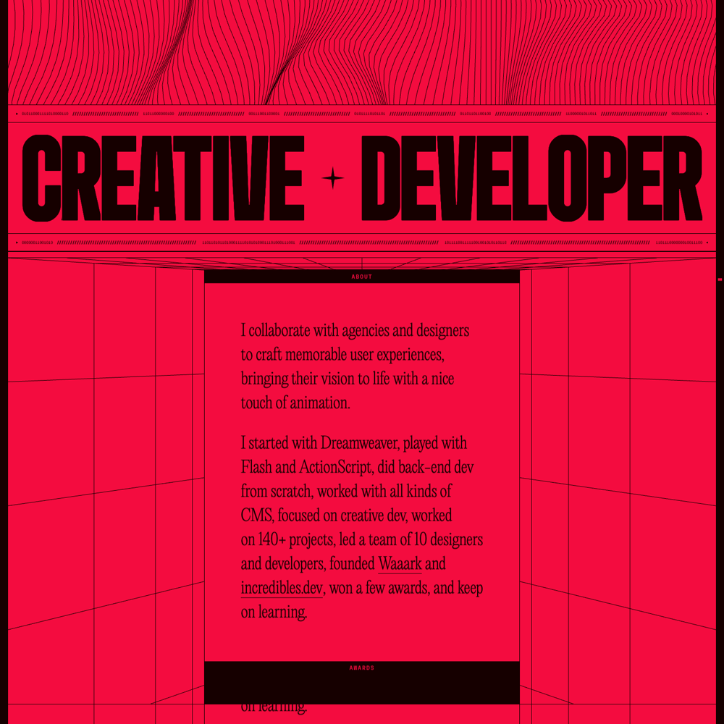
Antoine Wodniack · kinetic restraint
220 words
A compressed career sentence sits inside a highly distinctive typographic and spatial system.
Borrow: one trajectory sentence and one governing geometry.
Avoid: using awards as the only proof.
Notes:
Award source: https://winners.webbyawards.com/2025/websites-and-mobile-sites/features-design/best-home-page/332383/aw-portfolio
Live About: https://wodniack.dev/
Full capture: docs/research/about-page-direction/evidence/webby/screenshots/12-antoine-wodniack-about.png

Slide 15
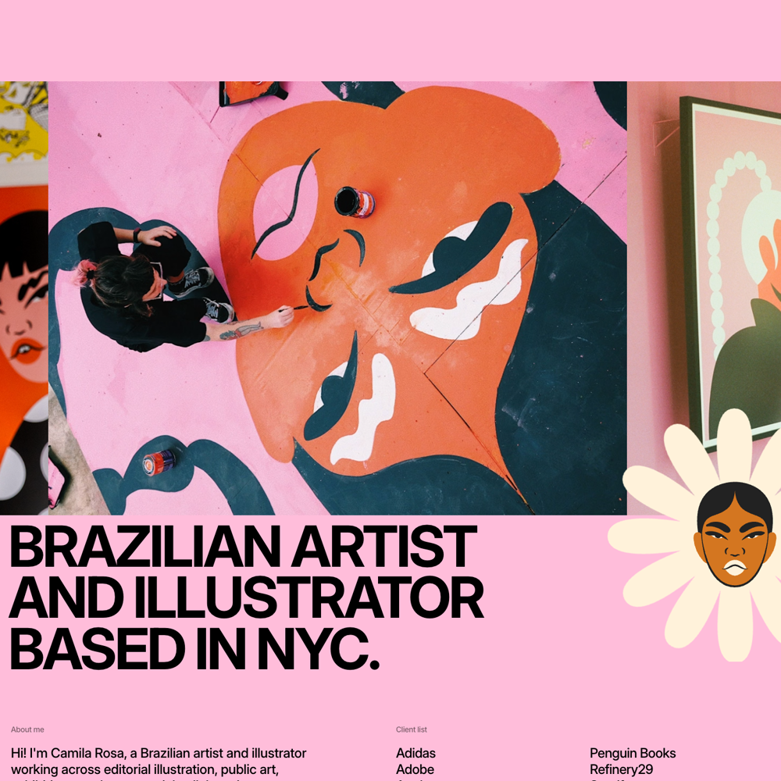
Camila Rosa · identity, then proof
92 words
Two clear statements define the practice. Clients and achievement counts supply credibility without slowing the first read.
Borrow: expandable proof after a memorable visual.
Avoid: a client list that becomes wallpaper.
Notes:
Award source: https://www.cssdesignawards.com/sites/camila-rosa-portfolio/48629/
Live About: https://www.camilarosa.net/about
Full capture: docs/research/about-page-direction/evidence/fwa-cssda/screenshots/01-camila-rosa-about.png

Slide 16
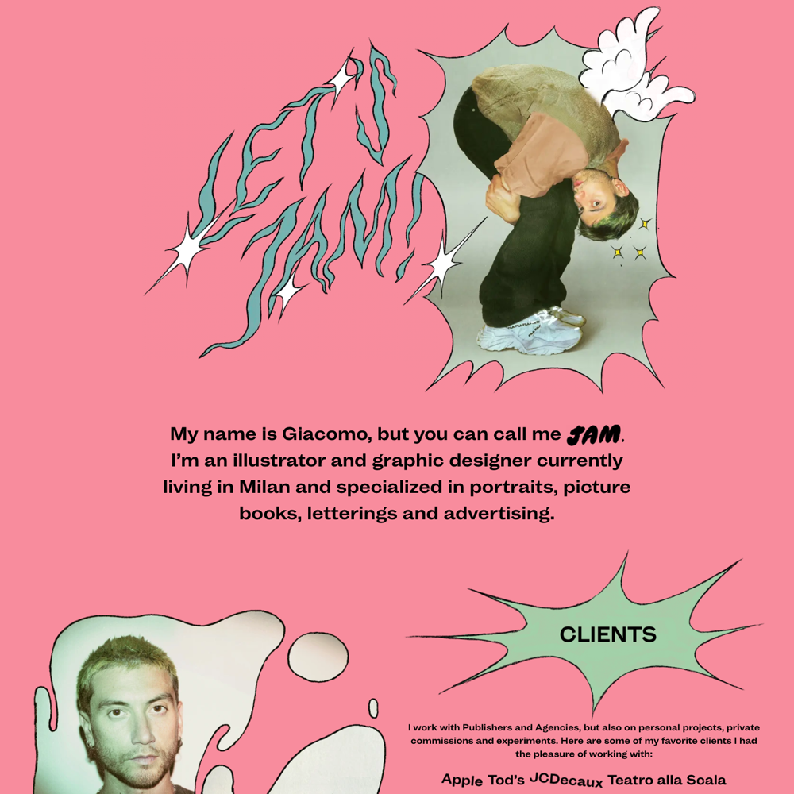
Giacomo Modica · personality with logic
226 words
Clients, influences, hobbies and side products form one causal story about the visual practice.
Borrow: purposeful taste labels and side-work reveals.
Avoid: copying the collage style rather than the logic.
Notes:
Award source: https://www.cssdesignawards.com/website-gallery?industry=art
Live About: https://giacomoagnellomodica.com/info/
Full capture: docs/research/about-page-direction/evidence/fwa-cssda/screenshots/13-giacomo-agnello-modica-info.png

Slide 17
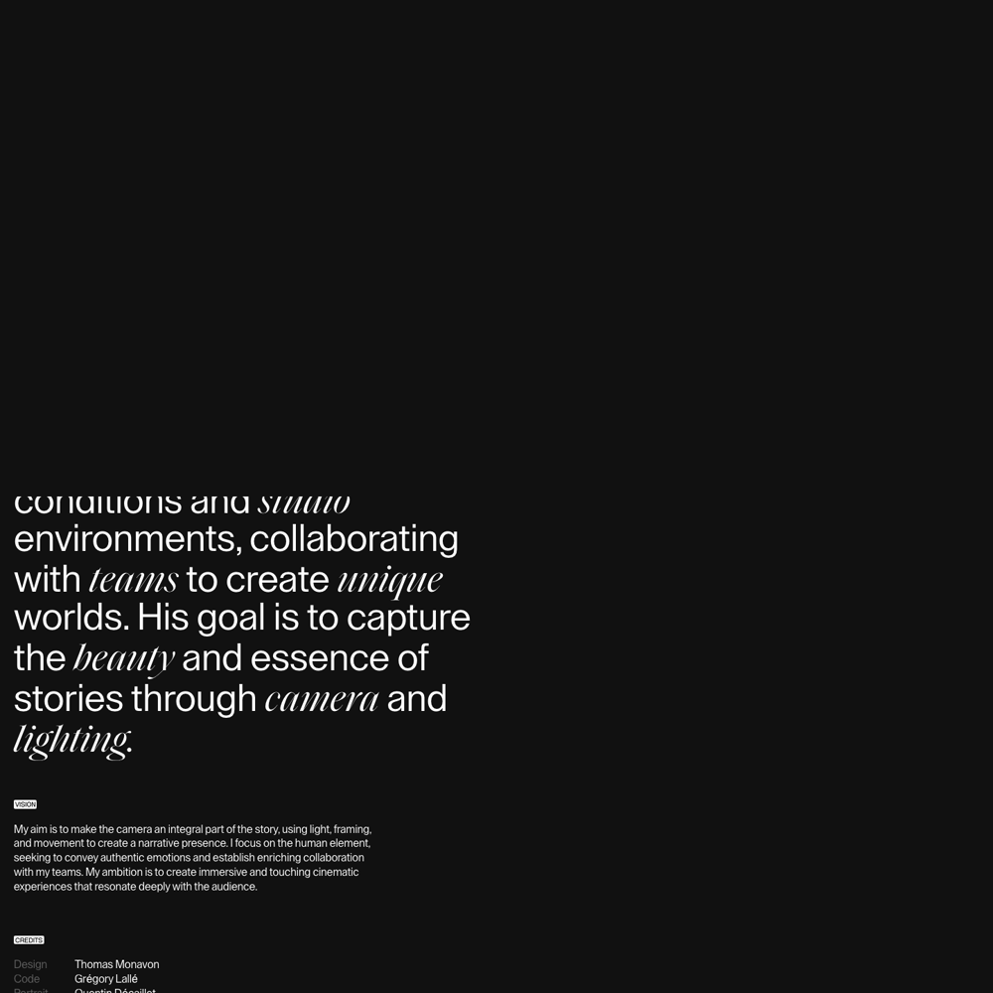
Thibaud Fellay · one belief, one circle
205 words
Mountains, light and collaboration frame the practice; imagery and credits carry the proof.
Borrow: one authored belief plus restrained visual chapters.
Avoid: letting atmosphere replace concrete contribution.
Notes:
Award source: https://www.awwwards.com/sites/thibaud-fellay-portfolio-24
Live About: https://thibaud.film/about/
Full capture: docs/research/about-page-direction/evidence/awwwards/thibaud-fellay-about-full.png

Slide 18
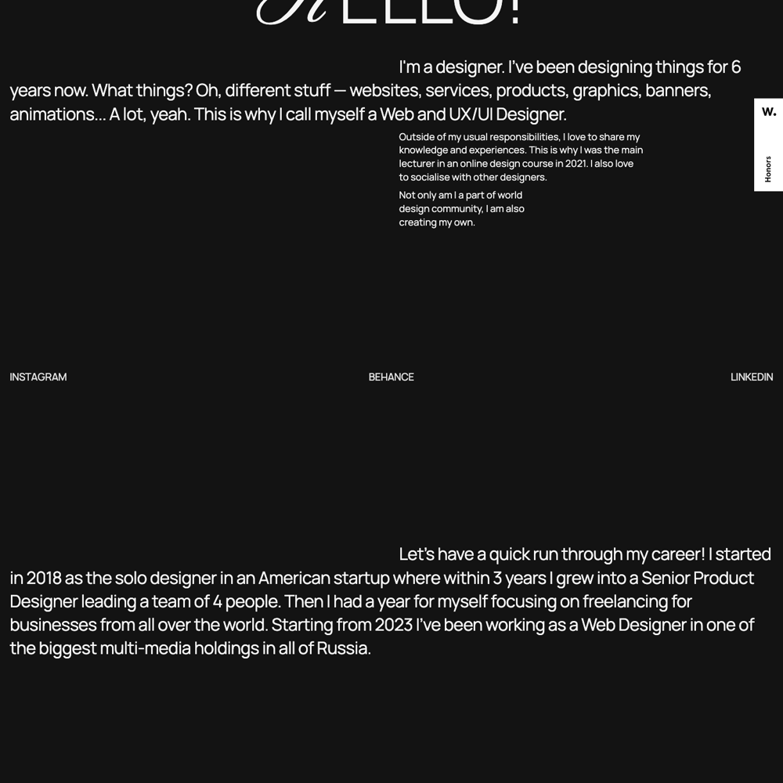
Veronica Zubakova · quiet confidence
Playful voice
Self-aware questions, community projects and varied work make the page personal without becoming casual.
Borrow: personality through specific activity.
Avoid: scattering too many mini-stories.
Notes:
Award source: https://www.awwwards.com/sites/veronica-zubakova-portfolio
Live About: https://veronicazubakova.com/about/
Full capture: docs/research/about-page-direction/evidence/awwwards/veronica-zubakova-about-full.png

Slide 19

Motion evidence · Antoine Wodniack
Scroll deforms one visual system while the biography stays concise.
Use: a single spatial grammar.
Avoid: content hidden until animation completes.
Notes:
Award source: https://winners.webbyawards.com/2025/websites-and-mobile-sites/features-design/best-home-page/332383/aw-portfolio
Live About: https://wodniack.dev/
Video: docs/research/about-page-direction/evidence/webby/video/01-antoine-wodniack-scroll.mp4

Slide 20
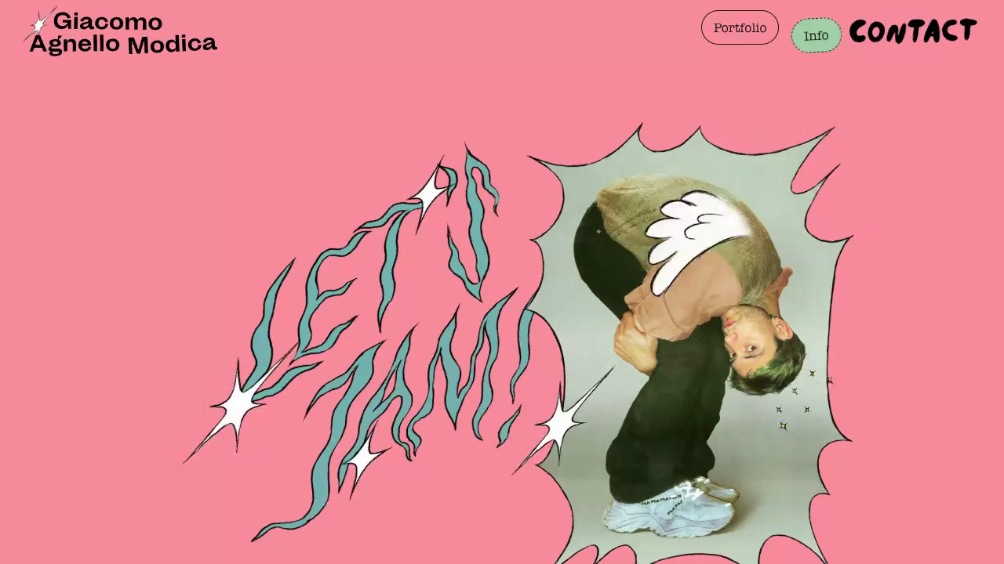
Motion evidence · Giacomo Modica
Tap and scroll reveal taste, personality and side work that already have meaning.
Use: interaction as evidence.
Avoid: mandatory novelty.
Notes:
Award source: https://www.cssdesignawards.com/website-gallery?industry=art
Live About: https://giacomoagnellomodica.com/info/
Video: docs/research/about-page-direction/evidence/fwa-cssda/videos/giacomo-info-scroll.mp4

Slide 21
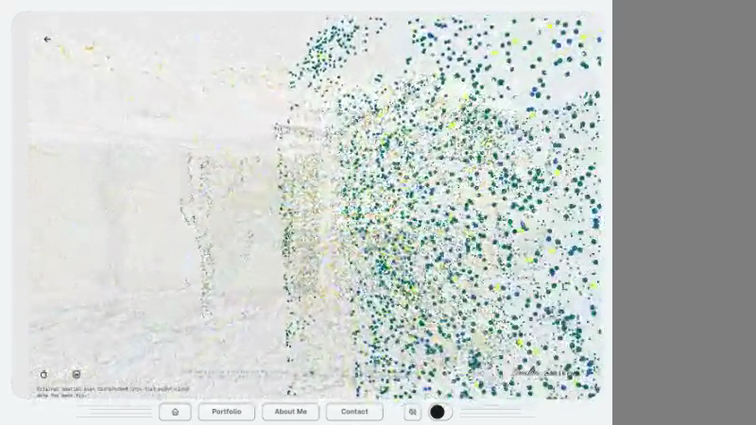
Existing ingredient · Spatial Scan
The parked lab already moves a flat-circle point cloud through loop, scroll and orbit camera modes.
Use: connective tissue between chapters.
Avoid: turning About into a 3D tour.
Notes:
Existing repo evidence: docs/simulations/spatial-scan.md
Video: docs/research/about-page-direction/evidence/spatial-scan-scroll.mp4

Slide 22
Typography tells the story. Dots carry the transitions.
RECOMMENDATION
BECK.FYI
Notes:
Detailed evidence: docs/research/about-page-direction/research-catalogue.json and research-catalogue.txt

Slide 23
A living editorial profile: the working mind, not the résumé
Creative north star
A short factual story moves through one stable room. Typography carries meaning; the dot field reforms only when the next sentence gives it a job.
Type is the narrator
One dominant sentence per scene.
Dots are connective tissue
The same material reforms with meaning.
Artifacts are proof
Posters and experiments explain curiosity.
Notes:
Detailed evidence: docs/research/about-page-direction/research-catalogue.json and research-catalogue.txt

Slide 24
A one-minute reading path
01 | 0–8s · Position · one current professional thesis
02 | 8–20s · Trajectory · three selective turns plus clients
03 | 20–35s · Specialties · three outcome-led strengths
04 | 35–48s · Side work · two or three artifacts with a reason
05 | 48–56s · Next · one honest aspiration
06 | 56–60s · Exit · one optional light interaction
Notes:
Timing is a content budget, not a forced scroll duration. Native scrolling remains under user control.

Slide 25
Keep the core story to 175–220 words
Budget
This is long enough to sound authored and short enough to read in roughly a minute. Deeper chronology and client detail can unfold on tap.
175–220
3
2–3
core
words
career
turns
side
artifacts
Notes:
Budget recommendation synthesizes the strongest one-minute references across all three lanes.

Slide 26
Be direct without sounding full of yourself
Tone equation
Confidence comes from clear decisions. Warmth comes from specificity and a little self-awareness.
Say this
“I turn ambiguous product problems into working systems teams can test.”
Avoid this
“I deliver world-class, high-impact design across disciplines.”
Verb first
Concrete object
Observable consequence
No superlatives
No role stack
No generic passion
Notes:
Copy direction also aligns with docs/reference/TONE-OF-VOICE.md.

Slide 27
One system, four behaviors
The rule
Scroll is the camera. Type controls pacing. Dots connect scenes. Tap and pointer only add local response.
Everything remains readable with reduced motion and without WebGL.
Scroll primary
Moves the camera or reorganizes one field.
Type meaning
Changes scale and density to mark chapters.
Dots continuity
Resolve into depth, proof clusters and artifacts.
Touch optional
Perturbs, unfolds or drags what is already visible.
Notes:
Accessibility requirement: every interaction has keyboard/touch/reduced-motion parity and is optional to the core narrative.

Slide 28
Spatial Scan · narrator, not background
Existing ingredient
The parked lab already supports scroll, loop and orbit camera modes in the site’s flat-circle language.
Use it to bridge chapters, reveal depth and frame artifacts. Do not turn About into a 3D tour.
Notes:
Repo source: docs/simulations/spatial-scan.md and react-app/app/src/routes/spatial-scan/SpatialScanPointCloud.jsx.

Slide 29
Five rules keep the page playful and purposeful
The story must work before the effects arrive.
These are the most common failure modes across the 40-site sample.
No second portfolio grid
No mandatory drag, audio or hover
No dense client-logo wall
No thin helper rings or lines
One major mechanic before the ending
Notes:
Detailed evidence: docs/research/about-page-direction/research-catalogue.json and research-catalogue.txt

Slide 30
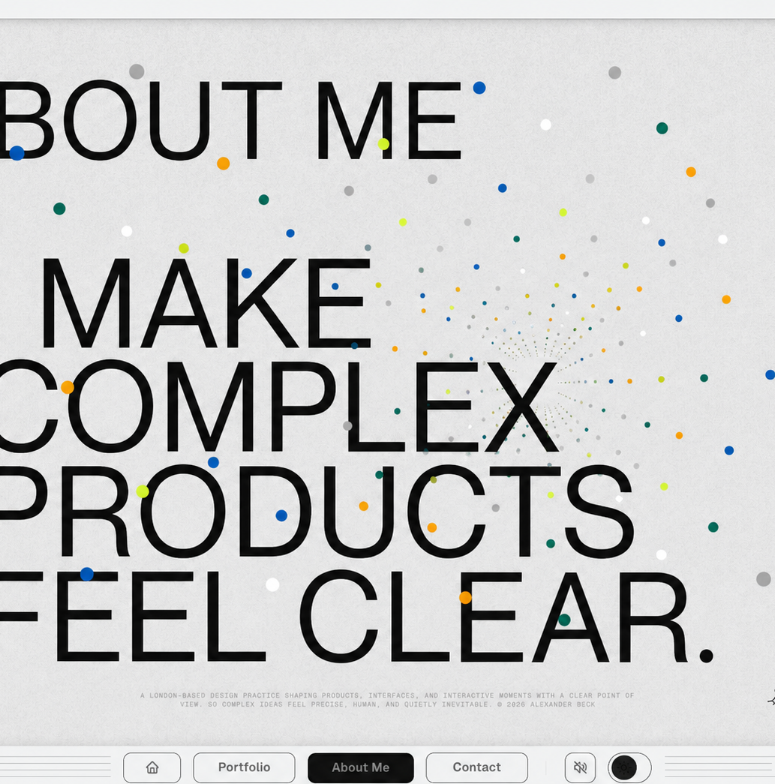
Concept 01 · Professional thesis
Hero
Large type does the positioning. A point-cloud corridor gives the line depth without adding another interface.
Notes:
Concept image generated from the current live About and Home screenshots. It is a directional sketch, not production UI or approved final copy.

Slide 31
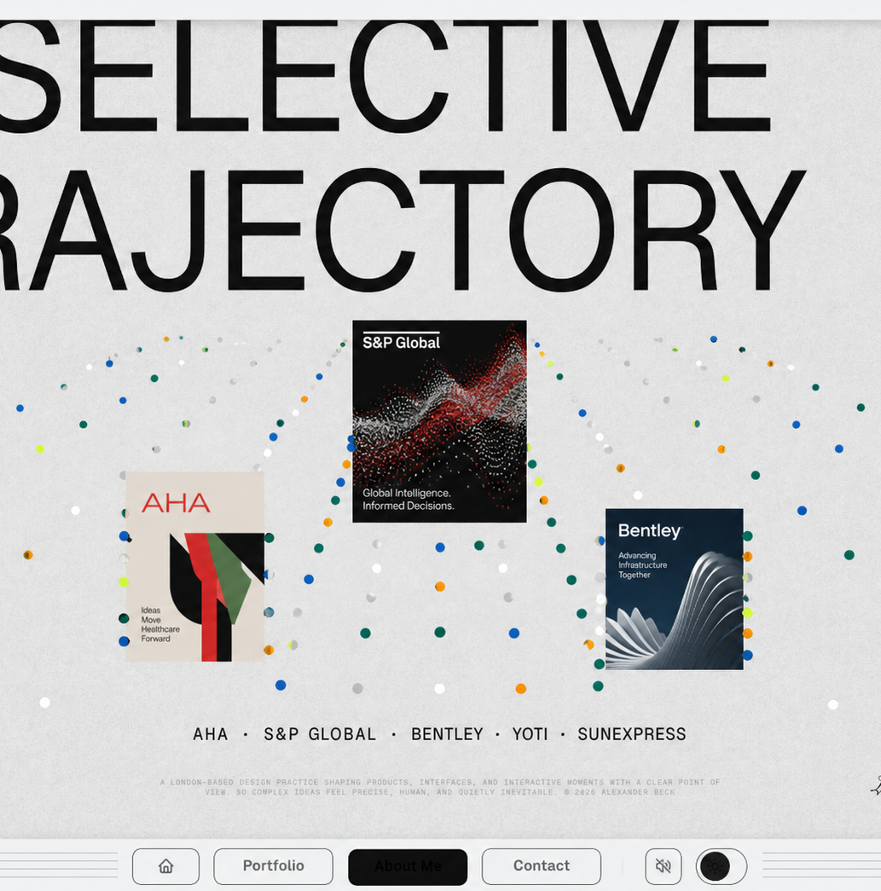
Concept 02 · Proof in the same room
Mid-scroll
Client names stay factual. Three artifacts interrupt the typography while the dot field reorganizes around them.
Notes:
Concept image generated from the current live About and Home screenshots. It is a directional sketch, not production UI or approved final copy.

Slide 32
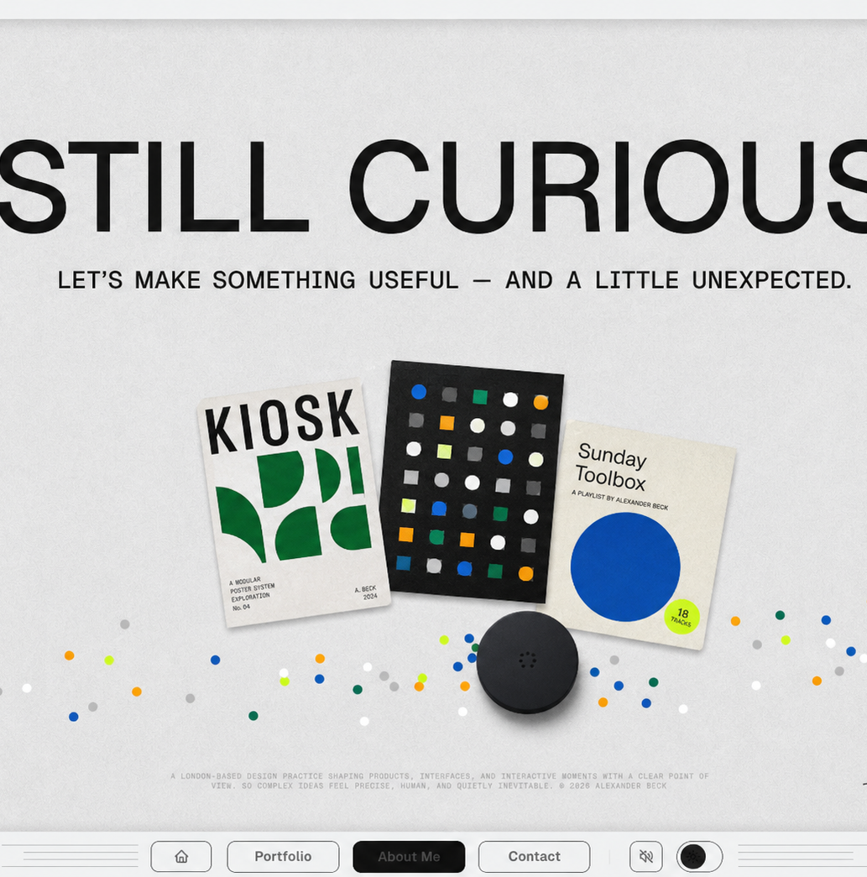
Concept 03 · Levity after credibility
Closing beat
Three personal artifacts and one draggable puck reward curiosity after the professional story is complete.
Notes:
Concept image generated from the current live About and Home screenshots. It is a directional sketch, not production UI or approved final copy.

Slide 33
The next phase needs five small, honest inputs
Copy comes after the creative direction is agreed.
The research tells us the container. A short interview should fill it with verified material.
One present-tense professional thesis
Three trajectory turning points
Three specialties with examples
Two or three side artifacts and why
One aspiration and one human closing beat
Notes:
LinkedIn and current portfolio content are provisional raw material only. Public copy should be interview-verified.

Slide 34
Approve the system before writing the full page
Recommended sequence
Decide the narrative and interaction model first; then interview, draft, storyboard and prototype.
Approve now
Living editorial profile + 175–220-word core + scroll-led dot field.
Defer until next phase
Final copy, exact artifacts and final simulation states.
Narrative arc
Interaction rules
Concept tone
Interview
Rights and assets
Prototype testing
Notes:
Recommended next step: interview-led content definition after creative-direction approval.

Slide 35
The complete award-research index
APPENDIX
40 SITES
Notes:
Detailed evidence: docs/research/about-page-direction/research-catalogue.json and research-catalogue.txt

Slide 36
Research index · 01/05
David Heckhoff Portfolio
Awwwards · 80 words
Giats — Portfolio
Awwwards · 480 words
Pedro Matos Chaves · Design
Awwwards · 358 words
Thibaud Fellay — Portfolio 24
Awwwards · 205 words
Jhosue Mesias — Portfolio
Awwwards · 95 words
Veronica Zubakova — Portfolio
Awwwards · 258 words
Sai Narayanan
Awwwards · 595 words
Grégory Lallé — 24
Awwwards · 213 words
Notes:
David Heckhoff Portfolio
Award source: https://www.awwwards.com/sites/david-heckhoff-portfolio
Live About: https://david-hckh.com/
Giats — Portfolio
Award source: https://www.awwwards.com/sites/https-giats-me
Live About: https://giats.me/about
Pedro Matos Chaves · Design
Award source: https://www.awwwards.com/sites/pedro-matos-chaves-design
Live About: https://pedromc.design/about
Thibaud Fellay — Portfolio 24
Award source: https://www.awwwards.com/sites/thibaud-fellay-portfolio-24
Live About: https://thibaud.film/about/
Jhosue Mesias — Portfolio
Award source: https://www.awwwards.com/sites/jhosue-mesias-portfolio
Live About: https://www.jhosuemesias.com/
Veronica Zubakova — Portfolio
Award source: https://www.awwwards.com/sites/veronica-zubakova-portfolio
Live About: https://veronicazubakova.com/about/
Sai Narayanan
Award source: https://www.awwwards.com/sites/sai-narayanan
Live About: https://www.sainarayanan.com/about
Grégory Lallé — 24
Award source: https://www.awwwards.com/sites/gregory-lalle-24
Live About: https://gregorylalle.com/about

Slide 37
Research index · 02/05
Jack Elder Design
Awwwards · 276 words
Nalaprasad — Portfolio
Awwwards · 213 words
Luc Hohler Design
Awwwards · 189 words
Tomoya Okada — Portfolio v7
Awwwards · 154 words
Dennis Snellenberg — Portfolio
Awwwards · 215 words
Agustin Burgos — Portfolio
Awwwards · 445 words
Grilled Pixels - Adam Roberts
Webby · 1670 words
Won J. You Studios - My Story
Webby · 605 words
Notes:
Jack Elder Design
Award source: https://www.awwwards.com/sites/jack-elder-design
Live About: https://www.jackelder.design/#pixel-scroll
Nalaprasad — Portfolio
Award source: https://www.awwwards.com/sites/nalaprasad-portfolio
Live About: https://nalaprasad.com/about
Luc Hohler Design
Award source: https://www.awwwards.com/sites/luc-hohler-design
Live About: https://luchohler.com/
Tomoya Okada — Portfolio v7
Award source: https://www.awwwards.com/sites/portfolio-ver7-tomoya-okada
Live About: https://v7.usestate.org/about/
Dennis Snellenberg — Portfolio
Award source: https://www.awwwards.com/sites/dennis-snellenberg-portfolio
Live About: https://dennissnellenberg.com/about
Agustin Burgos — Portfolio
Award source: https://www.awwwards.com/sites/agustin-burgos-portfolio
Live About: https://agustinburgos.com/about
Grilled Pixels - Adam Roberts
Award source: https://winners.webbyawards.com/winners/websites-and-mobile-sites/general-desktop-mobile-sites/professional-services-self-promotion
Live About: https://www.grilledpixels.com/about/
Won J. You Studios - My Story
Award source: https://winners.webbyawards.com/winners/websites-and-mobile-sites/general-desktop-mobile-sites/professional-services-self-promotion
Live About: https://wonjyou.studio/about/

Slide 38
Research index · 03/05
Righteous Creative
Webby · 249 words
Fiddle.Digital
Webby · 541 words
Raw Materials - An Unusual Design Company
Webby · 420 words
Lusion - About Us
Webby · 349 words
Locomotive - Agency
Webby · 771 words
Someoddpilot - About
Webby · 984 words
Better Off Studio - The Lookback
Webby · 442 words
Metalab - About
Webby · 461 words
Notes:
Righteous Creative
Award source: https://winners.webbyawards.com/winners/websites-and-mobile-sites/general-desktop-mobile-sites/professional-services-self-promotion
Live About: https://righteouscreative.com/
Fiddle.Digital
Award source: https://winners.webbyawards.com/2025/websites-and-mobile-sites/general-desktop-mobile-sites/professional-services-self-promotion/339211/fiddledigital-design-agency
Live About: https://fiddle.digital/about
Raw Materials - An Unusual Design Company
Award source: https://winners.webbyawards.com/2024/websites-and-mobile-sites/features-design/best-navigationstructure/281127/raw-materials--an-unusual-design-company
Live About: https://www.therawmaterials.com/
Lusion - About Us
Award source: https://winners.webbyawards.com/2024/websites-and-mobile-sites/mobile-features-design/best-mobile-visual-design-aesthetic-mobile-features/281405/lusion
Live About: https://lusion.co/about/
Locomotive - Agency
Award source: https://winners.webbyawards.com/winners/websites-and-mobile-sites/general-desktop-mobile-sites/professional-services-self-promotion
Live About: https://locomotive.ca/en/agency
Someoddpilot - About
Award source: https://winners.webbyawards.com/2024/websites-and-mobile-sites/general-desktop-mobile-sites/professional-services-self-promotion/294858/someoddpilot
Live About: https://someoddpilot.com/about/
Better Off Studio - The Lookback
Award source: https://winners.webbyawards.com/winners/websites-and-mobile-sites/general-desktop-mobile-sites/professional-services-self-promotion
Live About: https://tlb.betteroff.studio/about/
Metalab - About
Award source: https://winners.webbyawards.com/winners/websites-and-mobile-sites/general-desktop-mobile-sites/professional-services-self-promotion
Live About: https://www.metalab.com/about

Slide 39
Research index · 04/05
Dops Agency
Webby · 631 words
AW Portfolio - Antoine Wodniack
Webby · 220 words
Mark Woodland
Webby · 503 words
Camila Rosa
CSSDA · 92 words
Elsa Hanneke
CSSDA · 118 words
Wendy Andrade
CSSDA · 127 words
Ania Melnik
CSSDA · 818 words
Alex Ryan Design
CSSDA · 374 words
Notes:
Dops Agency
Award source: https://winners.webbyawards.com/winners/websites-and-mobile-sites/general-desktop-mobile-sites/professional-services-self-promotion
Live About: https://dops.agency/
AW Portfolio - Antoine Wodniack
Award source: https://winners.webbyawards.com/2025/websites-and-mobile-sites/features-design/best-home-page/332383/aw-portfolio
Live About: https://wodniack.dev/
Mark Woodland
Award source: https://winners.webbyawards.com/2026/websites-and-mobile-sites/features-design/best-home-page/363849/mark-woodland
Live About: https://markwoodland.com.au/
Camila Rosa
Award source: https://www.cssdesignawards.com/sites/camila-rosa-portfolio/48629/
Live About: https://www.camilarosa.net/about
Elsa Hanneke
Award source: https://www.cssdesignawards.com/sites/elsa-hanneke/48653/
Live About: https://elsa.works/about
Wendy Andrade
Award source: https://www.cssdesignawards.com/sites/wendy-andrade/48473/
Live About: https://www.wendyandrade.co/en/bio
Ania Melnik
Award source: https://www.cssdesignawards.com/sites/ania-melnik-portfolio/47394/
Live About: https://amelnik.com/
Alex Ryan Design
Award source: https://www.cssdesignawards.com/website-gallery?industry=graphic+design&page=1
Live About: https://www.alexryan.design/about

Slide 40
Research index · 05/05
Luca Ravanelli
CSSDA · 277 words
Maria Vareva
CSSDA · 151 words
Aya El Ouahdani
CSSDA · 397 words
Stan Khoruzhenko
CSSDA · 361 words
AKIS.STUDIO
CSSDA · 494 words
Jess Hill
CSSDA · 2311 words
Bogdan Kolomiyets
CSSDA · 320 words
Giacomo Agnello Modica
CSSDA · 226 words
Notes:
Luca Ravanelli
Award source: https://www.cssdesignawards.com/sites/luca-ravanelli-portfolio/48733/
Live About: https://lucaravanelli.com/about/
Maria Vareva
Award source: https://www.cssdesignawards.com/sites/maria-vareva/48730/
Live About: https://mariavareva.com/about
Aya El Ouahdani
Award source: https://www.cssdesignawards.com/sites/interactive-web-portfolio/48731/
Live About: https://www.ouahdina.com/
Stan Khoruzhenko
Award source: https://www.cssdesignawards.com/sites/stan-design-portfolio/48716/
Live About: https://stan-khoruzhenko.com/bio
AKIS.STUDIO
Award source: https://www.cssdesignawards.com/sites/akis-studio/48714/
Live About: https://akis.studio/en/about
Jess Hill
Award source: https://www.cssdesignawards.com/sites/jess-hill/48500/
Live About: https://www.jesshill.com.au/about
Bogdan Kolomiyets
Award source: https://www.cssdesignawards.com/website-gallery?industry=web+design%2Fdev
Live About: https://bogdankolomiyets.com/about
Giacomo Agnello Modica
Award source: https://www.cssdesignawards.com/website-gallery?industry=art
Live About: https://giacomoagnellomodica.com/info/

Slide 41
Shape the story
NEXT
Interview and verify the narrative · choose artifacts and media
Prototype the scroll system
Notes:
Recommended next phase: interview-led content definition, storyboarding, then a lightweight interactive prototype.

