Slide 1
SISTEMAS OPERATIVOS
SO
E – M 2020

Slide 2
Introduction to CS and OS
Organization and Architecture of a Computer System (CS)
Structure and Operations of an Operating System (OS)

Slide 3
Computer Systems / Operating Systems
Users want convenience, ease of use and good performance
Don’t care about resource utilization
Computer Systems: different sizes, then Operating Systems . . .
But shared computer such as mainframe or minicomputer must keep all users happy
Users of dedicate systems such as workstations / PC have dedicated resources but frequently use shared resources from servers
Handheld computers are resource poor (compared with a computer), optimized for usability and battery life
Some computers in a device have little or no user interface, such as embedded computers in devices and automobiles

Slide 4
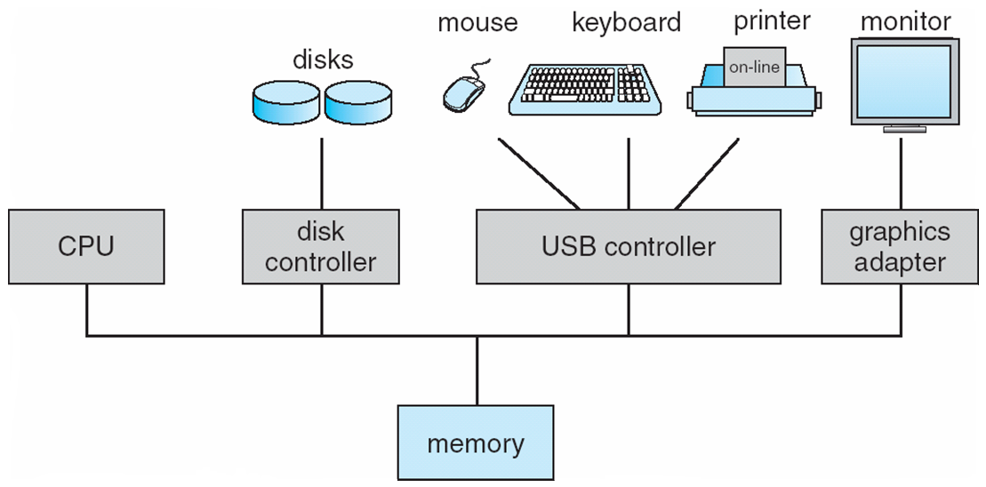
Computer System Organization
Computer-system organization
One or more CPUs, Device Controllers connect through Common Bus providing access to Shared Memory.
Concurrent execution of CPUs and Devices, competing for Memory Cycles.
controller

Slide 5
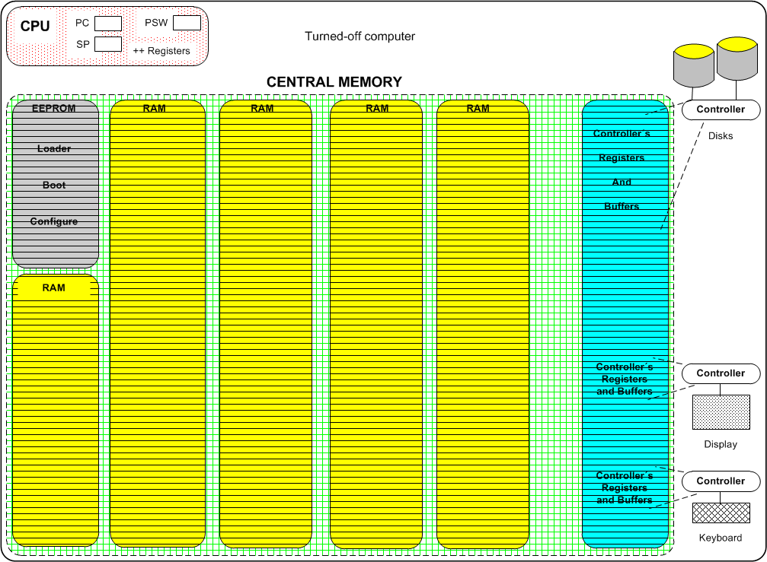

Slide 6
Computer Startup
Bootstrap program is started at Power-up or Reboot
Typically stored in EPROM or EEPROM, generally known as firmware
Initializes all aspects of the Computer System
Loads Operating System Kernel and starts execution
What needs the CPU to run the bootstrap program after the power-up? _____

Slide 7
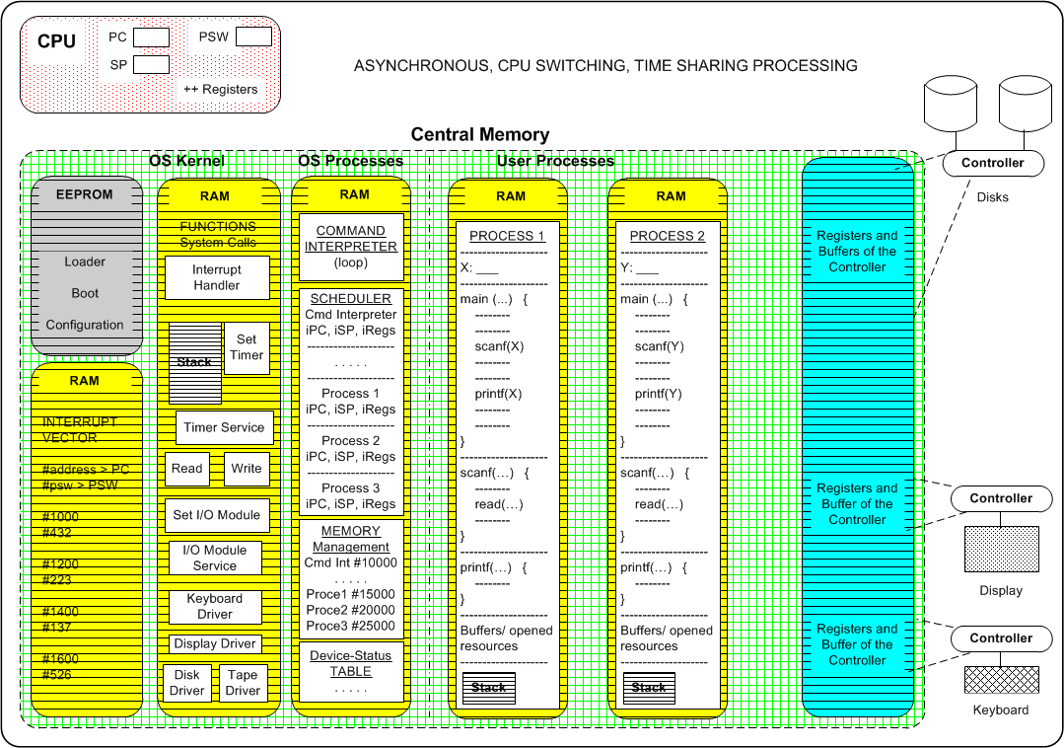

Slide 8
Operating System Kernel
Subroutines / functions
Loader, Boot, Configure, Run, Dir, Read, Write, …
Interrupt Vector
Contains the starting memory address and process status word of every subroutine / function in the Kernel

Slide 9
Operating System Processes
Command Interpreter
Receives and validates the user or program commands, and execute them up
Process Administrator
Builds, starts, manages and terminates processes
Scheduler (part of the process administrator)
Selects the next process to have CPU time

Slide 10
Operating System Processes
Memory Administrator
Allocates and manage memory for every process
File Administrator
Creates, opens, copies, close or delete files and directories

Slide 11
Computer-System Operation
I/O devices and the CPU execute concurrently
Each device controller is in charge of a particular device type
Each device controller has a local buffer and control registers
Every I/O is started inside a process, and completed in several ways
CPU moves data between main memory and controller’s local buffers
I/O is between the device and the controller’s local buffer

Slide 12
CPU needs for exec
To transfer the execution to any other software entity the system need to fill in the next CPU registers
PC (program counter) _ with _ the memory address of the next instruction
PSW (processor status Word) _ with _ flags initial values, in particular the one with the supervisor (privigiled) or user mode of execution
SP (stack pointer) _ with _ the initial address of the stack área of a program in a process

Slide 13
I/O completed
Example: Reading from Keyboard or Disk, inside a process
How the CPU learns that an I/O has been completed? Two ways
CPU checks _______________ (synchronous mode, polling)
CPU receives ______________ (asynchronous mode)

Slide 14
I/O Handling
The two types of I/O produces:
synchronous processing
asynchronous processing

Slide 15
Computer Startup
Bootstrap program
What needs the CPU to run the bootstrap program after the power-up? _____

Slide 16
Referencias
Presentación de Ramon Ríos.
Capítulos: Operating System Concepts; Silberschatz, Galvin, Gagne.
23, 28-enero-2020

