Slide 1
SISTEMAS OPERATIVOS
SO
E – M 2020

Slide 2
IO Computer-System Operation
Device I/O finished event
Device (disk, keyboard, monitor) controller informs CPU that it has finished its operation by causing
a change in a register of the controller (polling) or
generating an interrupt

Slide 3
POLLING I/O Structure
POLLING – synchronous processing
After I/O starts, control returns to user program only upon I/O completion
Wait loop, in READ or WRITE, (contention for memory access)
Wait instruction (checking registers content) idles the CPU until the I/O completion, in READ or WRITE
At most one I/O request is outstanding at a time, no simultaneous I/O processing

Slide 5
¿A cuál modo de operación corresponde el prompt RtrNm# ? _______________
01 A
01 D
05 N
02B,Fz; 03A,Gz; 04 A, E
01 B
01 E
01 C
04 Gz
05 L
05 J
05 A
02 C, E
05 M
05 K
03 B, F
01 Ez
04 B, D
02A
04 F
02 D; 04 C; 03 C, E
05 B
[03 D]

Slide 6
Interrupt I/O Structure
VECTORED Interrupt System – asynchronous processing
After I/O starts, control returns to another user program without waiting for I/O completion.
System call – request to the OS to set an I/O on a device, to allow user to wait for I/O completion
E.g. READ, WRITE
Device-status table contains entry for each I/O device indicating its type, address, and state
OS indexes into I/O device table to determine device status and to modify table entry to include interrupt
At IO completion, controller generates an interrupt signal, that bounds the CPU to be transferred to a kernel service subroutine.

Slide 7
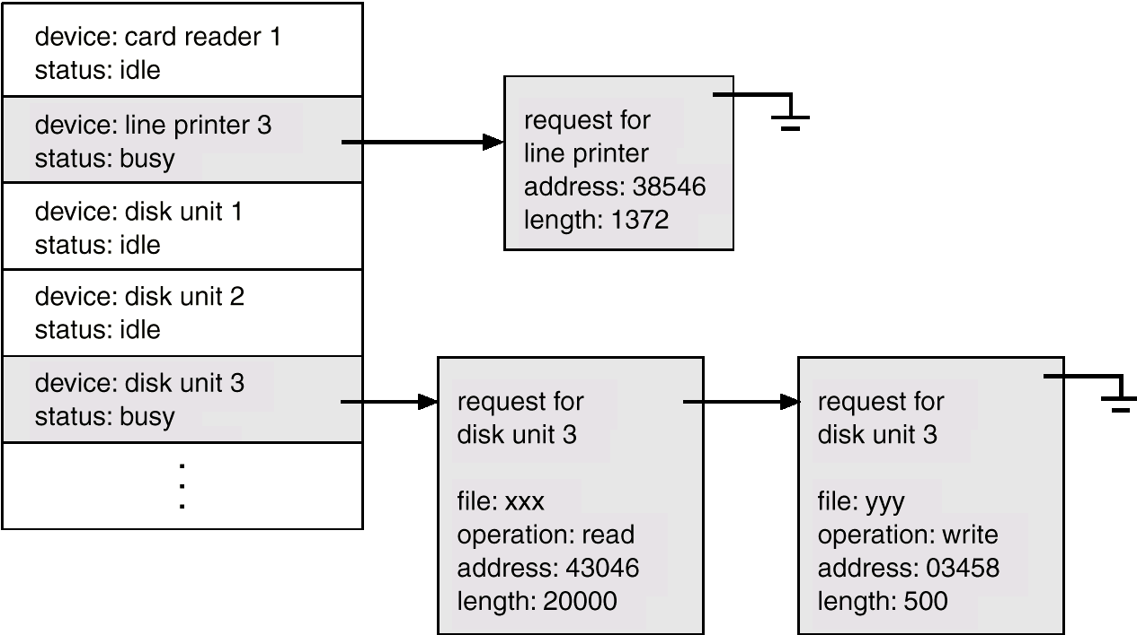
Device-Status Table

Slide 8
ASYNCHRONOUS, CPU SWITCHING, SEQUENTIAL PROCESSING
SISTEMAS OPERATIVOS

Slide 9
ASYNCHRONOUS, CPU SWITCHING, SEQUENTIAL PROCESSING
01 A
01 C
03 K
04 B int
04 F
01 B
06 L+
02 A
05 A
03 Jnext
06 Jnext
06 C
03 C
03 I
04 E
02 B
05 B
03 Bx
03 D
03 Azzz
06 Azzz
06 Bx
03 F
03 Hx
06 K
04 Cx
04 Dx
03 Ex
03 Gx
03 Ey
04 A

Slide 10
Common Functions of INTERRUPTs
When an I/O is done an Interruption transfers control to the interrupt service routine (ISR: read, write, …)generally, through the interrupt vector, which contains the addresses of all the service routines
How come a Hardware Interrupt is programmed?
A trap or exception is a software-generated interrupt caused either by an error or a user request (System Call)
User executes a System call function (invoking Read), through the interrupt vector, to start an I/O operation in a device controller; the invoking Read throws a trap or exception.
User can cause a zero division, throwing a trap or exception invoking a kernel function.
Interrupt architecture must save the address of the interrupted instruction. The operating system preserves the state of the CPU by storing registers and the Program Counter (PC)
A modern operating system is interrupt driven

Slide 11
Storage Structure
CPU Registers
Main memory only large storage media that the CPU can access directly
Random access. Typically volatile: RAMs, ?RAMs
Non volatile: EEPROMs, …
Secondary storage – extension of main memory that provides large nonvolatile storage capacity: disks, tapes, flash memories, …
Hard disks – rigid metal or glass platters covered with magnetic recording material
Disk surface is logically divided into tracks, which are subdivided into sectors
The disk controller determines the logical interaction between the device and the computer
Solid-state disks – faster than hard disks, nonvolatile
Various technologies. Becoming more popular

Slide 12
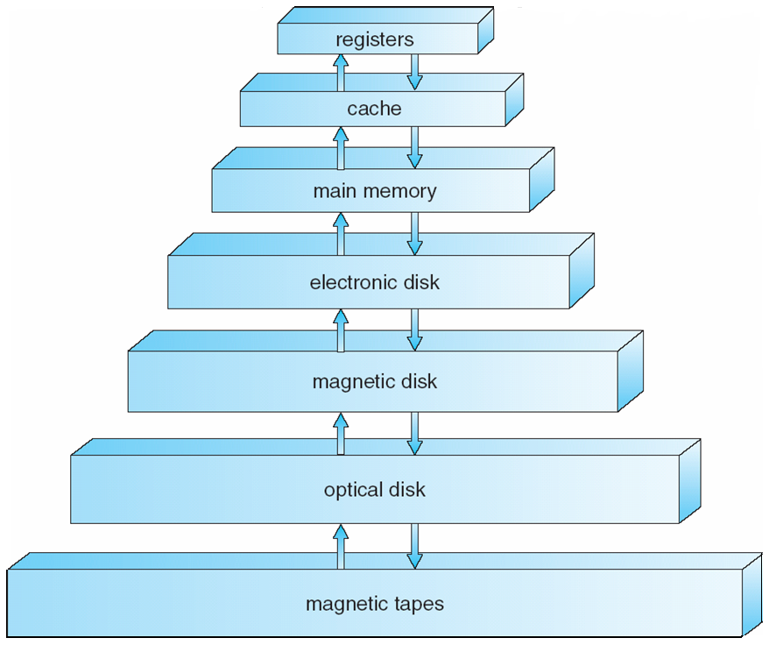
Storage-Device Hierarchy

Slide 13
Storage Hierarchy
Storage systems organized, in hierarchy, by
Access Speed ____
Cost per bit ____
Volatility ____
Storage Size _____
Device Driver for each device controller to manage I/O
Provides uniform interface between Controller and Kernel

Slide 14
Caching 1
Caching – copying information, in use, from slower to faster storage system or “cache”; e. g. :
main memory is a “cache” for secondary electronic disk
Electronic disk is a “cache” for magnetic disk
Important principle, performed at many levels in a computer (in hardware, operating system, software)

Slide 15
Caching 2
Faster storage (“cache”) checked first to determine if information is there ____
If it is, information used directly from the cache (fast)
If not, data copied to cache and used there
“Cache” smaller than storage being cached (slower)
Cache management important design problem
Cache size and replacement policy
CACHE MEMORY, close to CPU
Central Memory (?RAM, EEPROM) >> Cache memory
Cache memory >> CPU registers

Slide 16
Caching: Main Memory <> Cache Memory
Memory
Address
Slot
Number
Tag
Block
0
0
1
1
2
Block
(k words)
2
3
C - 1
Block Length
(k words)
(b) Cache Memory
Block
2^{n} - 1
Word Length
(a) Main Memory

Slide 17
Direct Memory Access DMA Structure
Unit used for high-speed I/O devices able to transmit blocks of information at close to memory speeds, e.g.
Hard disks, magnetic tapes
Graphic cards, Network cards, Sound cards
DMA transfers blocks of data between the Buffer storage of the Device Controller directly and the Main Memory almost without CPU intervention
CPU commands the DMA to do the transfer
DMA does the transfer without CPU intervention
At the end of the transfer the DMA launches an interrupt to inform about the termination
Only one interrupt is generated per block, rather than the one interrupt per byte

Slide 18
Referencias
Presentación de Ramon Ríos.
Capítulos: Operating System Concepts; Silberschatz, Galvin, Gagne.
30-enero-2020

