Slide 1
SISTEMAS OPERATIVOS
SO
E – M 2020

Slide 2
OS Increasing Performance
Multiprogramming
Time Sharing

Slide 3
OS Functional characteristics
Monoprogramming and Multiprogramming
amount of processes in memory
Synchronous I/O, Asynchronous I/O and Time Sharing with Asynchronous I/O
CPU execution method for a process with I/Os
Monouser and Multiuser
total of users being served

Slide 4
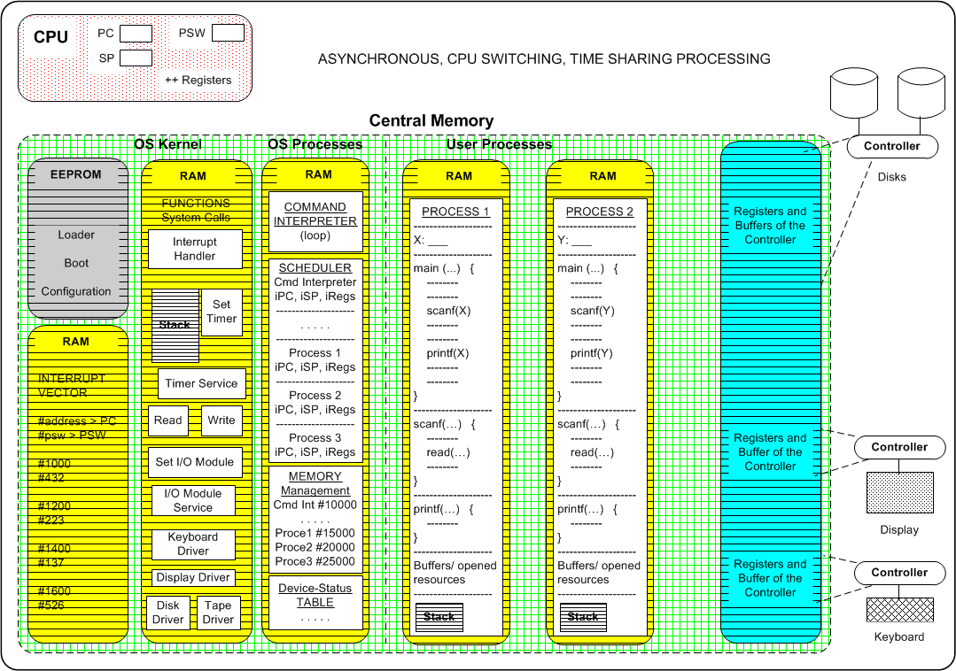
Memory Layout for Multiprogrammed System

Slide 5
Time Slice computation

Slide 6
Operating System Structure
Multiprogramming needed for efficiency
Single user cannot keep CPU and I/O devices busy at all times
Multiprogramming organizes processes (code and data) so CPU always has one to execute
A subset of total processes in system is kept in memory
One process selected and run via process scheduling
Timesharing is logical extension in which CPU switches jobs so frequently that users can interact with each job while it is running, creating interactive computing
Response time should be < 1 milisecond
Each user has at least one program executing in memory process
If several processes ready to run at the same time  CPU scheduling
If processes don’t fit in memory, swapping moves them in and out to run
Virtual memory allows execution of processes not completely in memory
When it has to wait (for I/O for example), OS switches to another job

Slide 7
OS Operations 1
Interrupt driven (hardware and software)
Hardware interrupt by one of the devices
Power on
I/O devices, finished task
DMA, finished task
Hardware fails
Exhausted Processing clock
Others …
Hardware Interrupt: notification of a finished event
The CPU switches, from what it is doing, to a Kernel Routine
Uses the Interrupt Vector to pick up the values for the PC and PSW to switch into a Kernel Routine.

Slide 8
OS Operations 2
Interrupt driven (hardware and software)
Software interrupt (exception or trap):
Request for operating system service
Starting an I/O
Shutdown
To invoke any Kernel routine ( open, run, mkdir, fork, …)
Software error
Arithmetic overflow, underflow
Zero division
Illegal instruction
Memory address violation
The software interrupt is provoked inside a process / program
Software Interrupt: to initiate or finish an event
The CPU jumps into a Kernel Routine (System Call function)
Uses the Interrupt Vector to pick up the values for the PC and PSW to switch into a Kernel Routine.

Slide 9
OS Operations (cont.)
Dual-mode operation (hardware) allows OS to protect itself and other system components
User mode and kernel (privileged) mode
Mode bit provided by hardware (PSW register)
Provides ability to distinguish when system is running user code or kernel code
Some instructions designated as privileged, only executable in kernel mode
System call changes mode to kernel, return from call, resets it to user

Slide 10
Dual mode operation
Mode bit in PSW register: kernel (0), user(1)
Trap: program switches to kernel mode
Interrupt: hardware switches to kernel mode
Controller
Interrupt
Trap
kernel
user
set user mode

Slide 11
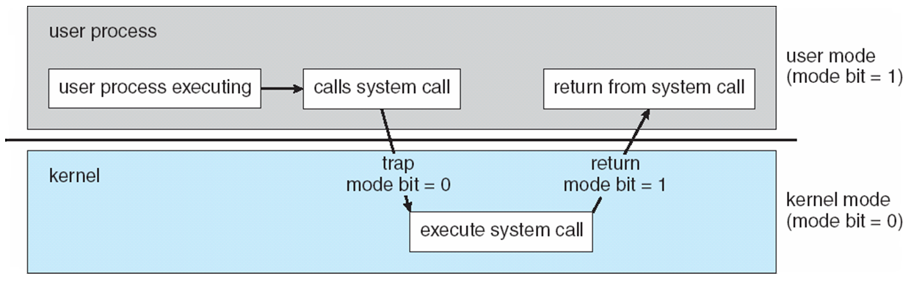
Trap from User to Kernel Mode

Slide 12
References
Presentación de Ramon Ríos.
Capítulos: Operating System Concepts; Silberschatz, Galvin, Gagne.
04 febrero 2020

