Slide 1
SISTEMAS OPERATIVOS
SO
E – M 2020

Slide 2
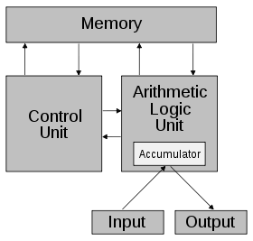
Computer System Architecture
Normal architecture – CPU (Control Unit), ALU, registers, storage unit, I/O devices, etc.….
Von Neumann’s – contribution
The addition of a stored-program in a single separate memory structure that keeps both instructions and data.
The computers that follow the "von Neumann architecture" are also known as the “Stored-Program Computer“.
Registers

Slide 3
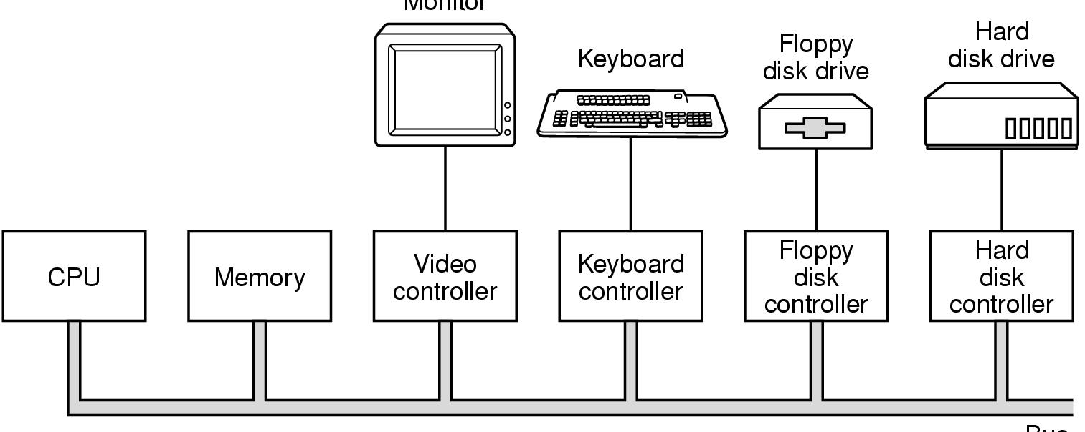
Von Neumann’s architecture + Bus
Monitor
Components of a General Purpose Computer System
Except CPU, every component has a Controller
Each Controller has: registers and a buffer, to take care of the Inputs and Outputs of the devices.
Stored-program
controller
Bus

Slide 4
Computer Structure
.
0
CPU
*PC
MAR
Memory
.
Stored-program
.
1
IR
MBR
Instruction
*SP
I/O AR
Instruction
I/O BR
Instruction
execution
unit
.
.
*PSW
BUS
.
PC - Program Counter
IR - Instruction Register
SP – Stack Pointer
*Must be saved and restored
Data
Data
Data
I/O Module Controllers
Data
.
.
.
.
N
.
MAR - Memory Address Register
MBR - Memory Buffer Register
I/O AR - I/O Address Register
I/O BE - I/O Buffer Register
Buffers

Slide 5
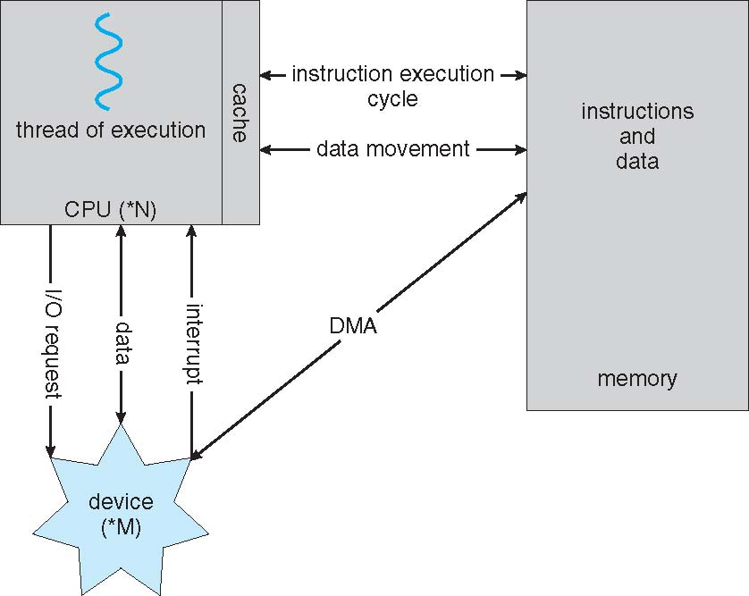
How a Computer Works
A von Neumann architecture

Slide 6
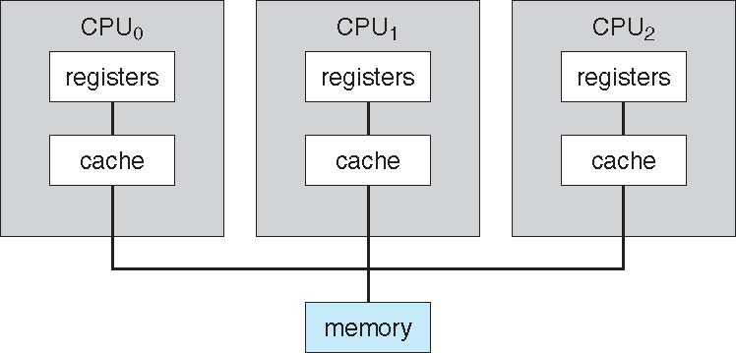
Multiprocessor Architecture
Several processors processing, one shared memory. One Computer System.
General purpose computer system
Every processor services a process for a time slice, next time could serve a different process.
Is there any issue with the shared memory? _____
One-Core/chip.

Slide 7
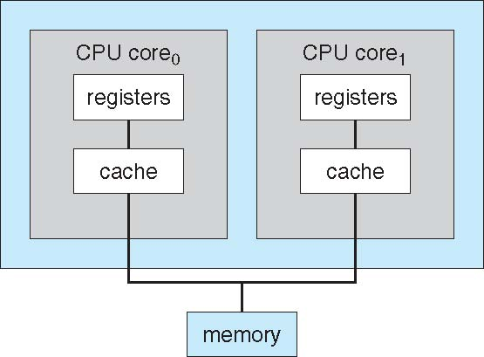
A Dual-Core Design
One-chip / multicore
Traditional: One-thread / core
Increase of processing : Two-threads / core
After math: Two-cores / chip & Two-threads / core = ___

Slide 8
Parallel Systems
Multiprocessors systems growing in use and importance
Also known as parallel systems, tightly-coupled systems
Advantages include:
Increased throughput
Economy of scale
Cooperative parallel applications - (e.g. vectorization).
Two types:
Asymmetric Multiprocessing – each processor is assigned a specific task.
Symmetric Multiprocessing – each processor performs all tasks

Slide 9
Clustered Systems
External Buses
External Buses

Slide 10
Clustered Systems
Multiple Computer Systems working together
Need an external bus to link the clustered computers
Usually sharing storage via a storage-area network (SAN, NAS)
Provides a high-availability service which survives failures
Asymmetric clustering has one machine in hot-standby mode
Symmetric clustering has multiple nodes running applications, monitoring each other

Slide 11
References
Presentación de Ramon Ríos.
Capítulos: Operating System Concepts; Silberschatz, Galvin, Gagne.
04 y 06-feb-2020

