Slide 1
SISTEMAS OPERATIVOS
SO
E – M 2020

Slide 2
Operating-System Components
Operating-System Components

Slide 3
Process Management
A process is a program in execution. It is a unit of work within the system. Program is a passive entity, process is an active entity.
Process needs resources to accomplish its task
CPU, memory, I/O, files
Initialization data
Process termination requires reclaim of any reusable resources
A process has one program counter specifying location of next instruction to execute
Typically system has many processes, some user, some operating system running concurrently on one or more CPUs
Concurrency by multiplexing the CPUs among the processes

Slide 4
Process Management Activities
The operating system is responsible for the following activities in connection with process management:
Creating and deleting both user and system processes
Suspending and resuming processes
Providing mechanisms for process synchronization
Providing mechanisms for process communication
Providing mechanisms for deadlock handling

Slide 5
Memory Management
To execute a program all (or part) of the instructions must be in memory
All (or part) of the data that is needed by the program must be in memory.
Memory management determines what is in memory and when
Optimizing CPU utilization and computer response to users
Memory management activities
Keeping track of which parts of memory are currently being used and by whom
Deciding which processes (or parts thereof) and data to move into and out of memory (from or to disks)
Allocating and deallocating memory space as needed

Slide 6
Storage Management
OS provides uniform, logical view of information storage
Abstracts physical properties to logical storage unit - file
Each medium is controlled by device (i.e., disk drive, tape drive)
Varying properties include access speed, capacity, data-transfer rate, access method (sequential or random)
File-System management
Files usually organized into directories
Access control on most systems to determine who can access what
OS activities include
Creating and deleting files and directories
Primitives to manipulate files and directories
Mapping files onto secondary storage
Backup files onto stable (non-volatile) storage media

Slide 7
I/O Subsystem
One purpose of OS is to hide peculiarities of hardware devices from the user
I/O subsystem responsible for
Memory management of I/O including buffering, caching, spooling
Drivers for specific hardware controller-devices
General device-driver interface

Slide 8
Computer Systems
Computer Systems (cont.)

Slide 9
Distributed Computer Systems
Distributed Computer System
Collection of separate, possibly heterogeneous, systems (nodes) connected together
Network is a communications path, TCP/IP most common
Local Area Network (LAN) or
Wide Area Network (WAN)
Distributed Operating System provides features between systems across network
Communication scheme allows systems to exchange messages
Sharing of CPUs, RAMs, Disks
The user has no idea where the process is running and which resources is using up
Illusion of a single system

Slide 10
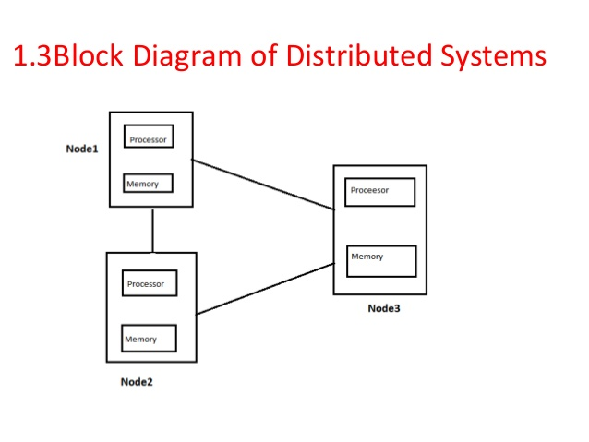
Distributed Computer Systems
CS-a
CS-b
CS-c

Slide 11
Client-Server Computer Systems
Client-Server Computer System
Personal Computers and Mobiles working like clients through browsers that access the servers
Many systems now servers, responding to requests generated by clients
Compute-server system provides an interface to client to request services (i.e. Bank Portals, Amazon, )
File-server system provides interface for clients to store and retrieve files (i.e. Drop Box, One Drive, …)

Slide 12
Real-Time Systems
Often used as a control device in a dedicated application such as controlling scientific experiments, medical imaging systems, industrial control systems, robots and some display systems
Well-defined fixed-time constraints
Critical tasks are completed on time
Utility in industrial control of robotics
Useful in applications (multimedia, virtual reality) requiring tight response times
Conflicts with time-sharing systems, not supported by general-purpose operating systems
Real-Time OS / CS

Slide 13
References
Presentación de Ramón Ríos.
Capítulos: Operating System Concepts; Silberschatz, Galvin, Gagne.
11-feb-2020

