Slide 1
SISTEMAS OPERATIVOS
SO
E – M 2020

Slide 2
What is an Operating System?
A collection of sequential programs and subprograms that act as intermediary between a computer’s user and the computer hardware, inside a Computer System.
Operating system goals:
Execute programs and make solving user problems easier.
Make the computer system convenient to use
Use the computer hardware in an efficient manner

Slide 3
Program and Process definitions
Program – Conjunto de instrucciones secuenciales, que siguiendo las reglas de algún lenguaje, implementan algún algoritmo. Reside en un archivo, constituyendo una entidad pasiva.
Source Program -
Object Program -
Executable Program -
Process (job, or task) – Es una instancia de un programa en ejecución, que reside en memoria central y constituye una entidad activa.

Slide 4
Units of execution
The PROGRAM in the CPU – for the CPU there is only one PROGRAM in the whole memory (the Program Counter contains the address of the next executable instruction). Executable program for the CPU.
The PROCESS in the Operating System – the Operating System places a PROGRAM inside a PROCESS, in the memory. The Operating System can place several PROCCESSes in memory. Then the Operating System tells the CPU which PROGRAM, that is inside a PROCCESS, must execute by replacing the content of the Program Counter. ID per process.

Slide 5
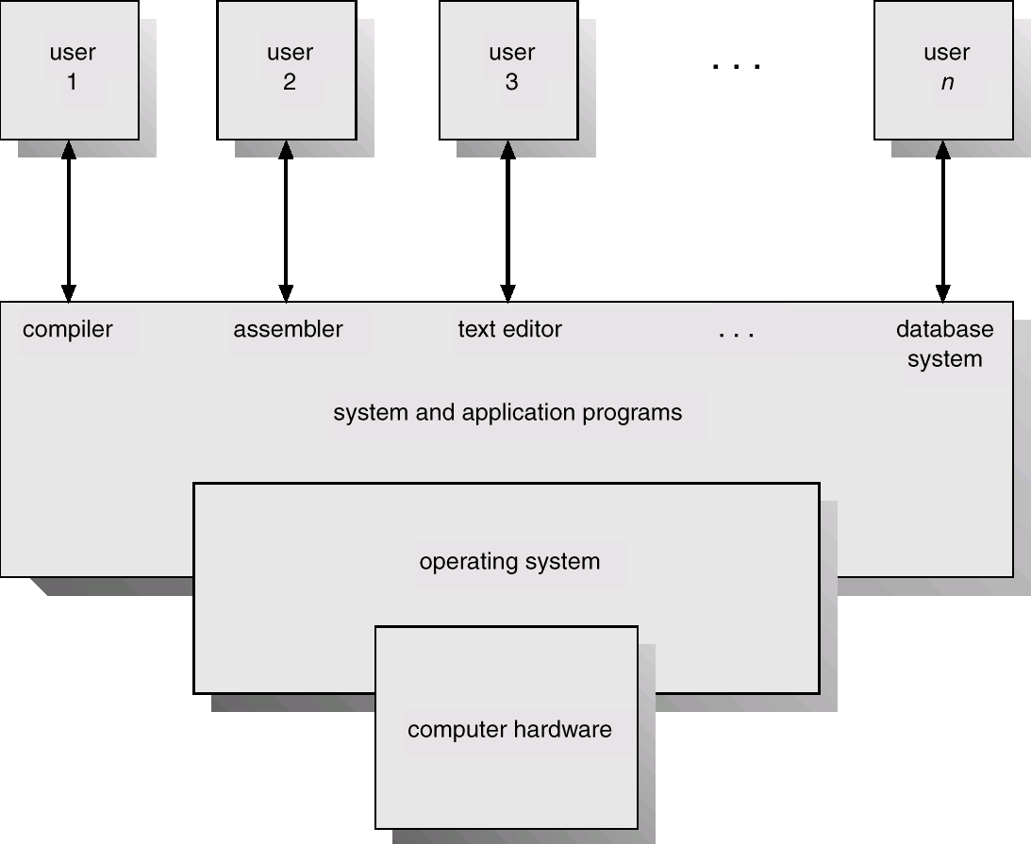
View of Computer System Components
Software

Slide 6
Computer System Components
Users (people, machines, other computers)
System and Applications programs : System programs – help the users to develop applications (compilers, assemblers, database systems, line text editors, etc.). Applications programs – help the users to solve their computing problems (spreadsheets, web explorers, video games, business programs, word processors). -Software-.
Operating system – controls and coordinates the use of the hardware among the various application programs for the various users. For these tasks contains programs and subprograms (kernel) -Software-.
Hardware – provides basic computing resources (CPU, memory, I/O devices)

Slide 7
A modern Operating System
Main services:
Execution of programs // objects: processes
Storage of user information // objects: files

Slide 8
Computer System views of the Op. Sys.
Resource allocator – manages and allocates resources (CPU time, memory space, file-storage space, I/O devices, etc.,…)
Control program – controls the execution of user programs and operations of I/O devices

Slide 9
Referencias
Presentación de Ramon Ríos.
Capítulos: Operating System Concepts; Silberschatz, Galvin, Gagne.
21-ene-2020

