Slide 1
SISTEMAS OPERATIVOS
SO
E – M 2020

Slide 2
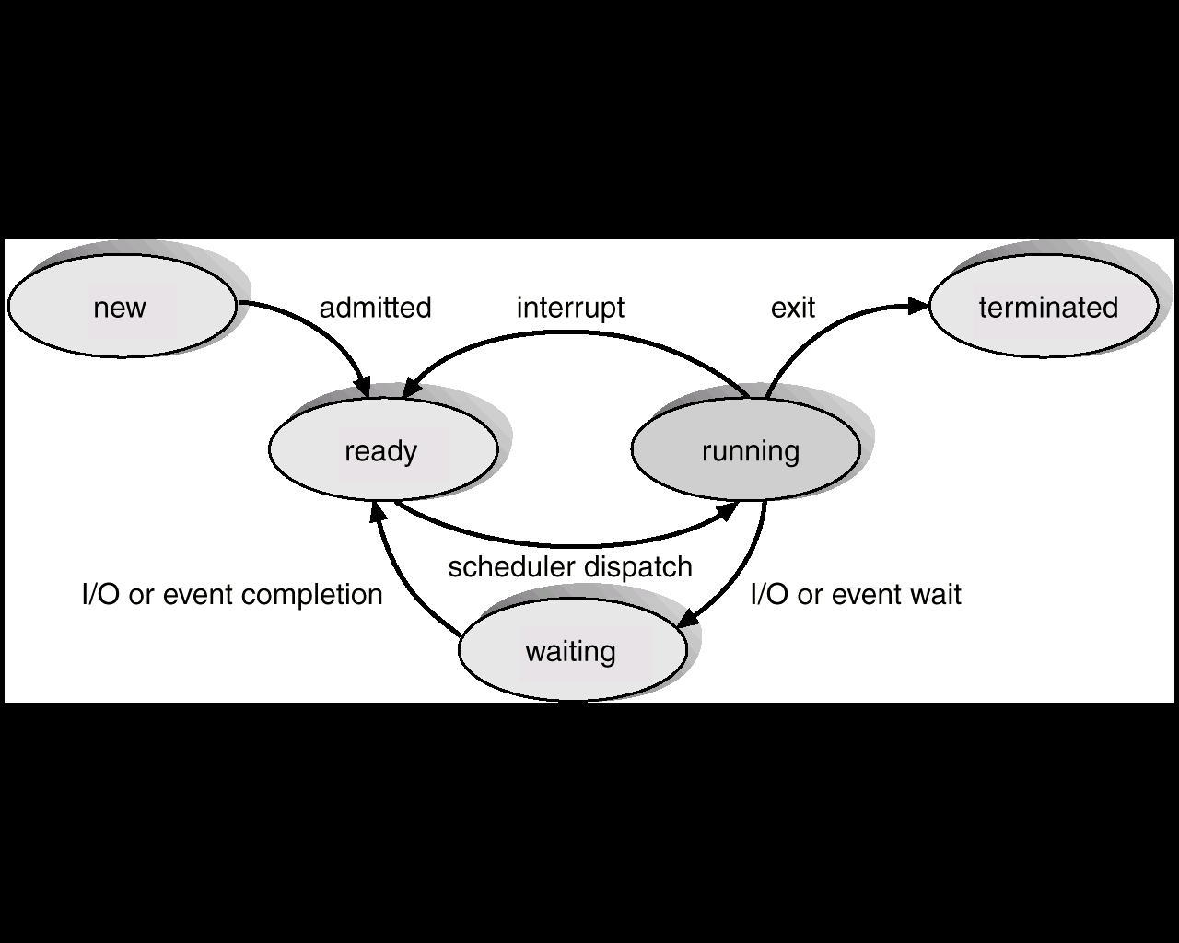
Scheduling
[finished]
[timeout]
[blocked]

Slide 3
Scheduling
CPU scheduler
Asynchronous way in the five-state diagram
No time sharing, and
Time-sharing schedulers

Slide 4
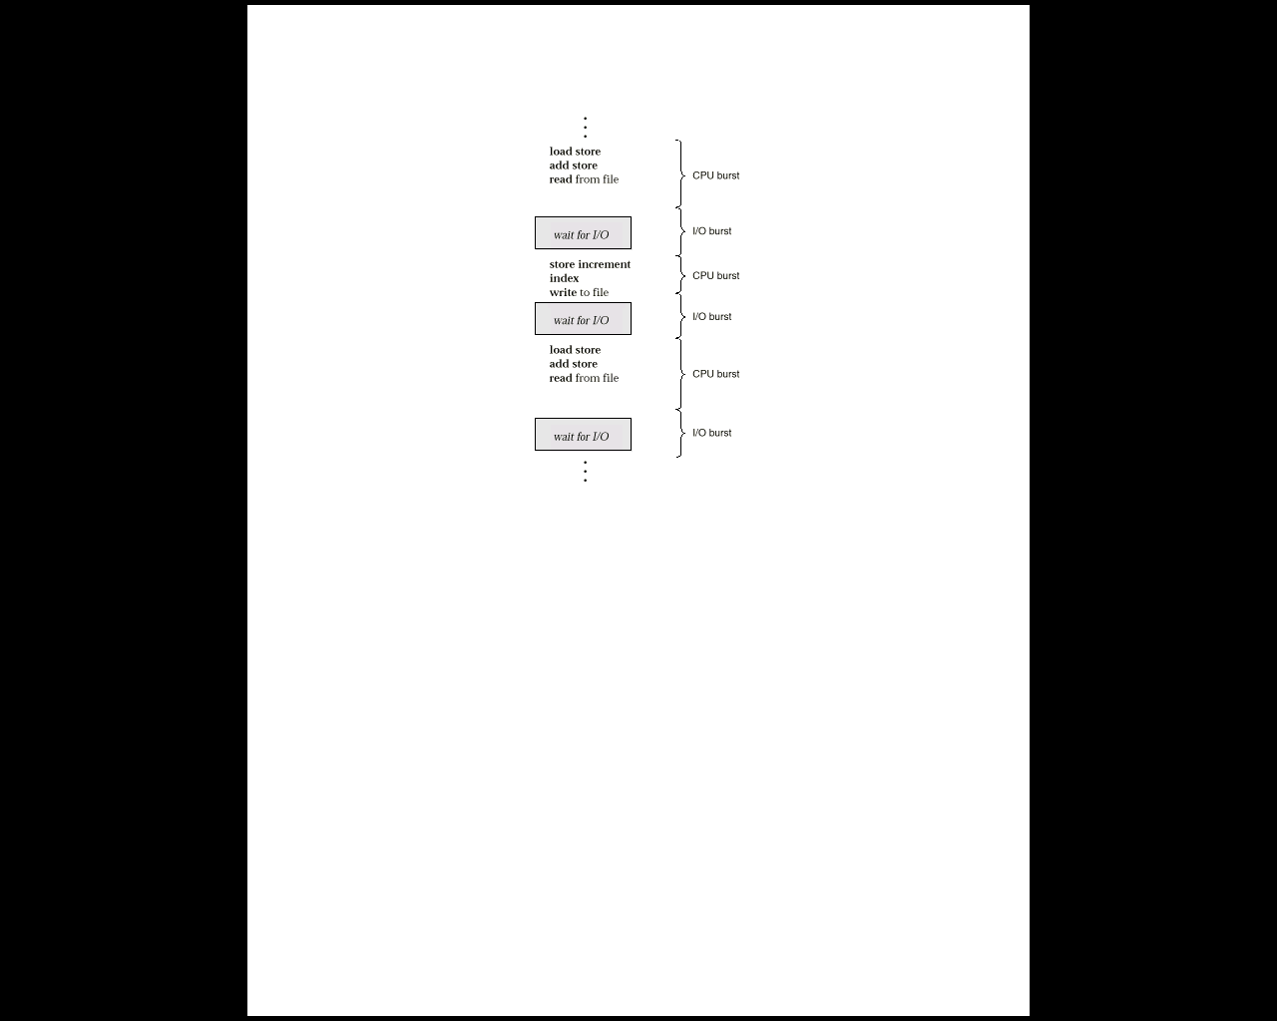
Process Alternating Sequence of CPU and I/O Bursts
begin
RUNNING
IO init
Asynchronous no time-sharing
WAITING
IO init
RUNNING
WAITING
IO init
RUNNING
WAITING
load store
exit
RUNNING
exit
CPU burst
exit

Slide 5
Process behavior
Maximum CPU utilization obtained with multiprogramming.
CPU & I/O Burst Cycle – Process execution consists of a cycle of alternating CPU execution and I/O wait.
A CPU burst – a group of instructions being executed, during the RUNNING sate of a program.
An I/O burst – a continuous time, waiting for an I/O completion, in the WAITING state.
Note: the key factor is the time-length of the CPU burst; never the time-length of the I/O burst.
CPU burst distribution. Out of System control.

Slide 6
State transitions around CPU bursts
Time division process: CPU Burst, [ I/O Burst, CPU Burst ]
CPU Bursts types in RUNNING, between:
Beginning main( ) ---- next I/O Init
After finished an I/O ---- next I/O Init
After finished an I/O ---- exit( )
Beginning main( ) ---- exit( )
Ready waiting time is not included into the bursts

Slide 7
Alternating Sequence of CPU And I/O Bursts
Several long CPU-bursts, very few I/O-bursts
CPU burst
I/O burst
Several short CPU-bursts, many I/O-bursts

Slide 8
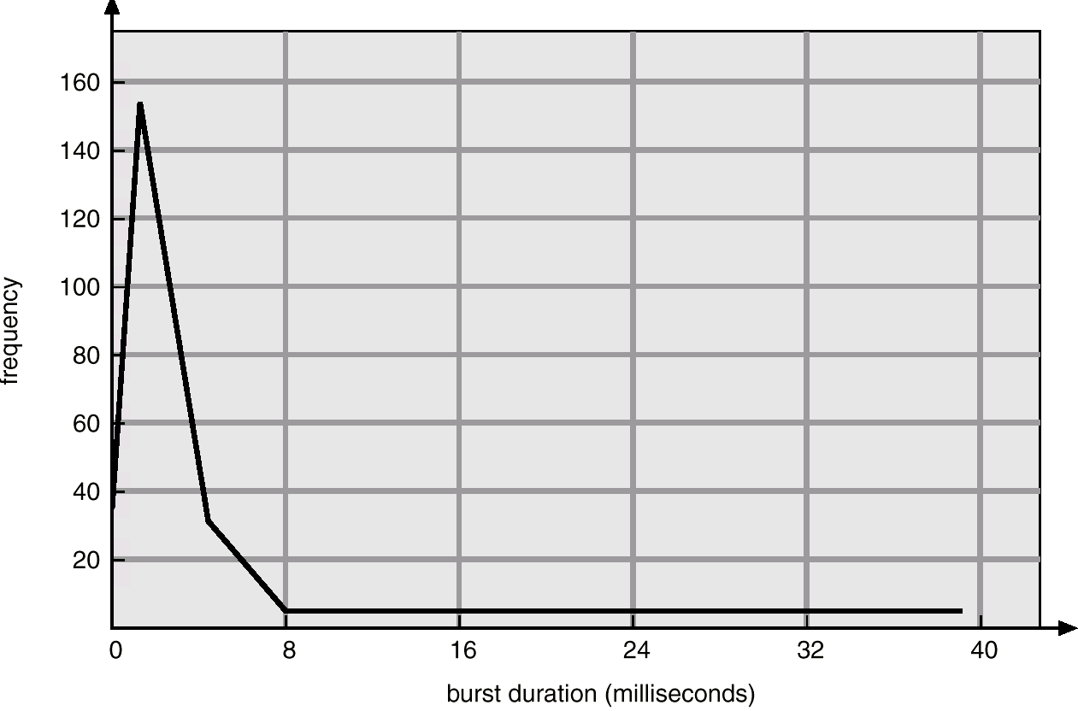
Histogram of CPU-burst Times

Slide 9
Non-preemptive vs Preemptive Scheduling
Scheduling is NON-PREEMPTIVE if once the CPU has been allocated to a process, the process can keep the CPU, until it releases CPU, either by terminating or switching to the waiting state.
Scheduling is PREEMPTIVE (red -) if the CPU can be taken away from a process during execution.
new
ready
running
terminates
waiting
new
ready
running
terminates
waiting

Slide 10
SCHEDULING ALGORITHMS
Non-preemptive algorithms:
Switching states
READY-->RUNNING-->WAITING-->READY
READY-->RUNNING-->TERMINATED
First-Come, First-Served (FCFS)
Shortest-Job-First (SJF)
Preemptive algorithms (time sharing):
Switching states
READY-->RUNNING-->READY
READY-->RUNNING-->WAITING-->READY
READY-->RUNNING-->TERMINATED
Shortest-Remaining-Time-First (SRTF)
Round-Robin (RR)

Slide 11
SCHEDULING ALGORITHMS
Non-preemptive :
What’s going on with a CPU Burst while is in Running? _______
Preemptive:
What’s going on with a CPU Burst while is in Running? _______

Slide 12
Scheduling Criteria
Different CPU scheduling algorithms, have different behavior and performance. The criteria used for comparing these algorithms include:
CPU utilization
Throughput
Waiting time
Turnaround time
Response time
Fairness
Service time

Slide 13
Scheduling Criteria
CPU utilization – keep the CPU as busy as possible - Should range from 50% (lightly loaded system) to 90% for a heavily used system.
Throughput – # of processes that complete their execution per time unit - This may be 1 process/hour for long jobs; or 10 processes/second, for short transactions.
Waiting time – amount of time a process spends waiting in the READY queue.
Turnaround time – amount of time spent in executing a particular process - i.e. The sum of the periods spent waiting to get into memory + waiting in the READY queue + executing on the CPU (RUNNING) + doing I/O (WAITING).
Response time – amount of time it takes from, when a request was submitted until the first response is produced.
Fairness – each process should have a fair share of the CPU.
Service time – CPU execution time (RUNNING).

Slide 14
Optimization Criteria
Max CPU utilization
Max throughput
Min waiting time
Min turnaround time
Min response time
Max fairness
____ Service time?

Slide 15
Process Scheduling
PLANIFICACION DE LOS PROCESOS
(Non-preemptive algorithms)
new
ready
running
terminates
waiting

Slide 16
First-Come, First-Served (FCFS) Scheduling
A non-preemptive algorithm.
First-Input, First-Output (FIFO) READY queue.
The process coming into READY queue goes to the last place (younger).
The process taken from READY queue is the first one (older).
The first process in the READY queue has the highest priority. On the other hand the last process in the queue has the lowest priority.
In the switching context, the next process for running is the older
The average waiting time (in ready) for FCFS policy is often quite long.
Preferred for BATCH processing.

Slide 17
First-Come, First-Served (FCFS) Scheduling
1st exercise: file FCFS01aS.xls
2nd exercise: file FCFS01b.xls
Which exercise is better? __________
Convoy effect : short process behind long process, results in lower CPU utilization, and long waiting and turnaround times.
3rd exercise: file FCFS02a.xls

Slide 18
FCFS troubles
How do you avoid the convoy effect in the FCFS

Slide 19
References
Presentación de Ramon Ríos.
Capítulos: Operating System Concepts; Silberschatz, Galvin, Gagne.
16-abr-2020

