Slide 1
SISTEMAS OPERATIVOS
SO
E – M 2020

Slide 2
Process Scheduling
PLANIFICACION DE LOS PROCESOS
(Non-preemptive algorithms: 2nd. one, SJF)

Slide 3
Shortest-Job-First (SJF) Scheduling
A non-preemptive algorithm.
Associate with each process the length (time) of its next CPU burst. Use these lengths to schedule the process with the shortest time.
Inside the READY queue
The last process is the one with the biggest CPU burst length and then with lowest priority.
The first process is the one with the lowest CPU burst length and then with highest priority.
SJF is optimal – gives minimum average waiting time for a given set of processes.

Slide 4
Determining Length of Next CPU Burst
The estimation of the new length (time) is done just when the process is entering to the Ready queue from the Waiting state
Can be done by using the length of previous CPU bursts, using exponential averaging.

Slide 5
Examples of Exponential Averaging
α =0
τ_{n+1} = τ_{n}
Recent history does not count.
α =1
τ_{n+1} = t_{n}
Only the actual last CPU burst counts.
If we expand the formula, we get:
τ_{n+1} = α t_{n}+(1 - α) α t_{n} -1 + …
+(1 - α )^{n} α t_{n} -1 + …
+(1 - α )^{n+1} t_{n} τ₀
Since both α and (1 - α) are less than or equal to 1, each successive term has less weight than its predecessor.

Slide 6
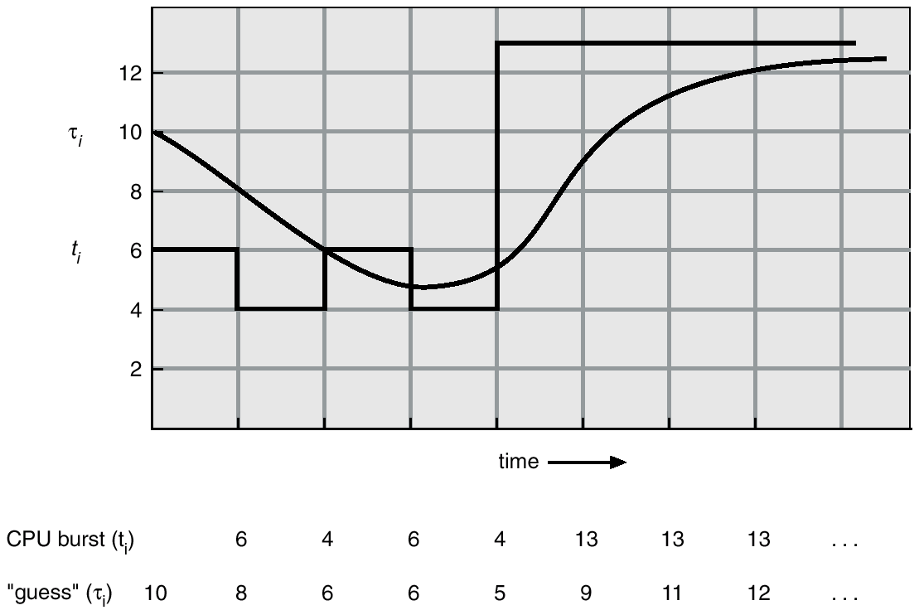
Prediction of the Length of the Next CPU Burst

Slide 7
Shortest-Job-First (SJF) Scheduling – Example 1a
All the processes arrived at the same time:
Process CPU burst time
P1 6
P2 8
P3 7
P4 3
P4
P1
P3
P2
0 3 9 16 24
Average waiting time = (0 + 3 + 9 + 16)/4 = 7 ms

Slide 8
Example 1b - of Non-Preemptive SJF
Process Arrival Time Burst Time
P₁ 0.0 7
P₂ 2.0 4
P₃ 4.0 1
P₄ 5.0 4
SJF (non-preemptive)
Average waiting time = (0 + 6 + 3 + 7)/4 = 4
P₁
P₃
P₂
P₄
0
3
7
8
12
16

Slide 9
Example 2
Solve problem in file SJF02a.xls

Slide 10
Shortest-Job-First (SJF) Scheduling
The SJF algorithm gives the minimum average waiting time for a given set of processes.
The difficulty with SJF is knowing the length (time) of the next CPU request.
For short-term scheduling (CPU Schd.), we have to predict the value of the next burst time.
When several process, inside READY, have the same predicted value of CPU Burst, they are queued under the FCFS algorithm.
Breakdowns
STARVATION problem, high CPU burst estimation, high waiting time, low priority.
AGING solution: if a process is becoming old and accumulates a high waiting time then increase priority, reduce CPU burst estimation.

Slide 11
References
Presentación de Ramón Ríos.
Capítulos: Operating System Concepts; Silberschatz, Galvin, Gagne.
21-abr-2020

