Slide 1
SISTEMAS OPERATIVOS
SO
E – M 2020

Slide 2
Process Scheduling
PLANIFICACION DE LOS PROCESOS – 4
(PREEMPTIVE algorithm RR)

Slide 3
Non-preemptive vs Preemptive Scheduling
Scheduling is NON-PREEMPTIVE if once the CPU has been allocated to a process, the process can keep the CPU until it releases it, either by terminating or switching to the waiting state.
Scheduling is PREEMPTIVE if the CPU can be taken away from a process during execution.
new
ready
running
terminates
waiting
new
ready
running
terminates
waiting

Slide 4
Round Robin (RR)
Preemptive scheduling. RR is the preemptive versión of non-preemptive FCFS.
Each process gets a small unit of CPU time (time quantum or slice), usually 10-100 milliseconds. After this time has elapsed, the process is preempted (interrupted) and added to the end of the Ready queue.
If there are n processes in the Ready queue and the time quantum is q, then each process gets 1/n of the CPU time in chunks of at most q time units at once. No process waits more than (n-1)q time units.

Slide 5
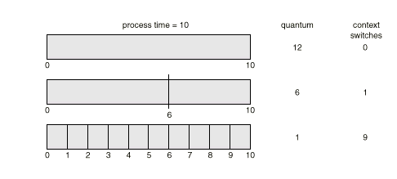
How a Smaller Time Quantum Increases Context Switches
Performance
q large ⇒ FIFO or FCFS
q small ⇒ q must be large with respect to context switch, otherwise overhead is too high.
CPU Burst

Slide 6
Example: RR with Time Quantum = 20
Process Burst Time
P₁ 53
P₂ 17
P₃ 68
P₄ 24
The Gantt chart is (file RR04aS.xls):
Typically, higher average turnaround than FCFS, but better response.
P₁
P₂
P₃
P₄
P₁
P₃
P₄
P₁
P₃
P₃
0
20
37
57
77
97
117
121
134
154
162

Slide 7
Other exercise
A file RR04b.xls.
Process priority in READY. Highest, lowest.

Slide 8
Priority Scheduling
A priority number (integer) is associated with each process, no matter of what scheduling algorithm is on.
The CPU is allocated to the process with the highest priority (smallest integer ≡ highest priority or viceversa).
Preemptive
nonpreemptive
FCFS is a priority scheduling where priority is function of the arriving place from any state.
SJF is a priority scheduling where priority is function of the predicted next CPU burst time.
SJF Problem ≡ Starvation – low priority processes may never execute.
SJF Starvation Solution ≡ Aging – as time progresses increase the priority of the process.

Slide 9
Multilevel Queue
READY QUEUE is partitioned into separate queues: foreground (interactive) background (batch)
Each queue has its own scheduling algorithm, foreground – RR background – FCFS
Scheduling must be done between the queues.
Fixed priority scheduling; i.e., serve all from foreground then from background. Possibility of starvation.
Time slice – each queue gets a certain amount of CPU time which it can schedule amongst its processes; i.e.,
80% to foreground in RR
20% to background in FCFS

Slide 10
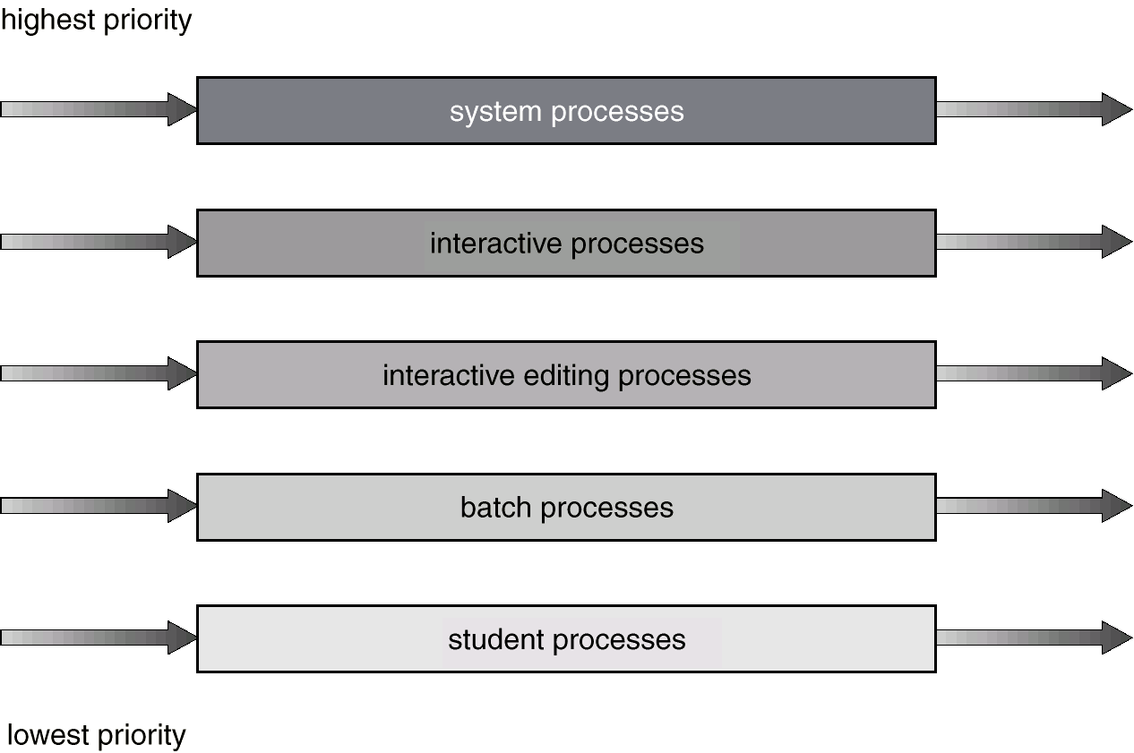
Multilevel Queue Scheduling

Slide 11
Multilevel Feedback Queue
A process can move between the various queues; aging can be implemented this way.
Multilevel-feedback-queue scheduler defined by the following parameters:
number of queues
scheduling algorithms for each queue
method used to determine when to upgrade a process
method used to determine when to demote a process
method used to determine which queue a process will enter when that process needs service

Slide 12
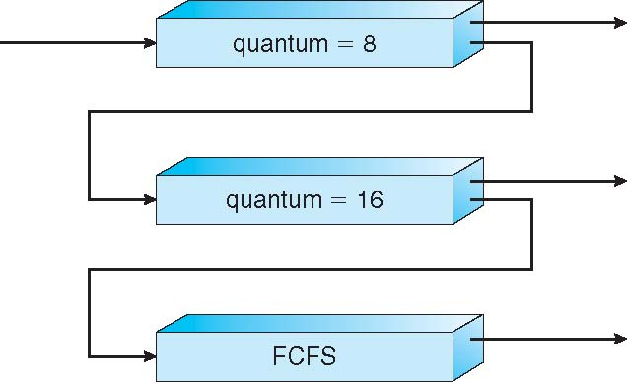
Example of Multilevel Feedback Queue
Three queues:
Q₀ – RR with time quantum 8 milliseconds
Q₁ – RR time quantum 16 milliseconds
Q₂ – FCFS
Scheduling
A new job enters queue Q₀ which is served FCFS
When it gains CPU, job receives 8 milliseconds
If it does not finish in 8 milliseconds, job is moved to queue Q₁
At Q₁ job is again served FCFS and receives 16 additional milliseconds
If it still does not complete, it is preempted and moved to queue Q₂

Slide 13
References
Presentación de Ramón Ríos.
Capítulos: Operating System Concepts; Silberschatz, Galvin, Gagne.
28-abr-2020

