Slide 1
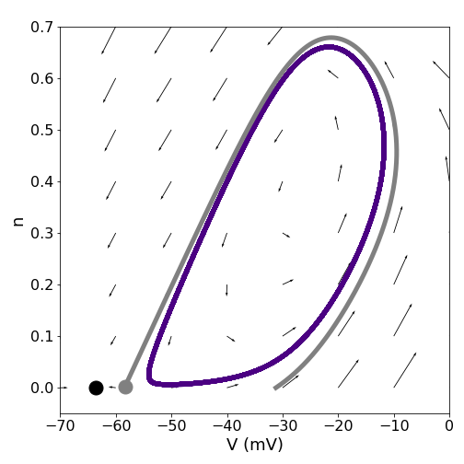
Master thesis defence
Noisy dynamics of a neuron with
co-existing spiking and resting states
Tatiana Prudnikova
Supervisor: Prof. Dr. Susanne Schreiber

Slide 2
Saddle-Node Loop bifurcation

Slide 3
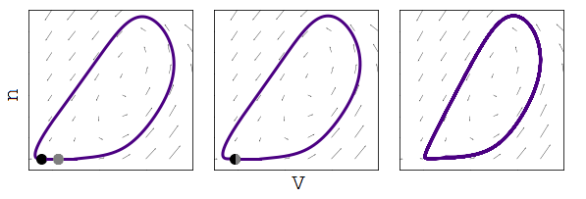
Saddle-Node Loop bifurcation
SNIC

Slide 4
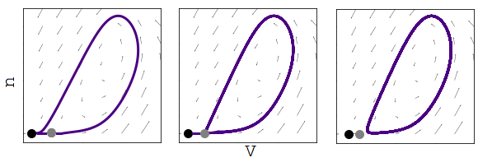
Saddle-Node Loop bifurcation
SNIC
HOM

Slide 5
Saddle-Node Loop bifurcation
SNIC
SNL
HOM

Slide 6
Bistability

Slide 7
Bistability

Slide 8
The INa,p+IK model
$$CV^{′}=I-I_{L}-I_{Na,p}-I_{K}+I_{noise}$$

Slide 9
The INa,p+IK model
$$CV^{′}=I-I_{L}-I_{Na,p}-I_{K}+I_{noise}$$
$$I_{L}=g_{L}(V-E_{L})$$
$$I_{Na,p}=g_{Na}m_{∞}(V)(V-E_{Na})$$
$$I_{K}=g_{K}n(V-E_{K})$$

Slide 10
The INa,p+IK model
$$CV^{′}=I-I_{L}-I_{Na,p}-I_{K}+I_{noise}$$
$$I_{L}=g_{L}(V-E_{L})$$
$$I_{Na,p}=g_{Na}m_{∞}(V)(V-E_{Na})$$
$$I_{K}=g_{K}n(V-E_{K})$$
$$n^{′}=(n_{∞}-n)/τ_{n}$$

Slide 11
The INa,p+IK model
$$CV^{′}=I-I_{L}-I_{Na,p}-I_{K}+I_{noise}$$
$$I_{L}=g_{L}(V-E_{L})$$
$$I_{Na,p}=g_{Na}m_{∞}(V)(V-E_{Na})$$
$$I_{K}=g_{K}n(V-E_{K})$$
$$n^{′}=(n_{∞}-n)/τ_{n}$$
$$n_{∞}=\frac{1}{1+e^{(-25-V)/5}}$$
$$m_{∞}=\frac{1}{1+e^{(-20-V)/15}}$$

Slide 12
The INa,p+IK model
$$CV^{′}=I-I_{L}-I_{Na,p}-I_{K}+I_{noise}$$
$$C=1μF/cm^{2}$$
$$g_{L}=8mS/cm^{2}$$
$$I_{L}=g_{L}(V-E_{L})$$
$$g_{Na}=20mS/cm^{2}$$
$$I_{Na,p}=g_{Na}m_{∞}(V)(V-E_{Na})$$
$$g_{K}=10mS/cm^{2}$$
$$E_{L}=-80mV$$
$$I_{K}=g_{K}n(V-E_{K})$$
$$E_{Na}=60mV$$
$$n^{′}=(n_{∞}-n)/τ_{n}$$
$$E_{K}=-90mV$$
$$I_{noise}:μ=3μA,σ^{2}=1μA^{2}$$
$$n_{∞}=\frac{1}{1+e^{(-25-V)/5}}$$
$$m_{∞}=\frac{1}{1+e^{(-20-V)/15}}$$

Slide 13
The INa,p+IK model
$$CV^{′}=I-I_{L}-I_{Na,p}-I_{K}+I_{noise}$$
$$C=1μF/cm^{2}$$
$$g_{L}=8mS/cm^{2}$$
$$I_{L}=g_{L}(V-E_{L})$$
$$g_{Na}=20mS/cm^{2}$$
$$I_{Na,p}=g_{Na}m_{∞}(V)(V-E_{Na})$$
$$g_{K}=10mS/cm^{2}$$
$$E_{L}=-80mV$$
$$I_{K}=g_{K}n(V-E_{K})$$
$$E_{Na}=60mV$$
$$n^{′}=(n_{∞}-n)/τ_{n}$$
$$E_{K}=-90mV$$
$$I_{noise}:μ=3μA,σ^{2}=1μA^{2}$$
$$n_{∞}=\frac{1}{1+e^{(-25-V)/5}}$$
$$m_{∞}=\frac{1}{1+e^{(-20-V)/15}}$$
$$I$$
parameters of the model
$$τ_{n}$$

Slide 14
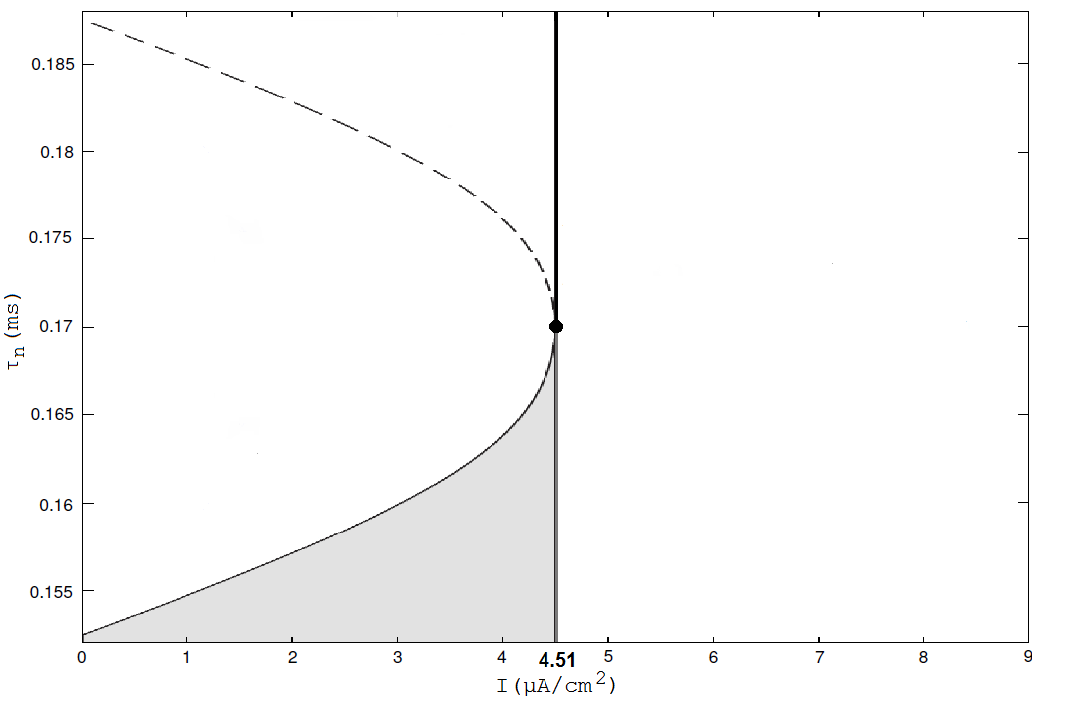
Bifurcation diagram

Slide 15
SNIC bifurcation

Slide 16
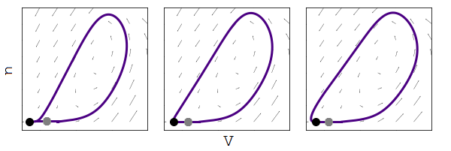
Changing manifold

Slide 17
HOM bifurcation

Slide 18
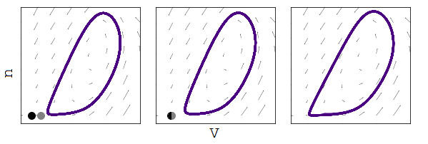
SN bifurcation

Slide 19
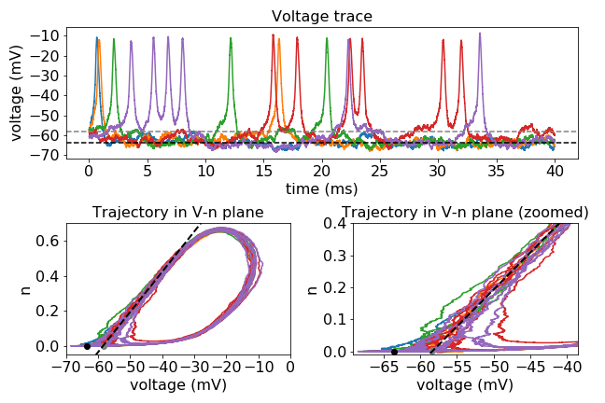
Voltage traces and trajectories

Slide 20
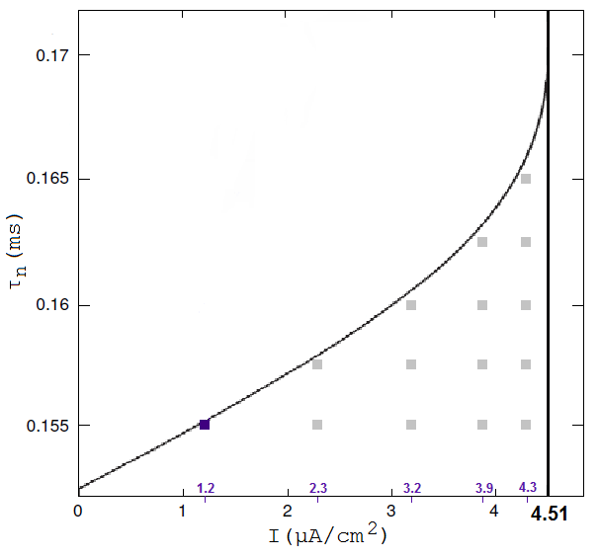
Selected points

Slide 21
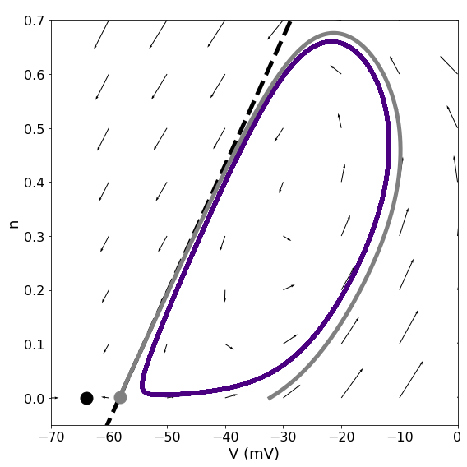
Separatrix approximation

Slide 22
Phase plane and applied current I

Slide 23
Phase plane and time constant τn

Slide 24
Overall ISI histogram and applied current I

Slide 25
Overall ISI histogram and time constant τn

Slide 26
log-histogram and applied current I

Slide 27
log-histogram and time constant τn

Slide 28
Burst/Quiet ISI histograms and applied current I

Slide 29
Burst/Quiet ISI histograms and time constant τn

Slide 30
Overall ISI shape
Three factors:

Slide 31
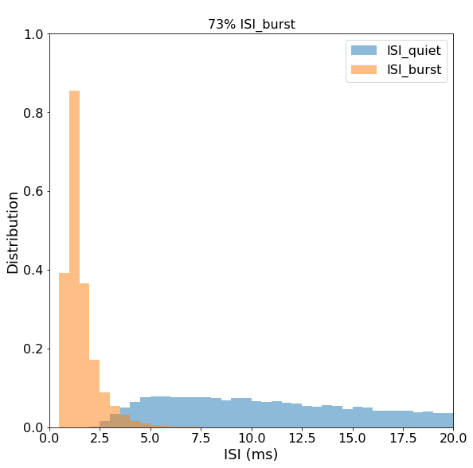
Overall ISI shape
Three factors:
Always early peak for quiet ISIs

Slide 32
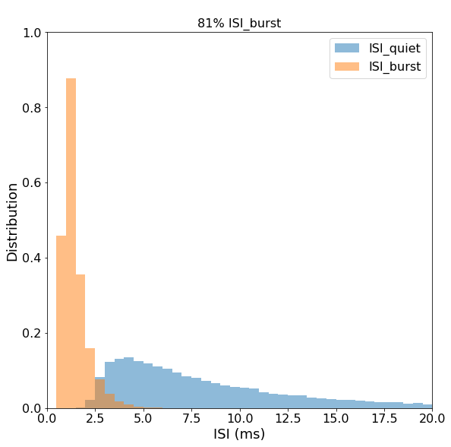
Overall ISI shape
Three factors:
Always early peak for quiet ISIs
Burst ISIs outnumber quiet ISIs

Slide 33
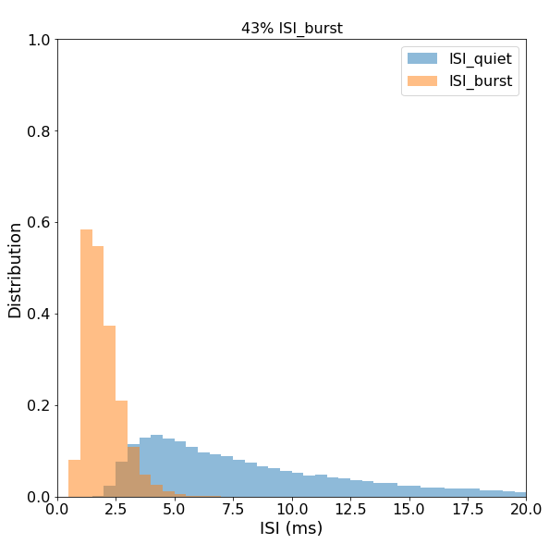
Overall ISI shape
Three factors:
Always early peak for quiet ISIs
Burst ISIs outnumber quiet ISIs
When they don’t, the overlap between the distributions is bigger

Slide 34
Conclusion
Distribution with initial peak and long exponential shoulder

Slide 35
Conclusion
Distribution with initial peak and long exponential shoulder
Bursting != Bimodal ISI

Slide 36
Conclusion
Distribution with initial peak and long exponential shoulder
Bursting != Bimodal ISI
Similar distributions observed in other models with HOM bifurcation

Slide 37
Thank you!
Questions?

