Slide 1
RA-GARK
Product Recommendation via Rationale-Aware Gating over Sparse Review-Aspect Knowledge Graphs
基於理由感知門控與稀疏評論面向知識圖譜之產品推薦
KG-aware Recommendation · Sparse KG · Rationale-aware Gating · Graceful Degradation
Main idea
KG should be a gateable side channel, not a mandatory scoring path.
01

Slide 2
INTRODUCTION
Roadmap
30 分鐘配置
• Introduction
• Related Work
• Methodology
• Experiments
• Conclusion & future work
Focus
Methodology is the main part; related work is only for positioning.
02

Slide 3
INTRODUCTION
Motivation
Sparse KG breaks KG-aware recommendation
| Method | NDCG@20 |
|---|---:|
| MCCLK | 0.1067 |
| KGCL | 0.1073 |
| KGAT | 0.1079 |
| KGRec | 0.1095 |
| Pure LightGCN | 0.1179 |
Key point
On this sparse KG, every KG-aware baseline loses to pure LightGCN.
03

Slide 4
INTRODUCTION
Why Sparse KG
Where sparse KG comes from
• review-derived KGs inherit their density from whatever users happened to mention
• cold-start and emerging domains rarely have a curated KG
• privacy-constrained domains deliberately restrict relational signals
• aggressive KG completion introduces its own noise and needs seed signal
What this means
• sparse KG is the more common practical setting
• robustness under unreliable KG signal deserves dedicated study
• the primary design objective is robustness, not only peak performance
Takeaway
• sparse KG is the regime this thesis targets
04

Slide 5
RELATED WORK
Design Challenge
Observed tension in prior KG-aware methods
• KG entity embeddings participate directly in message passing
• the implicit assumption is that KG can inject useful signal everywhere it appears
• under sparse KG, that assumption breaks down
Why LightGCN wins
• It uses only user-item interactions
• No KG contamination
• Strong safe default
Our response
• route KG signal through a dedicated side channel
• let the model attenuate or fully disengage KG when unreliable
05

Slide 6
RELATED WORK
Research Question
Research question
How can a recommender use KG when it helps, but avoid KG contamination when KG is sparse or unreliable?
RA-GARK answer
KG should be a gateable side channel.
06

Slide 7
RELATED WORK
Related Work I
LightGCN
• immediate predecessor of our local view
• strong non-KG anchor on sparse review KG
KGAT
• canonical deep-fusion approach
• KG entities participate directly in propagation
Position of RA-GARK
• adopt LightGCN verbatim as local view
• isolate KG signal into a separate global view
07

Slide 8
RELATED WORK
Related Work II
Contrastive KG methods
• KGCL
• MCCLK
Assumption
• KG structure remains informative under perturbation
• collaborative, semantic, and structural views can be aligned
Sparse-KG issue
• sparse or perturbed KG gives weak supervision
• contrastive alignment may become noise-dominated
08

Slide 9
RELATED WORK
Related Work III
KGRec vs RA-GARK
| Axis | KGRec | RA-GARK |
|---|---|---|
| Granularity | KG edge | latent aspect slot |
| Selection | Bernoulli dropout + CL | softmax attention |
| Integration | inside KGAT propagation | separate side channel |
| KG trust | cannot disengage KG | can suppress KG |
Main difference
KGRec assumes useful edges exist; RA-GARK assumes the whole KG channel may be unreliable.
09

Slide 10
RELATED WORK
Related Work IV
Gating gap
• Highway Networks: bias toward a safe identity path
• MMoE / PLE: gate over expert towers
• SGL / DCCF: alignment over views from the same graph
Gap in KG-aware recommendation
• no bias-initialized fusion gate
• no architectural graceful degradation under sparse or unreliable KG
10

Slide 11
METHODOLOGY
Design Principle
RA-GARK principle
KG should be a gateable side channel, not a mandatory scoring component.
Three consequences
• separate local and global views
• fuse late
• bias the gate toward LightGCN at initialization
11

Slide 12
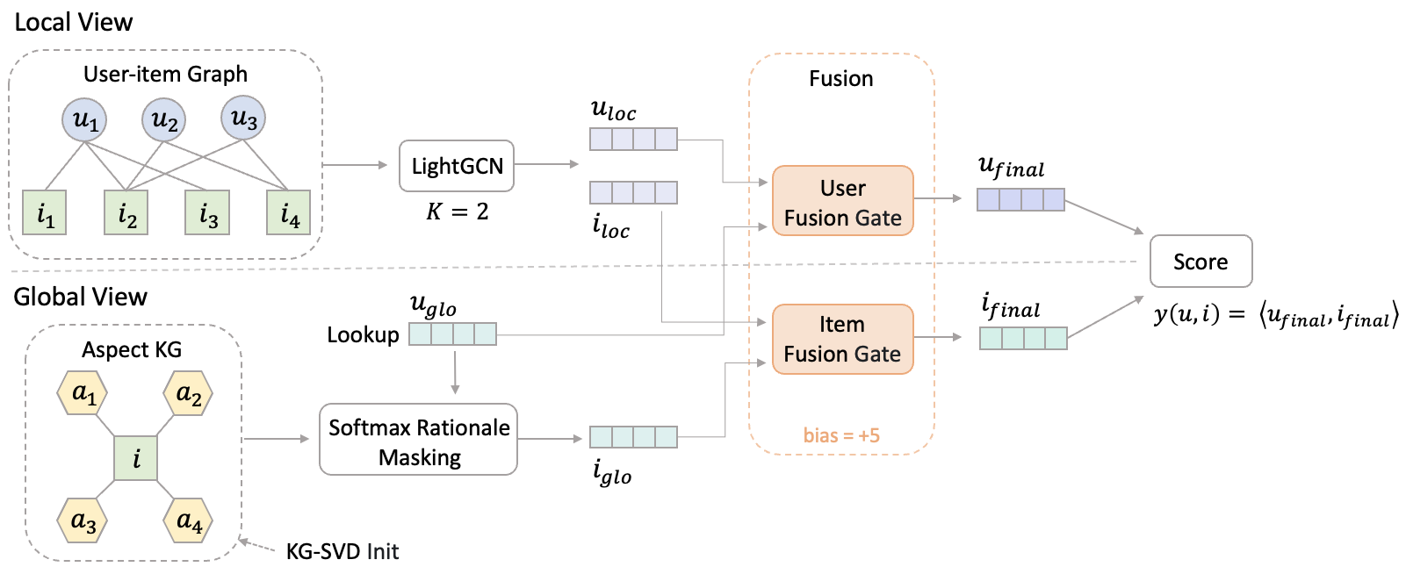
METHODOLOGY
Overview
Modules
| Module | Output |
|---|---|
| Local View | `u_loc`, `i_loc` |
| Global View | `u_glo`, `i_glo` |
| Fusion Gate | `u_final`, `i_final` |
| Training Loss | ranking objective |
12

Slide 13
METHODOLOGY
Problem Setup
Implicit top-K recommendation
• rank unseen items for each user
• train with positive and sampled negative pairs
Score
y_hat(u, i) = <u_final, i_final>
Fusion
u_final = alpha_u * u_loc + (1 - alpha_u) * u_glo
i_final = alpha_i * i_loc + (1 - alpha_i) * i_glo
13

Slide 14
METHODOLOGY
Local View
Pure LightGCN
• no KG in this branch
• no nonlinear transform
• no extra weights in propagation
Why
• preserve a clean CF backbone
• keep a safe fallback path
14

Slide 15
METHODOLOGY
Local Propagation
Graph
• user-item bipartite graph
• training interactions only
Propagation
E^(l+1) = A_norm E^(l)
E_loc = average(E^(0), E^(1), ..., E^(K))
Setting
• K = 2
• output: `u_loc`, `i_loc`
15

Slide 16
METHODOLOGY
Global View
Why latent aspect slots
• raw review-aspect KG is sparse
• direct propagation is fragile
• latent slots give a compact KG representation
Representation
item_kg_aspects[i] in R^(A x d)
A = 4
d = 128
16

Slide 17
METHODOLOGY
KG-SVD Step 1
Build item-aspect matrix
M[i, a] = 1 if item i has aspect a
IDF weighting
M_tilde[i, a] = M[i, a] * idf(a)
idf(a) = log(N_items / support(a) + 1) + 1
Purpose
• downweight generic aspects
• keep discriminative aspects
17

Slide 18
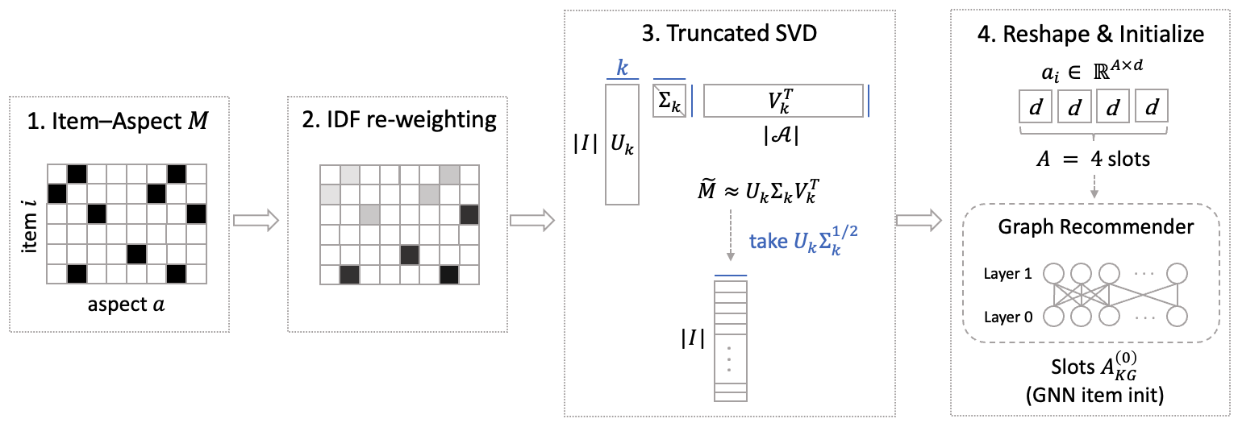
METHODOLOGY
KG-SVD Step 2
Truncated SVD
M_tilde ~= U Sigma V^T
E_KG = U sqrt(Sigma)
Reshape
E_KG[i] -> item_kg_aspects[i] in R^(4 x 128)
Why
• give KG a semantic starting geometry
• preserve the aspect co-occurrence structure before training
18

Slide 19
METHODOLOGY
KG-SVD Ablation
| Model | NDCG@20 | MAP@20 |
|---|---:|---:|
| RA-GARK (full) | 0.1243 | 0.0594 |
| w/o KG-SVD init | 0.1171 | 0.0545 |
Observation
• KG-SVD preserves the initial semantic geometry
19

Slide 20
METHODOLOGY
Softmax Masking
Goal
Select which aspect slot should represent the item for a given user-item pair.
Computation
logit_k = MLP([u_glo || aspect_slot_i,k])
w_k = softmax(logit_k / tau)
i_glo = sum_k w_k * aspect_slot_i,k
Why user-conditioned
• different users care about different item aspects
20

Slide 21
METHODOLOGY
Softmax vs Sigmoid
Normalization assumption
| Normalization | Assumption |
|---|---|
| Sigmoid | each slot is independently important |
| Softmax | slots compete under fixed mass |
In RA-GARK
• softmax controls both weight competition and output magnitude
• this matters because the KG channel is intentionally throttled
21

Slide 22
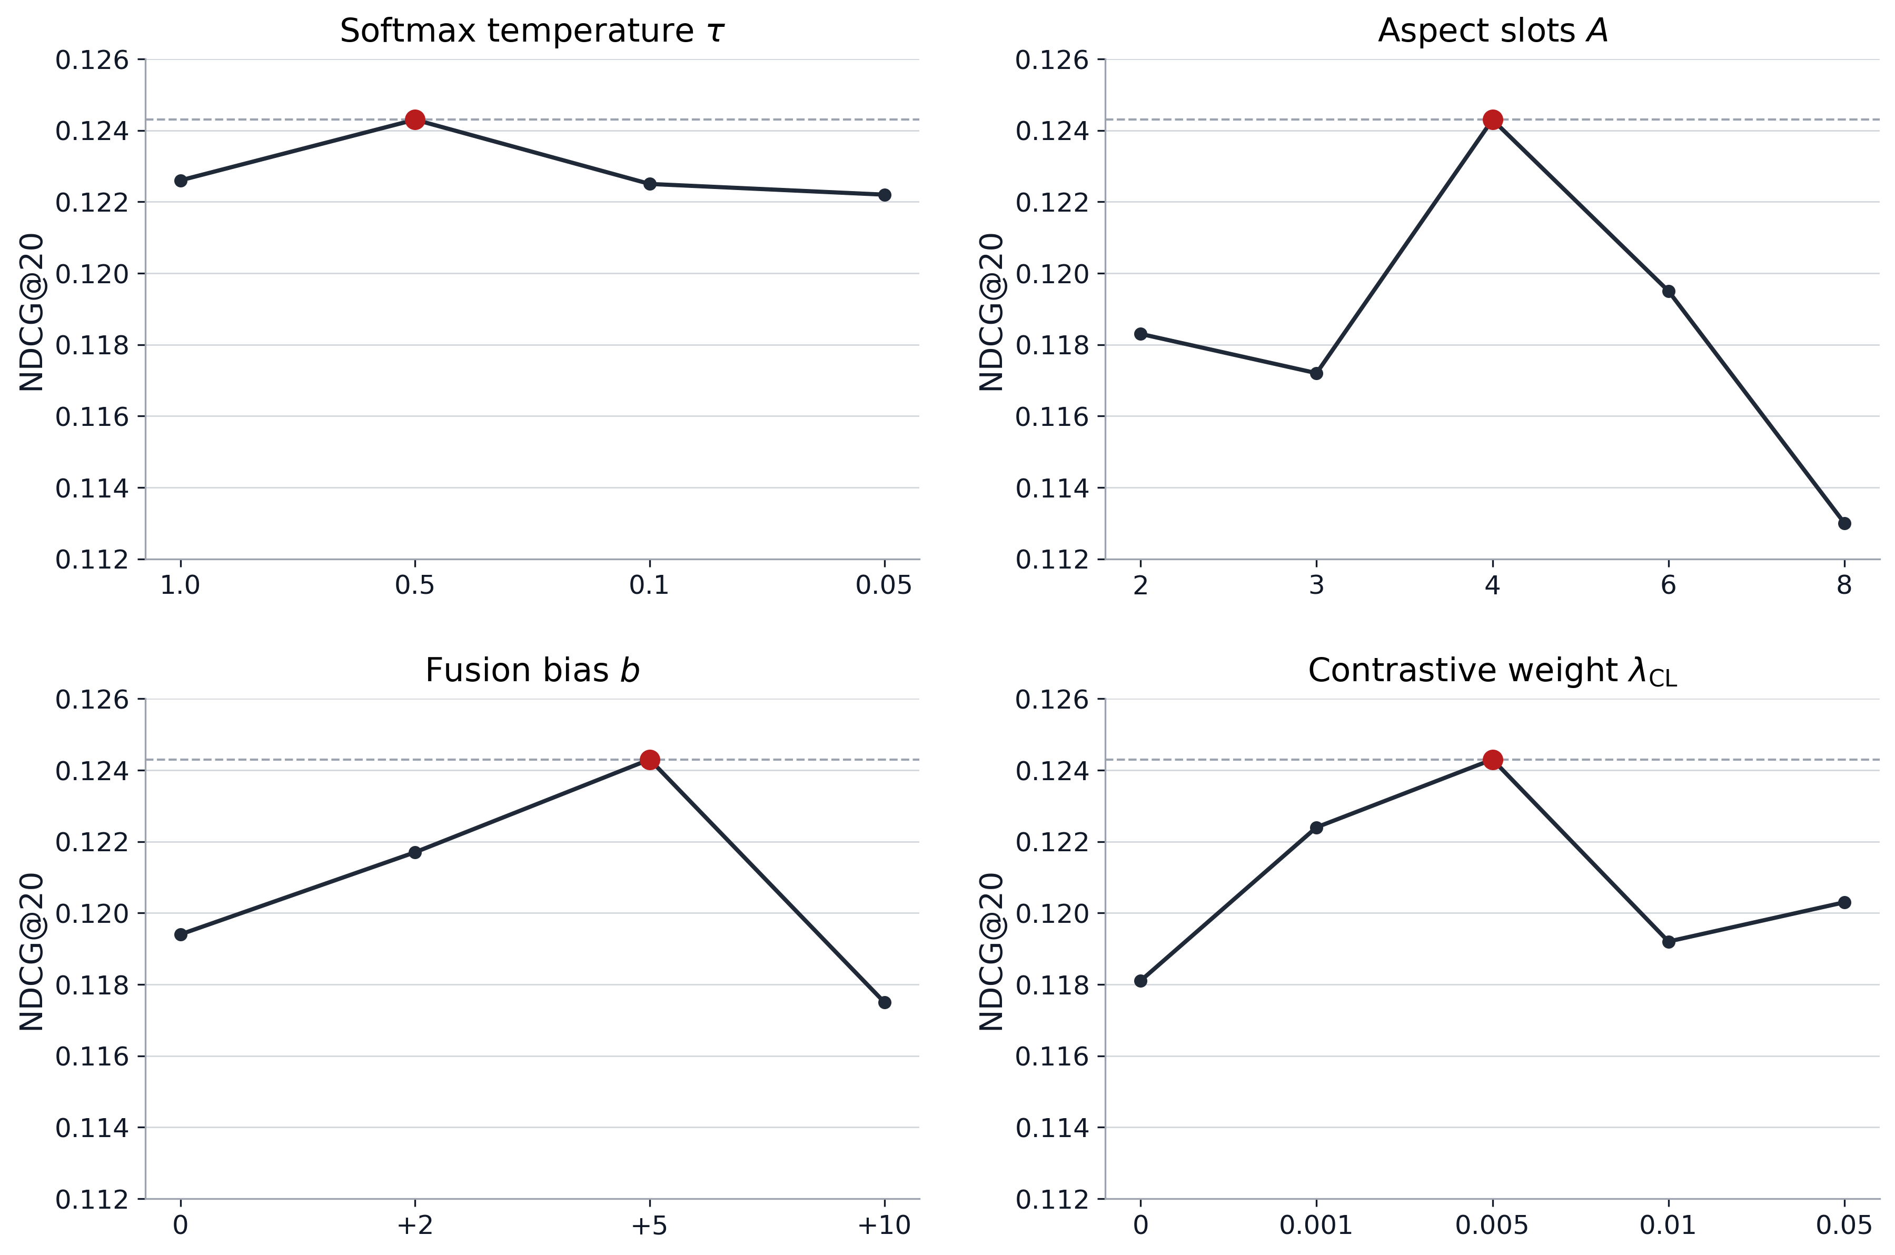
METHODOLOGY
Softmax Ablation
| Model | NDCG@20 | MAP@20 |
|---|---:|---:|
| RA-GARK (full) | 0.1243 | 0.0594 |
| w/o softmax head | 0.1005 | 0.0451 |
Observation
• softmax is the thesis-normalized rationale operator
22

Slide 23
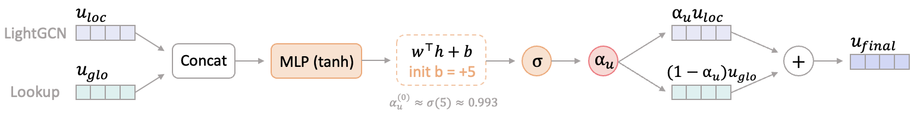
METHODOLOGY
Fusion Gate
Gate
alpha_u = sigmoid(MLP_gate([u_loc || u_glo]))
alpha_i = sigmoid(MLP_gate([i_loc || i_glo]))
Fusion
u_final = alpha_u * u_loc + (1 - alpha_u) * u_glo
i_final = alpha_i * i_loc + (1 - alpha_i) * i_glo
23

Slide 24
METHODOLOGY
Gate Bias
Bias initialization
gate final bias = +5
alpha_0 = sigmoid(+5) ~= 0.993
Meaning
• start almost as LightGCN
• open KG only when useful
24

Slide 25
METHODOLOGY
Graceful Degradation
Graceful degradation
If KG is not useful, RA-GARK falls back to LightGCN.
Ablation
| Model | NDCG@20 | MAP@20 |
|---|---:|---:|
| RA-GARK (full) | 0.1243 | 0.0594 |
| w/o fusion-gate bias | 0.1194 | 0.0555 |
Observation
• the bias initialization is part of the architecture, not a tuning trick
25

Slide 26
METHODOLOGY
Contrastive Regularization
Main objective
L = L_BPR + lambda_CL (L_aCL + L_uCL)
lambda_CL = 0.005
Role
• auxiliary only
• weak alignment
• not the main fusion mechanism
Conservative design
• small weight
• stop-gradient on KG side
• projection head
26

Slide 27
EXPERIMENTS
Training Setup
Dataset signal
• 905 users
• 1,399 items
• 22,265 interactions
• 3,370 KG edges
• 2,098 aspects
Training
• Adam
• learning rate 1e-3
• batch size 128
• 80 epochs with early stopping
27

Slide 28
EXPERIMENTS
Evaluation Setup
Evaluation
• full ranking
• exclude training interactions
• metrics: HR, Precision, Recall, F1, MAP, NDCG @20
Efficiency
• about 1.5 seconds per epoch
• comparable to KGRec
• no extra training burden
28

Slide 29
EXPERIMENTS
Main Results
| Model | NDCG@20 | HR@20 | Recall@20 | MAP@20 |
|---|---:|---:|---:|---:|
| MCCLK | 0.1067 | 0.4530 | 0.1720 | 0.0497 |
| KGCL | 0.1073 | 0.4696 | 0.1827 | 0.0479 |
| KGAT | 0.1079 | 0.4773 | 0.1807 | 0.0491 |
| KGRec | 0.1095 | 0.4729 | 0.1834 | 0.0500 |
| LightGCN | 0.1179 | 0.4917 | 0.1937 | 0.0555 |
| RA-GARK | 0.1243 | 0.4972 | 0.2020 | 0.0594 |
| Model | NDCG@10 | HR@10 | Recall@10 | MAP@10 |
|---|---:|---:|---:|---:|
| MCCLK | 0.0804 | 0.3182 | 0.1047 | 0.0416 |
| KGCL | 0.0809 | 0.3260 | 0.1096 | 0.0410 |
| KGAT | 0.0786 | 0.3215 | 0.1102 | 0.0388 |
| KGRec | 0.0874 | 0.3249 | 0.1155 | 0.0465 |
| LightGCN | 0.0908 | 0.3436 | 0.1201 | 0.0483 |
| RA-GARK | 0.0966 | 0.3558 | 0.1265 | 0.0520 |
Key point
• RA-GARK is best at both Top-20 and Top-10.
29

Slide 30
EXPERIMENTS
Ablation Summary
| Model | NDCG@20 | MAP@20 |
|---|---:|---:|
| RA-GARK (full) | 0.1243 | 0.0594 |
| w/o softmax head | 0.1005 | 0.0451 |
| w/o KG-SVD init | 0.1171 | 0.0545 |
| w/o fusion-gate bias | 0.1194 | 0.0555 |
| w/o MLP gate | 0.1180 | 0.0552 |
| w/o user CL ($\mathcal{L}_{\mathrm{uCL}}$) | 0.1192 | 0.0563 |
| w/o aspect CL ($\mathcal{L}_{\mathrm{aCL}}$) | 0.1200 | 0.0570 |
| w/o rationale-enabled selection | 0.1213 | 0.0568 |
| w/o global view (CL-only dual view) | 0.1219 | 0.0575 |
| Model | NDCG@10 | MAP@10 |
|---|---:|---:|
| RA-GARK (full) | 0.0960 | 0.0519 |
| w/o softmax head | 0.0785 | 0.0397 |
| w/o KG-SVD init | 0.0922 | 0.0479 |
| w/o fusion-gate bias | 0.0923 | 0.0482 |
| w/o MLP gate | 0.0926 | 0.0484 |
| w/o user CL ($\mathcal{L}_{\mathrm{uCL}}$) | 0.0924 | 0.0492 |
| w/o aspect CL ($\mathcal{L}_{\mathrm{aCL}}$) | 0.0940 | 0.0502 |
| w/o rationale-enabled selection | 0.0943 | 0.0495 |
| w/o global view (CL-only dual view) | 0.0949 | 0.0504 |
Takeaway
• the core architecture rows dominate the ranking loss
30

Slide 31
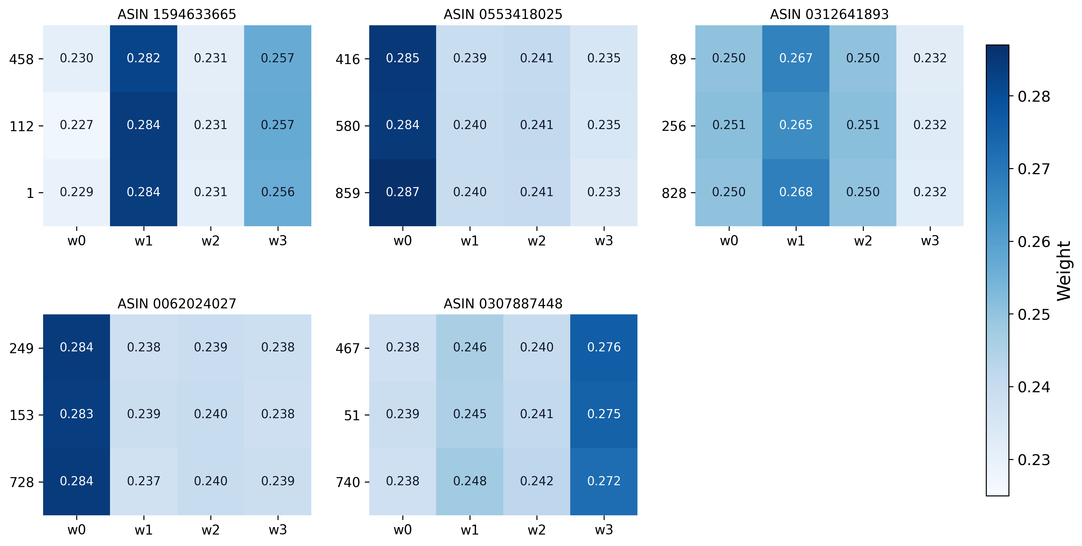
CONCLUSION
Case Study and Takeaways
Takeaways
• different items activate different aspect slots
• rationale masking gives interpretability
• the model is not only accurate, it also shows which slot is used
31

Slide 32
CONCLUSION
Conclusion
Conclusion
When the KG is unreliable, what an architecture most needs is not a better KG aggregator but a structural switch by which the KG can be opted out of.
Contributions
• gateable KG side channel
• KG-SVD initialization
• softmax rationale masking
• local-biased fusion gate
Limitations
• one sparse review-aspect KG dataset
• KG construction pipeline is adopted
• dense-KG settings may still favor deep fusion
32

