Slide 1

MA 汇报7
Fang
08. September 2026

Slide 2
Content
1. Eye-tracking
2. HMM training

Slide 3
Eye-tracking
Initial comparison-rule
Discussion
✅
Data diagnosis
rule refinement
Discussion
✅
Synchronization-rule update
Discussion
✅
Final rule
final rule
new
raw
raw
anchor data
comparison
result
Synchronization result
Annotation-rule update
Discussion
Final check/review
✅

Slide 4
Eye-tracking
1. Initial comparison-rule drafting & discussion
initial gaze comparison rules based on union logic（>=100ms)
Cases: containment, partial overlap, and no overlap
2. Data diagnosis and rule refinement & discussion
Diagnosed the two annotation datasets before final comparison
more complex cases:
a. one-to-one overlap, too long
b. complex overlap: one to many/many to one/many to many(unequal/equal segment counts)
3. Synchronization-rule update & discussion
normal cases: use averaged RunN_Start as the anchor
P06 AV0 and P21 HV1: manually identify scenario start from POV videos & average
4. Update all rules(final) & data comparison+ Synchronization
Final rules: gaze annotation, comparison, synchronization
Results: comparison + synchronization
5. Next Step(check / review)

Slide 5
HMM training
1. Overall training plan(updated)
GMM-HMM modeling
Primitive extraction & diagnosis
Interaction chain and pattern identification
Pooled training
Subject-level
Cross-validation
Broad CV
Focused CV
2. Broad CV candidate screening
Main comparison metrics : train_LL_per_frame；test_LL_per_frame ；Generalization gap（ train_LL_per_frame - test_LL_per_frame ）；Valid / healthy restarts…
Main findings:
a) Higher N improved train/test likelihood
b) But high N also showed weaker model health and optimization robustness ➡️ Therefore, focused CV candidates were selected based on a predictive-health trade-off
selected candidate：N = 12, 13, 16, 17, 18, 19, 20

Slide 6
HMM training
3. Focused CV restart expansion
first expanded selected candidates: N = 12, 13, 16, 17, 18, 19, 20
Main comparison metrics: train/held-out likelihood; valid/healthy solution stability; pairwise ARI / NMI
4. Additional focused CV extensions
1: Added N14 and N15(fill the gap between N13 and N16 and check whether the gain is gradual)
2: Added N10 and N11(include lower complexity comparison models and test whether simpler models are sufficient & examine elbow rule)
5. Next step
Compare all N = 10–20 results in detail (total: 11 N × 5 folds × 15 restarts = 825 model fits)

Slide 7
疑问点
1. Eye-tracking
现在的comparison和同步用的average 方法是否可以？（可以）
2. HMM training
若后续得出inteaction pattern，很多都共享比如 2 ➡️4 ➡️ 5 ➡️ 6，在6之后进行分叉，那主要关注的是否就是分叉之后，博弈论也是关注分叉之后？

Slide 8
谢谢

Slide 9
Backup

Slide 10
Eye-tracking
Comparison category | Subcategory | Number of groups
One-to-one overlap | Total | 445
 | Containment | 323
3 | Partial overlap | 122
Complex overlap | Total | 119
Complex overlap | Equal segment counts | 9
 | Different segment counts | 110
No overlap | Single annotator gaze intervals | 1433
Summary(>=100ms)
Total overlap groups: 564

Slide 11
Eye-tracking（raw）
1. Drafting synchronization rules（MD）
Drafted an initial set of synchronization rules for aligning eye-tracking annotations with driving data
target_TimeMS and matched_TimeMS：
Target ASC TimeMS = ASC first-frame TimeMS + (Eye-tracking Time - RunN_Start Time) × 1000
Target ASC TimeMS = ASC Scenario Start TimeMS + (Eye-tracking Time - Scenario_N_Start Time) × 1000（Missing Run Start Marker）
2. Data synchronization
Completed synchronization for 496 interaction events
3. Data sharing
Shared the drafted synchronization rules and my synchronized eye-tracking dataset with the collaborator（next step: discuss synchronization rules and comparison method)

Slide 12
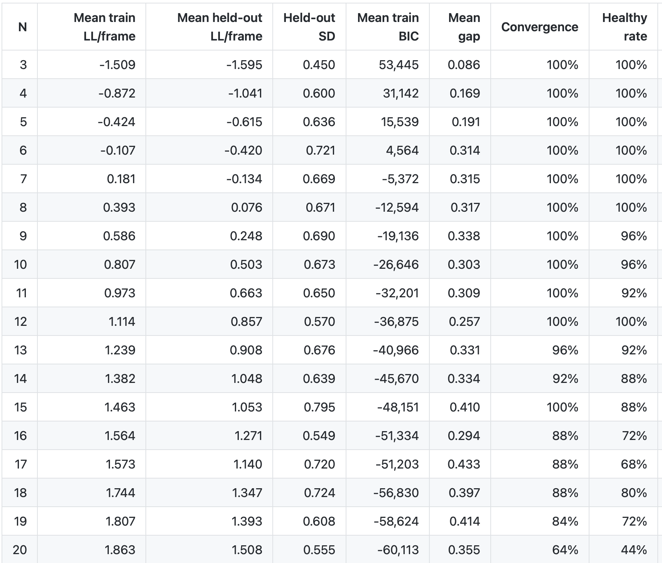
HMM training(initial)
1. Broad CV

Slide 13
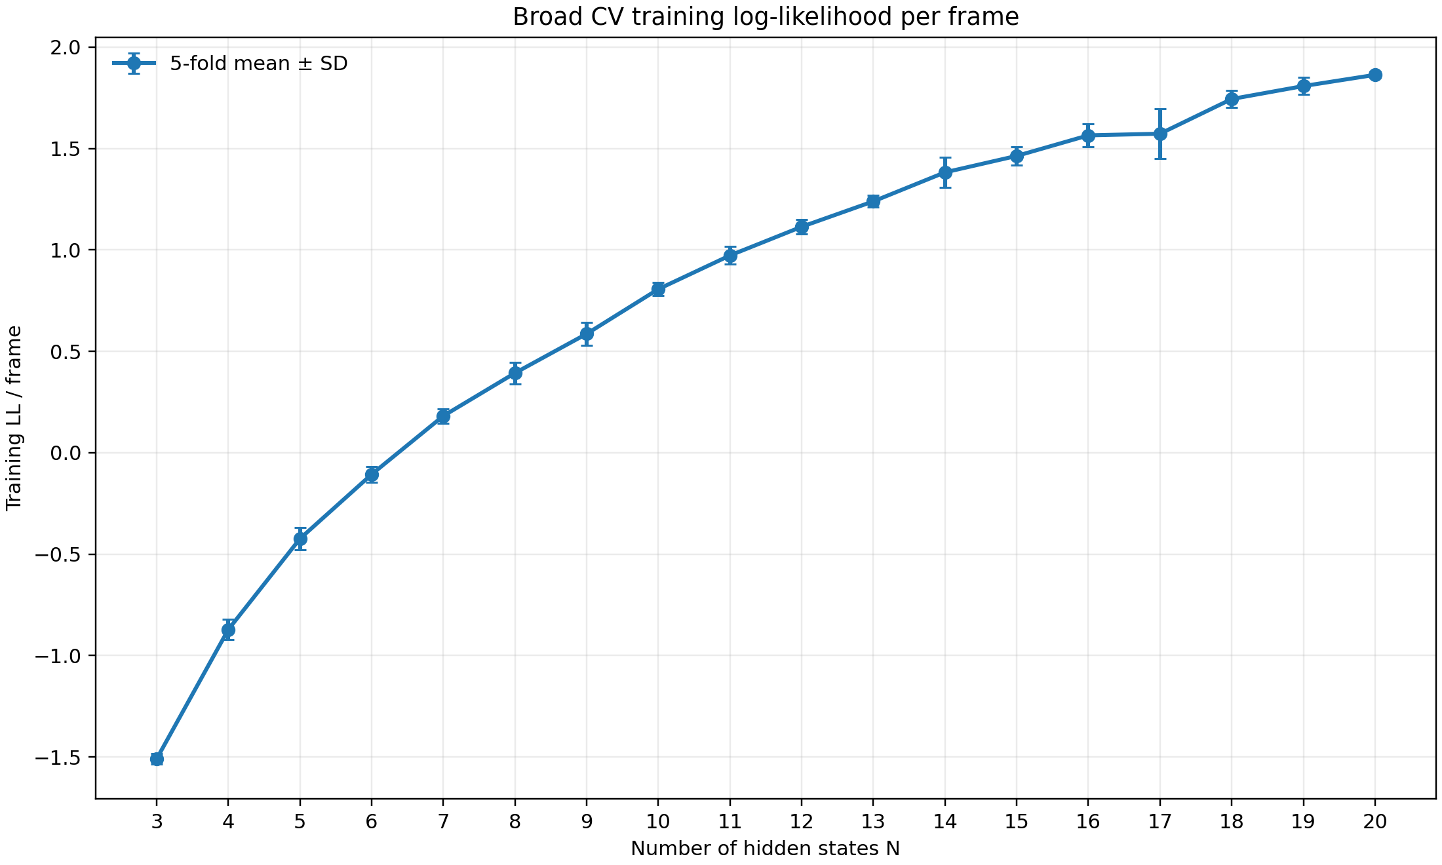
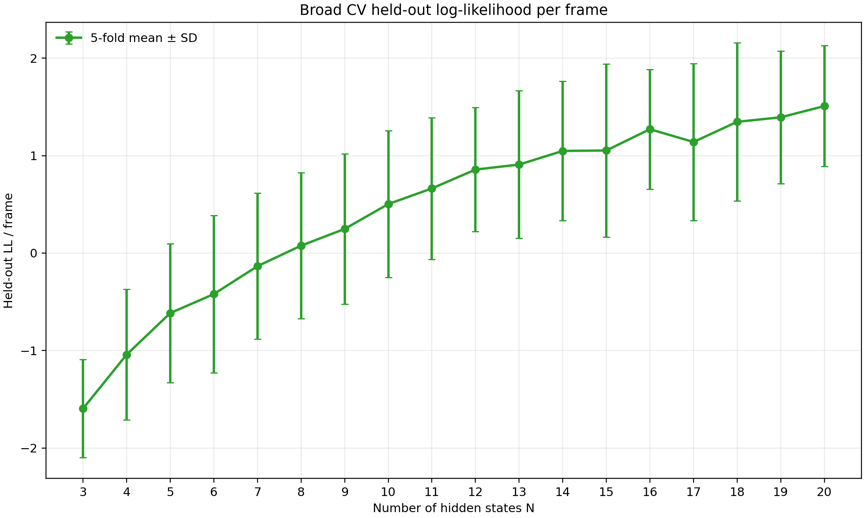
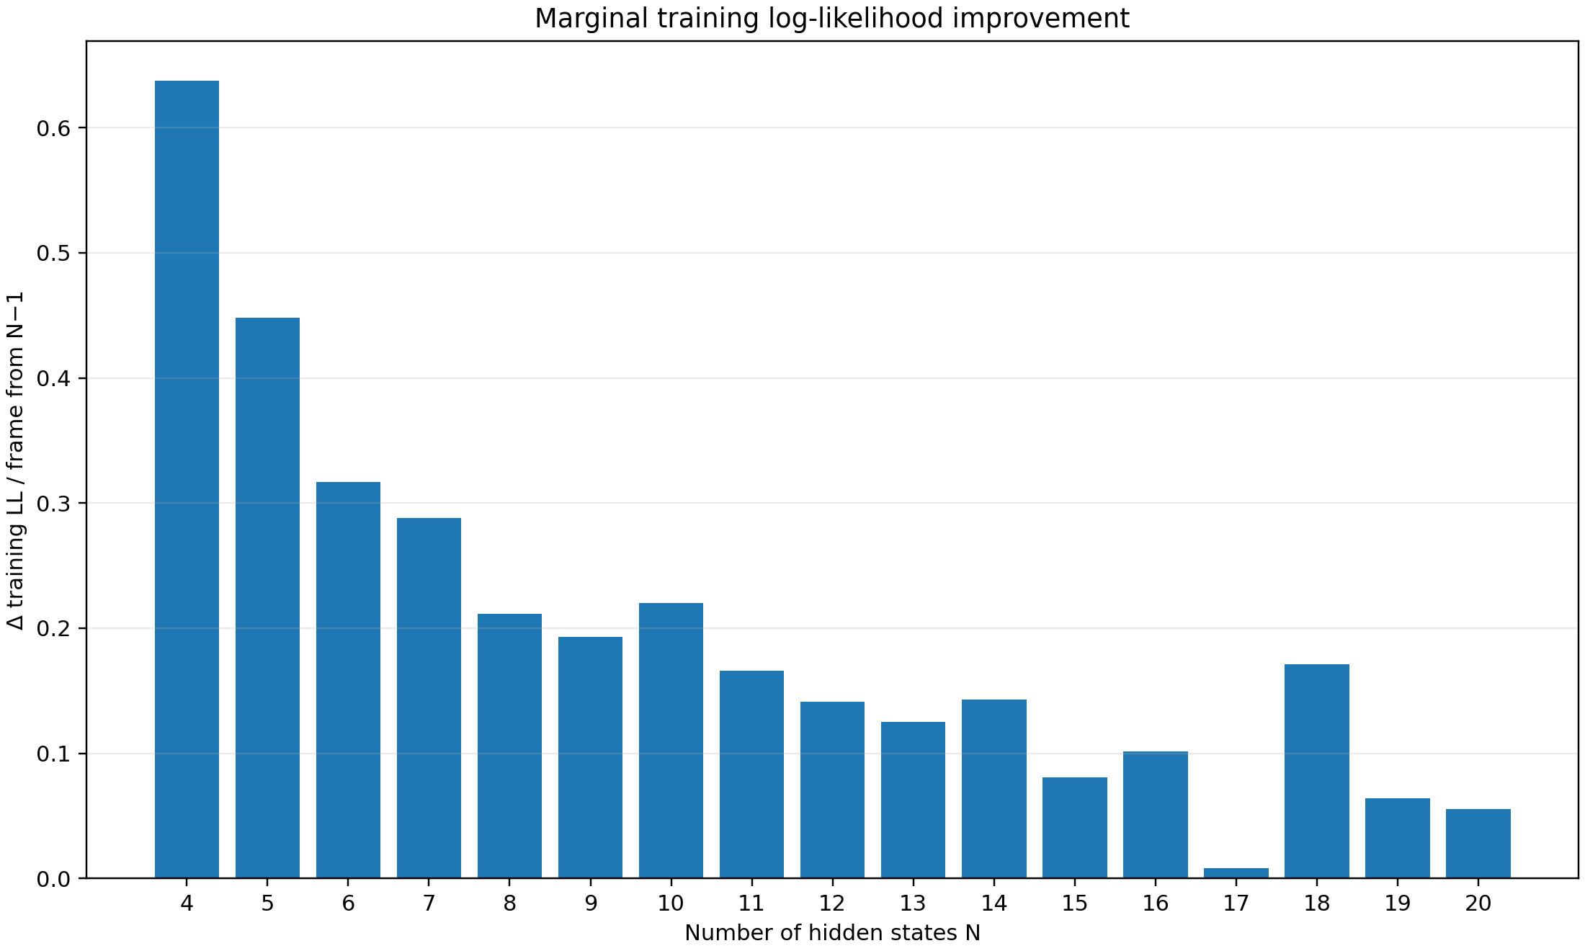
HMM training(initial)
1. Broad CV

Slide 14
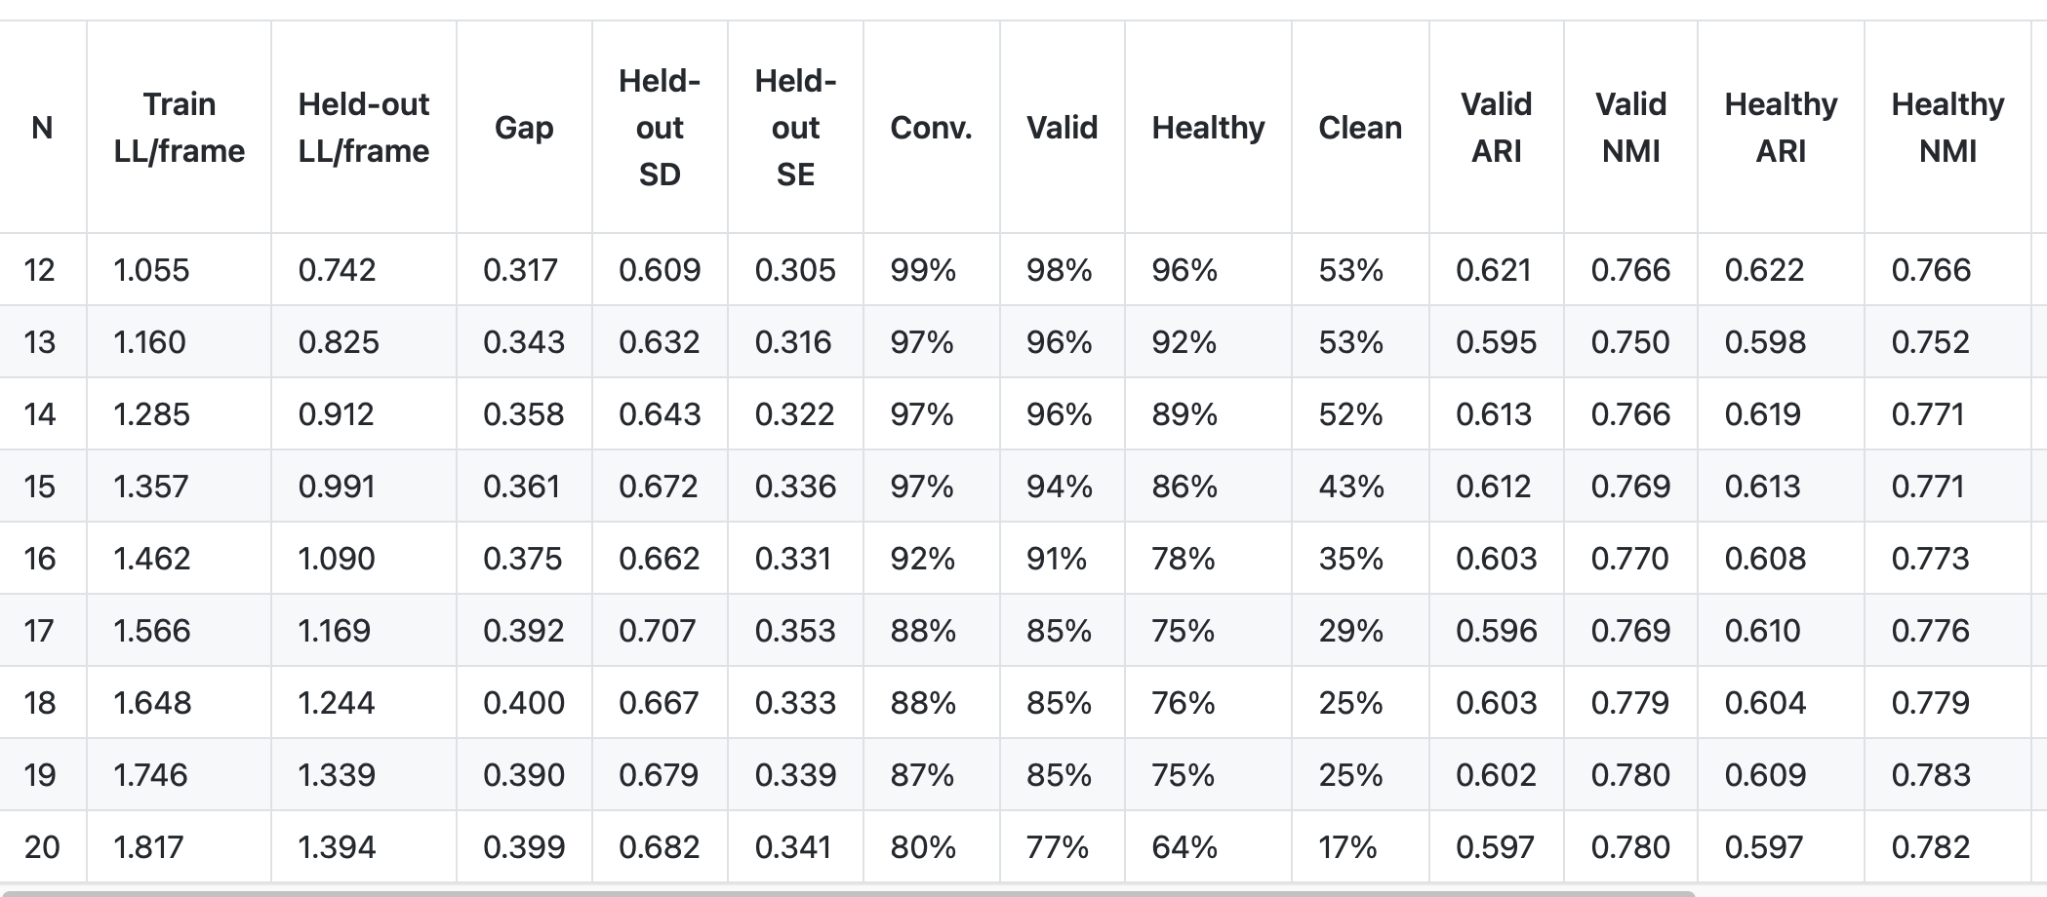
HMM training(initial)
2. Focused CV(N=12-20)

Slide 15
HMM training(initial)
1. Overall training plan
GMM-HMM modeling
Primitive extraction and clustering
Interaction chain and pattern identification
Pooled training
Subject-level
Cross-validation
Broad CV
Focused CV
2. Broad CV candidate screening
Design ：N = 3–20; n_iter=1000; restarts = 5; covariance_type= diag(18 N × 5 folds × 5 restarts = 450 model fits )；5-fold; group variable: subject_id
Main comparison metrics : test_LL_per_frame ；Generalization gap（ train_LL_per_frame - test_LL_per_frame ）；Valid / healthy restarts…

