Slide 1

MA 汇报8
Fang
15. September 2026

Slide 2
Content
1. Eye-tracking
2. Data processing
3. GitHub Repository Preparation

Slide 3
Eye-tracking
1. Collaborator verification
the comparison and synchronization results ✅
Flagged-case review：One-to-one: disagreement > 2000 ms and IoU < 0.20 → 23 cases ；
Complex: disagreement > 4000 ms and IoU < 0.20 → 6 cases
2. Main disagreement sources（ flagged-case）
Short interruptions within gaze intervals
Very distant or partly covered initiator vehicles
Borderline gaze points close to, but not clearly on, the initiator
3. Final decision
Keep the rule-based result as the final dataset for all cases（ Differences were mainly due to definition differences, not annotation errors）

Slide 4
Data processing
lane / map relationship
Scenario 1
lateral displacement reconstruction
MLC
Coordinate reconstruction
Scenario 4
interaction-end detection

Slide 5
Data processing(Scenario 1)
1. lane / map relationship
Checked videos, lane IDs, and map information
Summarized the relationship between lane_id, actual lane position, and map spur/road segments
2. lateral displacement reconstruction
Coordinate-system note：The y-coordinate of the Map1（spur1、2、3，part of spur 5？） centerline has the opposite sign compared with Global Y in the driving data
Reconstructed initiator lateral displacement relative to the current road centerline
163/162 remain empty（no map detail，not match？）
Raw LaneID | Physical road / lane | Map1 reference | Handling in coordinate reconstruction
5, 218, 219, 220, 221 | Main-road lane 5 | Spur 1 | Use corresponding road centerline as main-road lane reference
6, 192, 129, 148, 160 | Main-road lane 6 | Spur 2
7, 193, 130, 149, 161 | Main-road lane 7 | Spur 3
195, 196, 131, 150 | Merging / ramp lane | Spur 5 | Use ramp / spur centerline as local reference
163，162 | Branch toward / merge into lane 7 | Transition toward Spur 3 | left empty

Slide 6
Data processing(Scenario 4)
1. Coordinate reconstruction
map1/map2（for s1&s2）cannot be directly used for Scenario 4
Ego-based shared coordinate system，consistent with the DLC method
2. interaction-end detection（initial）
Target end point: initiator enters lane 7 and becomes laterally stable
difficult cases：Off-ramp scenario makes fixed-coordinate thresholds difficult to apply（y_main, lateral v, and a may change due to road curvature rather than lane-change motion；Some events do not satisfy the original rule（no stable）；Strict position / acceleration thresholds may reject visually reasonable end points）
3. revised rule for difficult cases
Status | Main rule
Success（79） | |v_y| < 0.10 m/s； |a_y| < 0.10 m/s² ； Stable for ≥ 0.5 s
Fallback（33） | Used only if success fails； |v_y| < 0.10 m/s ； |a_y| < 0.20 m/s² ； Stable for ≥ 0.5 s
Warning（12） | First choice: last low-velocity segment before permanent lane-7 corridor exit (|v_y| < 0.10 m/s for ≥ 0.3 s) ； Second choice: confirmed y_main = 0 center crossing

Slide 7
GitHub Repository Preparation
1. Organized the materials to be uploaded to GitHub
the eye-tracking data
the processing data（DLC+MLC）
Manipulation check

Slide 8
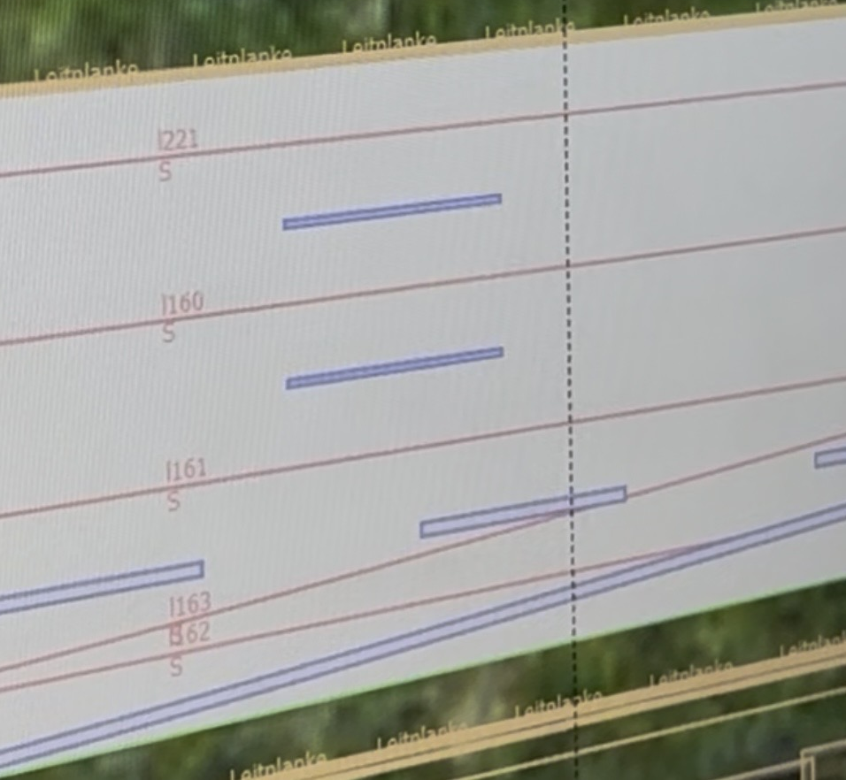
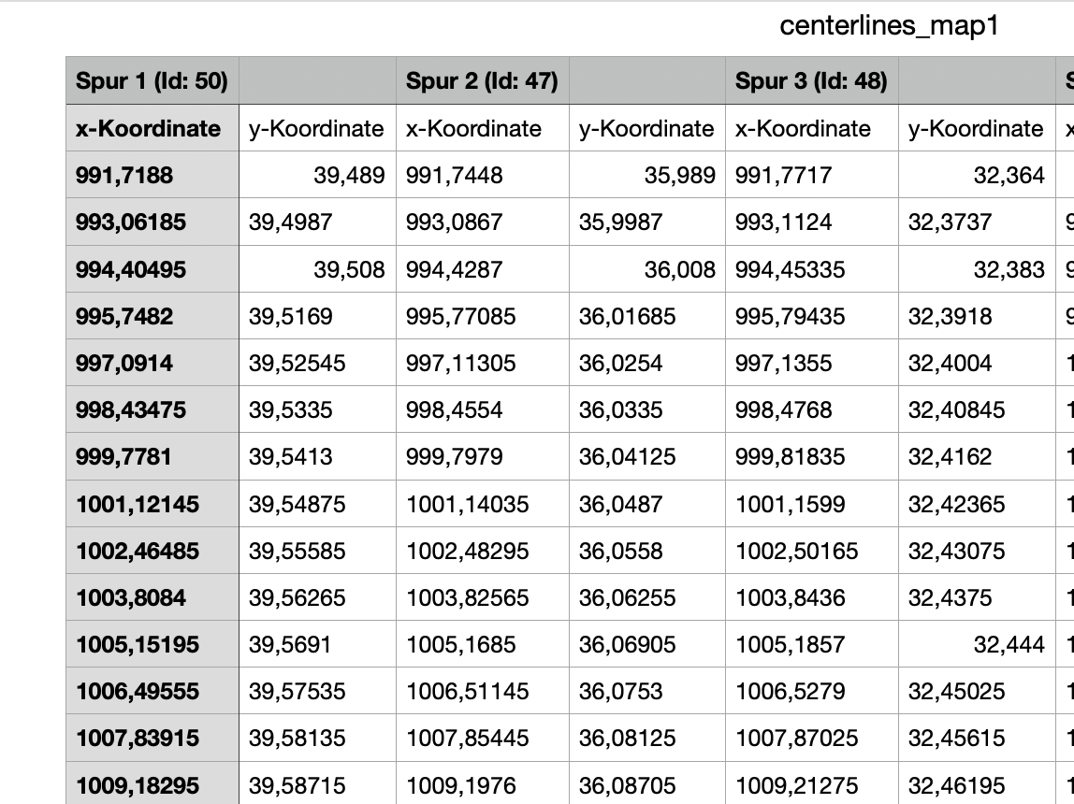
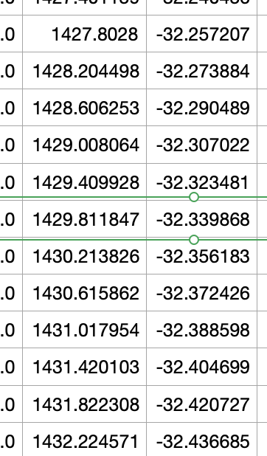
疑问点
1、map1信息中y是不是就是错了，直接取反合理吗？map1 的spur 5centerline到底是到163还是162还是到7，为什么坐标一开始符号对后来又反了（直接取反，163先空，162算spur5）
2、S1重构的横向位移存疑：Mlc场景1交汇处centerline后期符号和数值感觉不太对。和地图对应关系奇怪，initiator在驾驶数据中lane_id 从149-161-163-7，和地图匹配不上，实际不可能161跑到163？End点还是稳定点，ego共享坐标）
3、S4 的interaciton区剪裁也暂定，因场景复杂，规定特殊性比较强（暂定可以）

Slide 9
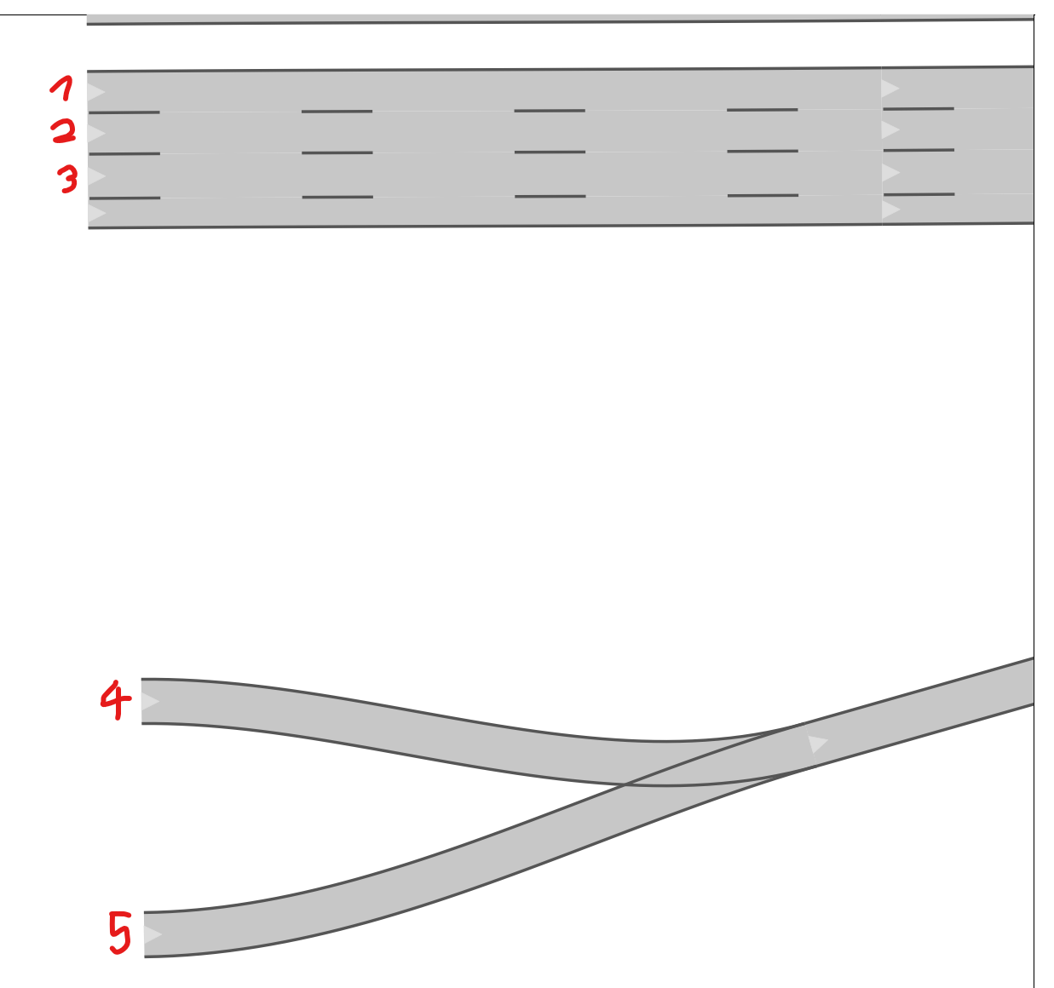
疑问点

Slide 10
谢谢

Slide 11
Backup

Slide 12
Eye-tracking（raw）
1. Drafting synchronization rules（MD）
Drafted an initial set of synchronization rules for aligning eye-tracking annotations with driving data
target_TimeMS and matched_TimeMS：
Target ASC TimeMS = ASC first-frame TimeMS + (Eye-tracking Time - RunN_Start Time) × 1000
Target ASC TimeMS = ASC Scenario Start TimeMS + (Eye-tracking Time - Scenario_N_Start Time) × 1000（Missing Run Start Marker）
2. Data synchronization
Completed synchronization for 496 interaction events
3. Data sharing
Shared the drafted synchronization rules and my synchronized eye-tracking dataset with the collaborator（next step: discuss synchronization rules and comparison method)

Slide 13
Eye-tracking
Comparison category | Subcategory | Number of groups
One-to-one overlap | Total | 445
 | Containment | 323
3 | Partial overlap | 122
Complex overlap | Total | 119
Complex overlap | Equal segment counts | 9
 | Different segment counts | 110
No overlap | Single annotator gaze intervals | 1433
Summary(>=100ms)
Total overlap groups: 564

Slide 14
Eye-tracking
Initial comparison-rule
Discussion
✅
Data diagnosis
rule refinement
Discussion
✅
Synchronization-rule update
Discussion
✅
Final rule
final rule
new
raw
raw
anchor data
comparison
result
Synchronization result
Annotation-rule update
Discussion
Final check/review
✅

Slide 15
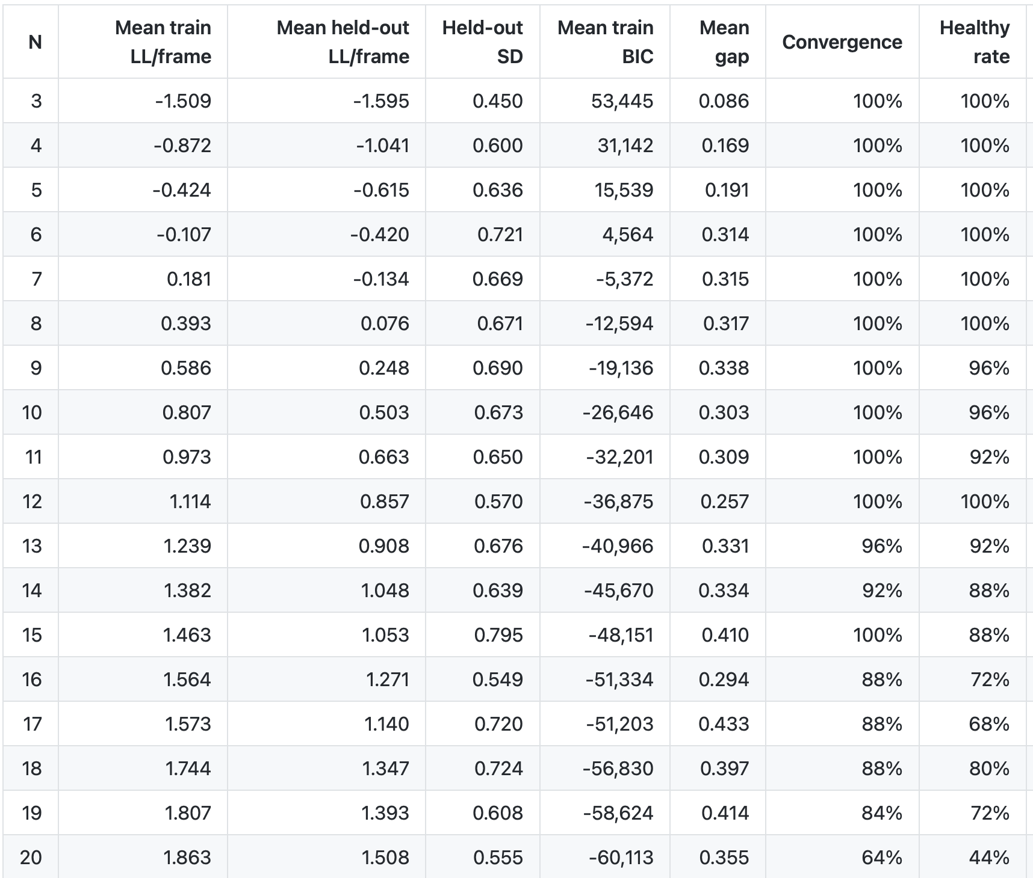
HMM training(initial)
1. Broad CV

Slide 16
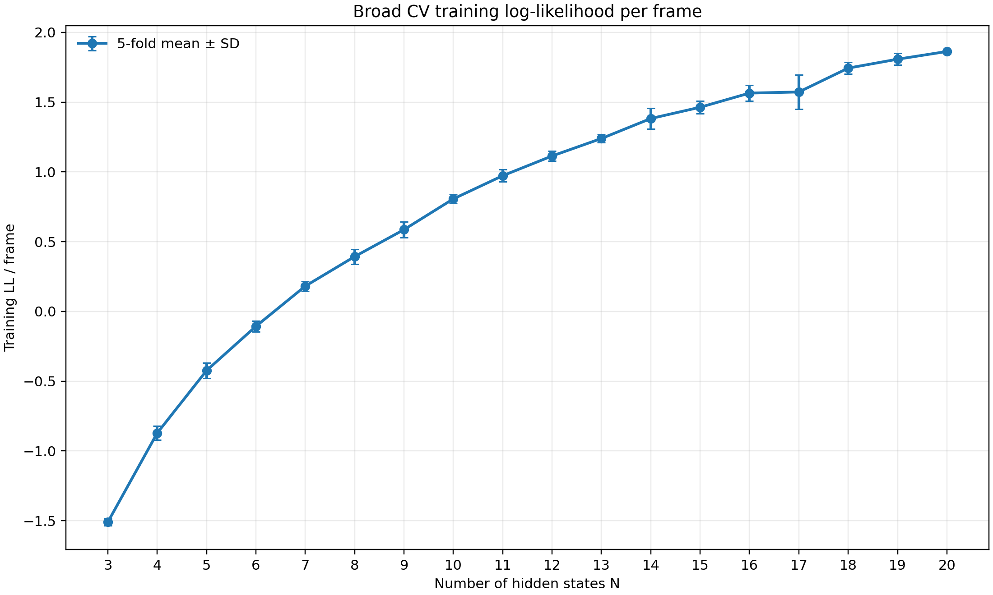
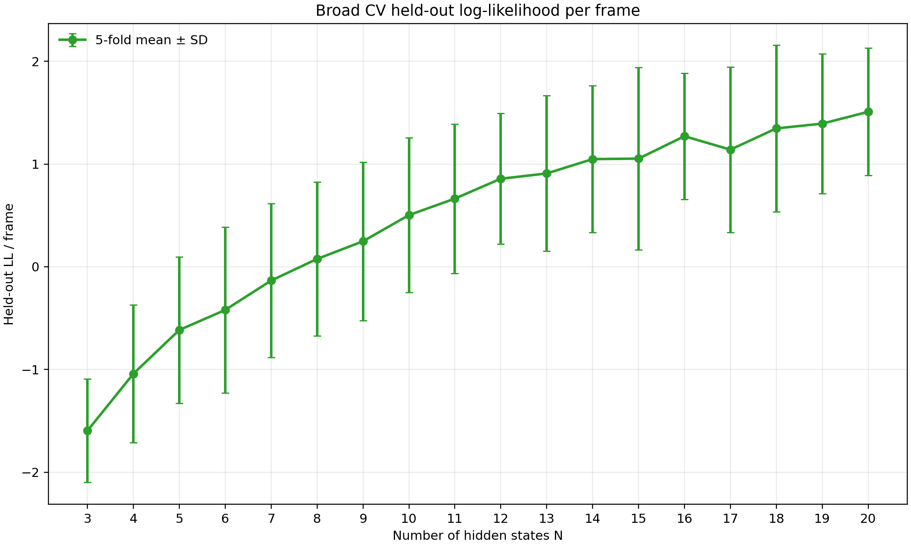
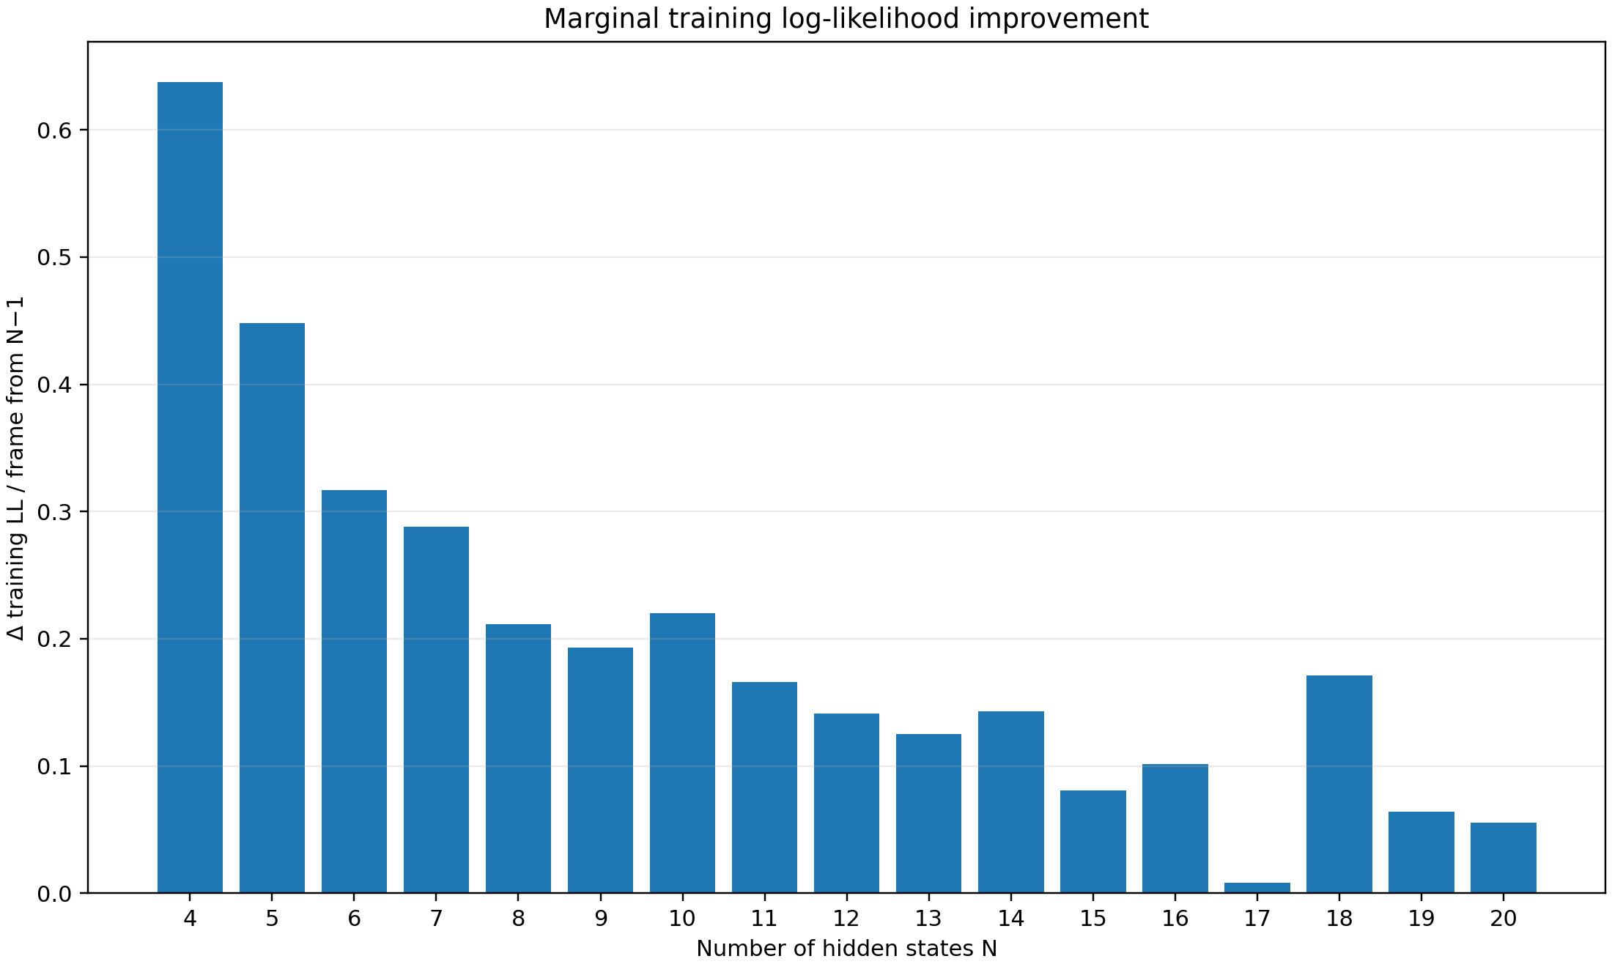
HMM training(initial)
1. Broad CV

Slide 17
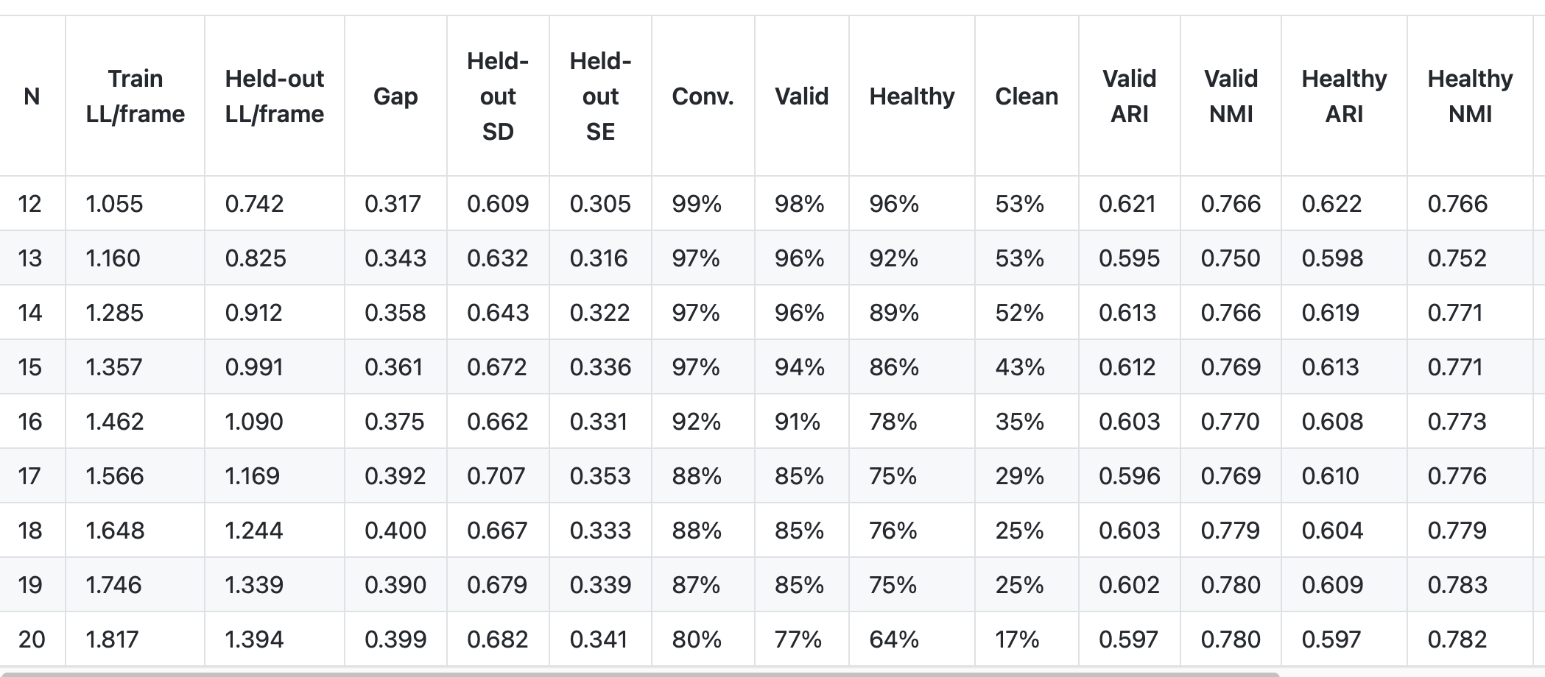
HMM training(initial)
2. Focused CV(N=12-20)

Slide 18
HMM training(initial)
1. Overall training plan
GMM-HMM modeling
Primitive extraction and clustering
Interaction chain and pattern identification
Pooled training
Subject-level
Cross-validation
Broad CV
Focused CV
2. Broad CV candidate screening
Design ：N = 3–20; n_iter=1000; restarts = 5; covariance_type= diag(18 N × 5 folds × 5 restarts = 450 model fits )；5-fold; group variable: subject_id
Main comparison metrics : test_LL_per_frame ；Generalization gap（ train_LL_per_frame - test_LL_per_frame ）；Valid / healthy restarts…

