Slide 1

MA 汇报5
Fang
18. August 2026

Slide 2
目录
1. Manipulation check
2. Eye-tracking
3. HMM training

Slide 3
Manipulation check
Scenario 1
delta_distance; ego_v; initator_v; delta_v; THW
Scenario 2
delta_distance; ego_v; initator_v; delta_v; THW
Metrics（Initial）
Scenario 3
delta_distance; ego_v; initator_v; delta_v; THW
Scenario 4
delta_distance; ego_v; initator_v; delta_v; THW
Statistical analysis
1、4 scenarios × 4 conditions (HV1 / AV0 / AV1 / AV2)
2、5 metrics per scenario，20 comparisons in total

Slide 4
Manipulation check
Statistical analysis workflow
significant
Data preparation
Descriptive statistics
Repeated-measures ANOVA
Sphericity check
Holm-corrected pairwise comparisons
delta_distance：
S1：Euclidean distance
S2-4：Longitudinal distance（raw 60Hz，recalculated）
Purpose:
Test whether there is an overall condition effect
Purpose:
Validate the ANOVA assumption
If violated（Mauchly p < 0.05）, use Greenhouse-Geisser corrected p-value.
Purpose:
Identify which condition pairs differ
Pair：6
Significant：
Holm-adjusted p-value < 0.05

Slide 5
Manipulation check（Results）
1. Descriptive statistics：Raincloud plots（full results available in the shared folder）
Example（Scenario 2）
2. Repeated-measures ANOVA + Holm-corrected pairwise comparisons
Repeated-measures ANOVA: 11 significant（total 20），delta_distance and THW showed significant condition effects across all four scenarios
Holm-corrected pairwise comparisons：36 pairs significant（total 66）
The main differences were between HV1/AV0 and AV1/AV2，AV1 and AV2 generally showed smaller initial distance and shorter THW than HV1 and AV0
Ego speed showed no significant condition effect in any scenario
S1 showed the largest number of significant condition effects

Slide 6
Eye-tracking
1. Drafting synchronization rules（MD）
Drafted an initial set of synchronization rules for aligning eye-tracking annotations with driving data
target_TimeMS and matched_TimeMS：
Target ASC TimeMS = ASC first-frame TimeMS + (Eye-tracking Time - RunN_Start Time) × 1000
Target ASC TimeMS = ASC Scenario Start TimeMS + (Eye-tracking Time - Scenario_N_Start Time) × 1000（Missing Run Start Marker）
2. Data synchronization
Completed synchronization for 496 interaction events
3. Data sharing
Shared the drafted synchronization rules and my synchronized eye-tracking dataset with the collaborator（next step: discuss synchronization rules and comparison method)

Slide 7
HMM training
1. Overall training plan
GMM-HMM modeling
Primitive extraction and clustering
Interaction chain and pattern identification
Pooled training
Subject-level
Cross-validation
2. Pooled training（ establish selection criteria ）
Valid restart（converged + numerically valid + no empty state + successful Viterbi decoding ） ➡️ healthy restart（No deterministic boundary-state）
Pairwise stability：ARI, NMI, terminal agreement
3. Next step（ subject-level cross-validation）
broad subject cv（N=3-20, restarts=5； 18 N × 5 folds × 5 restarts = 450 model fits ） ➡️ focused subject cv （ candidate N, restarts=20)

Slide 8
疑问点
1. Eye-tracking
我制定的初步同步规则可以吗？
2. HMM训练有关
目前决定的检查项可以吗？

Slide 9
谢谢

Slide 10
Backup

Slide 11
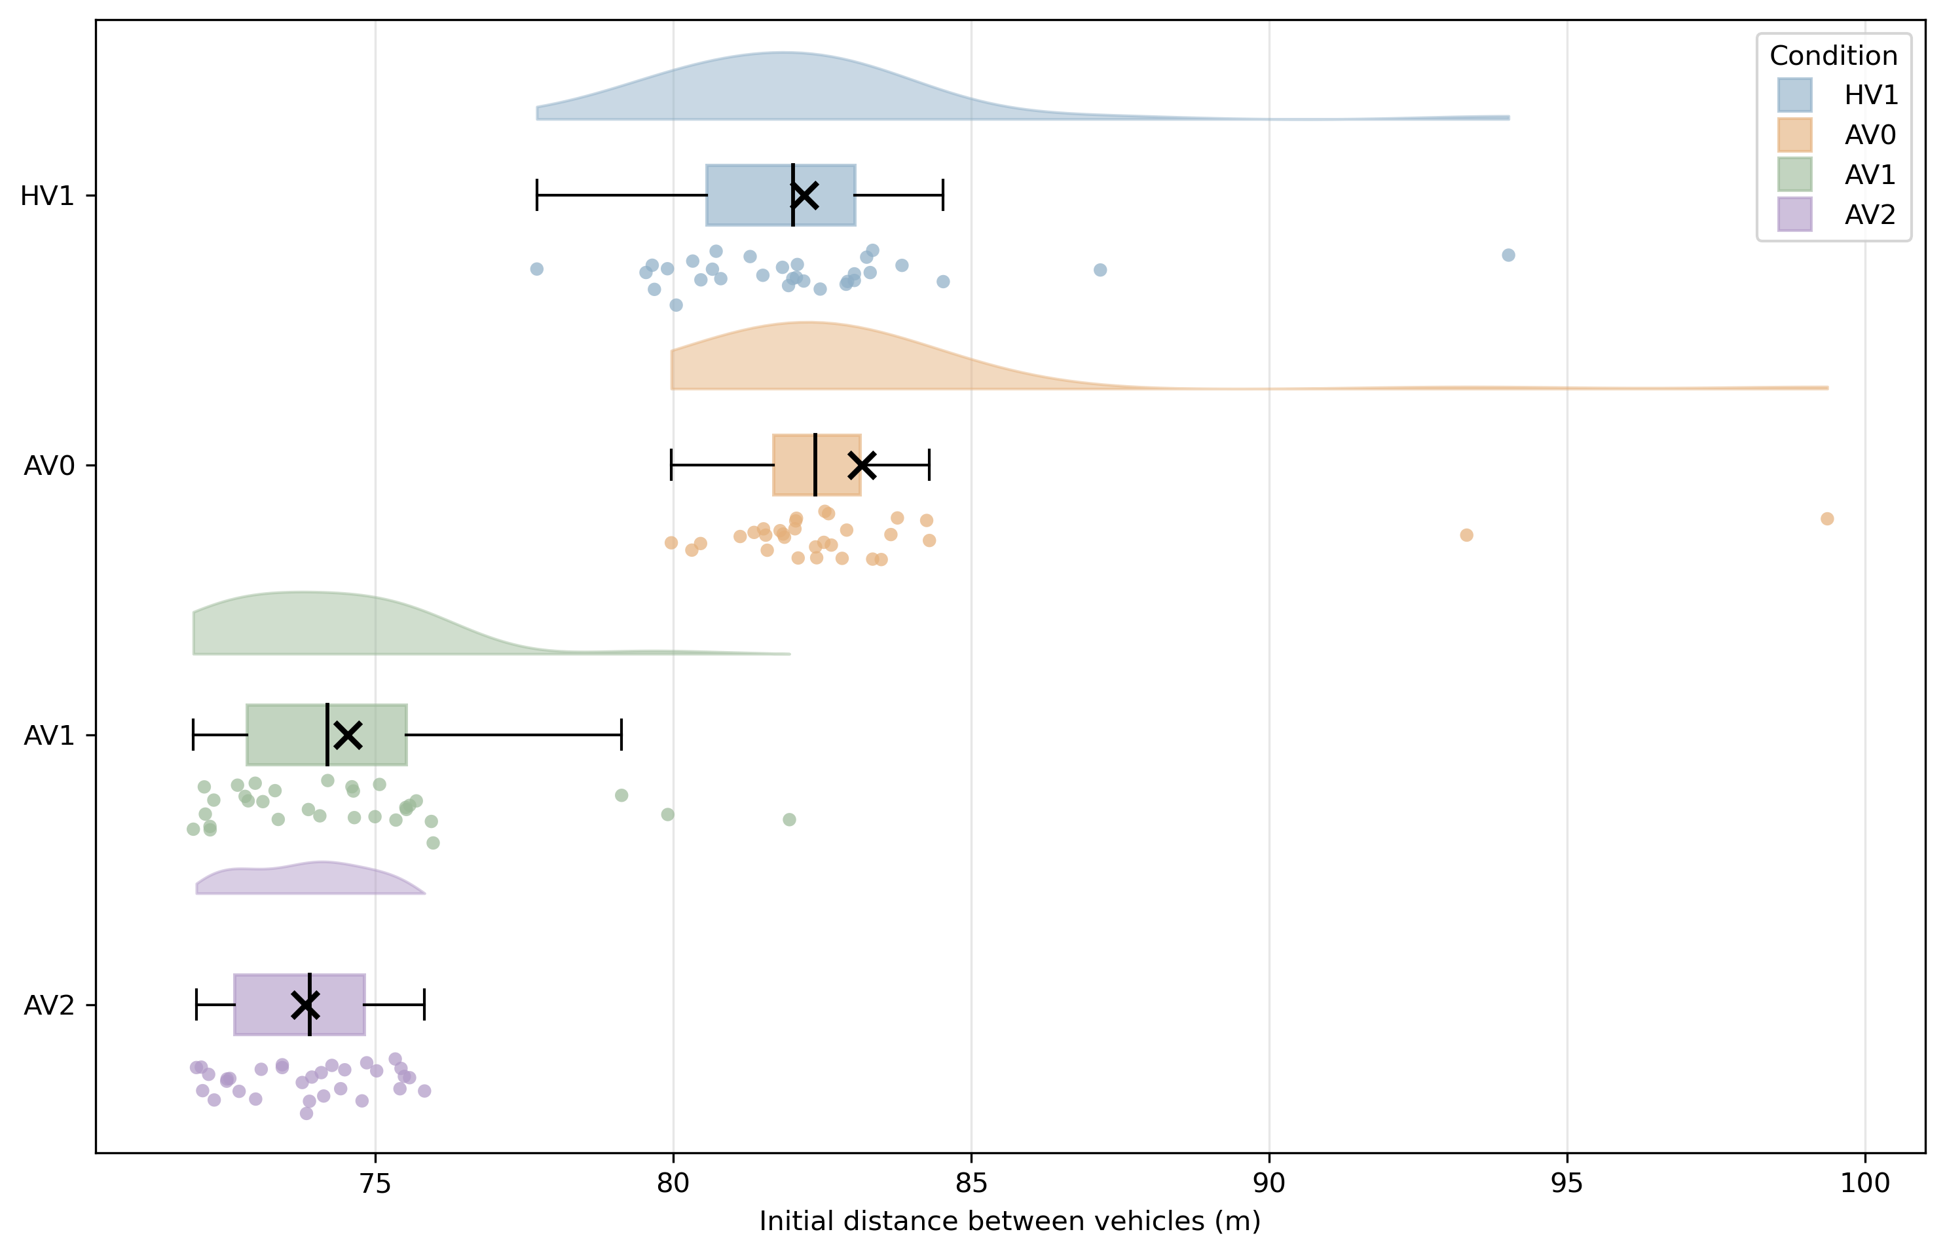
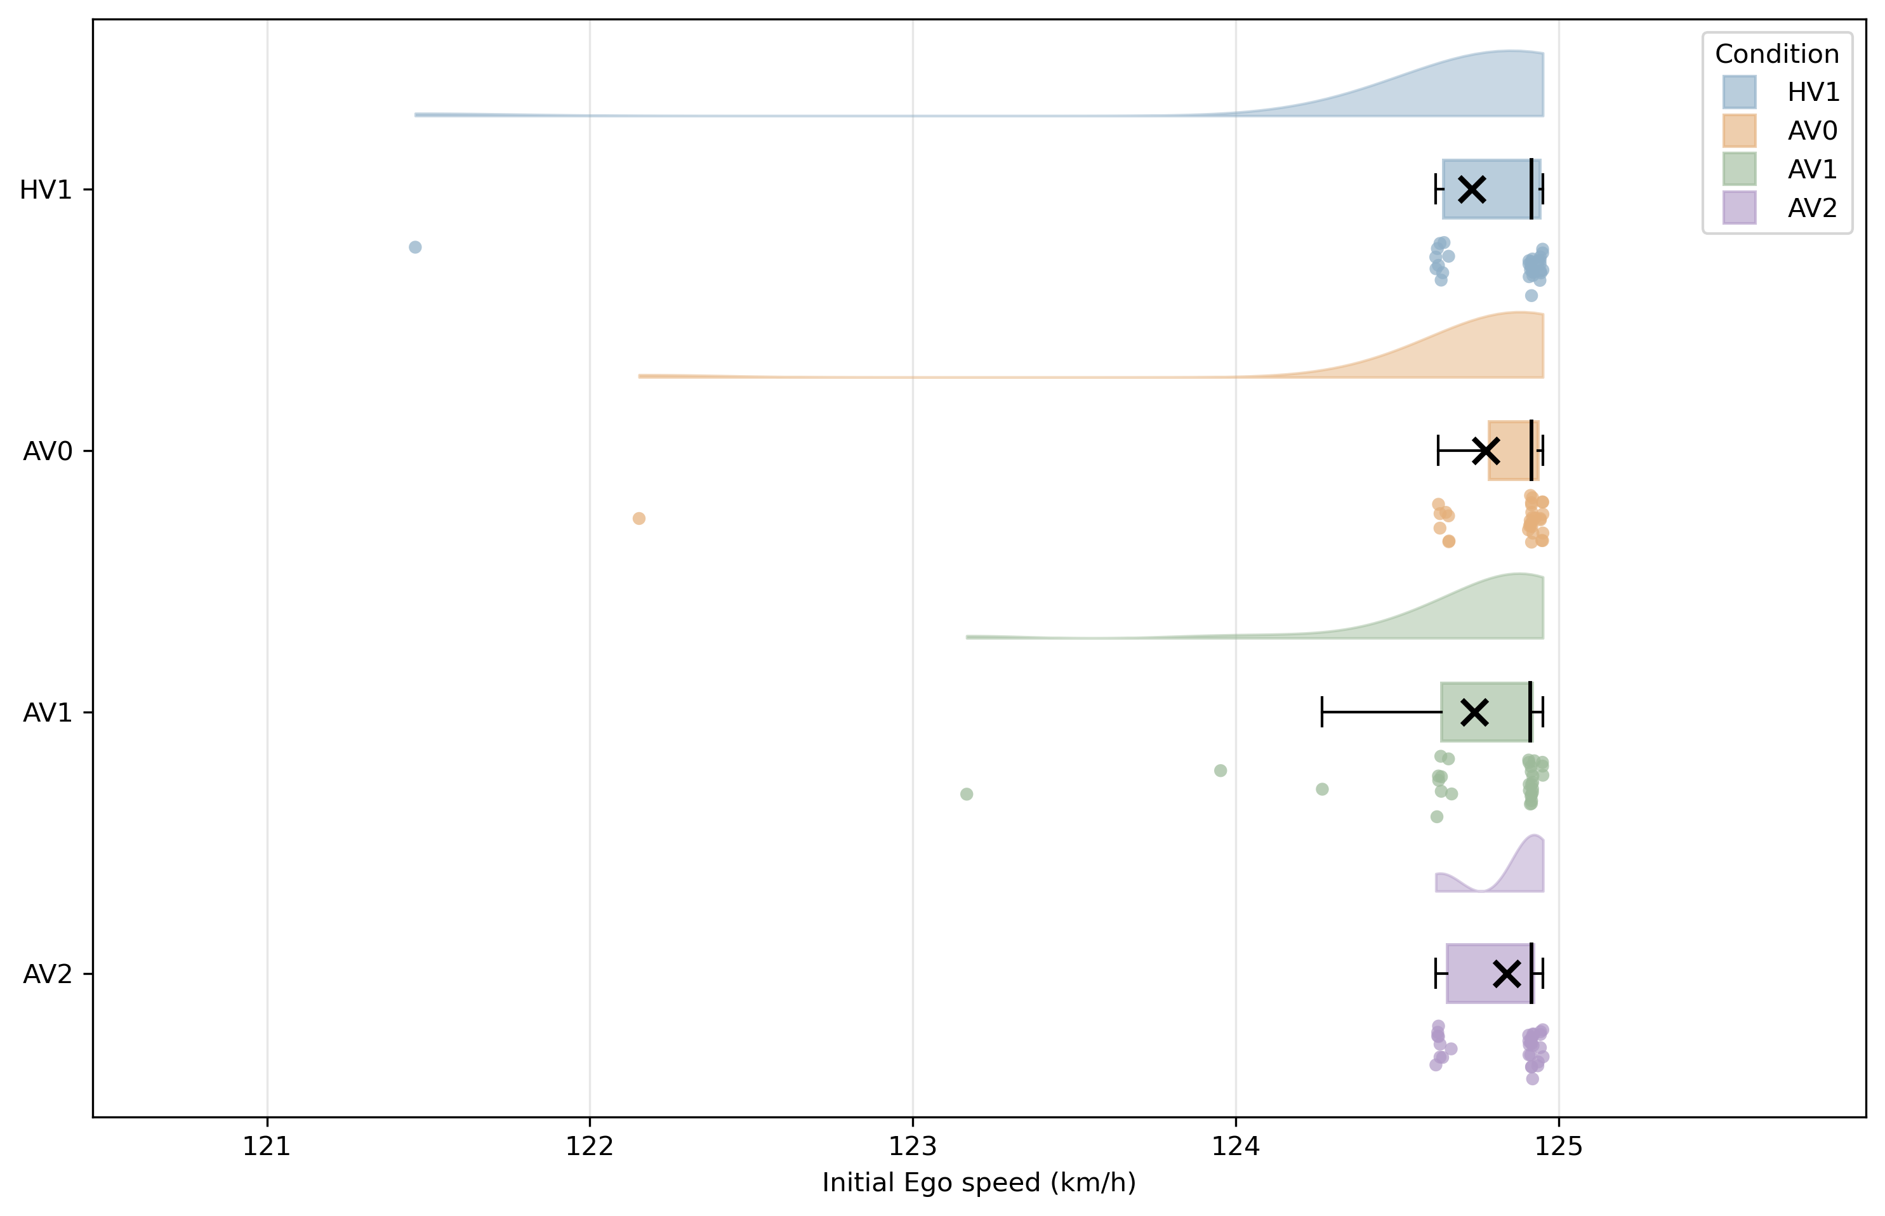
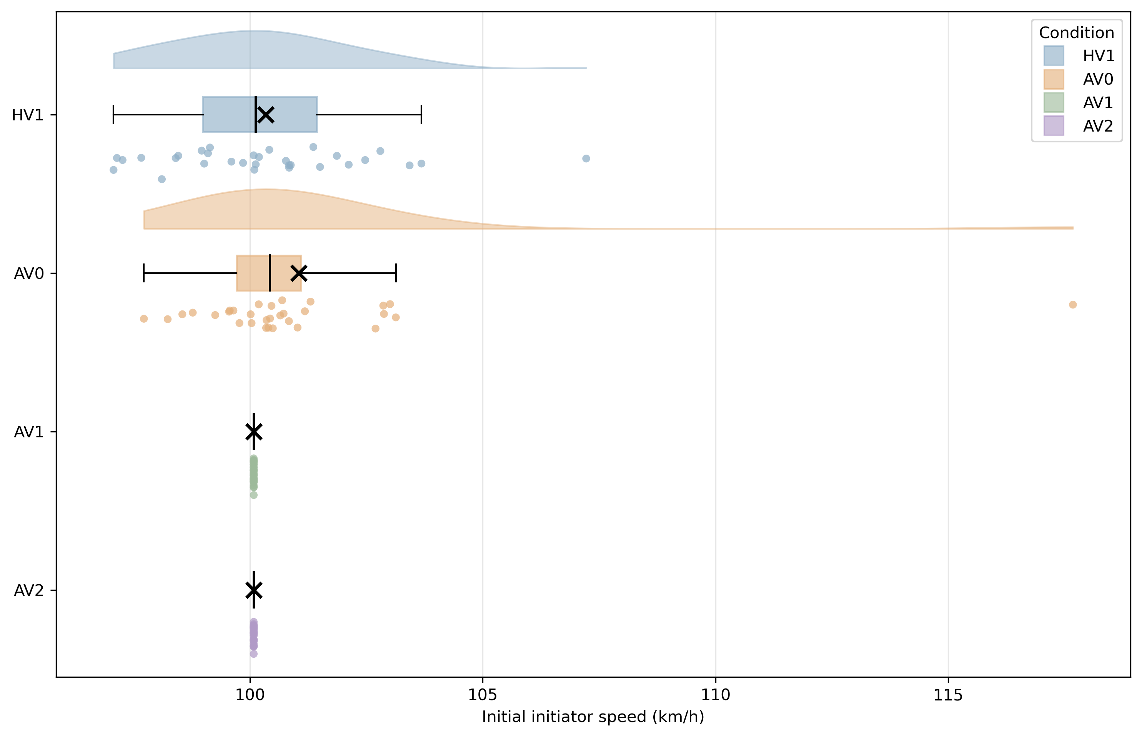
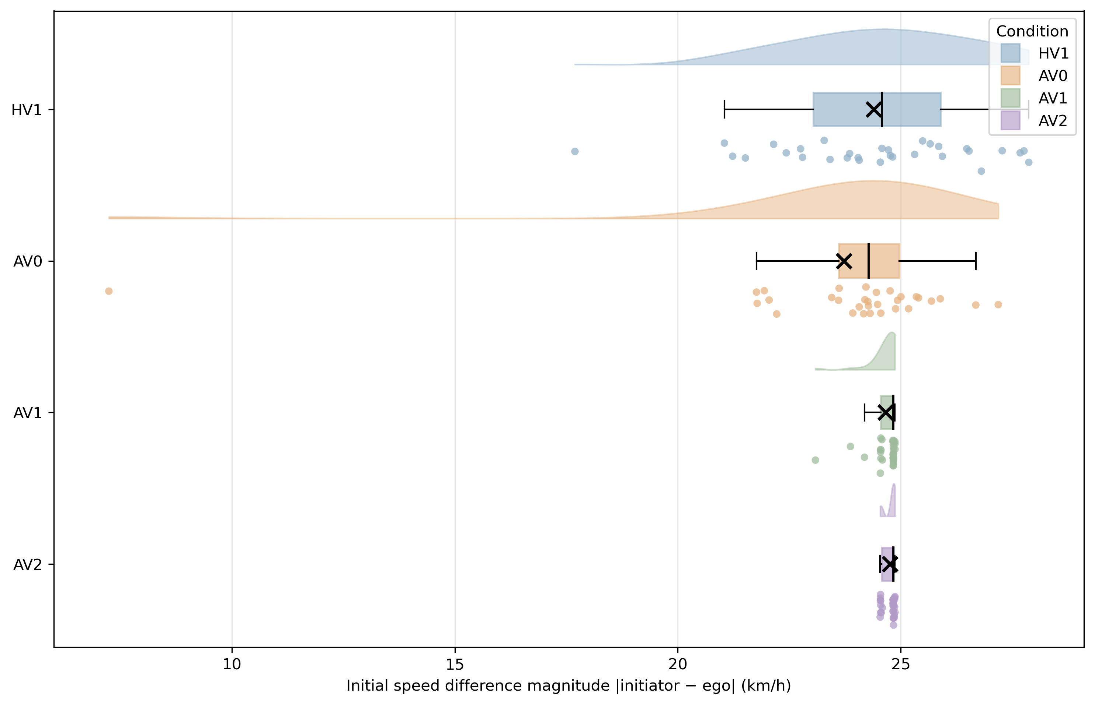
Manipulation check

Slide 12
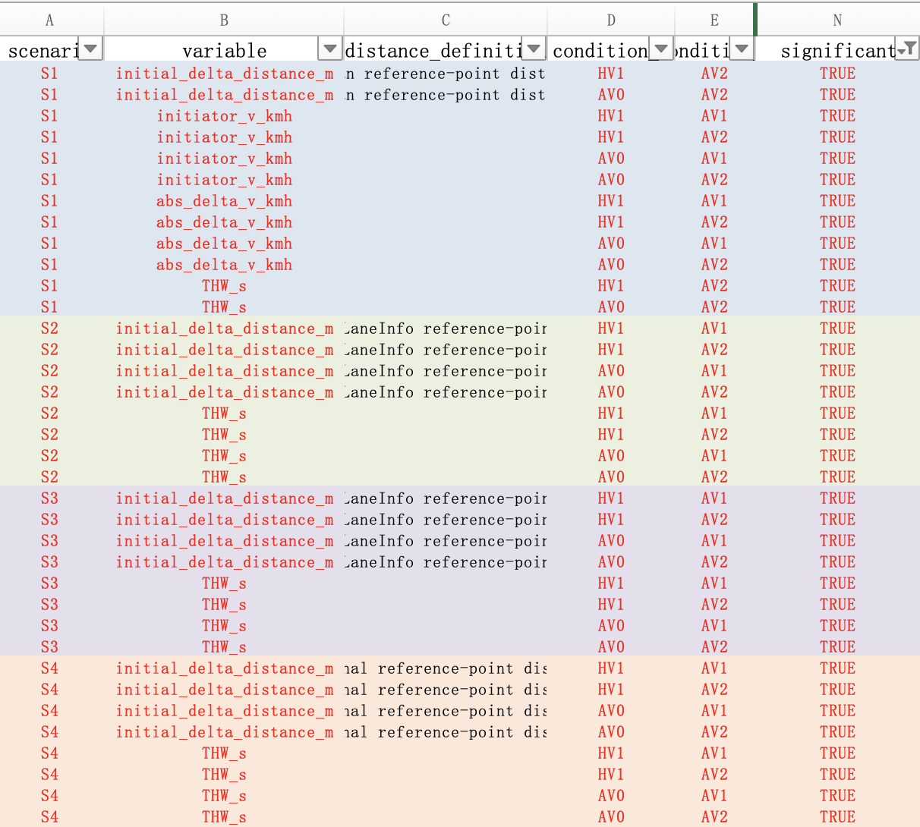
Manipulation check

