Slide 1

MA 汇报6
Fang
25. August 2026

Slide 2
Content
1. Eye-tracking
2. HMM training

Slide 3
Eye-tracking
1. Annotation data comparison
Compared the two annotators’ eye-tracking annotation results
Main differences:
the number of annotated intervals;
the duration of gaze intervals;
the consistency of interval START and STOP timing
2. Drafting gaze annotation protocol
Reviewed relevant literature
Drafted an initial gaze annotation protocol
a. the gaze AOI
b. interval-duration review rules (filter): 100–2000ms ✅；<100ms/>2000ms review?
3. Discussion and remaining issues
Shared and discussed the draft protocol with the collaborator

Slide 4
HMM training
1. Overall training plan
GMM-HMM modeling
Primitive extraction and clustering
Interaction chain and pattern identification
Pooled training
Subject-level
Cross-validation
Broad CV
Focused CV
2. Broad CV
Design ：N = 3–20; n_iter=1000; restarts = 5; covariance_type= diag(18 N × 5 folds × 5 restarts = 450 model fits )；5-fold; group variable: subject_id
Main comparison metrics : test_LL_per_frame ；Generalization gap（ train_LL_per_frame - test_LL_per_frame ）；Training AIC/BIC；Valid / healthy restarts…
3. Next step（ Broad CV ）
Evaluation ➡️ Candidate selection

Slide 5
疑问点
1. Eye-tracking
关于定位点：scenario开始点用ego出雾的时刻是否可以？实验设计的时候scenario开始点是对应driving data什么时刻？(先去掉没有run开始无法锚定的condition)
需要关注的gaze interval的 duration区间是什么，100-2000ms是否合理？其它的保留但最终不比较还是全都筛除（jakob有的1帧也标了）？再重新review范围外的比较费时（考虑到双方）（<100ms暂时不作为comapare的重点，>2s的也进入比较）
需要关注的gaze停止时刻是什么，是否只关注到initiator车差不多变道完成就行？（end变道完成）
校准误差问题：是否默认全都校准正确，若不在AOI，那就直接判定无gaze？（有些虽然在周围但完全没对上）
眼跳问题：在相邻帧快速移动，算一个gaze还是非常多个？（以jakob标的为准）
之后同步，run开始同步点：直接用平均值是否可以？（平均值）
Compare: 原始eye tracking标注比较，短gaze原则可行吗？（并集）

Slide 6
谢谢

Slide 7
Backup

Slide 8
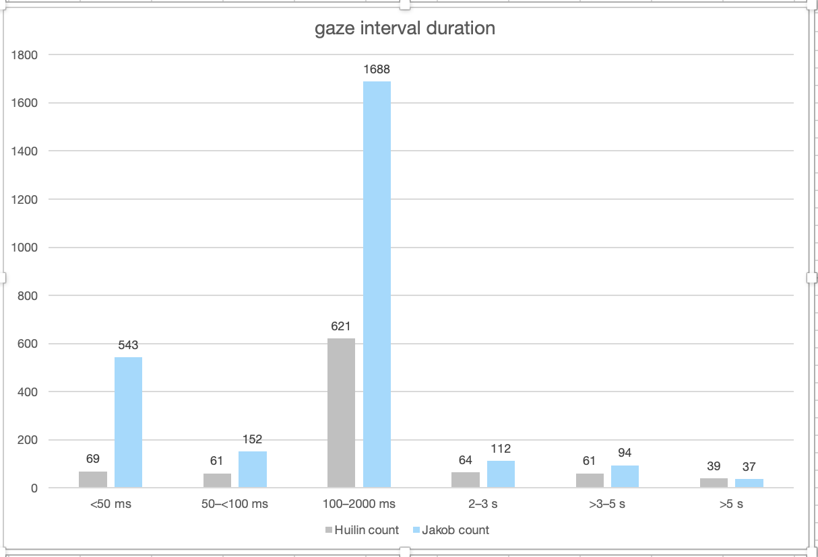
Eye-tracking

Slide 9
Eye-tracking（raw）
1. Drafting synchronization rules（MD）
Drafted an initial set of synchronization rules for aligning eye-tracking annotations with driving data
target_TimeMS and matched_TimeMS：
Target ASC TimeMS = ASC first-frame TimeMS + (Eye-tracking Time - RunN_Start Time) × 1000
Target ASC TimeMS = ASC Scenario Start TimeMS + (Eye-tracking Time - Scenario_N_Start Time) × 1000（Missing Run Start Marker）
2. Data synchronization
Completed synchronization for 496 interaction events
3. Data sharing
Shared the drafted synchronization rules and my synchronized eye-tracking dataset with the collaborator（next step: discuss synchronization rules and comparison method)

