Slide 1
TREC Evaluator
James, Gerry, Fiona and Paulius.

Slide 2

What is TREC?
TREC stands for Text REtrieval Conference. Hosted by NIST (National Institute of Standards and Technology), based in Maryland, USA.
Ongoing series of workshops focused on information retrieval.
Purpose is to evaluate different text retrieval methodologies.
http://www.nist.gov/ctl/images/NIST-Boulder_5.jpg

Slide 3
More about TREC...
During a TREC workshop, several different research areas are examined, called tracks.
Examples of tracks:
Web track - to explore information seeking behaviors common in general web search.
Legal track - to develop search technology that meets the needs of lawyers to engage in effective discovery in digital document collections.
Chemical track - to develop and evaluate technology for large scale search in chemistry-related documents, including academic papers and patents, to better meet the needs of professional searchers, and specifically patent searchers and chemists.
Spam track - to provide a standard evaluation of current and proposed spam filtering approaches.

Slide 4
Application Briefing
The purpose of this application is to provide a tool that lets researchers evaluate how good their search system is and how it compares to other systems (already submitted). Casual users can also use the application to view leaderboards.
Notes:
Casual

Slide 5
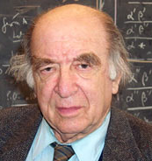
User Persona 1 : Fred
Fred is a 63 year old computer science lecturer concerned with information retrieval. He’s looking for a streamlined way to test new search algorithms he has been working on. Currently he uses the Text Retrieval Conference’s stand alone C program trec_eval, the program provides very detailed output about his algorithm's performance but the formatting is poor, there is no way to easily share the results with other researchers, nor to track improvements or regressions in the algorithm’s performance as he tweaks it. The trec_eval program also requires that the user built it from source which requires knowledge of the make program. This is not a problem for Fred as he has many years experience with C and make but he worries it may be a barrier to other less experienced researchers. For fun Fred and a fellow researcher have made a league table of whose algorithm is currently best performing over a selected TREC track, the league is cumbersome to maintain even for two participants. On a more serious note Fred thinks that a bit of competition is a good thing, and as such should a more extensive league, which is more professional maintained it could cause search algorithm efficiency to increase at an accelerated rate.
Notes:
Fred - wants easy way to test search algos performance
Uses trec_eval
manages fine but format poor
no way to track improvements between versions
worries make and C will be a barrier to others
would like a league for fun and to encourage development

Slide 6

User Persona 2 : Melvin
Melvin is a 21 year old, 2nd year computer science student, who is interested in search algorithms. Melvin has a good knowledge of algorithms performance and knows the basic theory of text retrieval. While Melvin likes the theory of information retrieval, he feels much of the theory he has learned is outdated and he wonders what researchers are working on right now, which researchers are leading the field and how their work preforms. He would like to see the results presented as a league table, on one central website which is easily sortable and filterable, and doesn’t require any sign up process.
Notes:
Melvin - casual user
knows about algorithms and search
feels theory he has learned is outdated
wants to know what researchers are working on
and how well they’re work preforms
wants a easy to use league table - no sign-in

Slide 7
Specifications
Users must be able to create an account and log in
Each user’s profile includes: description, website URL, profile picture and a list of their results
After selecting a track and a task registered users should be able to upload outputs from their search algorithms
Application then runs trec_eval program against uploaded results
Picks map (mean average precision), p10, p20 values out of trec_eval output
Stores values in the database along with researcher I.D.
Those values are then shown to the user together with current rank and a detailed comparison to other results for the same task
Users can view leaderboards without logging in (accessed by selecting a track and a task)
Leaderboards can be filtered/sorted by researcher, map, p10 or p20 values
Admin should be able to create new tracks and tasks

Slide 8
High Level System Architecture
Web browser
Middleware
Database
User
trec_eval
The TREC evaluator will only be accessible through a web browser. The Django middleware will interface with the trec_eval program and the database in order to generate sortable/filterable leaderboards and to evaluate and store the results of researchers’ search algorithms.

Slide 9
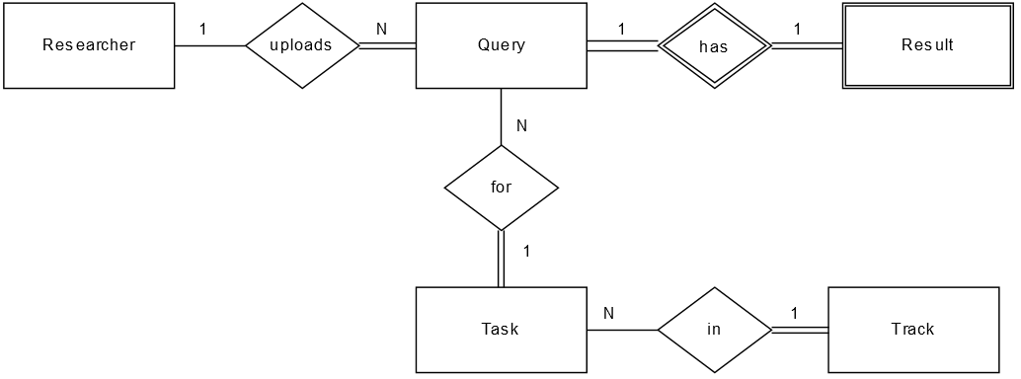
Entity Relationship Diagram

Slide 10
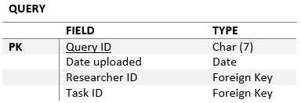
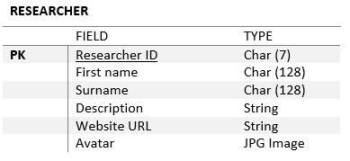
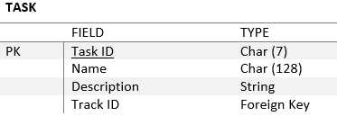
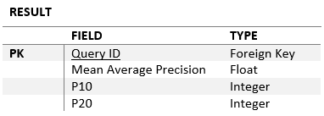
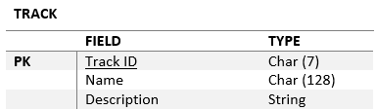
Entity Attributes

Slide 11
Wireframes

Slide 12
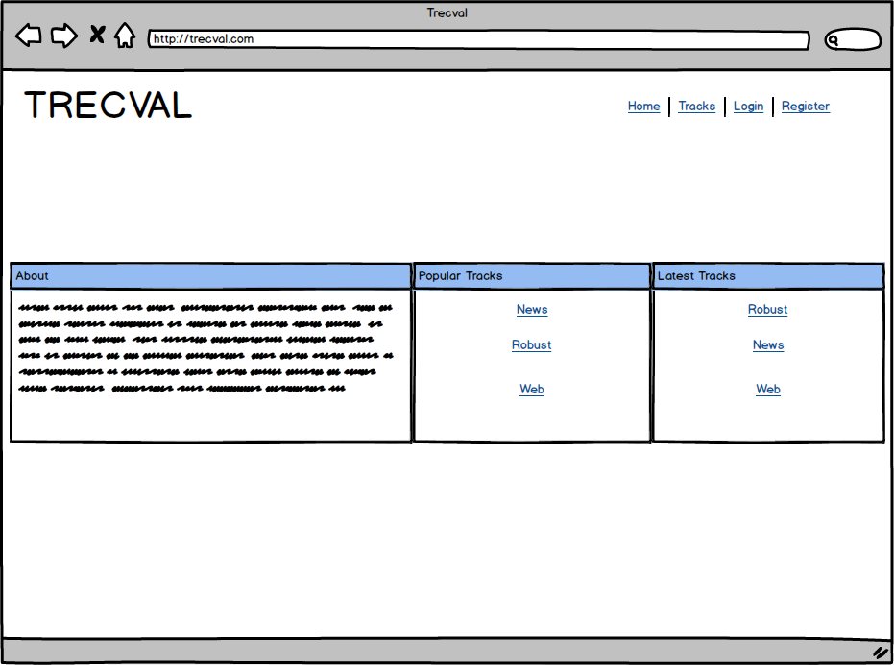
Home Page

Slide 13
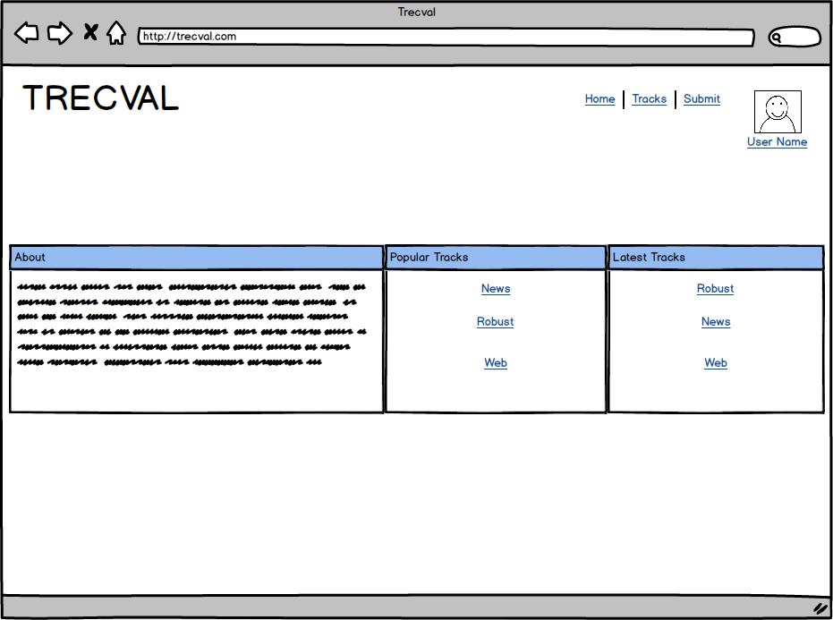
Home Page (logged in)

Slide 14
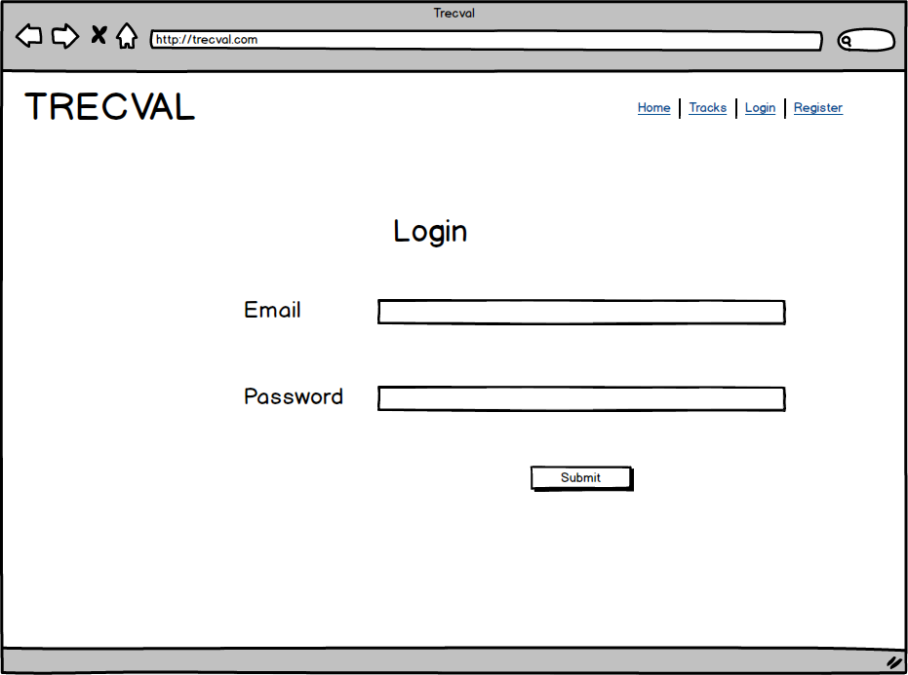
Login Page

Slide 15
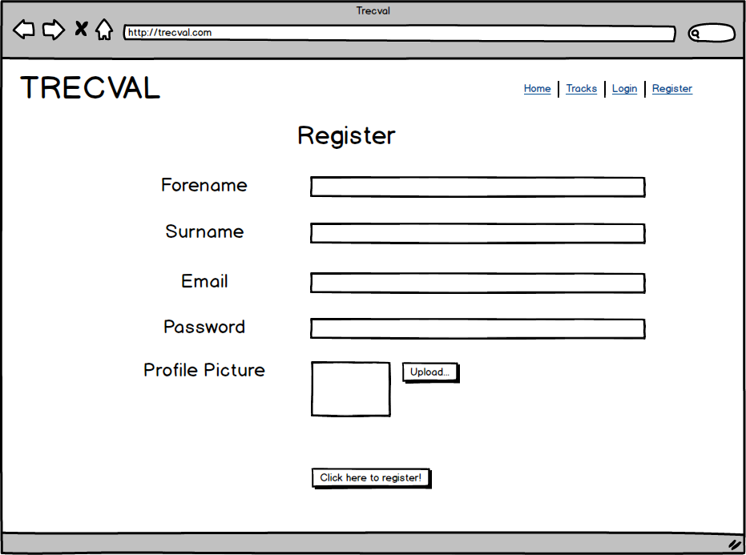
Registration Page

Slide 16
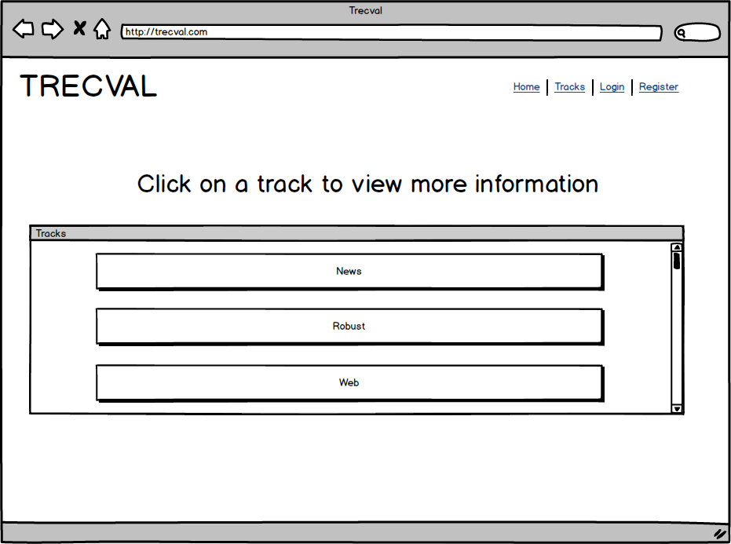
Tracks

Slide 17
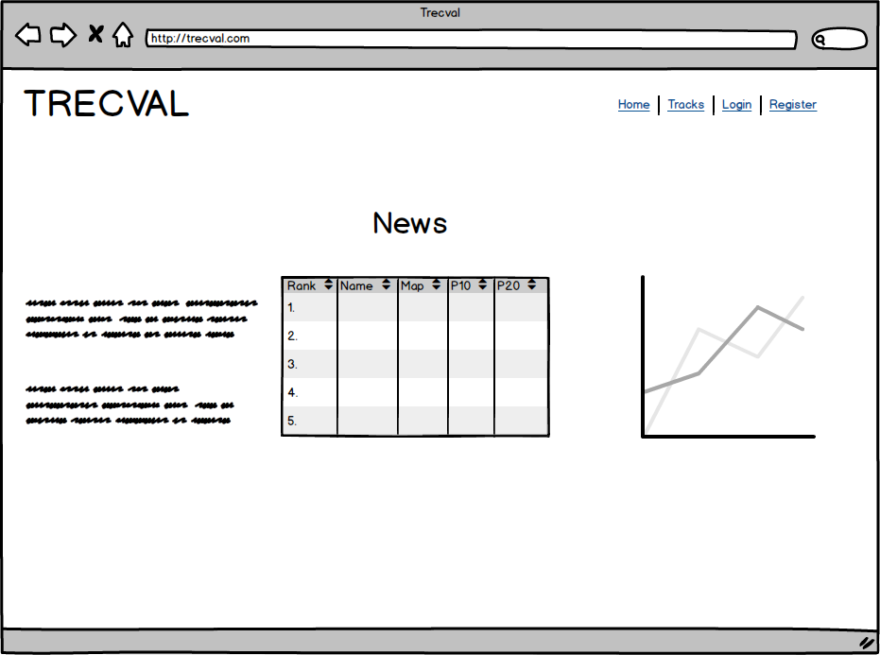
Leaderboard Page

Slide 18
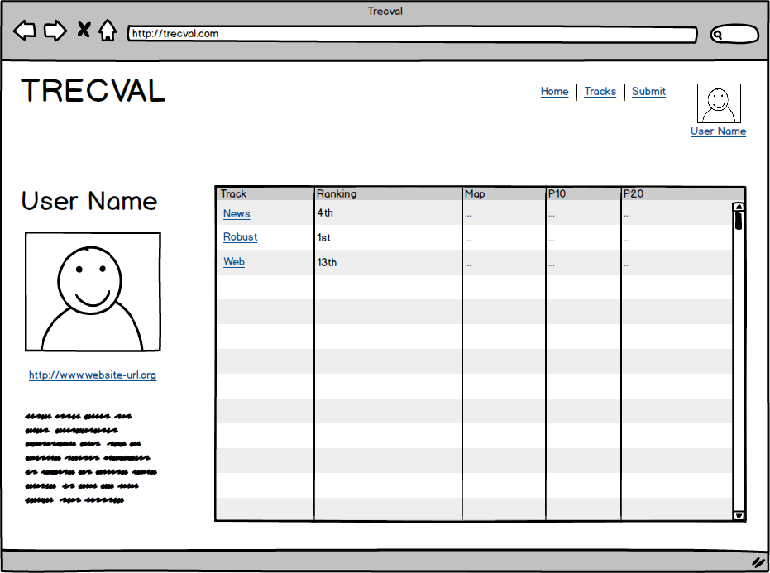
Profile Page

Slide 19
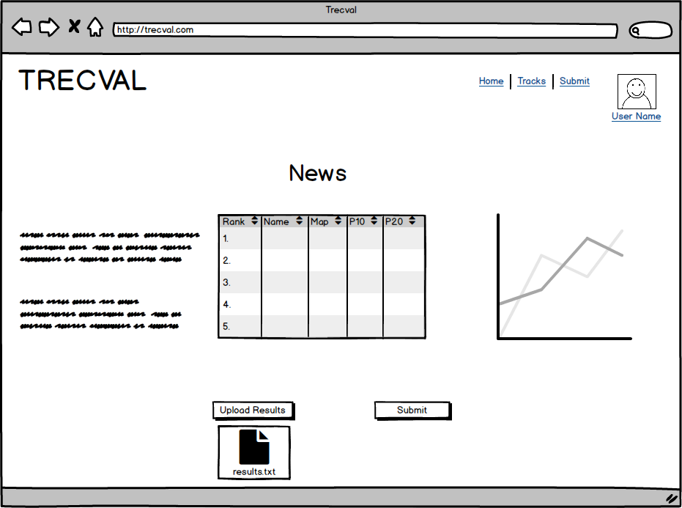
Leaderboard Page (logged in)

Slide 20
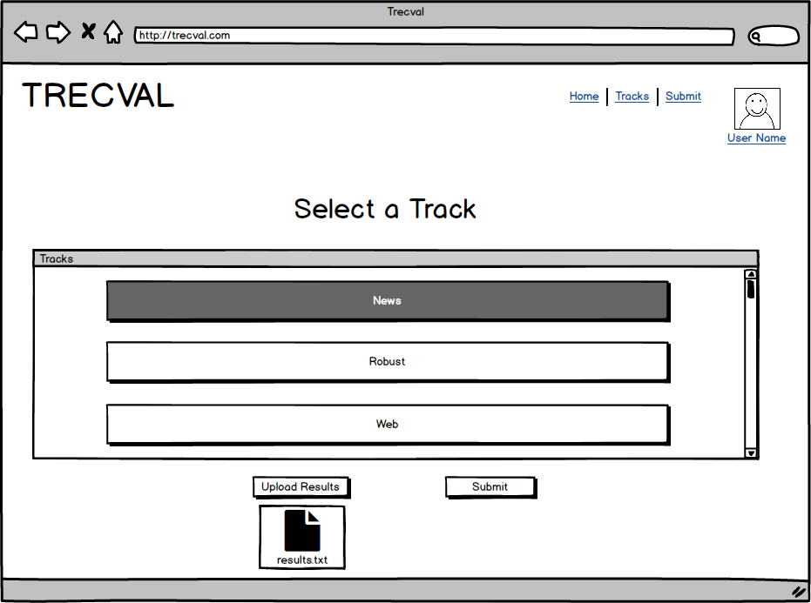
Track Selector

Slide 21
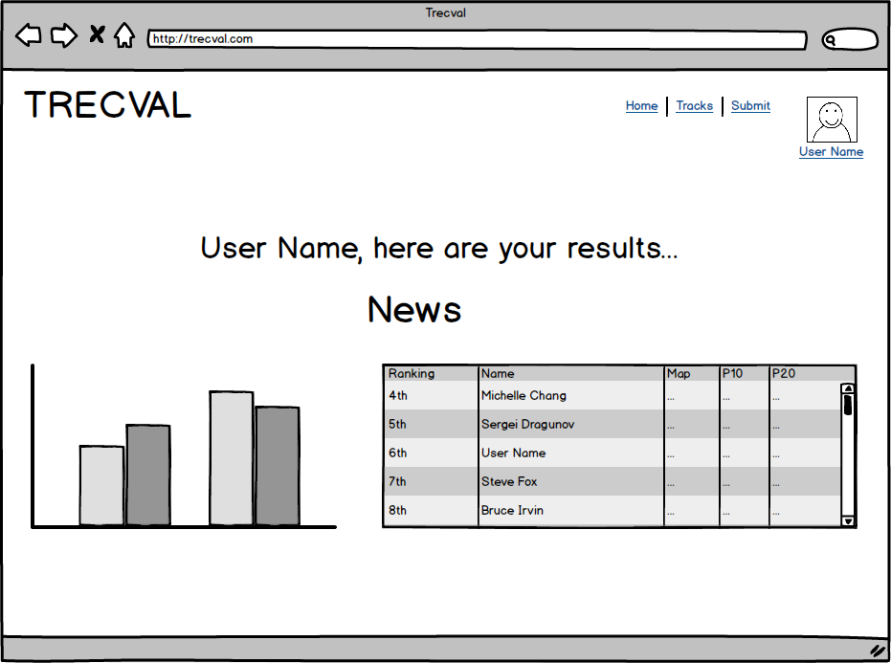
Feedback Page

Slide 22
Thanks for listening!

