Slide 1
Jarvis
Created by:
Kourtney Reynolds
Patrick Miles
Anibal Campos
Becky McClain

Slide 2
Our Motivation
Have you ever been overwhelmed by the cost of a hospital procedure?
Health care costs can vary widely between providers with little transparency.
Jarvis helps to take some of the guesswork out of the cost of major procedures.

Slide 3

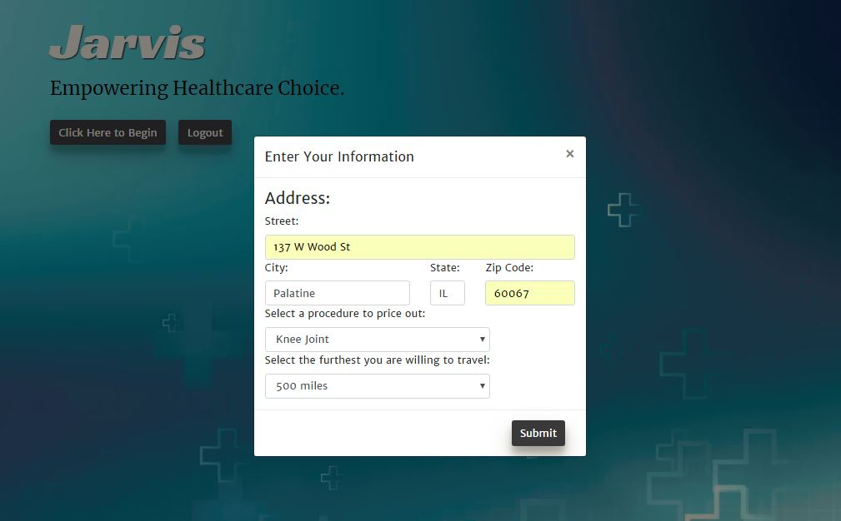
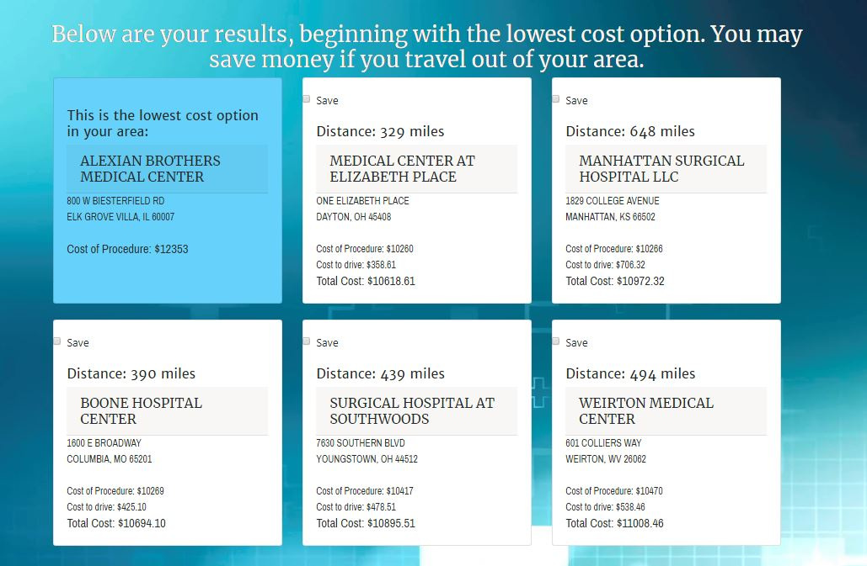
Results
The user logs in and provides us with their address.
We use a database from healthdata.gov that outlines costs of procedures in hospitals across the country.
We present the results to members in an easy to understand format.
The user can save the results of their search to reference later.

Slide 4
Team Efforts
We all had our hands in everything, but we focused on…
Kourtney- Javascript, HTML
Patrick- HTML, Javascript
Anibal- Authentication, Javascript
Becky- Javascript, HTML

Slide 5
Challenges
Handlebars
Getting data in the database correctly
Time constraints
Payload too large error

Slide 6
Moving Forward
We need to add other procedures to the options menu
Add more features in the results: maps, hotels, flights, ratings, etc.
Allow users to enter the actual price they paid for the procedure
Insurance information

