Slide 1
Ctrl-P: 3D Printer Depository
By Austin Johnson, Becky Price, Megan Petrillose

Slide 2
Introduction
What is our project?
Why is there a need for it?
How is ours different?
Notes:
Thingiverse.com (largest website dedicated to 3D printing)
-> recently purchased by a company claiming to own many patents to the technologies that have enabled open source 3D printing.
-> could be the killing stroke for the 3D printing culture.
As a result, many designers are looking to move away from Thingiverse.
Ctrl-P.net is trying to fill this new void better than any of the competitors by providing an all-encompassing 3D printing site.

Slide 3
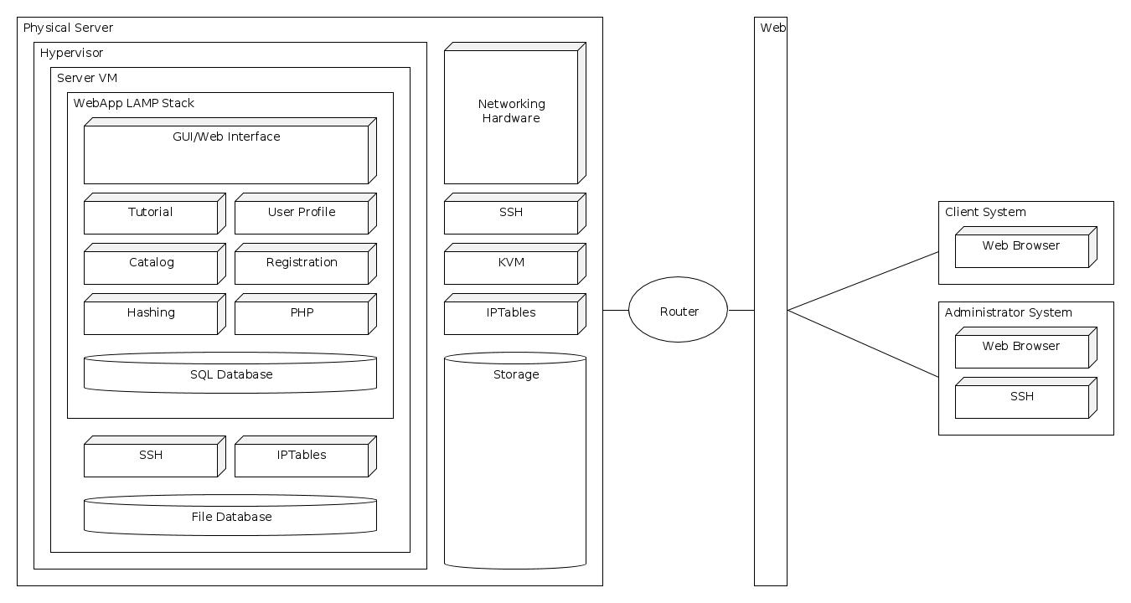
What went into making it?
Notes:
System Architecture - Austin

Slide 4
Features
User Profiles
Tutorials
Internal
External
Design Catalog
Individual designs
Service Locations
Notes:
User Profiles – Austin
Tutorials – Megan
Design Catalog - Becky

Slide 5
Questions???

