Slide 1
trove
Maptrips. Save memories. Share stories.
Notes:
Trove is a digital travel journal that turns a trip into an organized, good-looking story automatically. Users are able to upload photos, write notes, tag locations, and arrange them in a scrapbook designated to a specific trip. These scrapbooks can be kept personally or shared with friends and other travelers who may be looking for inspiration. Each user will have their own library of scrapbooks with saved memories from trips to look back on
TARGET AUDIENCE People who travel and want to remember it well without the manual cleanup.
Frequent travelers & backpackers
Journalers & scrapbookers
Friend groups and couples
Casual trip-takers
The problem :
After a trip, photos sit unsorted in the camera roll and notes get scattered. The memories effectively get lost. Existing tools fall short Photo galleries don't tell a story, note apps don't map places, and map apps don't hold memories. Trove fills the niche One place that auto-maps your photos, captures notes & voice, and packages it as a journal you can share

Slide 2
git link
beckyzh3/Trove
Notes:
Trove is a digital travel journal that turns a trip into an organized, good-looking story automatically. Users are able to upload photos, write notes, tag locations, and arrange them in a scrapbook designated to a specific trip. These scrapbooks can be kept personally or shared with friends and other travelers who may be looking for inspiration. Each user will have their own library of scrapbooks with saved memories from trips to look back on
TARGET AUDIENCE People who travel and want to remember it well without the manual cleanup.
Frequent travelers & backpackers
Journalers & scrapbookers
Friend groups and couples
Casual trip-takers
The problem :
After a trip, photos sit unsorted in the camera roll and notes get scattered. The memories effectively get lost. Existing tools fall short Photo galleries don't tell a story, note apps don't map places, and map apps don't hold memories. Trove fills the niche One place that auto-maps your photos, captures notes & voice, and packages it as a journal you can share

Slide 3
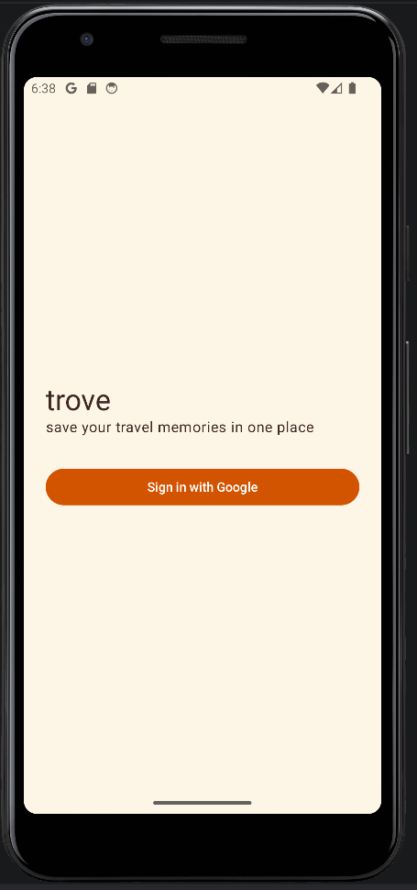
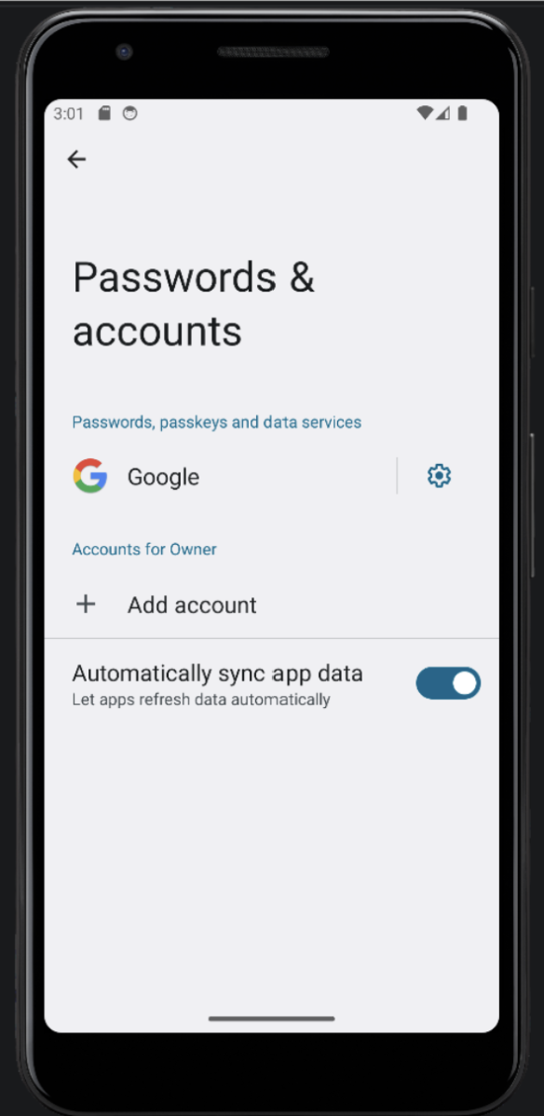
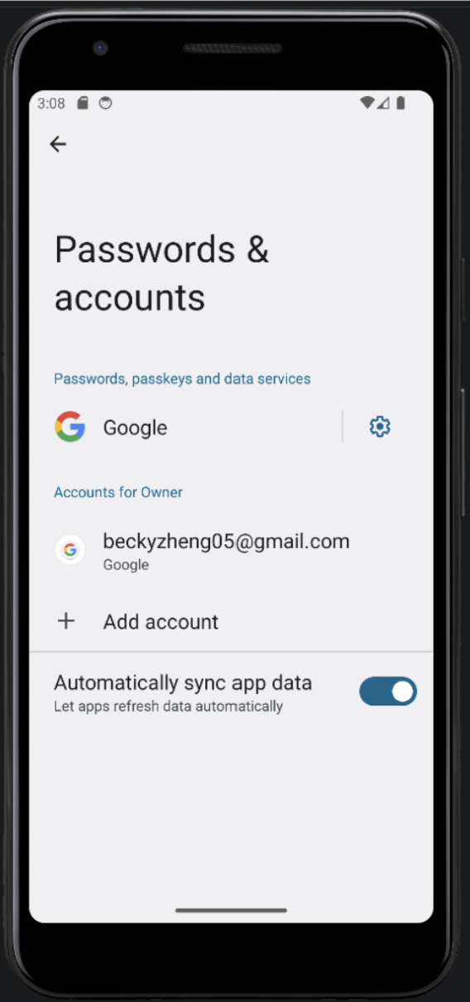
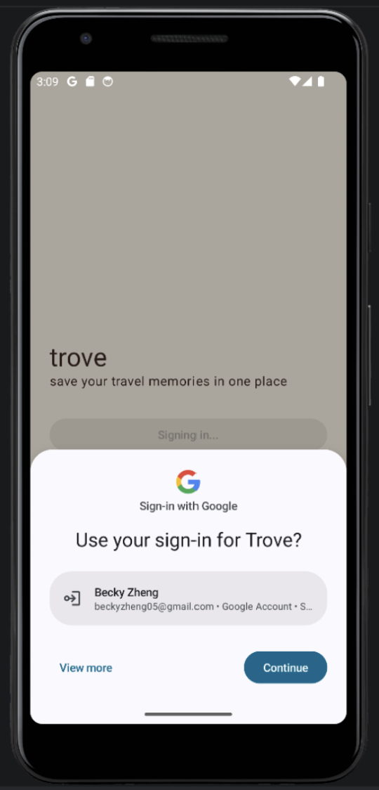
Sign-in with Google

Slide 4
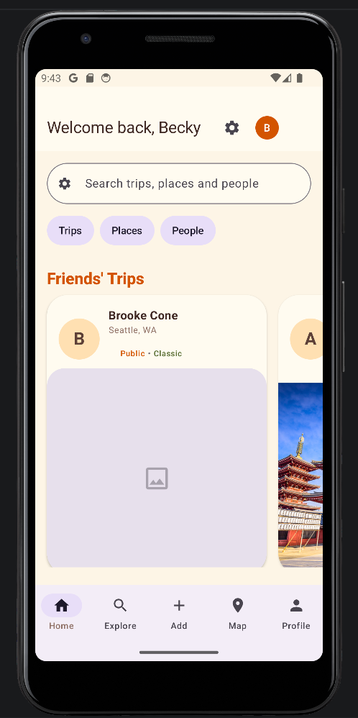
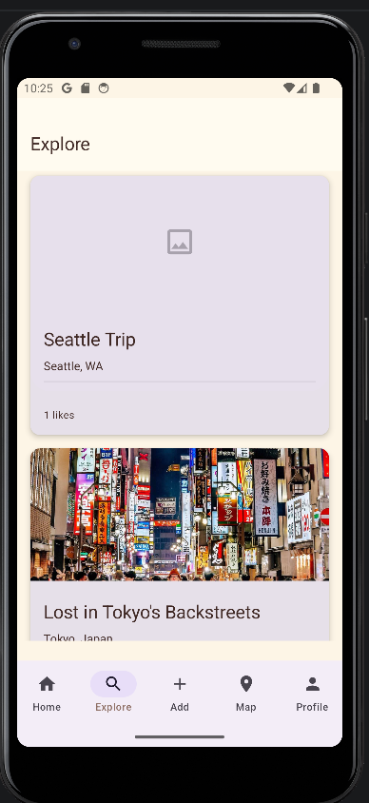
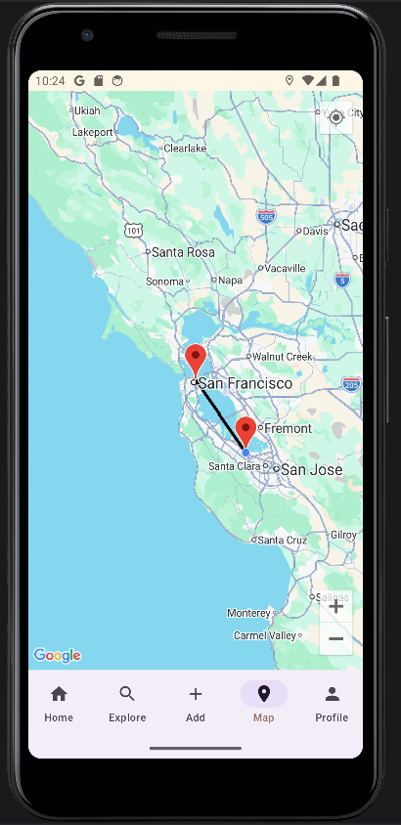
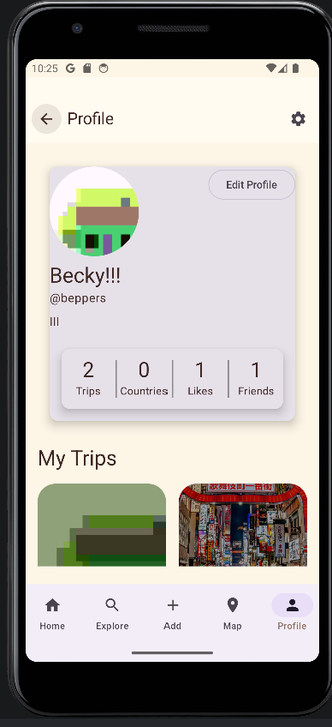
Main Screens

Slide 5
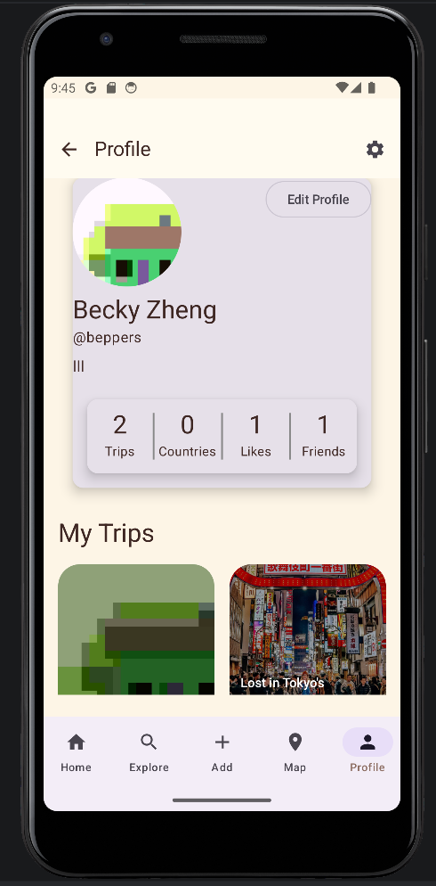
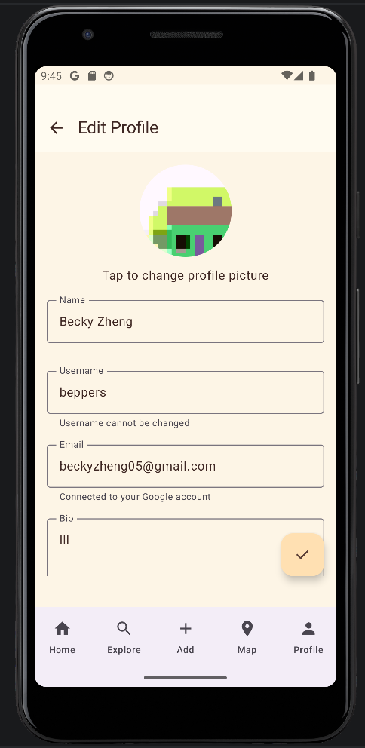
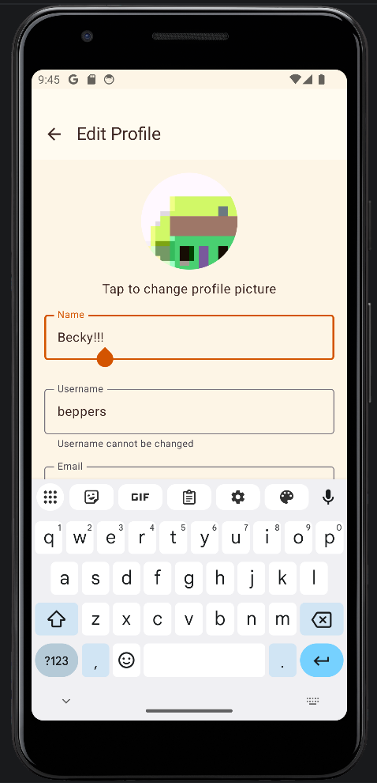
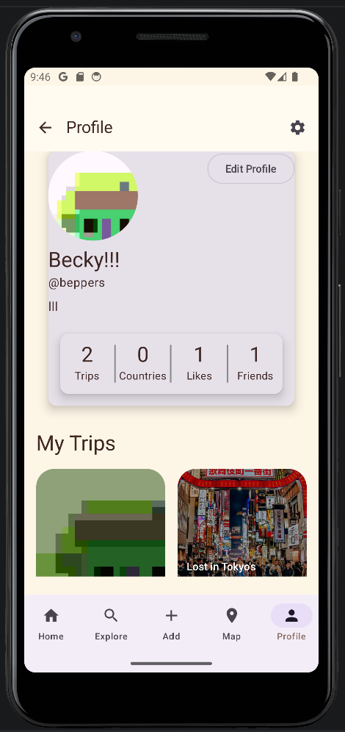
View and Edit Your Profile

Slide 6
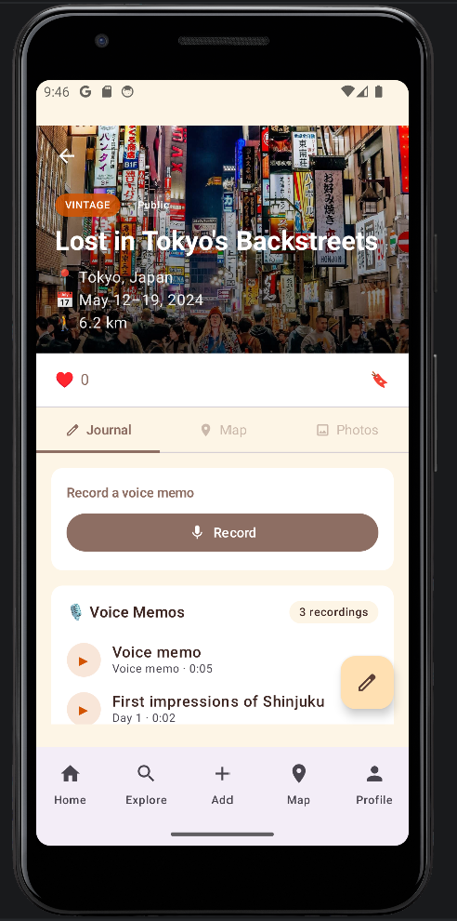
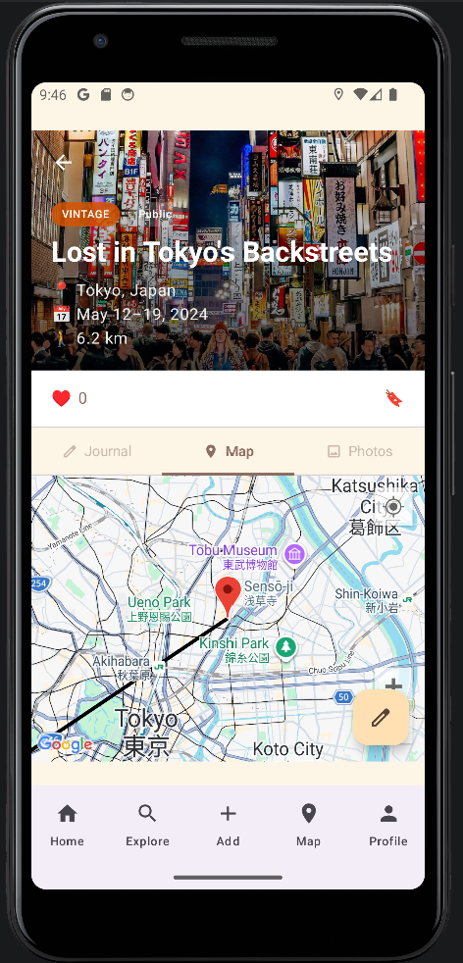
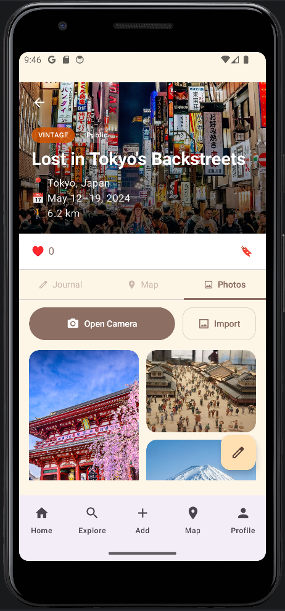
View and Edit Your Own Trips

Slide 7
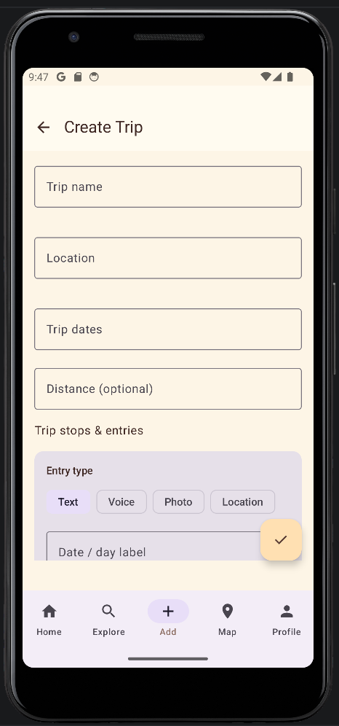
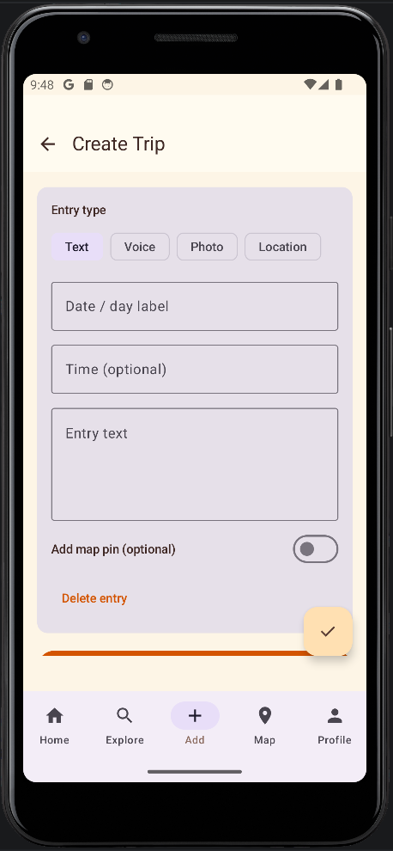
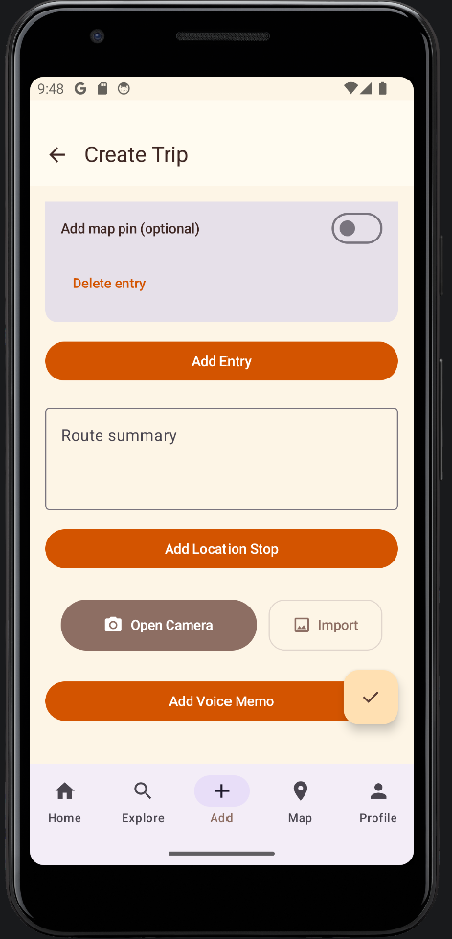
Document Your Travels

Slide 8
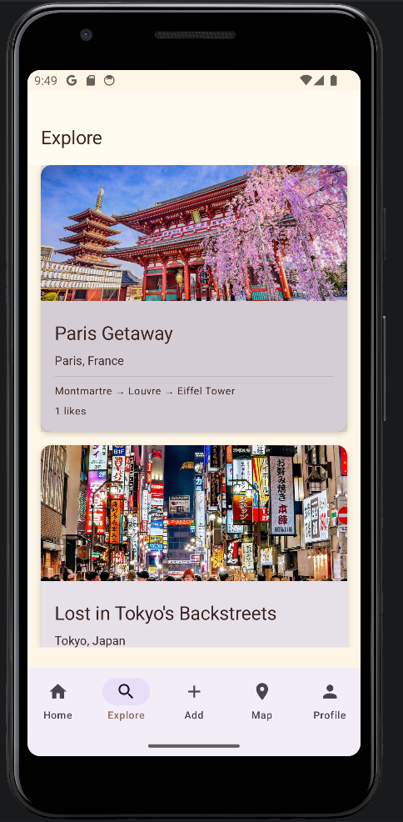
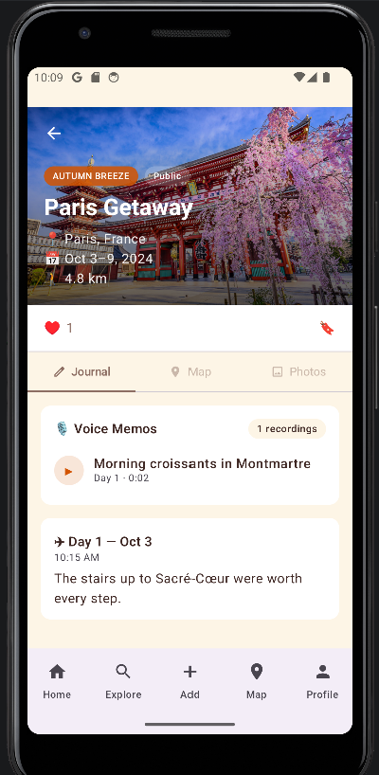
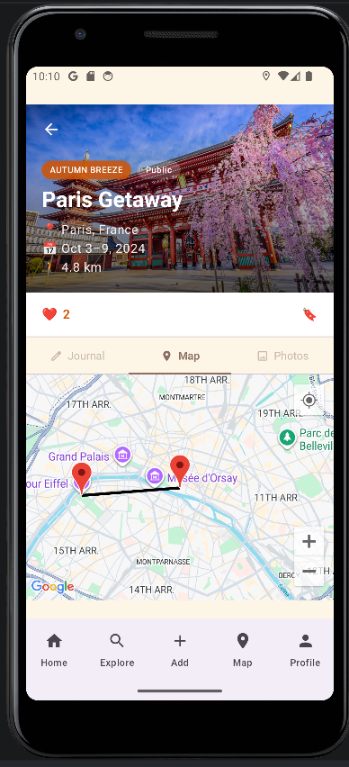
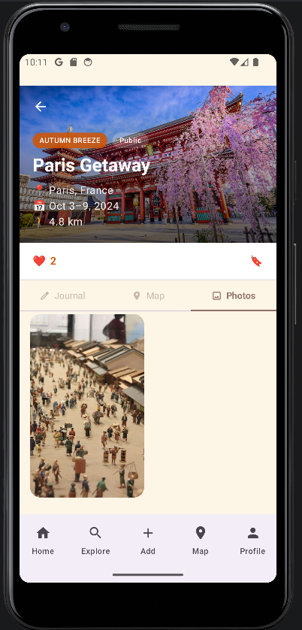
View Other People’s Trips

Slide 9
Future goals
Potential for expansion with features like a global map with pin drops
Our app is heavily based in the idea of unity so having a feature in the future to connect people who want to plan similar trips and allow them to plan together could be a cool way to expand
better support for our friend feature
way to view list of friends
friends and explore could be expanded on

Slide 10
Specific difficulties
as a group we had a bit of technical trouble figuring out some of the intricacies of github and ensuring we didn’t have conflicting code, duplicate code, or accidental overwritten code
working across multiple platforms with multiple people and accounts to manage was also a learning curve

Slide 11
overall experience
We think that while at times coordinating details as a group with everyone's differing schedules was a challenge the project was truly a collaborative effort and a great experience. We all participated in little things down to voting on the name and logo details. We had a great time putting together this app and a lot of fun with the open endedness of the assignment and how much it lent itself to creative design choices. We also picked up a lot of new skills through the process of creating the app.

