Slide 1

Decrease processing time
How to make your code faster?

Slide 2
Threat N°1:
Loops

Slide 3
Worth, nested loops
for list in sublist:
for sentence in list:
for word in sentence
print(word)

Slide 4
Best practices

Slide 5
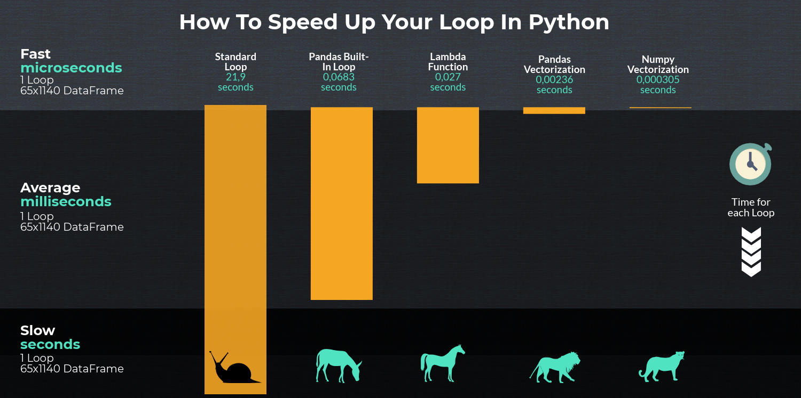
Dataframes

Slide 6
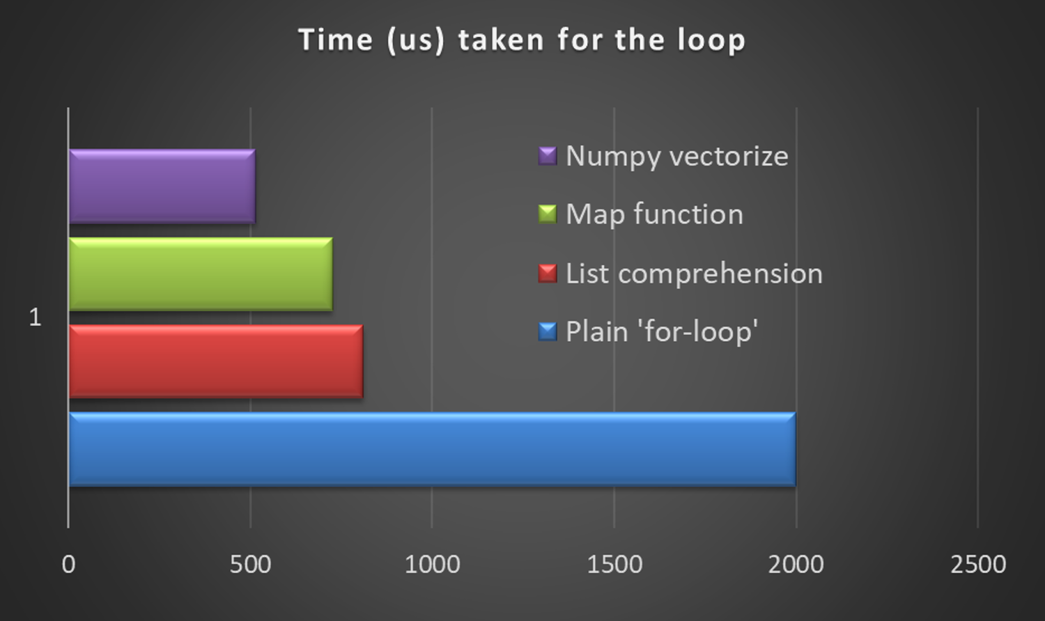
map or filter

Slide 7
How to map?
numbers = [1, 2, 3, 4]
result = []
for num in numbers:
step1 = num*2
step2 = step1 + 1
step3 = step2 - 10
result.append(step3)
numbers = [1, 2, 3, 4]
def my_func(number):
step1 = number*2
step2 = step1 + 1
step3 = step2 - 10
return step3
result_iterator = map(my_func, numbers)
result_list = list(result_iterator)
numbers = [1, 2, 3, 4]
def my_func(number):
step1 = number*2
step2 = step1 + 1
step3 = step2 - 10
return step3
result = list(map(my_func, numbers))

Slide 8
Parallelisme

Slide 9
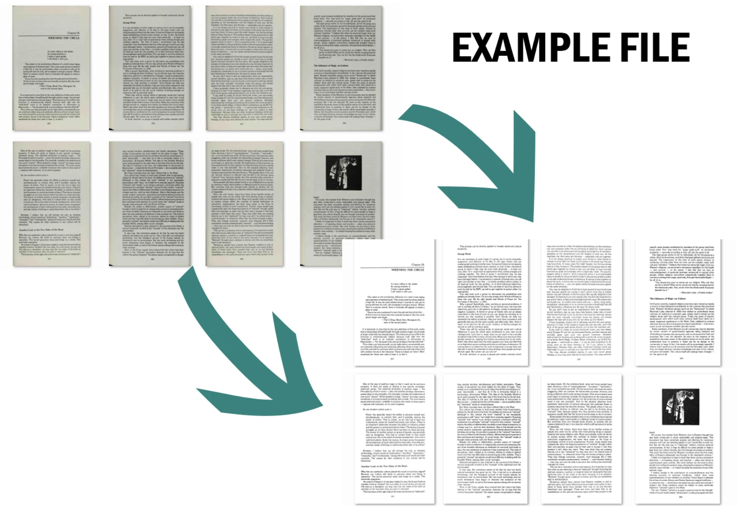
Image preprocessing

Slide 10
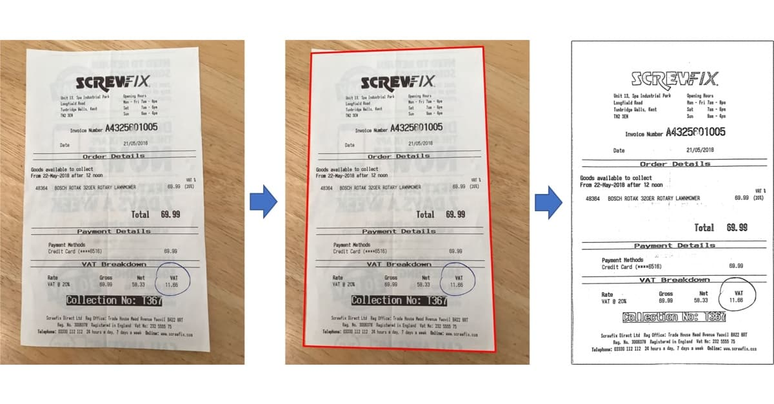

Classic approach
main.py

Slide 11
Classic approach
Add screen of HTOP with threads and cores

Slide 12
Parallel approach
main.py

Slide 13
Parallel approach
Add screen of HTOP with threads and cores

Slide 14
With list
clean_images = []
for image in image_list:
preprocessed_img = preprocess(image)
clean_images.append(preprocessed_img)
clean_images = [preprocess(image) for image in image_list]

Slide 15
With map
clean_image_iterator = map(preprocess, image_list)
clean_image = list(clean_image_iterator)
clean_image = list(map(preprocess, image_list))

Slide 16
With pool
from concurrent.futures.process import ProcessPoolExecutor
with ProcessPoolExecutor(max_workers=4) as pool:
clean_image = list(pool.map(preprocess, image_list))

Slide 17
How to fail

Slide 18
How to fail
Use pools in pools

Slide 19
How to fail
Use pools when it’s not needed

Slide 20
How to fail
Try to access to variables that are out of the pool

Slide 21
The end

