Slide 1
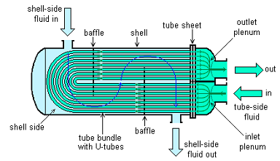
Thermal Development of Internal Flows
P M V Subbarao
Associate Professor
Mechanical Engineering Department
IIT Delhi
Concept for Precise Design ……

Slide 2
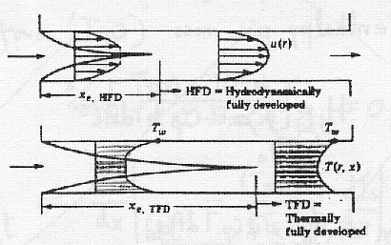
Development of Flow

Slide 3
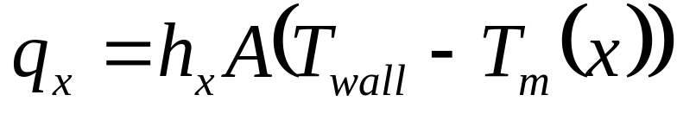
Temperature Profile in Internal Flow
Hot Wall & Cold Fluid
q’’
T_{s}(x)
T_{i}
T(x)
Cold Wall & Hot Fluid
T_{i}
q’’
T_{s}(x)
T(x)
The local heat transfer rate is:

Slide 4
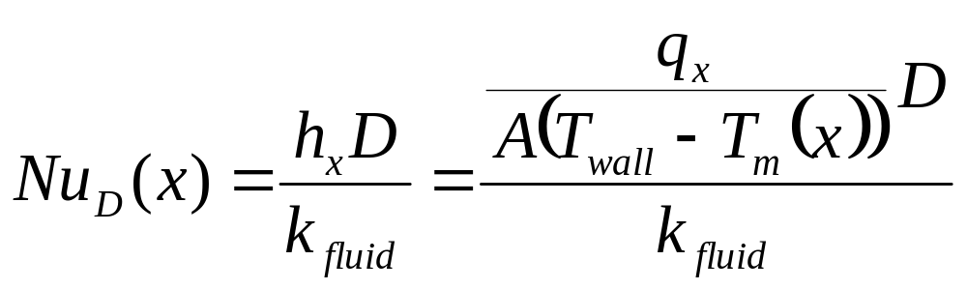
We also often define a Nusselt number as:

Slide 5
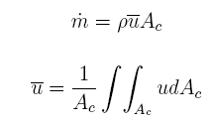
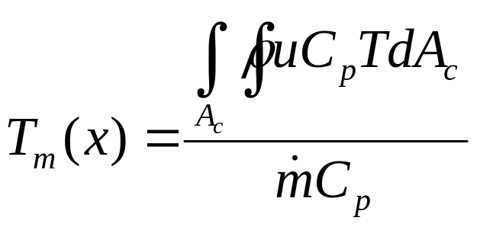
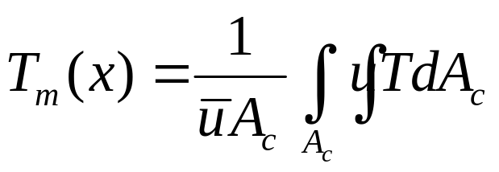
Mean Velocity and Bulk Temperature
Two important parameters in internal forced convection are the mean flow velocity u and the bulk or mixed mean fluid temperature T_{m}(z).
The mass flow rate is defined as:
while the bulk or mixed mean temperature is defined as:
For Incompressible Flows:

Slide 6
Mean Temperature (T_{m})
We characterise the fluid temperature by using the mean temperature of the fluid at a given cross-section.
Heat addition to the fluid leads to increase in mean temperature and vice versa.
For the existence of convection heat transfer, the mean temperature of the fluid should monotonically vary.

Slide 7
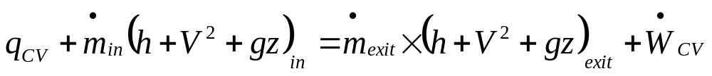
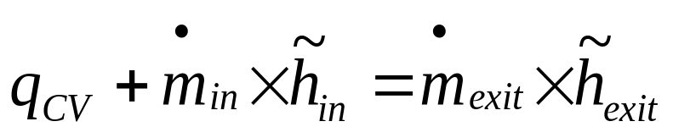
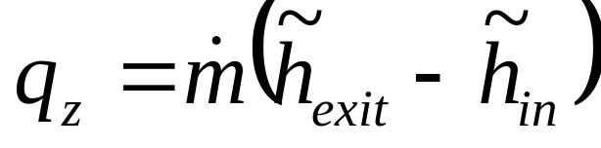
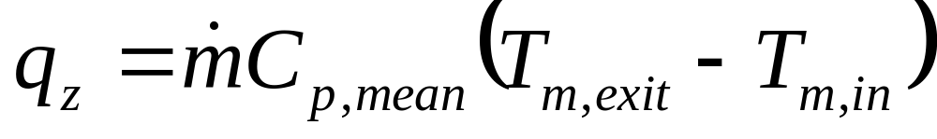
First Law for A CV : SSSF
q_{z}
T_{m,in}
T_{m,exit}
dx
No work transfer, change in kinetic and potential energies are negligible

Slide 8
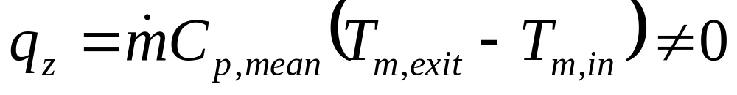
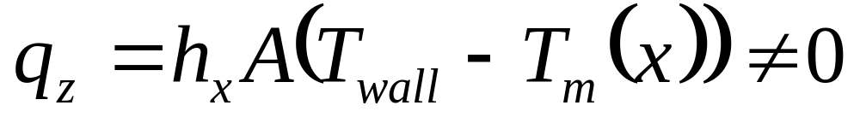
THERMALLY FULLY DEVELOPED FLOW
There should be heat transfer from wall to fluid or vice versa.
Then What does fully developed flow signify in Thermal view?

Slide 9
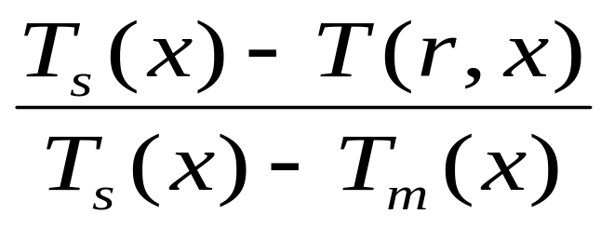
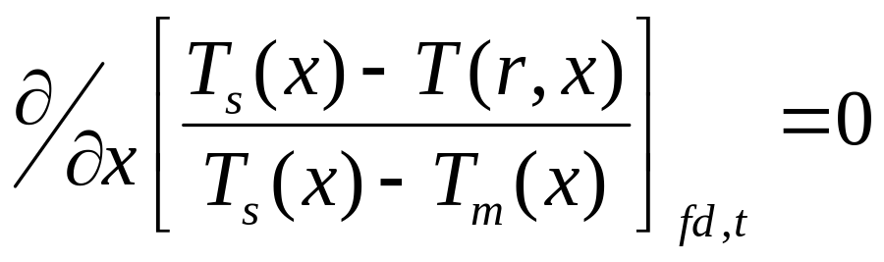
FULLY DEVELOPED CONDITIONS (THERMALLY)
(what does this signify?)
Use a dimensionless temperature difference to characterise the profile, i.e. use
This ratio is independent of x in the fully developed region, i.e.

Slide 11
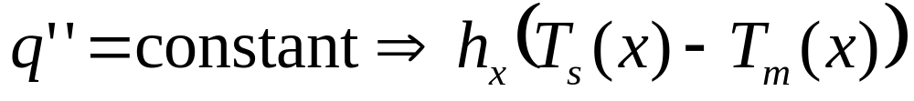
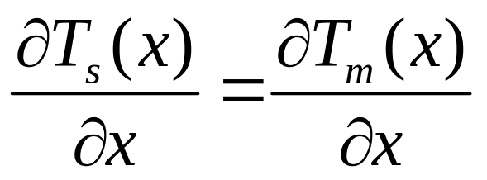
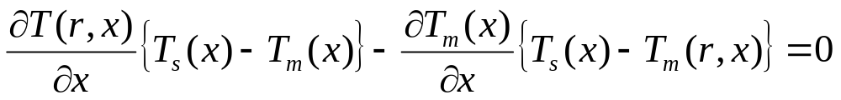
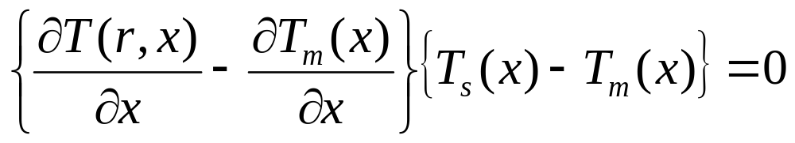
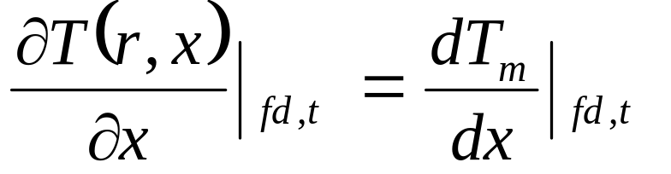
Uniform Wall Heat flux : Fully Developed Region
Temp. profile shape is unchanging.

Slide 12
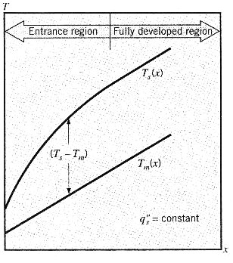
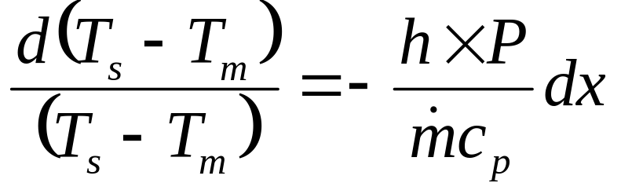
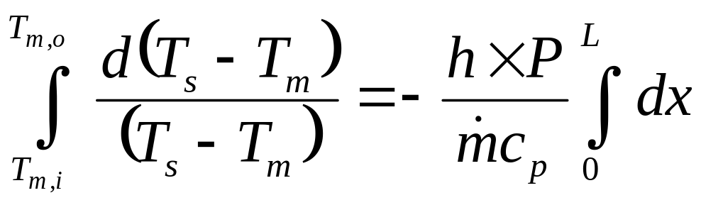
Constant Surface Heat Flux : Heating of Fluid
Integrating from x=0 (T_{m} = T _{m,i}) to x = L (T_{m} = T_{m,o}):

Slide 13
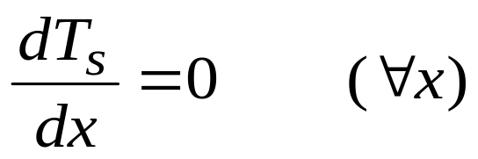
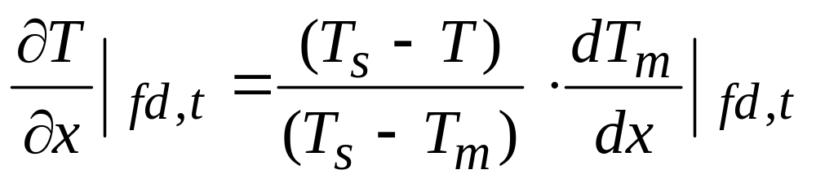
Temperature Profile in Fully Developed Region
Uniform Wall Temperature (UWT)
⇒ axial temp. gradient is not independent of r and shape of temperature profile is changing.

Slide 14
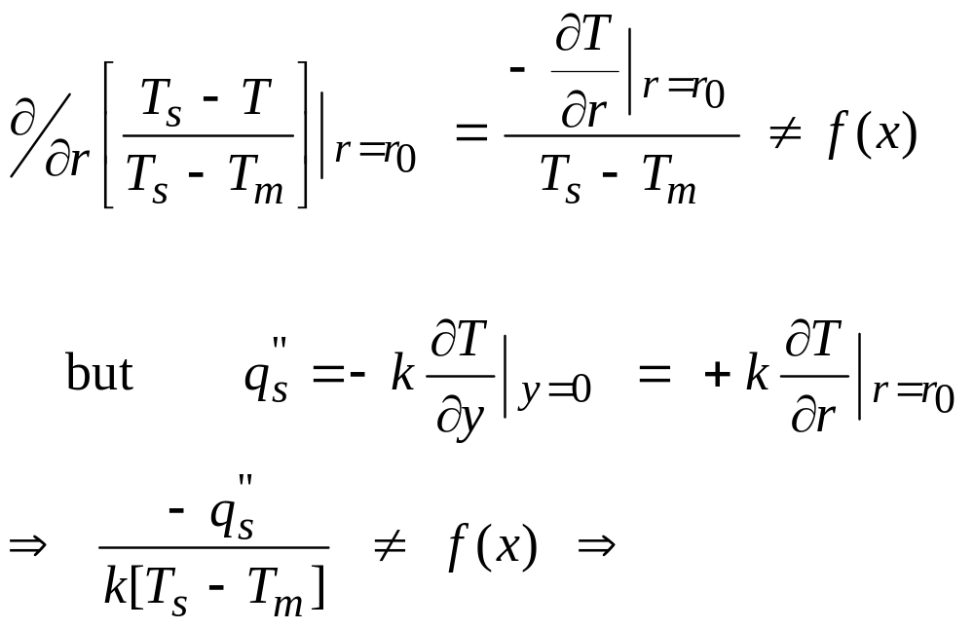
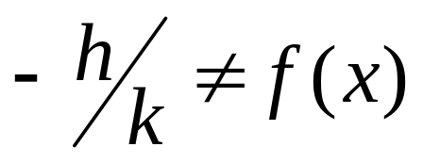
The shape of the temperature profile is changing, but the
relative shape is unchanged (for UWT conditions).
Both the shape and the relative shape are independent of x for
UWF conditions.
At the tube surface:

Slide 15
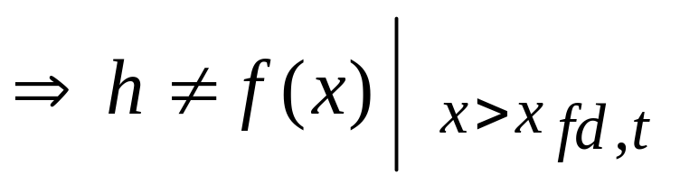
i.e. the Nusselt number is independent of x in the thermally fully
developed region.
Assuming const. fluid properties:-
This is the real significance of thermally fully developed

Slide 16
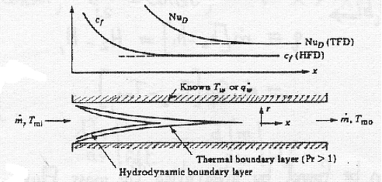
Evolution of Macro Flow Parameters

Slide 17
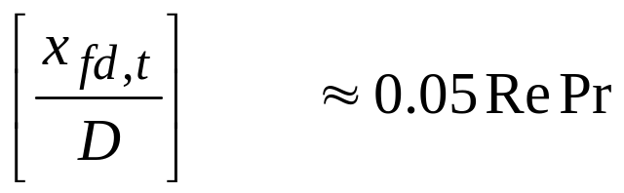
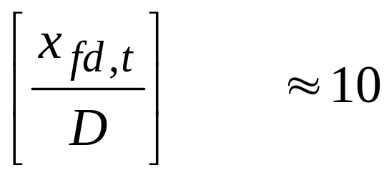
Thermal Considerations – Internal Flow
T _{fluid} ≠ T_{surface}
a thermal boundary layer develops
The growth of δ_{th} depends on whether the flow is laminar or turbulent
Extent of Thermal Entrance Region:
Laminar Flow:
Turbulent Flow:

Slide 18
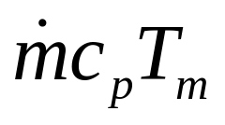
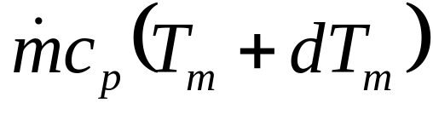
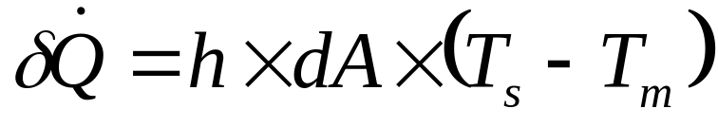
Energy Balance : Heating or Cooling of fluid
δQ
Rate of energy inflow
T_{m}
T_{m} + dT_{m}
dx
Rate of energy outflow
Rate of heatflow through wall:
Conservation of energy:

Slide 19
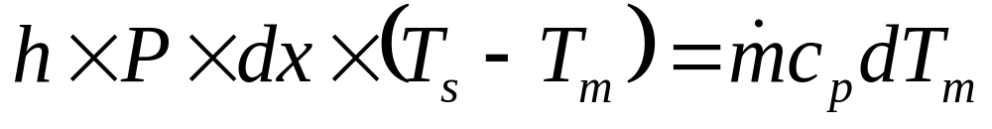
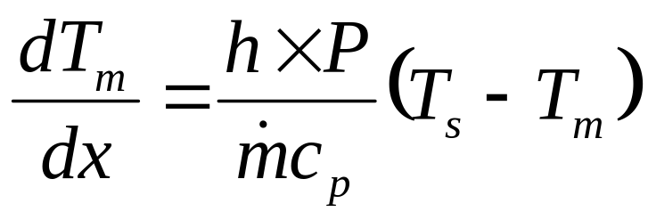
This expression is an extremely useful result, from which axial
Variation of T_{m} may be determined.
The solution to above equation depends on the surface thermal condition.
Two special cases of interest are:
Constant surface heat flux.
Constant surface temperature

Slide 20
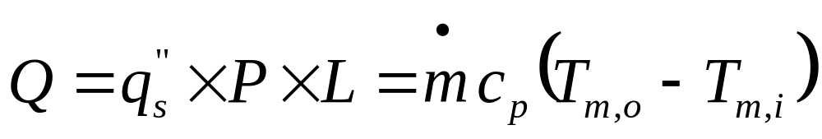
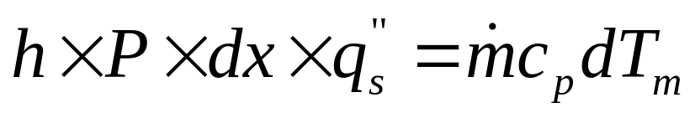
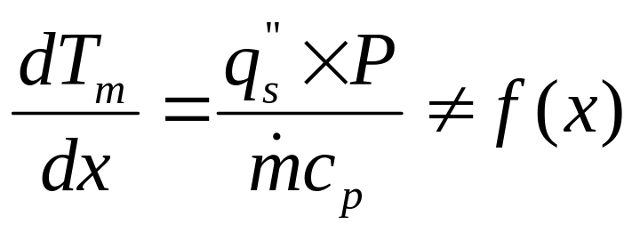
Constant Surface Heat flux heating or cooling
For constant surface heat flux:
For entire pipe:
For small control volume:

Slide 21
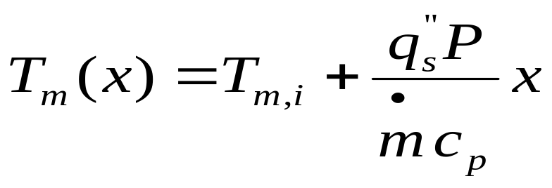
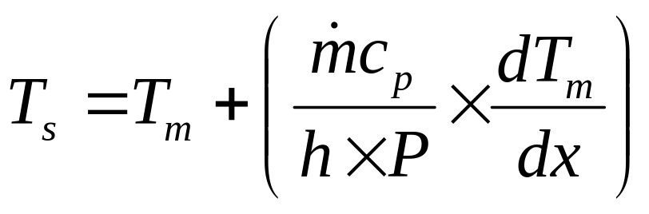
Integrating form x = 0
The mean temperature varies linearly with x along the tube.
For a small control volume:
The mean temperature variation depends on variation of h.

Slide 22
Constant Surface Heat Flux : Heating of Fluid
Integrating from x=0 (T_{m} = T _{m,i}) to x = L (T_{m} = T_{m,o}):

Slide 23
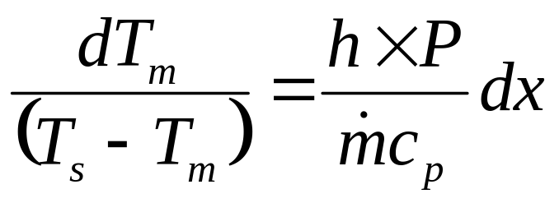
Constant Surface Heat flux heating or cooling
For a small control volume:
Integrating from x=0 (T_{m} = T _{m,i}) to x = L (T_{m} = T_{m,o}):

Slide 24
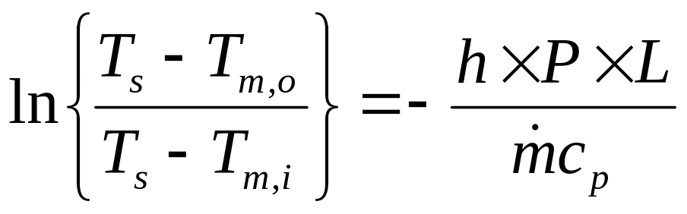
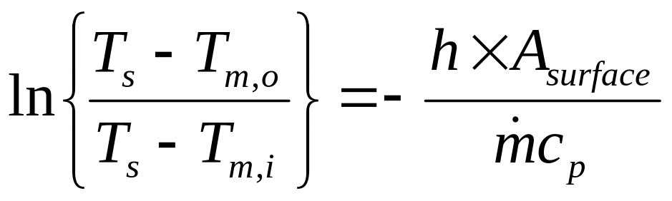
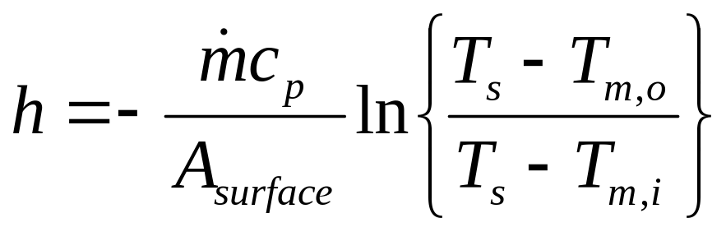
h : Average Convective heat transfer coefficient.

Slide 25
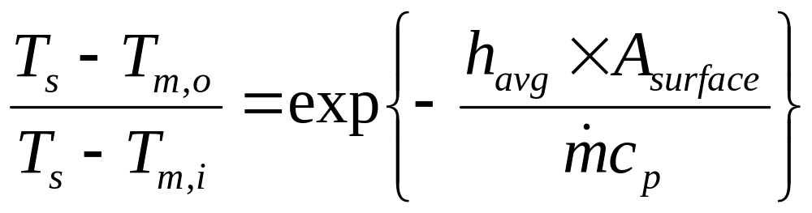
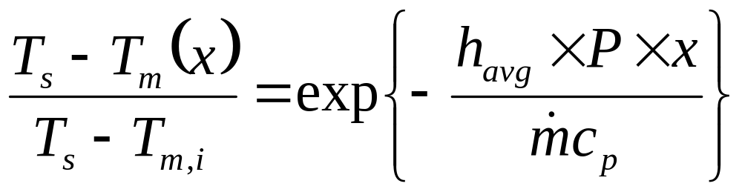
The above result illustrates the exponential behavior of the bulk fluid for constant wall temperature.
It may also be written as:
to get the local variation in bulk temperature.
It important to relate the wall temperature, the inlet and exit temperatures, and the heat transfer in one single expression.

Slide 26
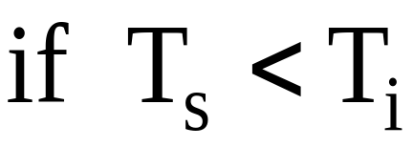
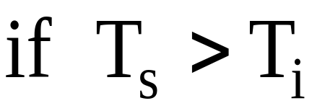


Constant Surface Heat flux heating or cooling
T
T
x
x

Slide 27
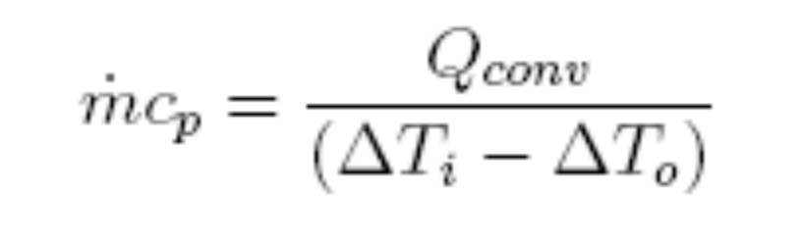


To get this we write:

Slide 28


which is the Log Mean Temperature Difference.
The above expression requires knowledge of the exit temperature, which is only known if the heat transfer rate is known.
An alternate equation can be derived which eliminates the outlet temperature.
We Know

Slide 29




Thermal Resistance:

Slide 30

Dimensionless Parameters for Convection
Forced Convection Flow Inside a Circular Tube
All properties at fluid bulk mean temperature (arithmetic mean of inlet and outlet temperature).

Slide 31
Internal Flow Heat Transfer
Convection correlations
  Laminar flow
  Turbulent flow
Other topics
  Non-circular flow channels
  Concentric tube annulus

Slide 32



Convection correlations: laminar flow in circular tubes
1. The fully developed region
from the energy equation,we can obtain the exact solution.
for constant surface heat fluid
for constant surface temperature
Note: the thermal conductivity k should be evaluated at average T_{m}

Slide 33


Convection correlations: laminar flow in circular tubes
The entry region : for the constant surface temperature condition
thermal entry length

Slide 34




Convection correlations: laminar flow in circular tubes
for the combined entry length
Valid for
All fluid properties evaluated
at the mean T

Slide 36


Thermally developing, hydrodynamically developed laminar flow (Re < 2300)
Constant wall temperature:
Constant wall heat flux:

Slide 37


Simultaneously developing laminar flow (Re < 2300)
Constant wall temperature:
Constant wall heat flux:
which is valid over the range 0.7 < Pr < 7 or
if Re Pr D/L < 33 also for Pr > 7.

Slide 38

Convection correlations: turbulent flow in circular tubes
A lot of empirical correlations are available.
For smooth tubes and fully developed flow.
For rough tubes, coefficient increases with wall roughness. For fully developed flows

Slide 39


Fully developed turbulent and transition flow
(Re > 2300)
Constant wall Temperature:
Where
Constant wall temperature:
For fluids with Pr > 0.7 correlation for constant wall heat flux can be used with negligible error.

Slide 40


Effects of property variation with temperature
Liquids, laminar and turbulent flow:
Subscript w: at wall temperature, without subscript: at mean fluid temperature
Nu = Nu₀
Gases, laminar flow
Gases, turbulent flow

Slide 41

Noncircular Tubes: Correlations
For noncircular cross-sections, define an effective diameter, known as the hydraulic diameter:
Use the correlations for circular cross-sections.

Slide 42


Slide 43
Selecting the right correlation
Calculate Re and check the flow regime (laminar or turbulent)
Calculate hydrodynamic entrance length (x_{fd,h} or L_{he}) to see whether the flow is hydrodynamically fully developed. (fully developed flow vs. developing)
Calculate thermal entrance length (x_{fd,t} or L_{te}) to determine whether the flow is thermally fully developed.
We need to find average heat transfer coefficient to use in U calculation in place of h_{i} or h_{o}.
Average Nusselt number can be obtained from an appropriate correlation.
Nu = f(Re, Pr)
We need to determine some properties and plug them into the correlation.
These properties are generally either evaluated at mean (bulk) fluid temperature or at wall temperature. Each correlation should also specify this.

Slide 44

Heat transfer enhancement
Enhancement
Increase the convection coefficient
Introduce surface roughness to enhance turbulence.
Induce swirl.
Increase the convection surface area
Longitudinal fins, spiral fins or ribs.

Slide 45

Heat transfer enhancement
Helically coiled tube
Without inducing turbulence or additional heat transfer surface area.
Secondary flow

