Slide 1
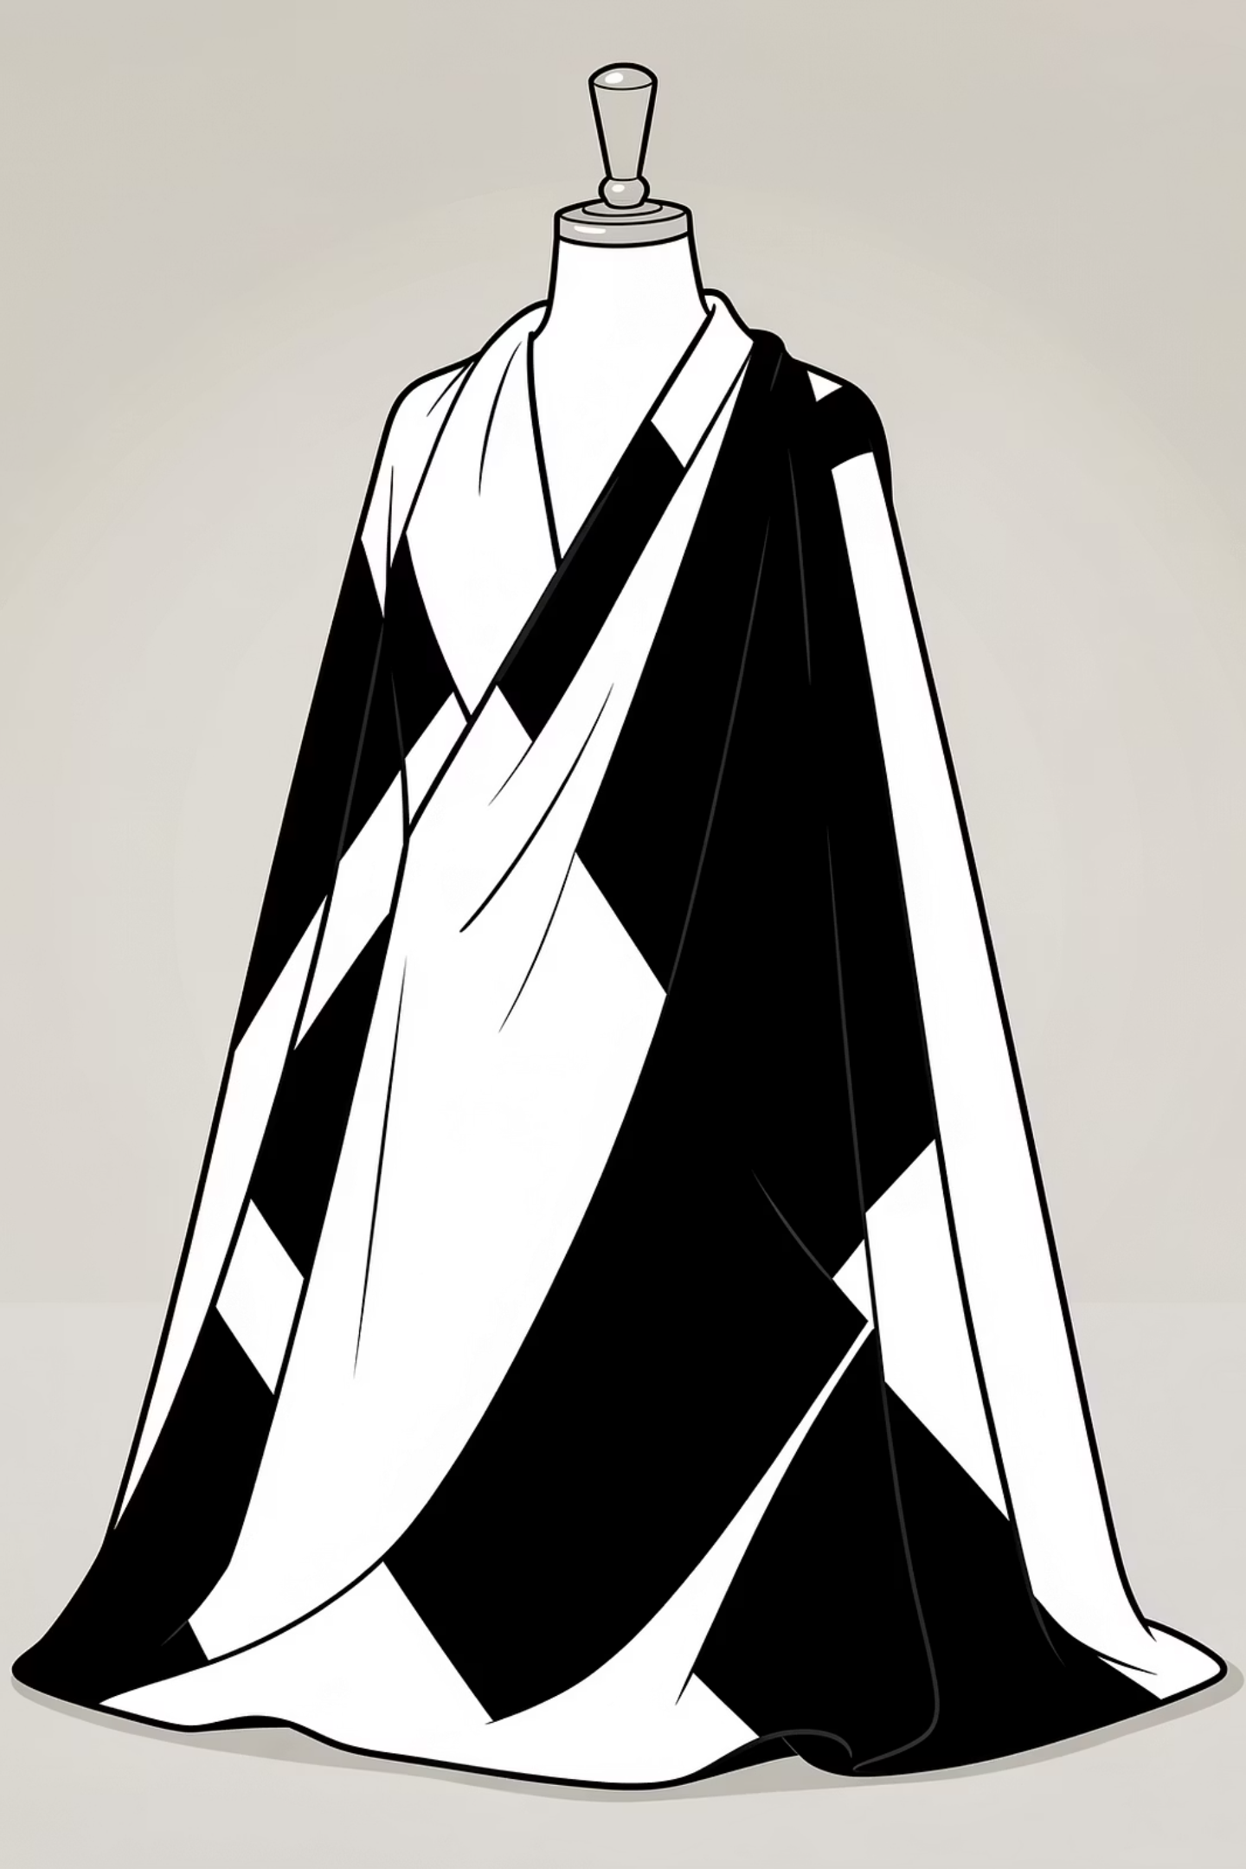
The Future of Fashion Visualisation
Transforming concepts into captivating digital reality for designers and merchandisers.

Slide 2
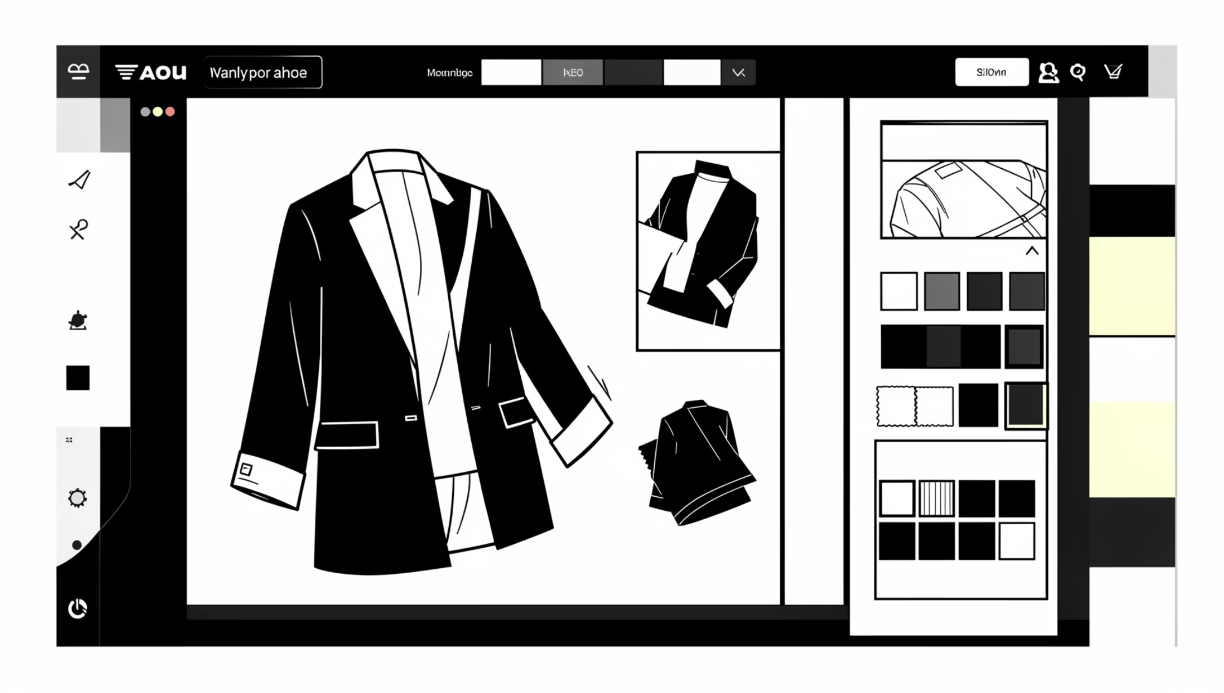
OUR MISSION
Crafting Bespoke Garment Visuals
We deliver realistic, high-quality garment visualisations, tailored to your exact specifications. From fabric to fit, every detail is meticulously rendered.

Slide 3

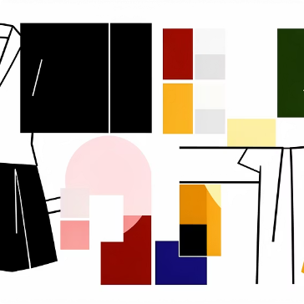
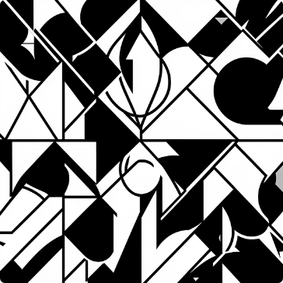
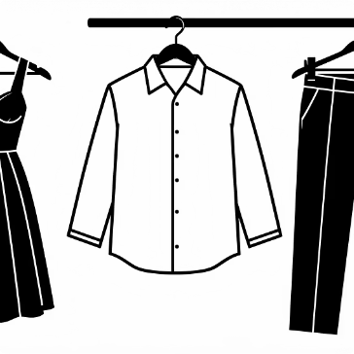
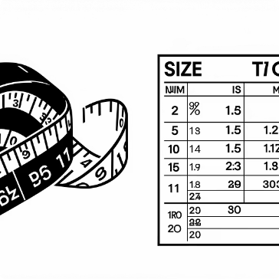
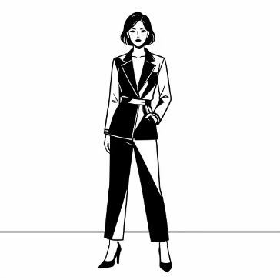
YOUR CREATIVE INPUTS
Your Vision, Our Canvas
Fabric Type
Garment Colour
Pattern Image
Garment Type
Choose from an extensive library of realistic textiles.
Specify the perfect hue for your design.
Seamlessly apply any uploaded pattern as a garment texture.
From dresses to denim, define the apparel.
Size
Reference Photo
Select the desired fit, from slim to loose.
Provide an optional user photo for personalised modelling.

Slide 4
UNDERSTANDING FIT
Precision in Proportions
1
2
Size S: Slim Fit
Size M: Regular Fit
Contoured to the body, emphasising the silhouette.
A balanced cut, comfortable yet classic.
3
4
Size L: Relaxed Fit
Size XL: Loose Fit
Generous proportions for a comfortable, easy wear.
An oversized aesthetic for maximum comfort and style.

Slide 5

DESIGN PRINCIPLES
Mastering Garment Realism
Our advanced rendering ensures unparalleled authenticity.

Slide 6





Fabric & Colour Application
Selected materials and colours applied with natural accuracy.
Seamless Pattern Integration
Pattern images flow effortlessly across garment surfaces.
Realistic Folds & Drape
Dynamic fabric behaviour mirroring real-world physics.
Accurate Size & Fit
Garment adheres to specified fit, maintaining proportions.
Proportion & Symmetry
Every aspect meticulously balanced for visual harmony.

Slide 7
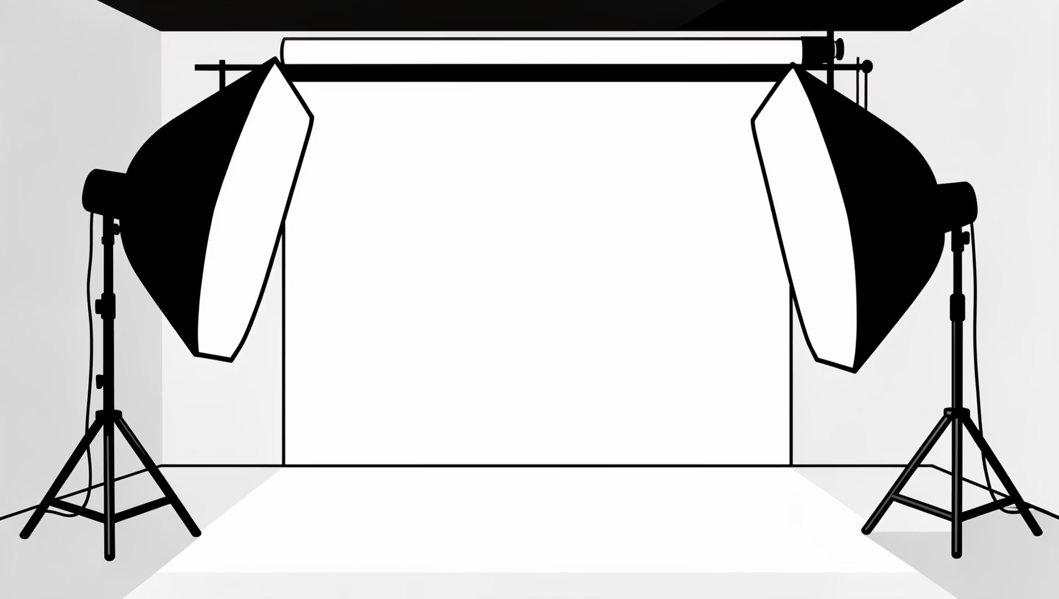
VISUAL & PHOTOGRAPHY STYLE
E-commerce Ready Excellence
Studio-Quality: Precision lighting, perfect angles.
Soft Professional Lighting: Enhances texture, minimises harsh shadows.
Clean, Neutral Background: Focus solely on the garment.
High Resolution, Sharp Focus: Crystal clear detail for every pixel.
E-commerce Ready: Optimised for online retail platforms.

Slide 8


IMPORTANT CONSIDERATIONS
Ethical & Aesthetic Constraints
No distortion of face, hands, or body in human models.
Avoid exaggerated or unrealistic styling; authenticity is key.
Absolutely no background clutter or distracting artefacts.

Slide 9
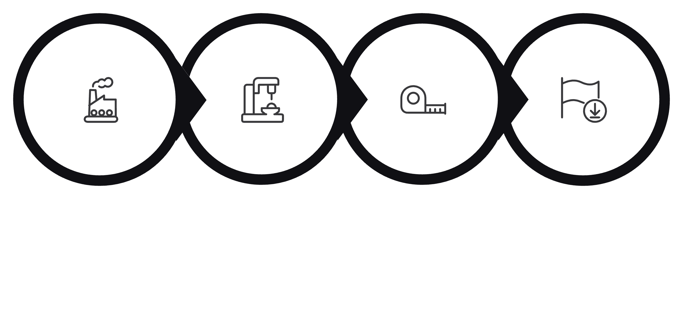

Our Seamless Workflow
Fabric Select
Construction
Fit Adjust
Final Render
From initial concept to final image, our process ensures efficiency and precision at every stage.

Slide 10
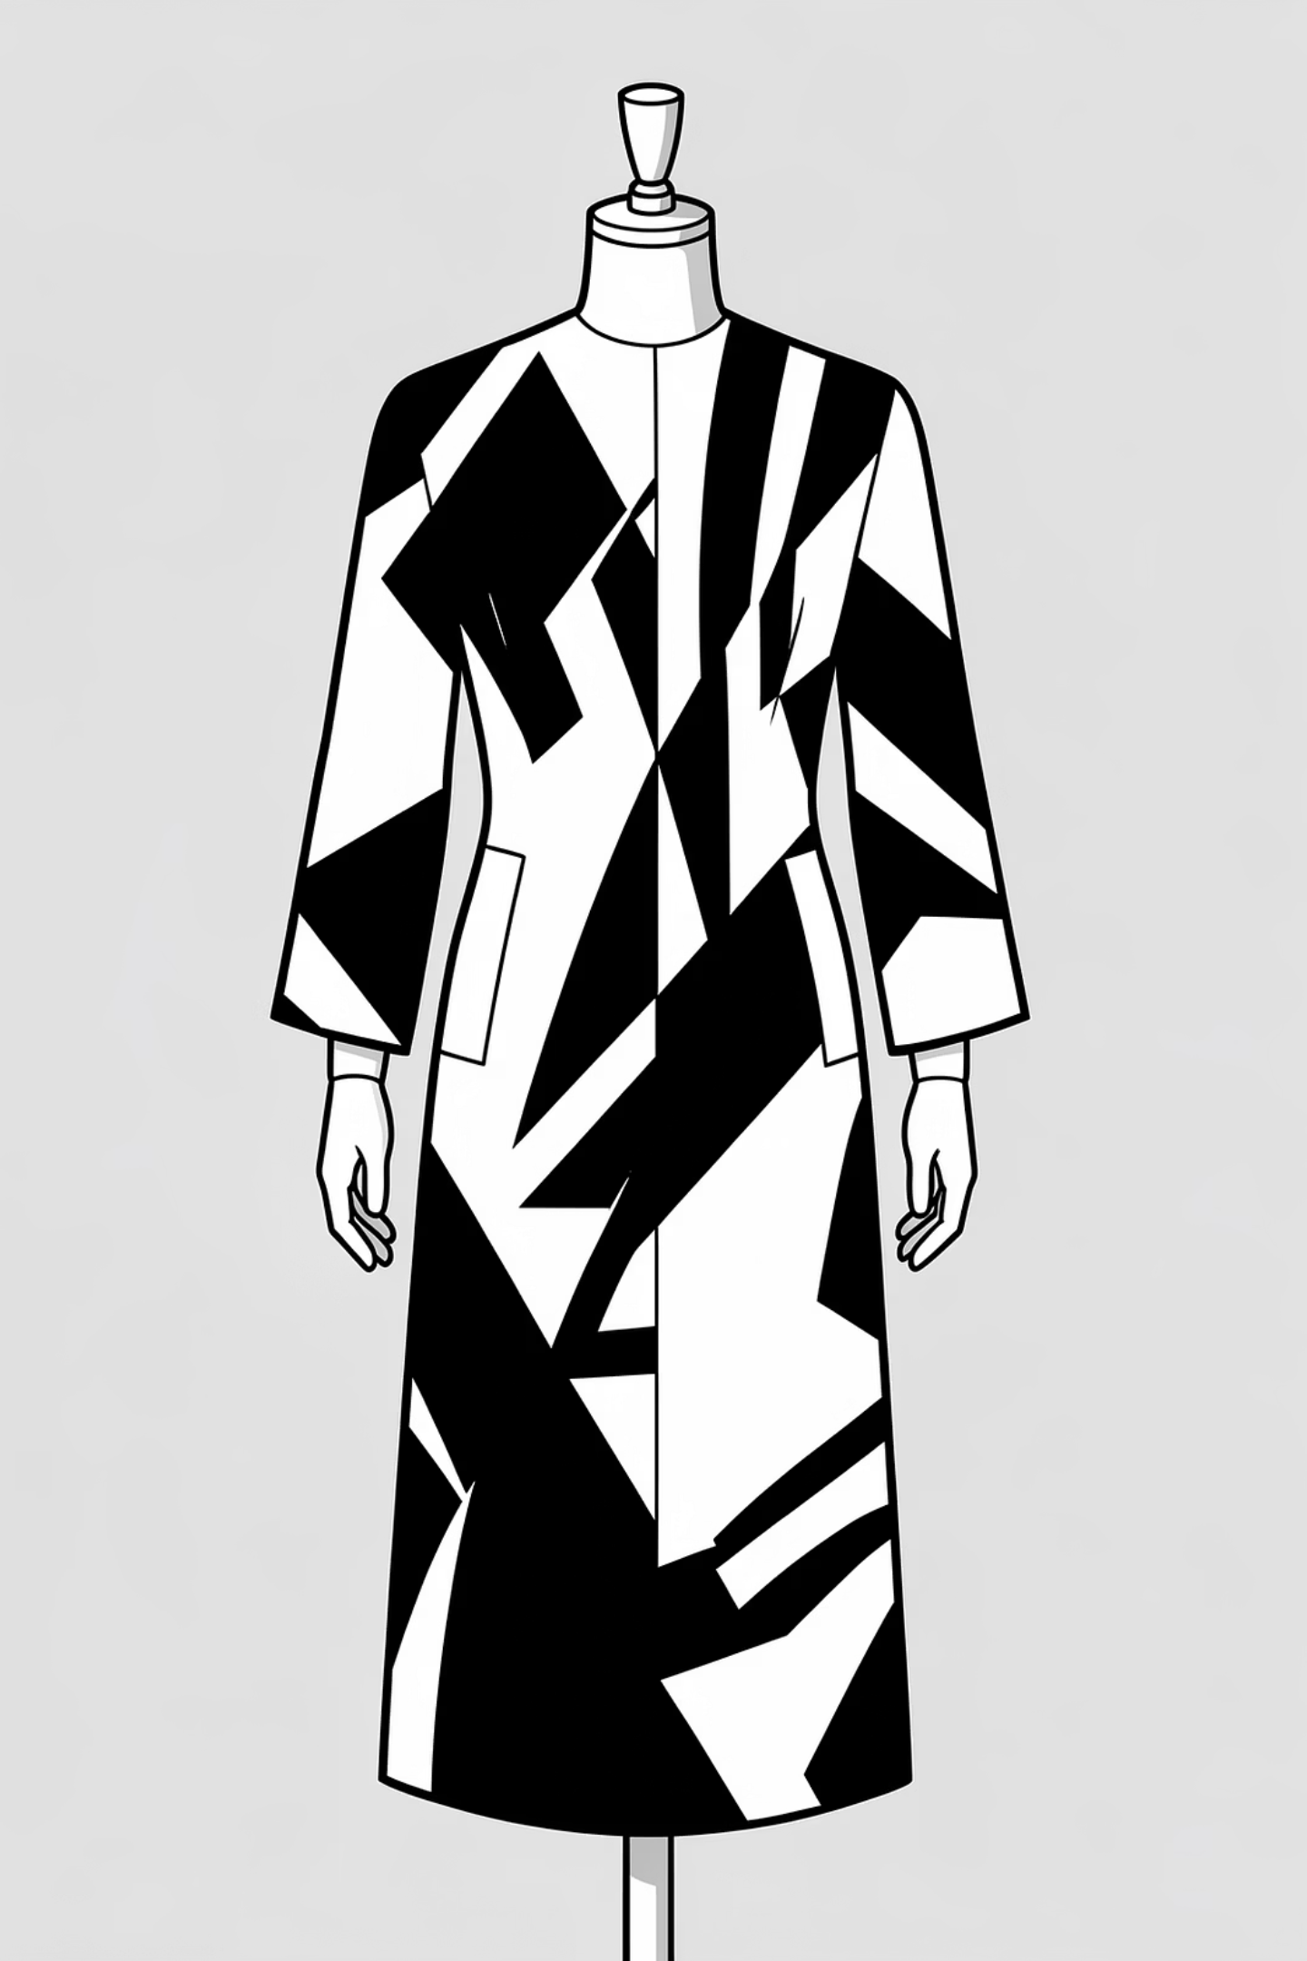
Your Final Product: A Visual Masterpiece
Experience the ultimate in digital garment representation – a photorealistic image ready to captivate your audience.

