Slide 1

VIDYA.IITG.AC.IN
Financial & Infrastructure Report
Expenditure, Revenue Analysis, and Scaling Requirements (Aug 2024 - Jun 2026)
for Vidya.iitg.ac.in

Slide 2

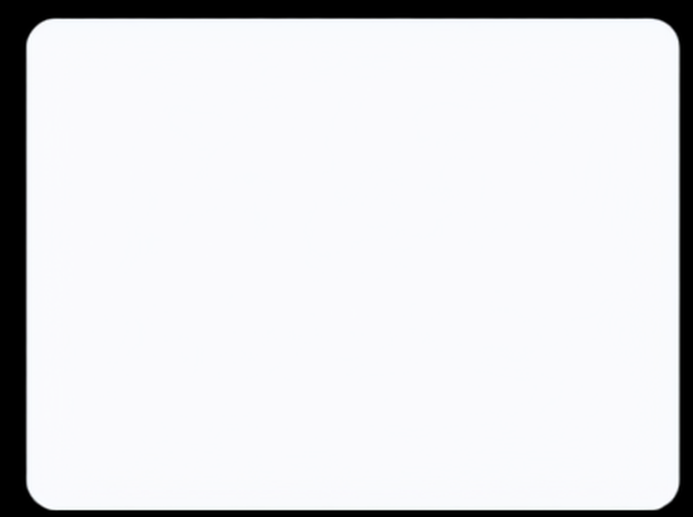





Executive Summary
₹5.24L
₹86.5K
₹4.38L
Total Earnings (TIH-IITG)
Total Operating Cost
Net Surplus Generated
The portal has proven to be a potential self-sustaining asset, generating roughly
six times its total operating and capital cost in revenue.

Slide 3
Revenue Generation Breakdown
Batch-wise earnings from TIH-IITG portal operations
Batch / Cohort
Duration
Students
Base Fee
Earnings (INR)
Pilot Batch
Aug – Oct 2025
25
₹2,500
₹62,500
Cohort 1
Oct – Dec 2025
42
₹3,000
₹1,26,000
Cohort 2
Nov 2025 – Jan 2026
23
₹3,000
₹69,000
Cohort 3
Jan – Mar 2026
11
₹3,000
₹33,000
Cohort 4
Jun – Aug 2026
78
₹3,000
₹2,34,000
Grand Total
179
₹5,24,500

Slide 4

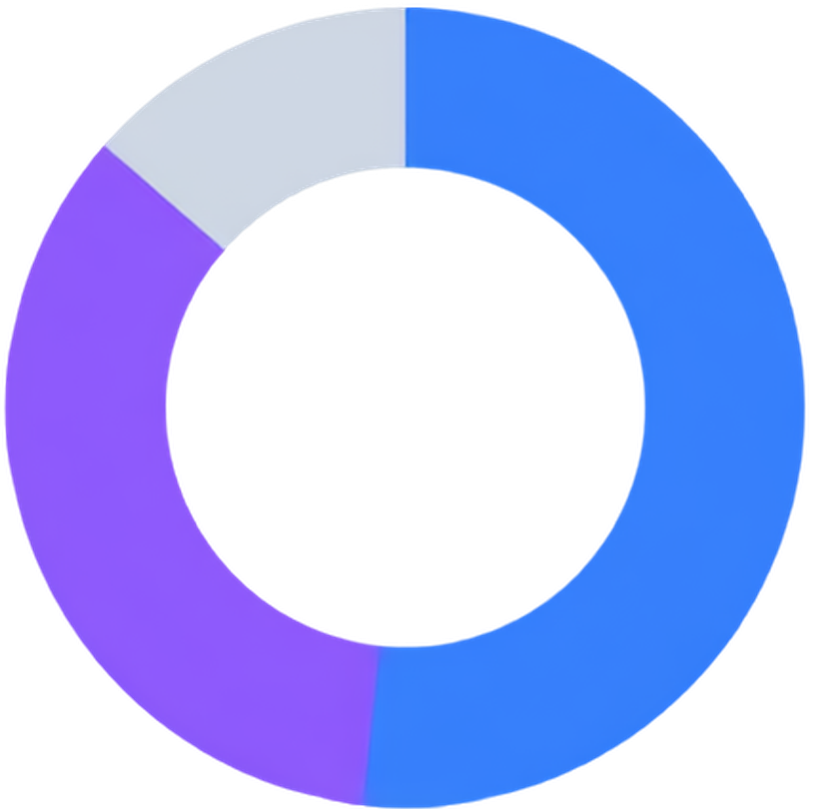



Operating Expenditure by Category
Server Maintenance (52%)
₹44,744
₹86.5K
Video Hosting (35%)
₹30,056
One-time Website Theme Cost (13%)
₹11,746

Slide 5
Financial Year-wise Expenditure Breakdown
EXPENSE CATEGORY
FY 2024-25
FY 2025-26
FY 2026-27
(Till Jun '26)
CATEGORY TOTAL
Website Theme
₹11,746
-
-
₹11,746
Server Maintenance
₹8,035
₹28,462
₹8,247
₹44,744
Video Hosting (VdoCipher)
₹14,747
₹15,309
-
₹30,056
Total Cash Outflow
₹34,528
₹43,771
₹8,247
₹86,546
* Note on Outflows: VdoCipher licenses are paid annually upfront in August (impacting FY 24-25 and FY 25-26). Server costs reflect the transition from USD to fixed INR billing (₹2,749/month) starting in July 2025.

Slide 6
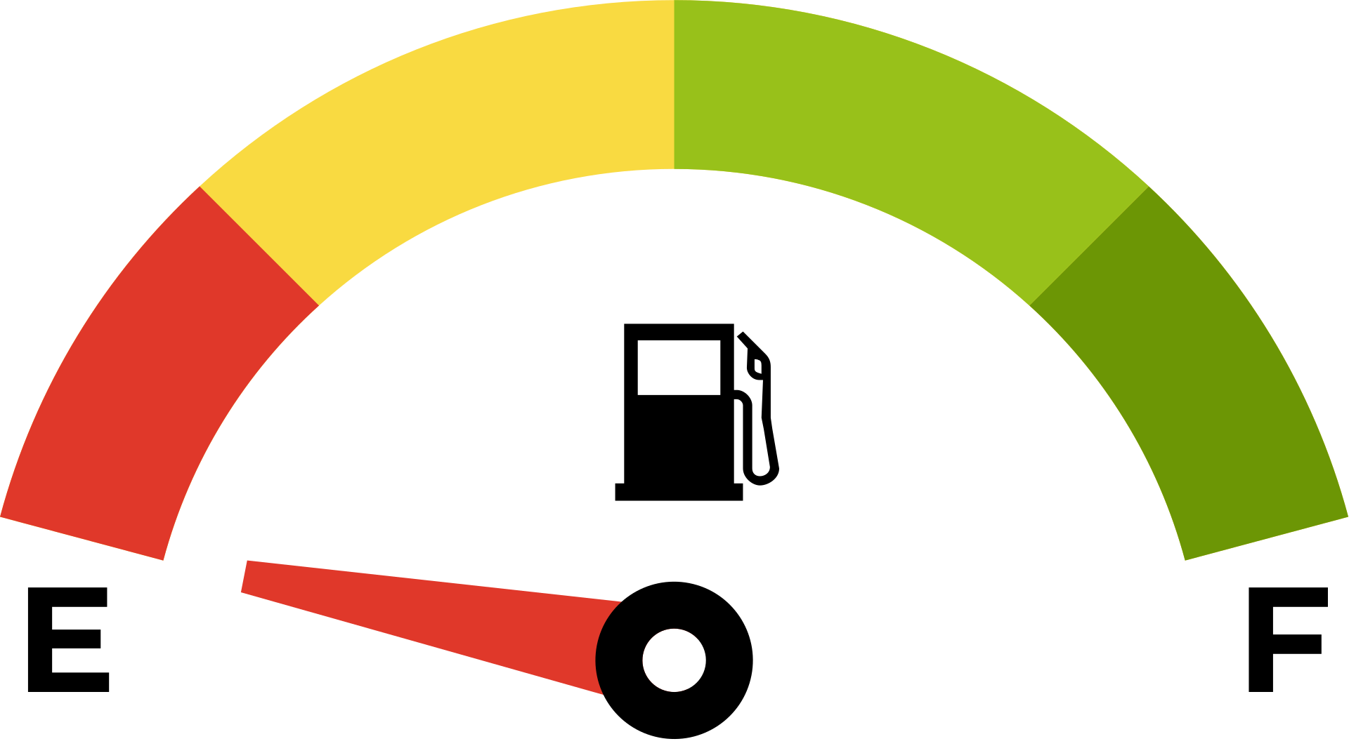
Scaling for Growth: Immediate Storage Requirements
VdoCipher Storage Capacity Analysis
Current Capacity Exhausted
Storage Status
Our VdoCipher plan has a strict 100 GB limit. Currently, 85 GB (85%) is already consumed by existing TIH course videos.
Current: 85 GB / 100 GB
85%
Required: 1 TB (1000 GB)
📦
The Transcoding Multiplier
We have 2 new courses ready to publish (~100-150 GB compressed). However, VdoCipher automatically generates multiple device-specific copies, inflating the server storage footprint to 200-250 GB per course.
10x
capacity increase needed
Upgrade: 100 GB → 1 TB
⚡
Action Required
To launch the two pending courses and maintain a buffer for future revenue-generating programs, an immediate upgrade to a minimum 1 TB storage capacity is strictly required.

Slide 7



Future Roadmap: Video Hosting Upgrades
Option A: High Security
Option B: Cost Optimization
₹1.5 Lakh
₹18,000
per year (VdoCipher)
per year (Vimeo)
DRM Security: High (Prevents piracy, downloads, and screen recording apps)
🔓
Security: Basic (No DRM; vulnerable to scraping and screen recording)
💾
Storage Capacity: 1 TB
💾
Storage Capacity: 4 TB (4x more storage)
Financial Impact: Significant increase in operational expenditure
Financial Impact: Drastic 88% cost reduction compared to Option A

Slide 8
THANK YOU!

