Slide 1
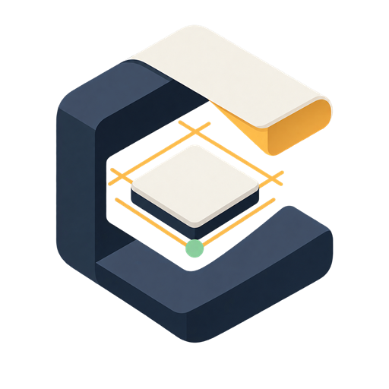
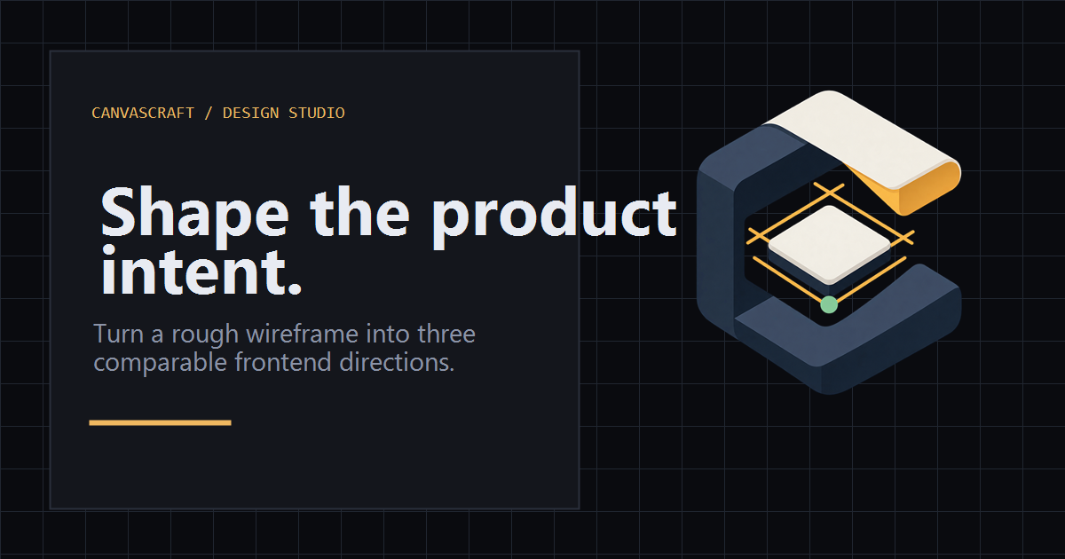
CANVASCRAFT / DESIGN STUDIO
Great product ideas
should not stall
as rough wireframes.
Sketches are ambiguous. Hand-offs are slow.
One-direction builds hide better answers.
THE GAP: intent → a credible prototype
A wireframe only captures the beginning.
CANVASCRAFT
FROM ROUGH INTENT TO LIVE OPTIONS
Notes:
CanvasCraft demo: start with the bottleneck. The team can capture an idea, but getting to a credible, comparable prototype tends to be slow and linear.
[Sources]
- Internal product artwork: apps/web/public/brand/canvascraft-social.png

Slide 2
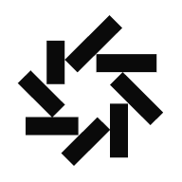
One wireframe. Three live design bets.
CanvasCraft fixes product intent, then gives visual and motion choices room to compete.
DAYTONA
Canvas
Interpret
Match
Launch
Sketch or import
Shared Screen Spec
Visuals + licence gate
Three live previews
COMPARABLE OUTPUTS
3
live branches
from one contract
Calm Trust
Playful Momentum
Editorial Precision
Clear hierarchy · restrained motion
Expressive rhythm · bold energy
Tight type · decisive density
CANVASCRAFT
OPENAI-COMPATIBLE · NOSANA · DAYTONA
Notes:
CanvasCraft converts the canvas to a shared Screen Spec, uses visual matching and a licence gate to ground component choices, then launches three directions as live Daytona branches.
[Sources]
- OpenAI mark: https://upload.wikimedia.org/wikipedia/commons/6/66/OpenAI_logo_2025_%28symbol%29.svg
- Nosana mark: https://nosana.com/_astro/nosanaLogoDark.D176lt8U_ZVySwW.svg
- Daytona mark: https://framerusercontent.com/images/6WPclDLAHHQgPFeA2DRTW1OXVSU.png

Slide 3
Decide before a sprint gets attached to the first aesthetic.
Hold the product contract steady. Compare hierarchy, states, and motion before committing.
WHAT CHANGES
LOCKED ACROSS EVERY BRANCH
Shared
Screen Spec
Same product meaning.
Same interaction model.
Same responsive states.
Calm Trust
Playful Momentum
Editorial Precision
✓
Low noise
More energy
Champion
INTENT PROTECTED
Choose the strongest direction.
Keep a live preview. Archive the rest.
CANVASCRAFT
COMPARE FIRST · COMMIT WITH CONFIDENCE
Notes:
The key value is not more variation for its own sake. CanvasCraft preserves the product contract, so reviewers compare true design decisions instead of accidentally comparing different products.
[Sources]
- Internal product model: CanvasCraft_PRD.md and docs/architecture.md

Slide 4
Every integration is visible in the demo trace.
A deliberately narrow stack: browser studio → credentialed orchestration → GPU matching → isolated previews.
Canvas
Orchestrator
DAYTONA
3
Studio
Keys + SSE
Match
Launch
CLIP + licence gate
Three live sandboxes
live
previews
React · Vite · TS
Fastify · Node · Zod
FastAPI · Python
Docker · Motion
SECURITY BOUNDARY
The browser never holds API keys or talks to integrations directly.
The orchestrator owns provider credentials, sandbox capability, progress events, and explicit fallback states.
IMPLEMENTED STACK
React
Vite
TS
Tailwind
Fastify
Docker
Zod
CANVASCRAFT
CREDENTIALS STAY SERVER-SIDE · FAILURES STAY VISIBLE
Notes:
CanvasCraft's architecture is intentionally narrow. The browser captures intent; a credentialed orchestrator validates and coordinates; Nosana provides visual matching; Daytona runs isolated previews.
[Sources]
- OpenAI mark: https://upload.wikimedia.org/wikipedia/commons/6/66/OpenAI_logo_2025_%28symbol%29.svg
- Nosana mark: https://nosana.com/_astro/nosanaLogoDark.D176lt8U_ZVySwW.svg
- Daytona mark: https://framerusercontent.com/images/6WPclDLAHHQgPFeA2DRTW1OXVSU.png
- React, Vite, TypeScript, Tailwind CSS, Fastify, FastAPI, Docker, Zod, Node.js, Python, and Framer marks: https://github.com/simple-icons/simple-icons

