Slide 1
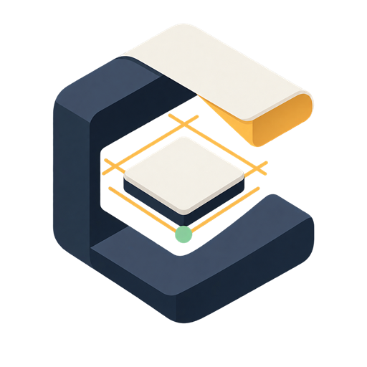
01 / PROBLEM
A sketch is not a decision.
It captures the pieces. The experience stays unresolved.
STATE
What happens next?
FLOW
What comes first?
FEEL
Which direction wins?
rough intent
ONE DIRECTION IS A GUESS.
CANVASCRAFT
01
Notes:
[Sources]
Product claim: CanvasCraft README.md and docs/architecture.md.
CanvasCraft mark: apps/web/public/brand/canvascraft-mark-512.png.
Component thumbnails: packages/registry/data/thumbnails/ (project-owned).

Slide 2

02 / SOLUTION
Interpret once. Explore three times.
One shared product contract. Three live visual directions.
3 LIVE DIRECTIONS
CANVAS
INTERPRET
MATCH
LAUNCH
CALM
BOLD
EDITORIAL
CANVASCRAFT
02
Notes:
[Sources]
Solution claim: CanvasCraft README.md and docs/architecture.md.
OpenAI mark: Wikimedia Commons, OpenAI 2025 symbol.
Nosana mark: official nosana.com brand mark.
Daytona mark: official daytona.io brand mark.
Branch visuals: packages/registry/data/thumbnails/ (project-owned).

Slide 3
03 / VALUE
Same product. Better decision.
Compare the experience before the sprint commits to one aesthetic.
ONE SHARED
SCREEN SPEC
CALM TRUST
PLAYFUL
EDITORIAL
COMPARE
CHOOSE
KEEP LIVE
CANVASCRAFT
03
Notes:
[Sources]
Value proposition claim: CanvasCraft README.md and docs/architecture.md.
CanvasCraft mark: apps/web/public/brand/canvascraft-mark-512.png.
Branch visuals: packages/registry/data/thumbnails/ (project-owned).

Slide 4
04 / TECHNICAL ARCHITECTURE
A visible trace. A protected boundary.
BROWSER
ORCHESTRATOR
INTEGRATIONS
Canvas Studio
Schemas + credentials
AI + GPU match + sandboxes
NO KEYS IN THE BROWSER
Only the orchestrator talks to OpenAI, Nosana, and Daytona.
3 LIVE PREVIEWS
A
B
C
CANVASCRAFT
04
Notes:
[Sources]
Architecture claim: docs/architecture.md.
OpenAI mark: Wikimedia Commons, OpenAI 2025 symbol.
Nosana mark: official nosana.com brand mark.
Daytona mark: official daytona.io brand mark.
Developer-tool marks: Simple Icons (simpleicons.org).
Preview visuals: packages/registry/data/thumbnails/ (project-owned).

